Slide 1

Ultra Low Power Processors
Presentation
Technische Universität München
Faculty of Electrical and Computer Science
München 29. January 2018
Karthik Sukumar

Slide 2

Low Power Reduction Techniques for Ultra Low Power Processors (IoT applications)

Slide 3
Contents
Circuit Level Design
  Motivation for Near Threshold design
  Near Threshold Processor Design Techniques
  Functionality, performance and variability issue
Architectural Level Design
  Motivation
  Offload Co-processor for Energy Efficiency
  GPS Case Study
Conclusion

Slide 4
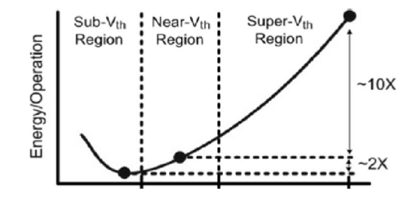
Circuit Level Design Techniques
Motivation for Near Threshold Operation
Notes:
In Near threshold, the transistors are operated at a voltage near the V_{th} of the transistor

Slide 5
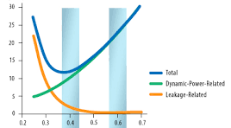
Near Threashold Operation – Total Energy per operation
Dynamic Power α CV²f
Static Power α 1/V
Notes:
All transistors can be operated in this region

Slide 6
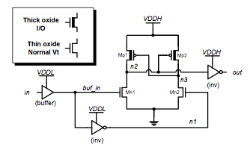
Near Threshold Operation - Functional Challenges
Shown to work for Logic and ALUs
Challenges are for
  Level Shifter Design
  SRAM Design

Slide 7
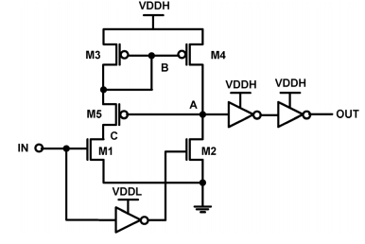
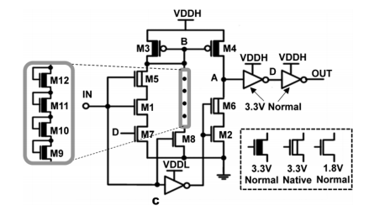
Functional Challenges – Level Shifter Design
Solution: To Level shifters
J. Zhou, et al., "An Ultra-Low Voltage Level Shifter Using Revised Wilson Current Mirror for Fast and Energy-Efficient Wide-Range Voltage Conversion from Sub-Threshold to I/O Voltage," Circuits and Systems I: Regular Papers, IEEE Transactions on , vol.62, no.3, pp.697,706, March 2015
Notes:
M5 cuts off when IN is HIGH therefore there is no static power consumption apart from leakage. This has a consequence of a weakened pull up which causes large
static current and standby power in the output buffer of the level shifter

Slide 8
Functional Challenges – SRAM Design
SRAM prefers small transistors for density
  Small transistors means small strength and large variation at low voltages causing disturbance during read and write
  Solution: 8T/10T SRAM with decoupled R/W interface is implemented
SRAM cells share the Read/Write interface
  Sharing a read write interface among many cells may cause low I_{on}/I_{off} ratio
  Solution: 9T SRAM with Bit line equalizer
Notes:
?

Slide 9
Performance Improvement
  Near Threshold Device Sizing
    Sized to avoid RSCE as sub/near channel operation is more affected by it than super threshold operation
  Parallel Processing
    Has been adopted to address performance degradation in near threshold designs
  Ultra wide DVS
    e.g: Operation from 280mV to 1.1V
Notes:
Lowers DIBL (Drain induced barrier lowering) and INWE (Inverse narrow width effect)
DVS – enables high performance when necessary

Slide 10
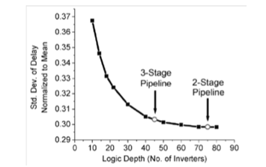
Managing Variability
  Library Pruning
    Characterizing Cells at ultra low voltage
  Processor Pipeline Optimization
    Large Logic depth relates to smaller process variation
Notes:
-Manufacturing imperfections need to be taken into account
-Characterizing existing libraries to reduce performance variations are performed
-A 2 stage ppln with 75 gates per stage reduces the standard deviation by 19%

Slide 11
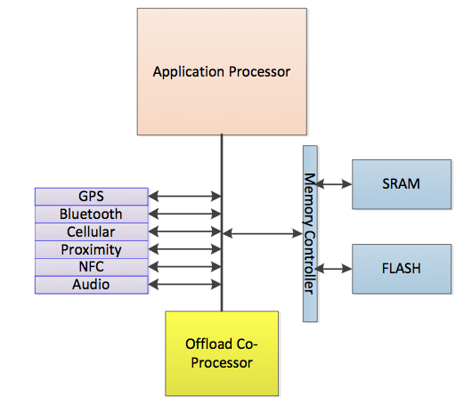
Architectural Level Design Techniques
Motivation
APs being woken up to service Interrupts and requests are energy expensive operations.
Hence an Offload Co-processor
to handle the interrupts
Notes:
-Very performant system as well as power efficient system

Slide 12
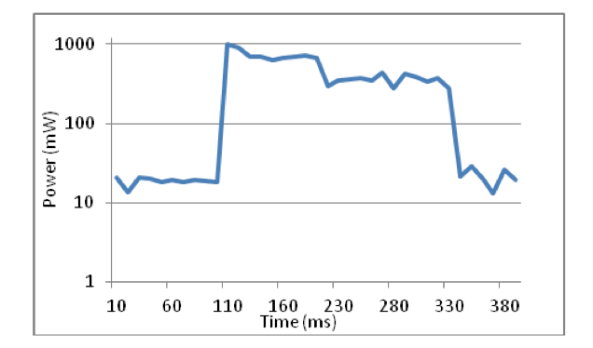
Sole Application Processor
Application Processor – ARM 11 CPU
  Commonly found in Mobile devices
650mW
400mW
20mW
Notes:
This is a power profile of an interrupt
Although the AP only needs to service the interrupt for 2ms its active for 200ms and consumes 60mJ
Interruption of the AP from sleep mode causes it to spin up to full power, thus leading to battery drain

Slide 13
Offload Co-Processor
Case Study
GPS (since it has a continuous sampling freq. of 1Hz)
Function | Processor | Power Consumption @ 200MHz (mW)
Application Processor¹ | ARM 11 | 1000
Offload Co-Processor | MIPS32 4KS | 60
  ¹ The AP doesn’t implement any dynamic voltage or frequency scaling hence spin up is instantaneous.
Notes:
We therefore introduce an Offload Co-Processor to handle the interrupts and other user requests.
This is a ultra low power MIPS32 processor which is integrated into the SoC
GPS Sampling at 1Hz to interrupt the CPU once/second
The authors of the paper chose GPS as its known to contribute about 95% of the power consumption of the mobile devices

Slide 14
Offload Co-Processor - Energy consumption analysis
Without OCP
E = P_{AP-sleep}(1-A₁)T₁ + P_{AP-active}A₁T₁
With OCP
E = P_{AP-sleep}T₂ + P_{OCP-sleep}(1-A₂)T₂ + P_{OCP-active}A₂T₂
Item | Power (mW)
P_{AP-sleep} | 20
P_{AP-active}(avg) | 300
P_{OCP-sleep} | 1
P_{OCP-active} | 60

Slide 15
Offload Co-Processor - Energy consumption analysis
A given battery of 3.7V and 1500mAh
A₁ = 20% and T₁ = 200ms
A₂ = 1.5% and T₂= 15ms
Scenario | Battery Life (hrs)
AP | 73
AP + OCP | 254
3.5 fold improvement in the battery life

Slide 16
Real world Scenarios with periodic interrupts
Modem tower pings
Wi-Fi traffic
Timer Interrupts
Bluetooth/NFC

Slide 17
Considerations for OCP Design
Different ISAs
  OCP ISR needs to be a subset of the AP ISR
Interrupt Overheads
  Choose architectures with fewer cycles to handle interrupts, e.g: 20-30 cycles for an ISR in the OCP
Interrupt Overflows
  In case the OCP cant handle the interrupt it needs to be passed on to the AP
HW Acceleration
  Saving the current context can be done in HW

Slide 18
Conclusion
Circuit design techniques are required to tackle the major challenges of the near-threshold processor design.
Architectural design techniques are required to add additional power and energy saving.

Slide 19
References
J.Zhou, T.H.Kim and Y.Lian, “Near-threshold processor design techniques for power-constrained computing devices,” 2017 IEEE 12th International Conference on ASIC (ASICON), Guiyang, China, 2017, pp.920-923
J. Tang, C. Liu, Y. L. Chou and S. Liu, "OCP: Offload Co-Processor for energy efficiency in embedded mobile systems," 2013 IEEE 24th International Conference on Application-Specific Systems, Architectures and Processors, Washington, DC, 2013, pp. 107-110
Thanks for listening

Slide 20
Near Threashold Operation - Leakage power
6 Units
8 Units

Slide 21
Functional Challenges – Level Shifter Design
Weaker PDNs compared to PUNs

Slide 22
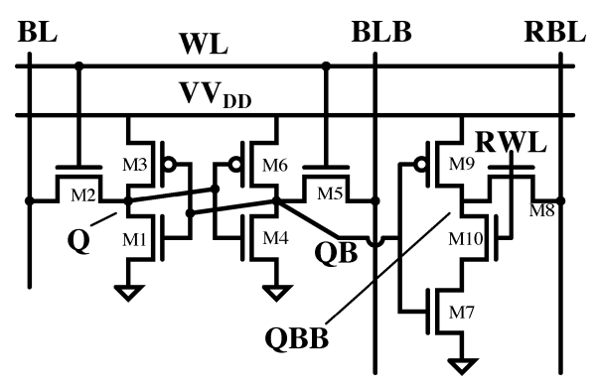
Functional Challenges – SRAM Design
Solution: To improve R/W disturbance
  8T/10T SRAM with decoupled R/W interface is implemented
  B.H. Calhoun, et al., "A 256-kb 65-nm Sub-threshold SRAM Design for Ultra-Low-Voltage Operation," Solid-State Circuits, IEEE Journal of , vol.42, no.3, pp.680,688, March 2007

Slide 23
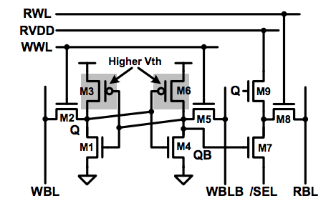
Functional Challenges – SRAM Design
Solution: Improve the I_{on}/I_{off} ratio
  9T SRAM with Bit line equalizer
  Multi V_{t} transistors are used for energy efficiency
  Q. Li,et al., "A 5.61 pJ, 16 kb 9T SRAM with Single-ended Equalized Bitlines and Fast Local Write-back for Cell Stability Improvement," IEEE European Solid-State Device Research Conference (ESSDERC), pp. 201-204, Sept. 2012

