Slide 1
Solar Tracking Network Kick-Off Presentation
Karthik Sukumar & Johannes Machleid
{Karthik.sukumar,johannes.machleid}@tum.de

Slide 2
Motivation
Sun Tracking to increase the power output
As the world energy demands increase, we are changing the source of energy production to renewable sources like solar power among others
Solar panels produce the maximim power output when the sun rays are orthognal to the panel
The Sun moves from East to West during the day, so a stationary solar panel will not achieve maximum power production.
1
Notes:
<number>

Slide 3
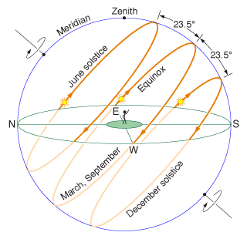
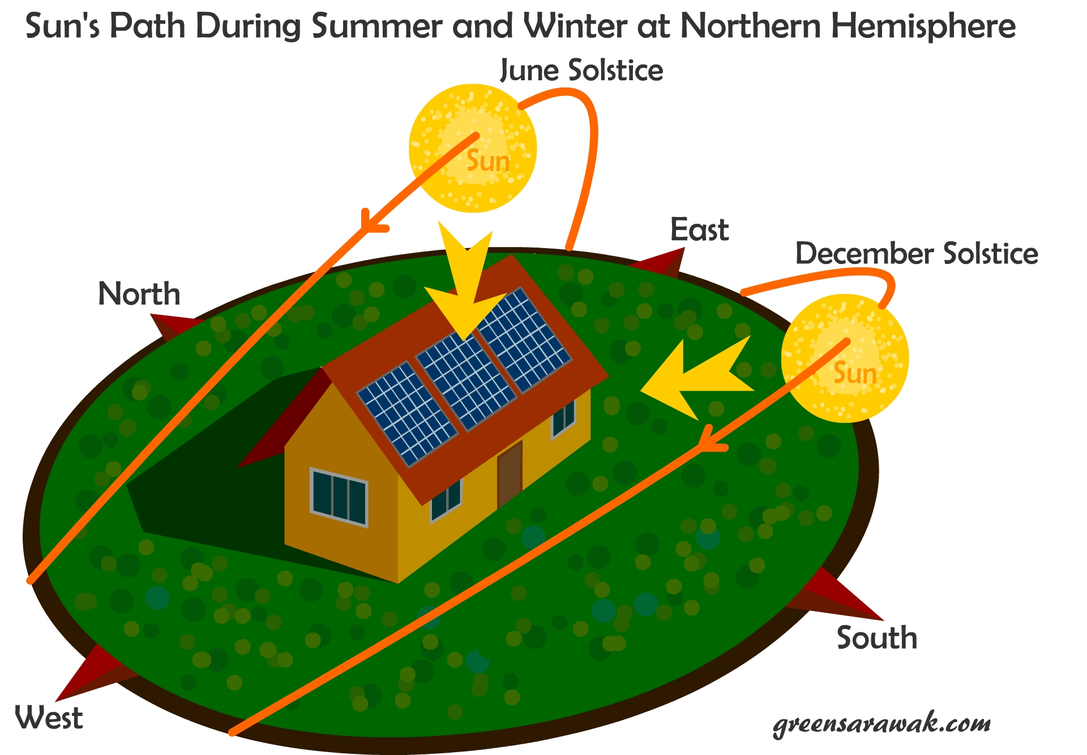
A major problem with solar panels is to track the sun in 2-axis
One during the day from East to west
One to change during the months

Slide 4
Advantages
More energy production, typically 10-25% increase
Disadvantages
More complex, need addional Hardware
Needs time to set up and maintenance work in the field
Shadowing

Slide 5
Approach and expected results
Approach
Main steps/tasks to achieve the goal:
Modeling of ...
Implementation of ... Into ... Using ...
Simulation ... Of ... Using ...
Comparison of ...
...
Expected result(s)
What should be the outcome and why this is important
1

Slide 6

Questions?
<number>
Notes:
<number>

Slide 7
Timeplan
<number>
Notes:
<number>

