Slide 1
Solar Tracking Network Kick-Off Presentation
Karthik Sukumar & Johannes Machleid
{Karthik.sukumar,johannes.machleid}@tum.de

Slide 2
Motivation
Sun Tracking to increase the power output
As the world energy demands increase, we are changing the source of energy production to renewable sources like solar power among others
Solar panels produce the maximim power output when the sun rays are orthognal to the panel
The Sun moves from East to West during the day, so a stationary solar panel will not achieve maximum power production.
1
Notes:
<number>

Slide 3
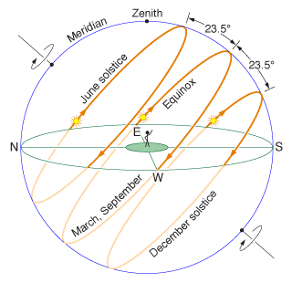
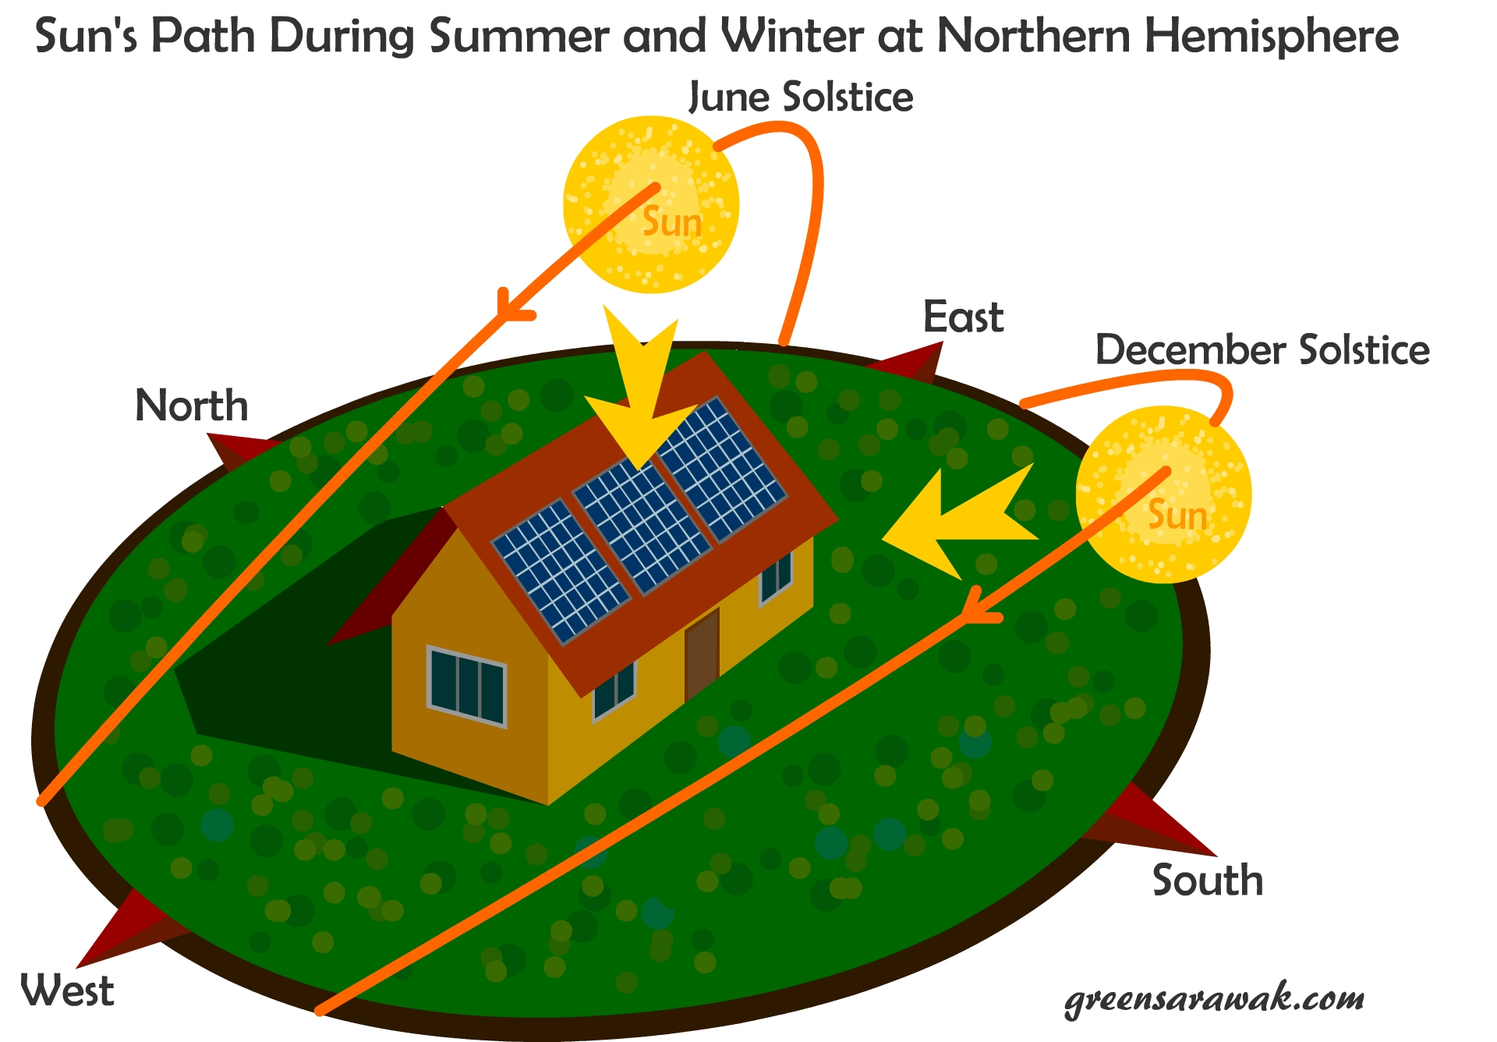
A major problem with solar panels is to track the motion of the sun in 2-axis
One during the day from East to West
One during the months from North to South

Slide 4
Advantages
More energy production, typically 10-25% increase
Disadvantages
More complex, need addional Hardware
Needs time to set up and maintenance work in the field
Shadowing

Slide 5
Currently Available Solutions
Currently commercial solutions exist for tracking but are expensive and bulky
They use the MPPT (mean peak power tracking) algorithms which are complex and take time consuming to develop.
These include single-axis and dual-axis tracking systems
Our Solution
In our proof of concept we are going to explore using the following
Control the panels rotation using a servo driven by a mote
Single axis East to West daily sun tracking
Individual Panel Power tracking
Base station monitoring the status of the panels

Slide 6
Approach and expected results
Our Approach
Main steps/tasks to achieve the goal:
Modeling of ...
Implementation of ... Into ... Using ...
Simulation ... Of ... Using ...
Comparison of ...
...
Expected result(s)
What should be the outcome and why this is important
1

Slide 7

Questions?
<number>
Notes:
<number>

Slide 8
Timeplan
<number>
Notes:
<number>

