Slide 1
Solar Pro Final Presentation
Karthik Sukumar, Johannes Machleid
karthik.sukumar@tum.de
johannes.machleid@tum.de
Notes:
1

Slide 2

Motivation of the Application
Fossil fuels reliance
Renewables
Solar Energy
37% Efficiency
2
Notes:
2

Slide 3
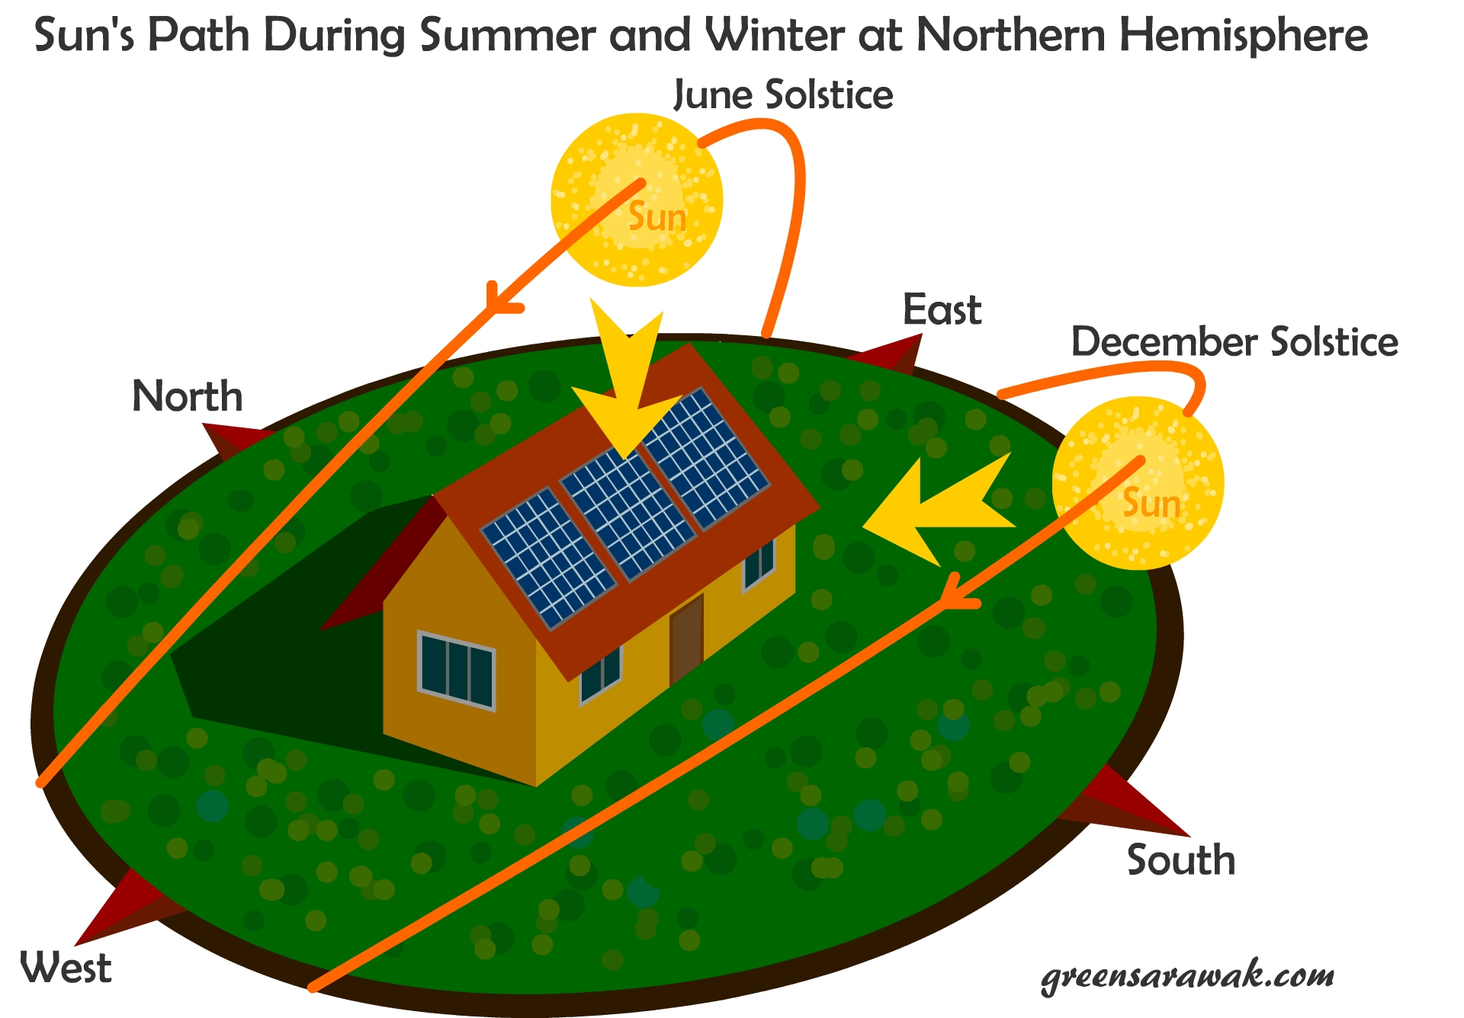
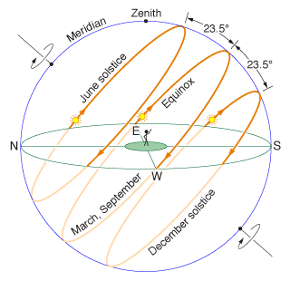
Solar Tracking
Advantages
Disdvantages
10-25% increased Energy
Expensive
Requires maintenance
Additional HW and set up required
3

Slide 4
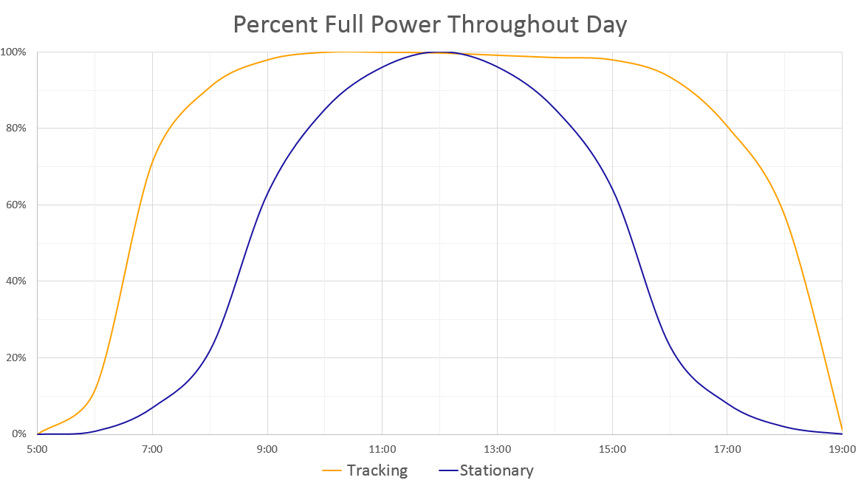
Solar Tracking
4

Slide 5

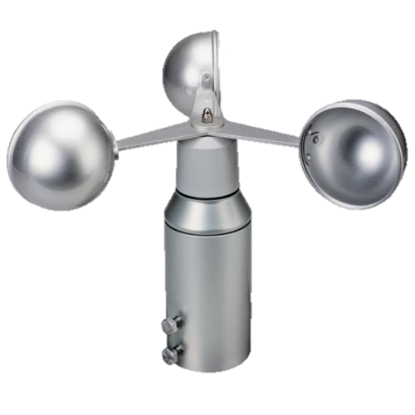
Sensors and Motes
7x Solar panel motes
Light sensor
Temperature sensor
4x Digital Servo
1x Base station mote
Anemometer
Connected GUI
GUI
5

Slide 6
Network and Routing
IDLE
BOOT UP
button press
Broadcast
Emergency
resume operation
NETWORK DISCOVERY
EMERGENCY
complete
Unicast
PATHMODE
next Mote
complete
UNICAST MODE
transmission error
next Mote
automatic or manual
6
Notes:
6

Slide 7
Network and Routing
Network Features
Provide high energy efficiency (RDC - ContikiMAC)
Low latency is not required
Priority on network stability and reliability (MAC - CSMA)
Self healing through Round Trip transmission failure detection
Distance Vector routing by exchanging routing tables
Bellman ford algorithm for distributed routing
7
Notes:
7

Slide 8
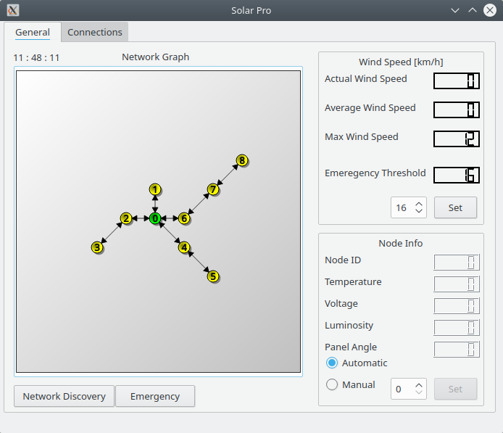
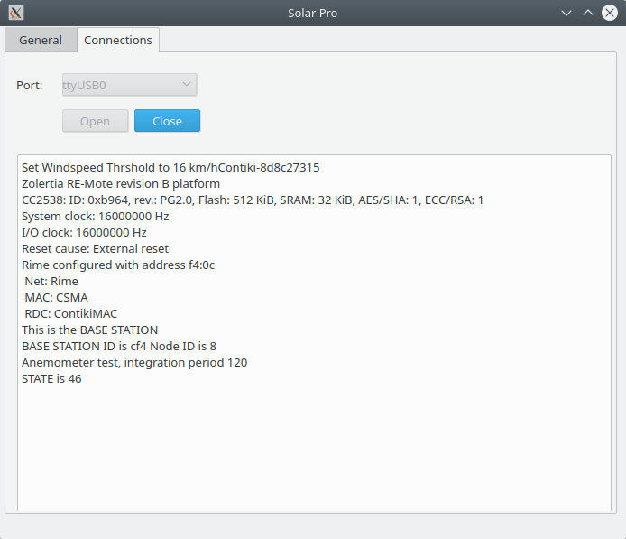
Graphical User Interface (GUI)
General Tab
Connections Tab
8
Notes:
8

Slide 9
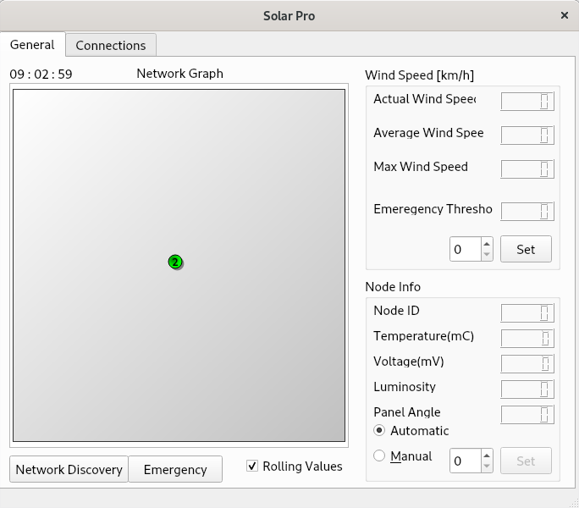
Graphical User Interface (GUI)
Before Network Discovery
After Discovery
9
Notes:
9

Slide 10

Future Work and Improvements
Data logging and visualization in GUI
Maintenance mote to operate solar panels in the field
Sun tracking algorithm based on sensor values
GUI
10

Slide 11
Cool Stats for Nerds
Over 220 commits
8 branches
58.5 MB of files
~ 4000 LoC in the Project
~ 2400 Lines of common code
Base Station and Panel
1100 LoC for Base station
~ 500 LoC for Panel
~ 40k BS Binary Code size vs ~ 35k Bytes for panel
11
Notes:
11

Slide 12

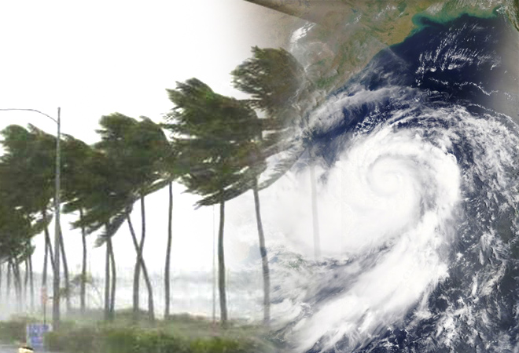
Demo
7 Panel Motes
1 Base Station connected to the GUI
1 Anemometer to detect excess windspeeds
1 Hair dryer to simulate extreme weather conditions
12
Notes:
12

Slide 13
Demo
Start from an IDLE state
Initiate Discovery with GUI/BS User Button
Shows Nodes appear in GUI
Simulate Emergency
Another Network Discovery after Emergency
Demonstarte dynamicity of network
Remove node(s) from Network
13
Notes:
13

Slide 14

Questions?
14
Notes:
14

