Slide 1
Solar Pro Final Presentation
Karthik Sukumar, Johannes Machleid
karthik.sukumar@tum.de
johannes.machleid@tum.de
Notes:
5

Slide 2

Motivation of the Application
Fossil fuels reliance
Renewables
Solar Energy
37% Efficiency
1
Notes:
5

Slide 3
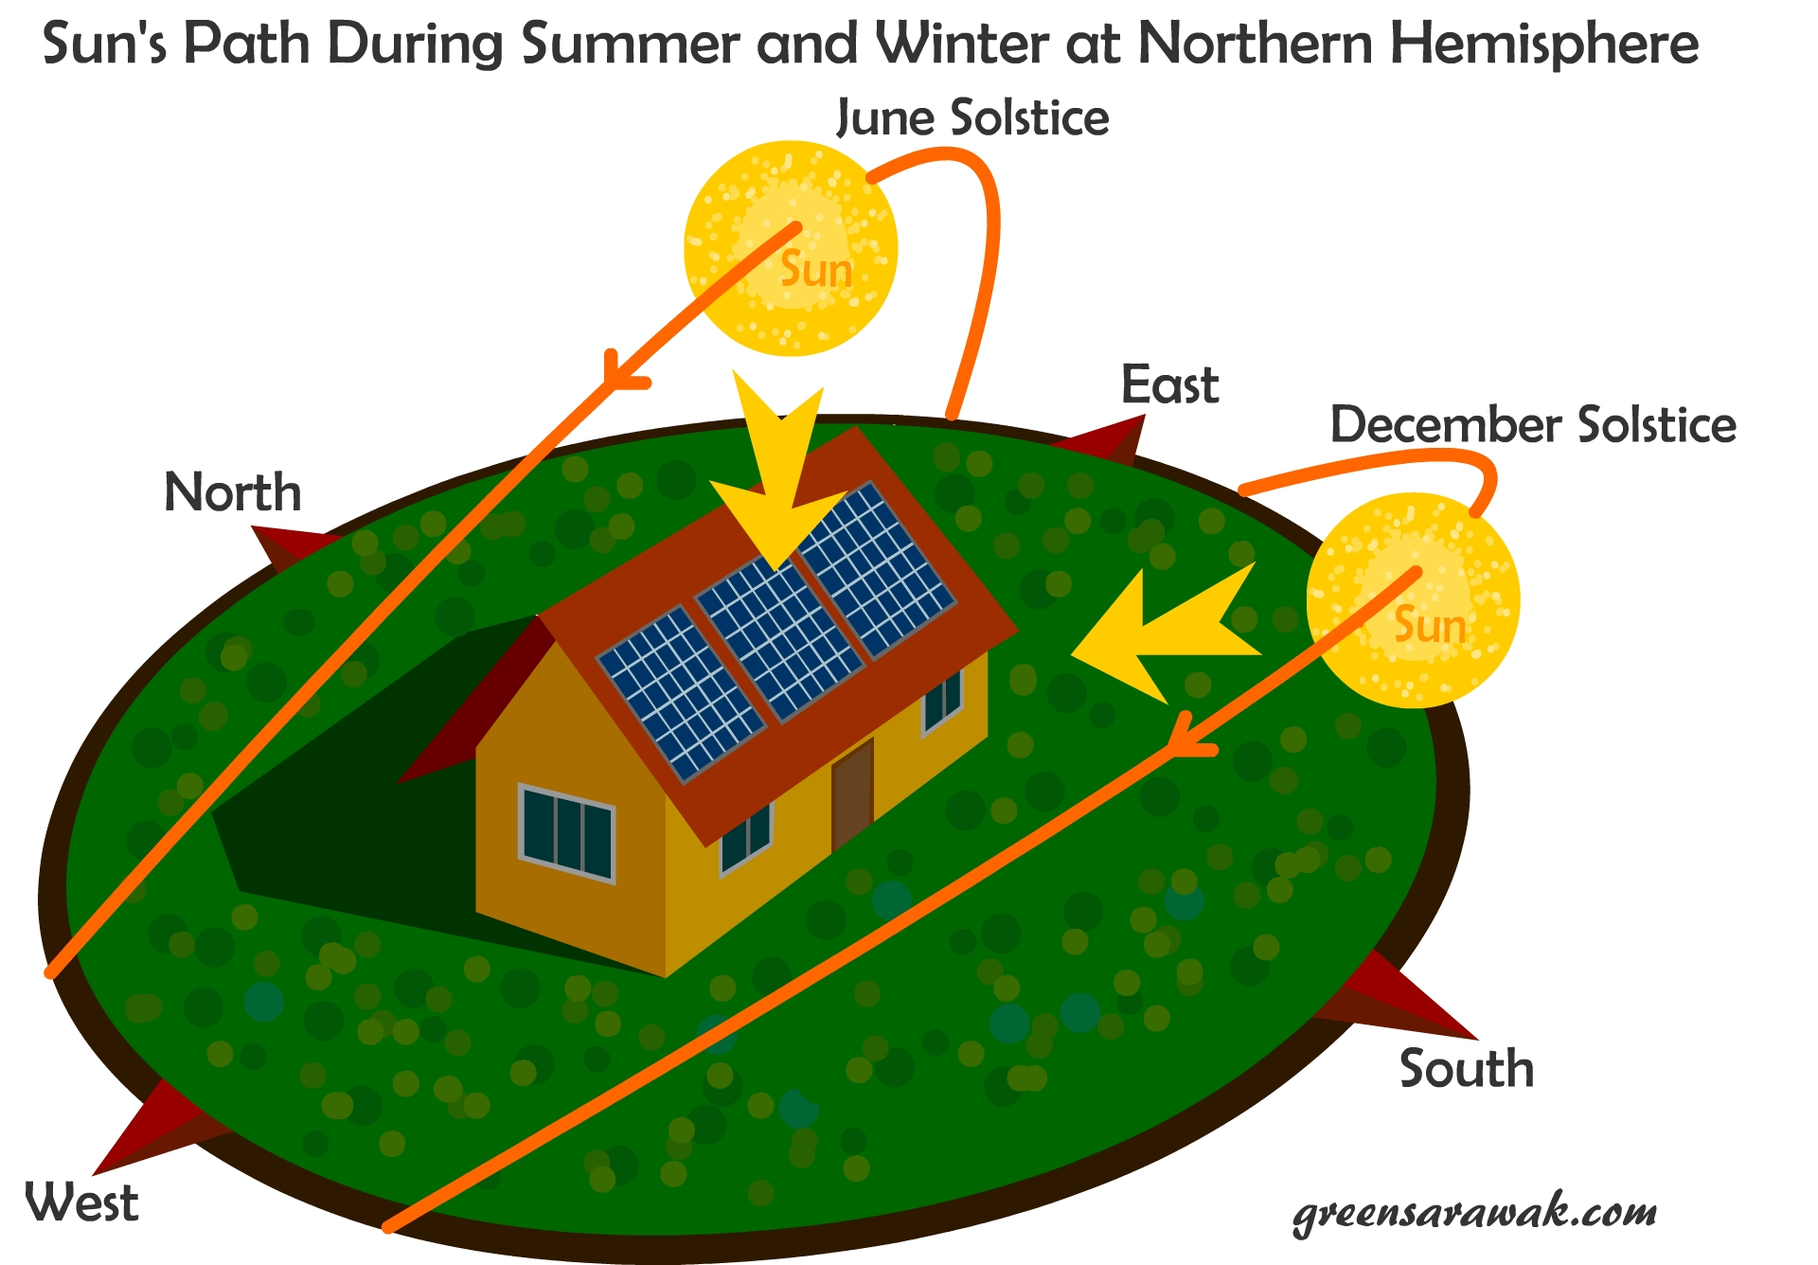
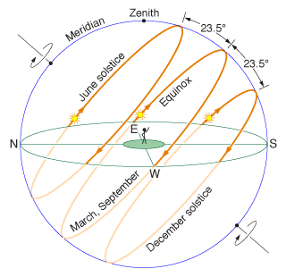
Solar Tracking
Advantages
Disdvantages
10-25% increased Energy
Expensive
Requires maintanence
Additional HW and set up required
1

Slide 4
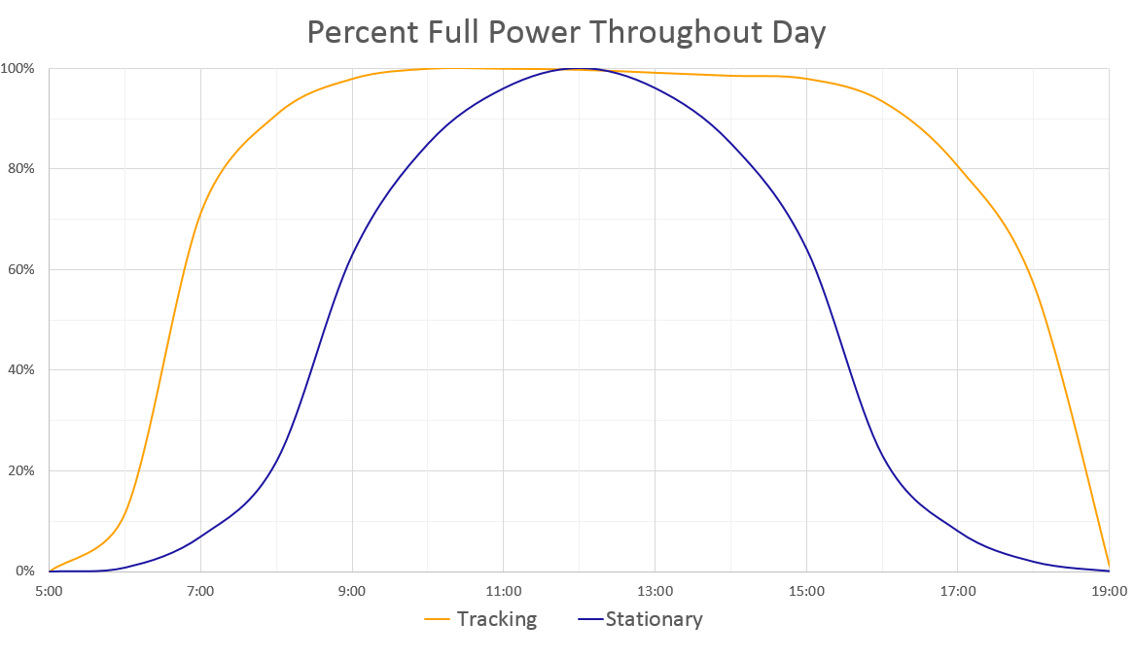
Solar Tracking
1

Slide 5

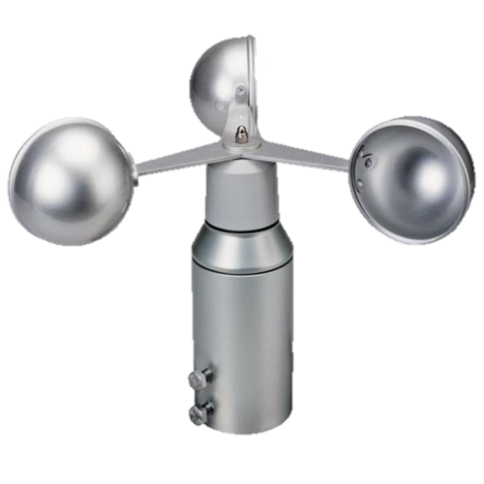
Sensors and Motes
7x Solar panel motes
Light sensor
Temperature sensor
4x Digital Servo
1x Base station mote
Anemometer
Connected GUI
GUI
1

Slide 6
Network and Routing
IDLE
BOOT UP
button press
Broadcast
Emergency
resume operation
NETWORK DISCOVERY
EMERGENCY
complete
Unicast
PATHMODE
next Mote
complete
UNICAST MODE
transmission error
next Mote
automatic or manual
5
Notes:
5

Slide 7
Network and Routing
Network Features
Provide high energy efficiency (RDC - ContikiMAC)
Low latency is not required
Priority on network stability and reliability (MAC - CSMA)
Self healing through Round Trip transmission failure detection
Distance Vector routing by exchanging routing tables
Bellman ford algorithm for distributed routing
5
Notes:
5

Slide 8
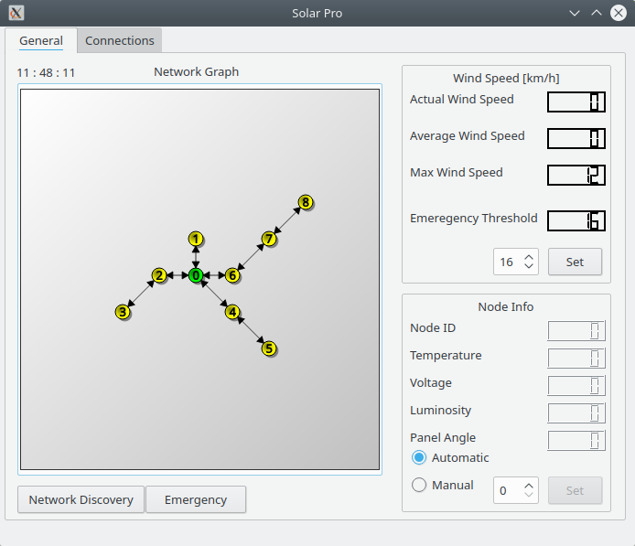
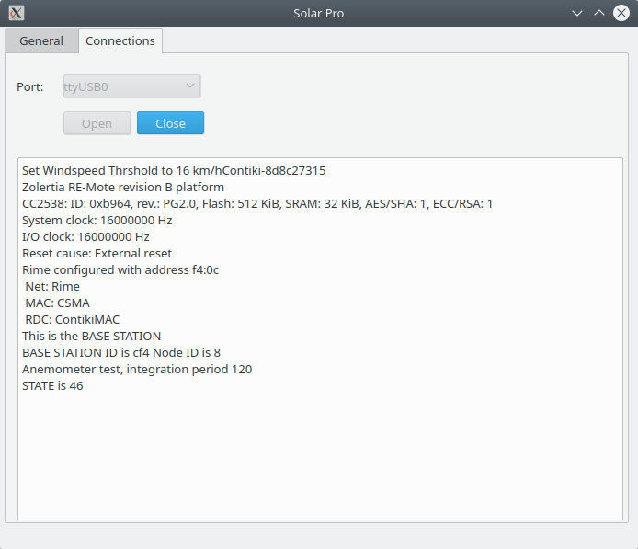
Graphical User Interface (GUI)
General Tab
Connections Tab
5
Notes:
5

Slide 9
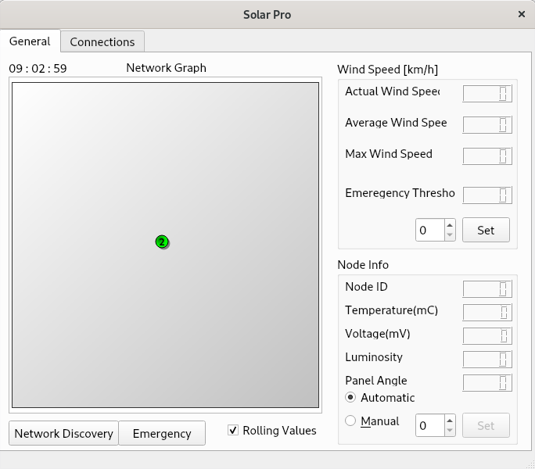
Graphical User Interface (GUI)
Before Network Discovery
After Discovery
5
Notes:
5

Slide 10

Future Work and Improvements
Data logging and visualization in GUI
Maintenance mote to operate solar panels in the field
Sun tracking algorithm based on sensor values
GUI
5

Slide 11
Cool Stats for Nerds
>220 commits
8 branches
58.5 MB of files
~4000 LoC in the Project
~2400 Lines of common code
Base Station and Panel
1100 LoC for Base station
~500 LoC for Panel
~40k BS Binary Code size vs ~ 35k Bytes for panel
5
Notes:
5

Slide 12

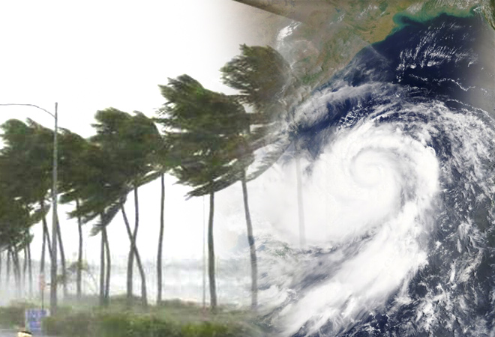
Demo
7 Panel Motes
1 Base Station connected to the GUI
1 Anemometer to detect excess windspeeds
1 Hair dryer to simulate extreme weather conditions
5
Notes:
<number>

Slide 13
Demo
Start from an IDLE state
Initiate Discovery with GUI/BS User Button
Shows Nodes appear in GUI
Simulate Emergency
Another Network Discovery after Emergency
Demonstarte dynamicity of network
Remove node(s) from Network
5
Notes:
<number>

Slide 14

Questions?
5
Notes:
<number>

