Slide 1
Solar Tracking Network Kick-Off Presentation
Karthik Sukumar & Johannes Machleid
{Karthik.sukumar,johannes.machleid}@tum.de

Slide 2

Motivation
Fossil fuels reliance
Renewables
Solar Energy
37% Efficiency
2
Notes:
As the world energy demands increase and as we transition the source of energy production to renewable and sustainable sources, we need more efficient ways of producing energy.
Solar energy being one of the most widespread renewables around would definitely benefit from increased efficiency of energy production
2

Slide 3
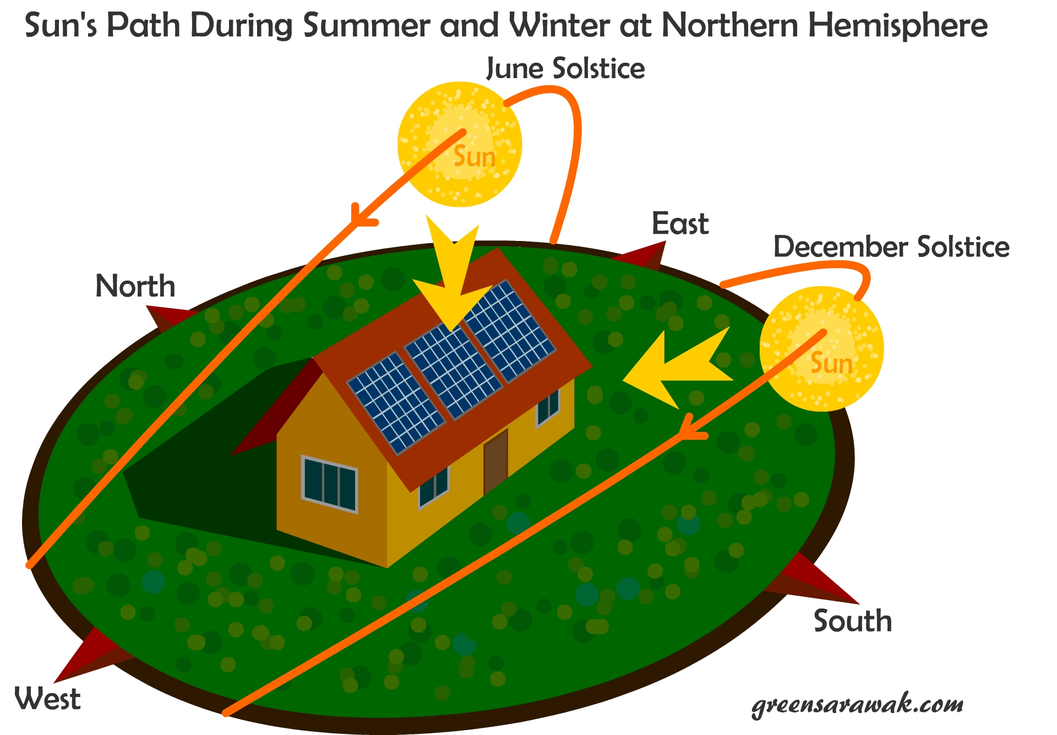
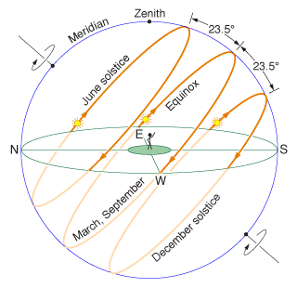
Solar Tracking
Advantages
Disdvantages
10-25% increased Energy
Expensive
Requires maintanence
Additional HW and set up required
3
10
Notes:
A major problem with solar panels is to track the motion of the sun in 2-axis
One during the day from East to West
One during the months from North to South
Advantages
More energy production, typically 10-25% increase
Disadvantages
More complex, need addional Hardware
Needs time to set up and maintenance work in the field
Shadowing

Slide 4
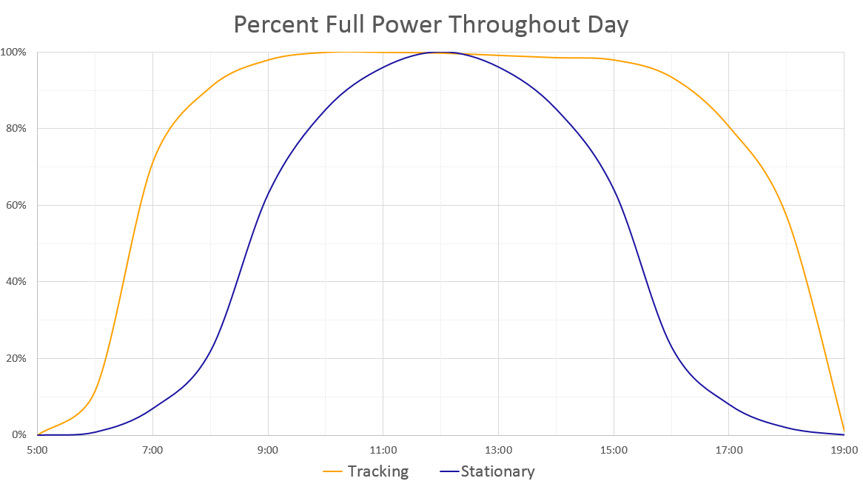
Solar Tracking
4
Notes:
A major problem with solar panels is to track the motion of the sun in 2-axis
One during the day from East to West
One during the months from North to South
Advantages
More energy production, typically 10-25% increase
Disadvantages
More complex, need addional Hardware
Needs time to set up and maintenance work in the field
Shadowing

Slide 5
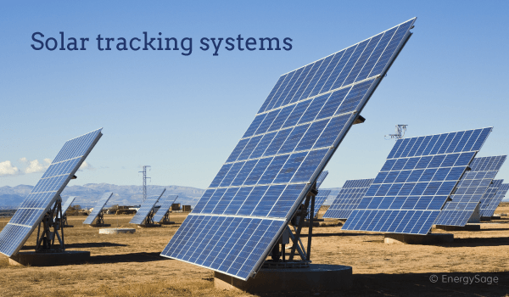
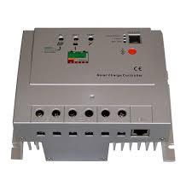
Currently Available Solutions
Currently commercial solutions exist for tracking but are expensive and bulky
They use the MPPT (mean peak power tracking) algorithms which are complex and take time consuming to develop.
These include single-axis and dual-axis tracking systems
5

Slide 6


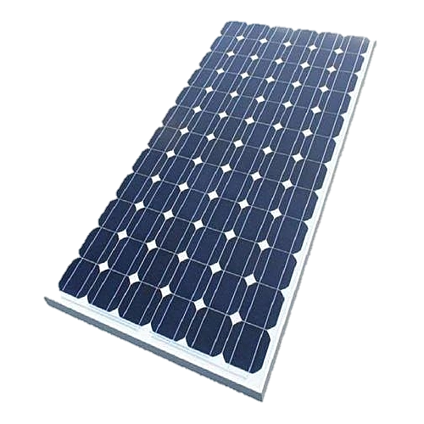
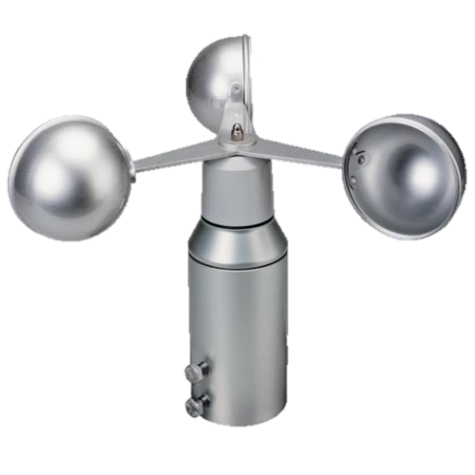
Our Solution
In our proof of concept we are going to explore using the following
Control the panels rotation using a servo driven by a mote
Link all the motes in a monitoring multihop network
Single axis East to West daily sun tracking
Individual panel power tracking
Base station monitoring the status and angle of the panels
GUI
6

Slide 7
Our Solution – Sensors and Motes
Hardware: 14 Motes in Total
10 Motes with a servo motor each attached to a solar panel
Sensor: power (simulated with light sensor), temperature
2 Motes
Sensor: anemometer (wind speed)
1 Mote with basestation
GUI with real time network display and sensor values
1 Mote for maintenance worker
Joystick to operate the solar panels manually
GUI
7

Slide 8
Our Solution – Networking
Multihop Network
Dynamic Routing
self-organizing network (automatic network discovery and routes)
failure-recovery mechanism (detect changes in the topology and re-establishment of the routes)
13 stationary motes and one freely moving mote (ad-hoc)
Focus on power efficiency (cyclic time triggered communication)
Additional event triggered communication (wind speed alert)
GUI
8

Slide 9
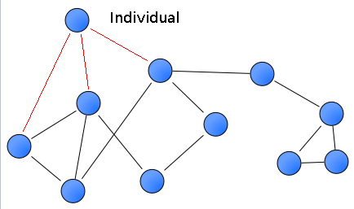
Our Solution – GUI on Basestation
Implementation with QT
Display of real time network communication and topology as directed graph
Display of each solar panel angle and power/temperature in second GUI layer in real time with configurable data history (rolling window)
Display of wind speed and alert if wind speed exceeds a threshold
Hop counter per mote
Emergency simulation feature from basestation
Manual operation (override) of the solar panel angle
GUI
https://fossbytes.com/how-to-monitor-system-temperature-in-linux-gui-based-temperature-monitoring-tool/
9

Slide 10
Our Solution – Application specific additional features
Networking
Provide high energy efficiency (RDC - ContikiMAC)
Low latency is not required
Priority on network stability and reliability (MAC - CSMA)
Good scalability
GUI
10

Slide 11
Timeplan
May 2019
July 2019
CW 22
CW 23
CW 24
CW 25
CW 26
CW 27
CW 28
CW 29
CW 30
28.05. – Kickoff Presentation
16.07. – Submission Report
Network Design and Implementation
23.07. – Final Presentation
Sensor and Function Implementation
Code Testing and Bugfixing
GUI Design and Implementation
Hardware Assembly and Testing
11
Notes:
11

Slide 12

Questions?
12
Notes:
12

