Slide 1
Solar Pro Final Presentation
Karthik Sukumar, Johannes Machleid
karthik.sukumar@tum.de
johannes.machleid@tum.de

Slide 2

Motivation of the Application
Fossil fuels reliance
Renewables
Solar Energy
37% Efficiency

Slide 3
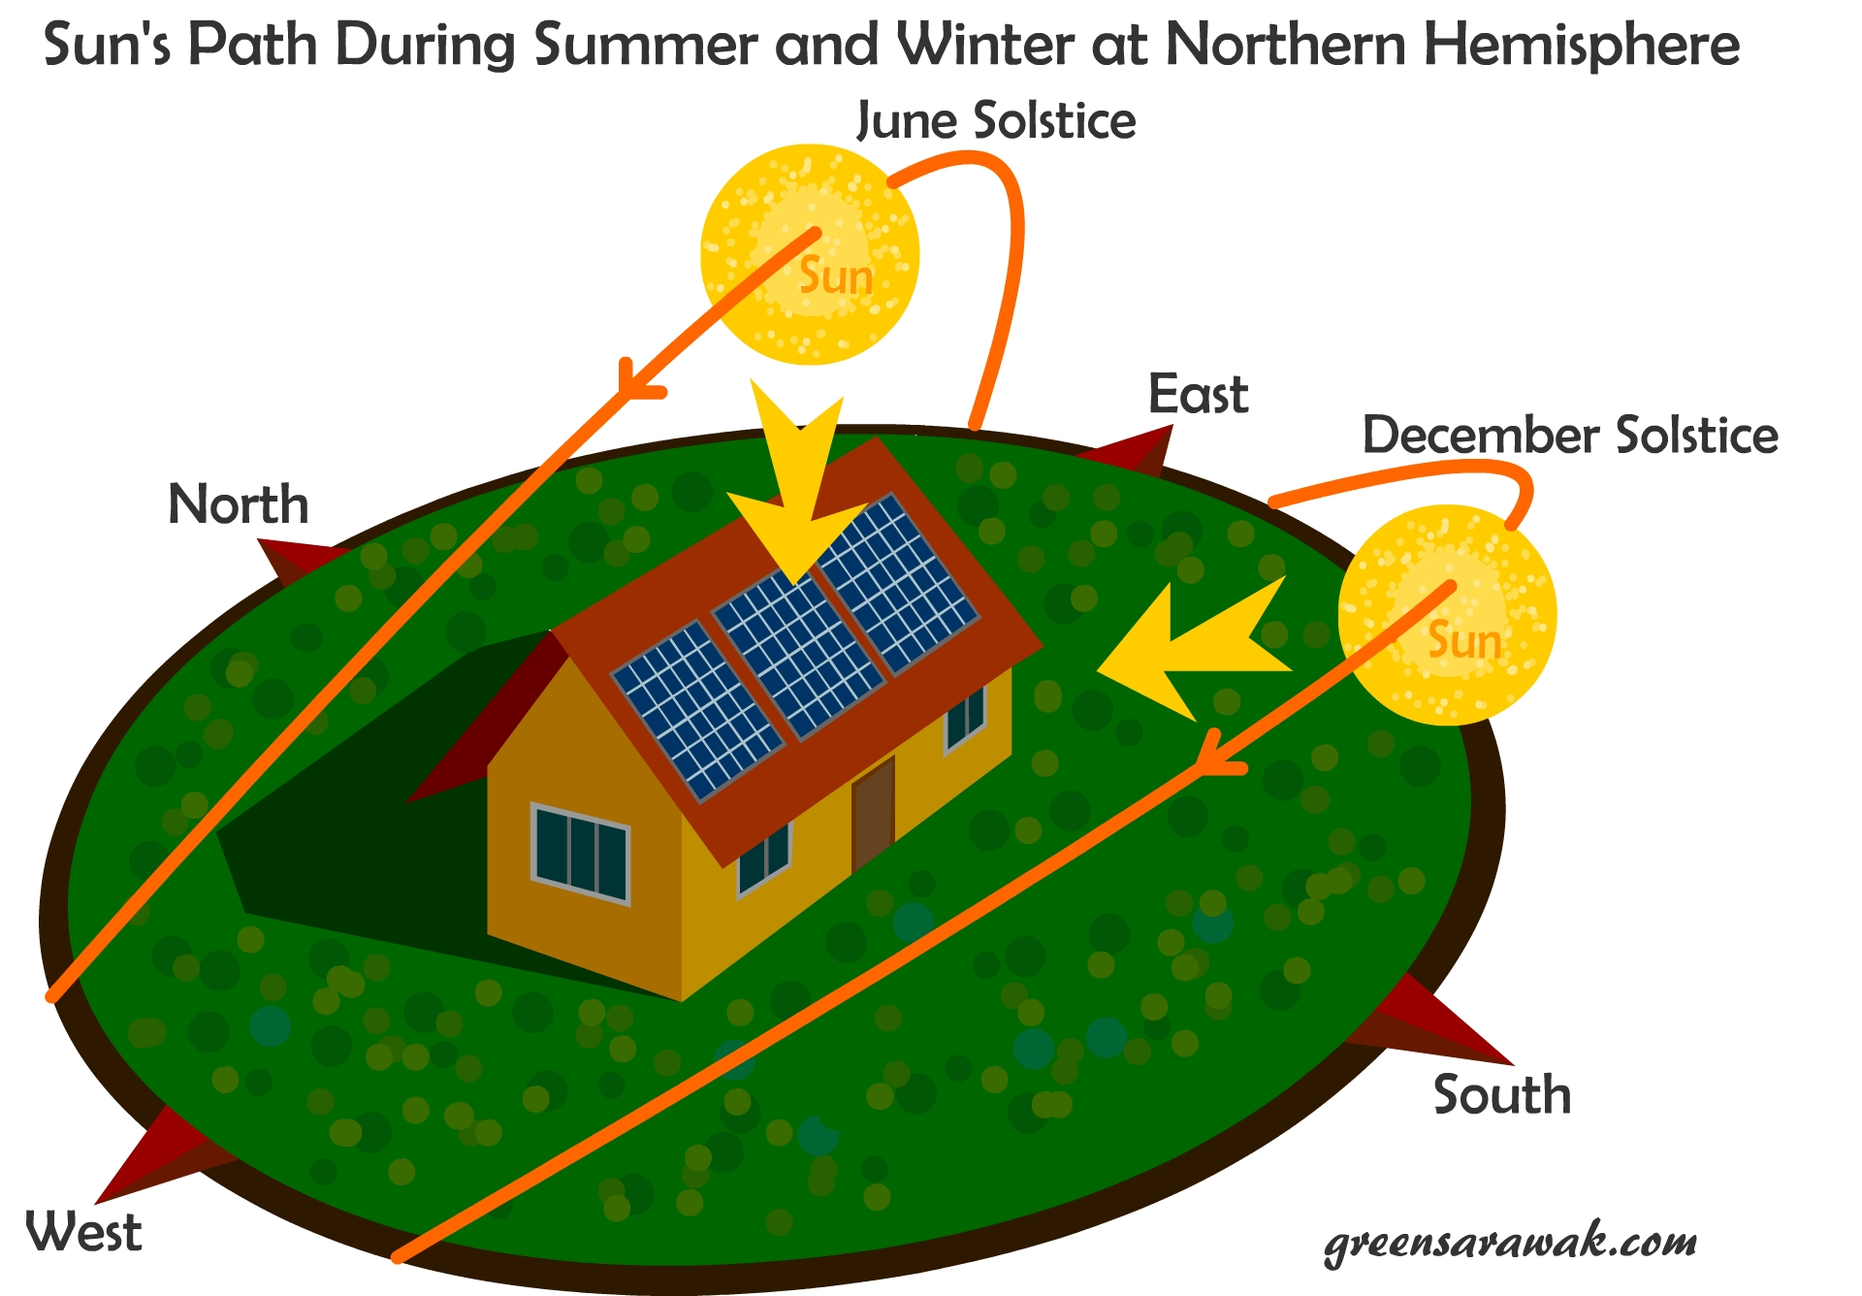
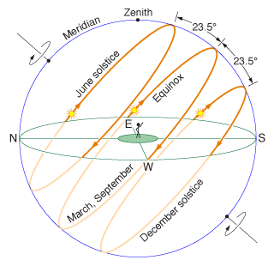
Solar Tracking
Advantages
Disdvantages
10-25% increased Energy
Expensive
Requires maintanence
Additional HW and set up required

Slide 4
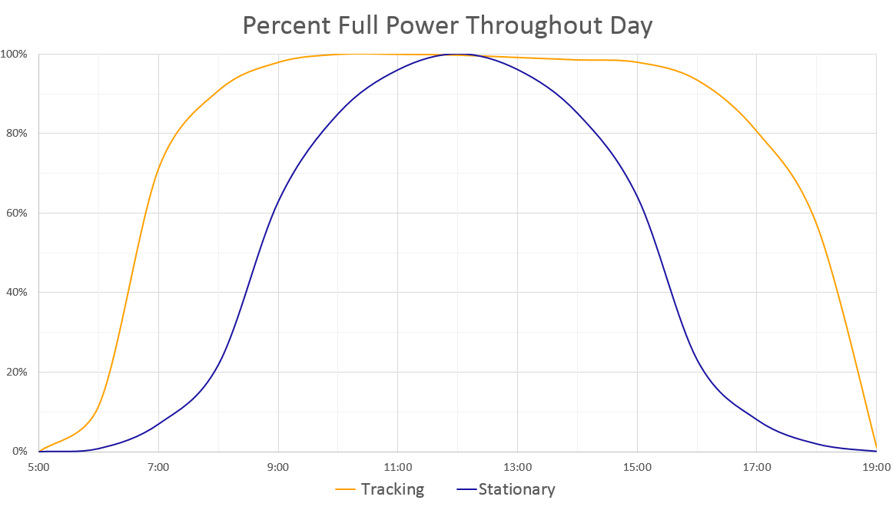
Solar Tracking

Slide 5

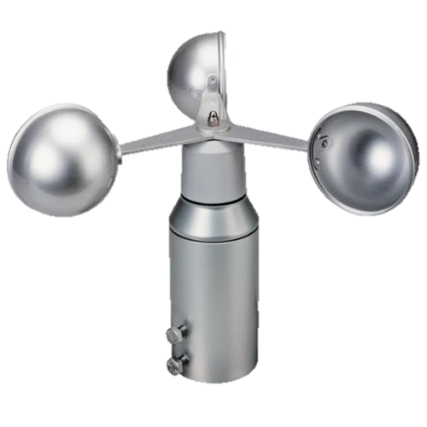
Sensors and Motes
7x Solar panel motes
Light sensor
Temperature sensor
4x Digital Servo
1x Base station mote
Anemometer
Connected GUI
GUI

Slide 6
Network and Routing
IDLE
BOOT UP
button press
Broadcast
Emergency
resume operation
NETWORK DISCOVERY
EMERGENCY
complete
Unicast
PATHMODE
next Mote
complete
UNICAST MODE
transmission error
next Mote
automatic or manual

Slide 7
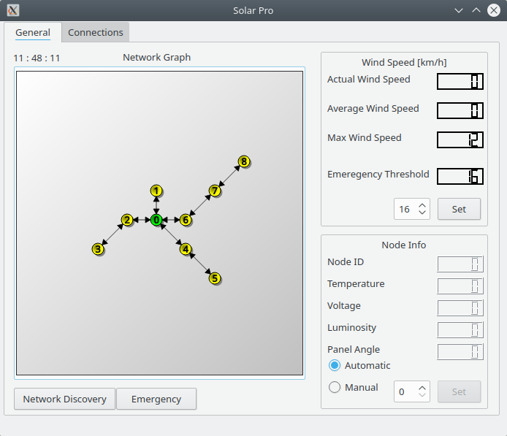
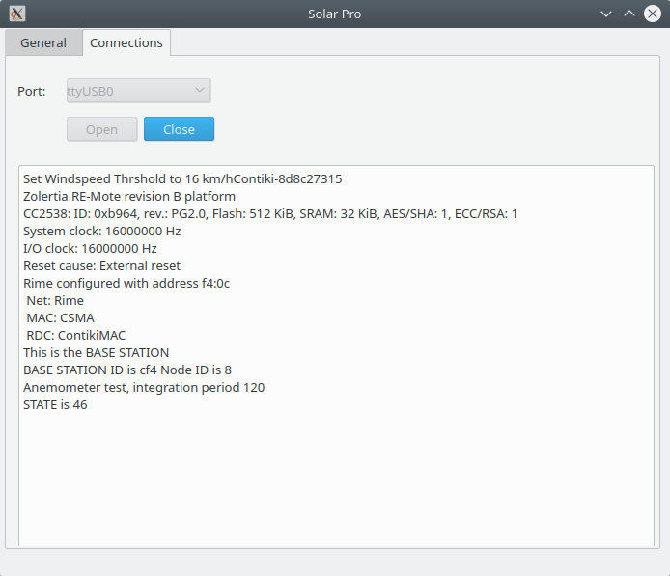
Graphical User Interface (GUI)
General Tab
Connections Tab

Slide 8
Additional Features
Networking
Provide high energy efficiency (RDC - ContikiMAC)
Low latency is not required
Priority on network stability and reliability (MAC - CSMA)
Good scalability
Self healing through failed transmission detection

Slide 9
Statistics
220 commits
8 branches
58.5 MB of files
Xxxx lines of code

Slide 10

Future Work and Improvements
Data logging and visualization in GUI
Maintenance mote to operate solar panels in the field
Sun tracking algorithm based on sensor values
GUI

Slide 11

Questions?

