Slide 1
Solar Tracking Network Kick-Off Presentation
Karthik Sukumar & Johannes Machleid
{Karthik.sukumar,johannes.machleid}@tum.de

Slide 2

Motivation
Fossil fuels reliance
Renewables
Solar Energy
1
Notes:
As the world energy demands increase and as we transition the source of energy production to renewable and sustainable sources, we need more efficient ways of producing energy.
Solar energy being one of the most widespread renewables around would definitely benefit from increased efficiency of energy production
<number>

Slide 3
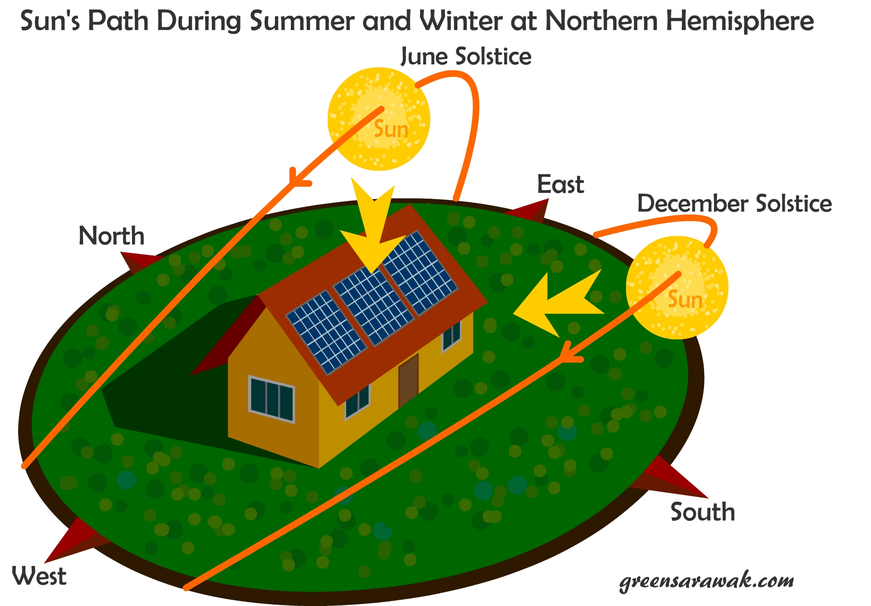
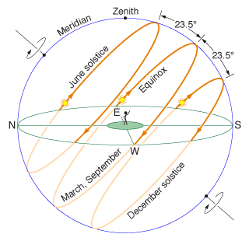
Challenges of Solar Tracking
Advantages
Disdvantages
10-25% increased Energy
Expensive
Requires maintanence
Additional HW and set up required
Notes:
A major problem with solar panels is to track the motion of the sun in 2-axis
One during the day from East to West
One during the months from North to South
Advantages
More energy production, typically 10-25% increase
Disadvantages
More complex, need addional Hardware
Needs time to set up and maintenance work in the field
Shadowing

Slide 4
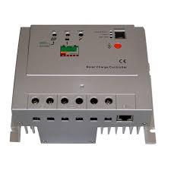
Currently Available Solutions
Currently commercial solutions exist for tracking but are expensive and bulky
They use the MPPT (mean peak power tracking) algorithms which are complex and take time consuming to develop.
These include single-axis and dual-axis tracking systems

Slide 5
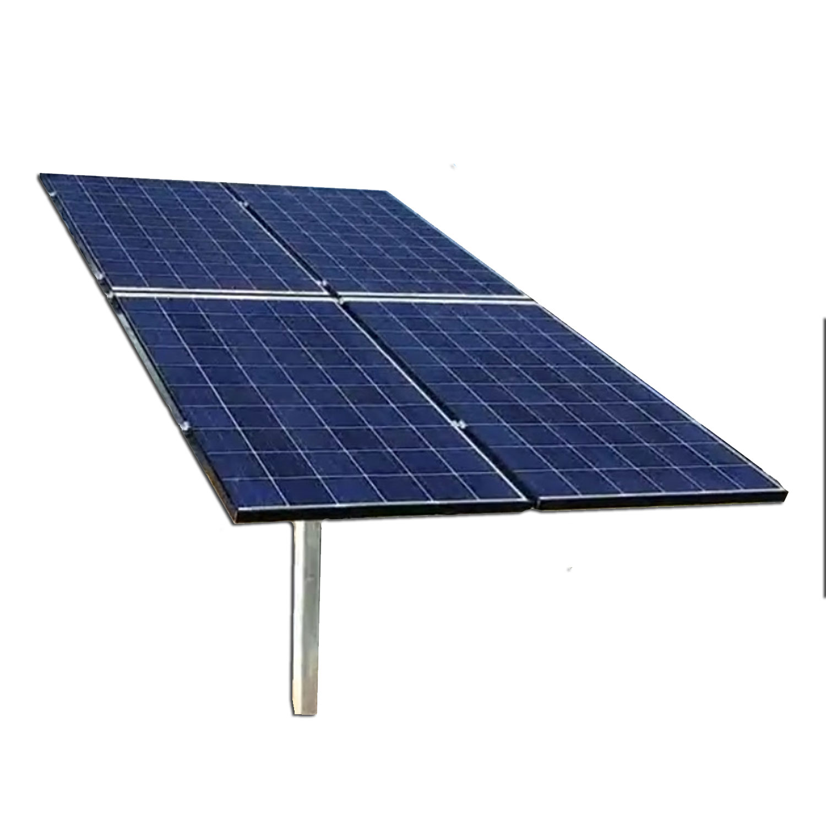

Our Solution
In our proof of concept we are going to explore using the following
Control the panels rotation using a servo driven by a mote
Link all the motes in a monitoring network
Single axis East to West daily sun tracking
Individual Panel Power tracking
Base station monitoring the status of the panels and reporting Status

Slide 6
Approach and expected results
Our Approach
Main steps/tasks to achieve the goal:
Modeling of ...
Implementation of ... Into ... Using ...
Simulation ... Of ... Using ...
Comparison of ...
...
Expected result(s)
What should be the outcome and why this is important
<number>

Slide 7

Questions?
<number>
Notes:
<number>

Slide 8
Timeplan
<number>
Notes:
<number>

