Slide 1
HEALTHPLUS CARE
Healthcare Service Utilization,
Financial Performance & Member Experience Analytics
SQL / MySQL Data Analytics Project
Analytics Focus
Service • Finance • Engagement • Experience

Slide 2
Project Overview
HealthPlus Care analyzes healthcare service utilization, member engagement, financial performance and member experience using a relational MySQL database.
Member Analytics
Member lifecycle and utilization patterns
Healthcare Services
Consultations, telemedicine and chronic care
Financial Analytics
Billing, payments and claims
Experience & Workforce
Feedback, clinics and staff distribution
HealthPlus Care | Healthcare Analytics 02

Slide 3
Business Objective
How effectively is HealthPlus Care delivering and monetizing its healthcare services while maintaining member engagement and service satisfaction?
Service Utilization
Measure consultation and healthcare activity
Financial Performance
Track billing, collection and claims
Member Engagement
Understand packages, corporate and chronic care usage
Member Experience
Measure feedback and satisfaction
HealthPlus Care | Healthcare Analytics 03

Slide 4
HealthPlus Care Business Flow
Member
Consultation
Specialist / Clinic
Prescription / Lab / Claim
Billing
Payment
Feedback
Package Path
Member → Health Package → Subscription → Payment Status
Corporate Path
Corporate → Corporate Member → Healthcare Usage
Connected Services
Telemedicine ↔ Consultation | Chronic Care ↔ Member + Specialist
HealthPlus Care | Healthcare Analytics 04

Slide 5
Database Overview
Database: healthplus_care_db | Technology: MySQL / SQL
Member & Organization
members
corporates
corporate_members
Healthcare Services
consultations
telemedicine_sessions
chronic_care_programs
Healthcare Support
prescriptions
lab_tests
claims
Packages
health_packages
package_subscriptions
Financial
billing
payments
Operations
clinics
specialists
staff
Experience
feedback
HealthPlus Care | Healthcare Analytics 05

Slide 6
Dataset Overview
Actual HealthPlus Care dataset coverage
Clinics
18
Specialists
220
Members
2,500
Corporates
60
Corporate Members
615
Consultations
6,000
Telemedicine Sessions
2,200
Chronic Care Programs
900
Health Packages
40
Package Subscriptions
3,000
Prescriptions
5,000
Lab Tests
3,500
Claims
1,800
Staff
450
Billing Records
6,000
Payment Records
6,000
Feedback Records
2,500
HealthPlus Care | Healthcare Analytics 06

Slide 7
Data Cleaning & Preparation
Raw Data
Missing Values
Standardization
Numeric Validation
Date Validation
Referential Validation
Clean Dataset
• Trim spaces and convert blanks to NULL
• Standardize gender, specialization, statuses and employment types
• Validate phone, email, numeric values and ratings
HealthPlus Care | Healthcare Analytics 07

Slide 8
Data Validation
Duplicate Primary Keys
Missing Values
Invalid Numeric Values
Invalid Foreign Keys
Invalid Dates
Phone Validation
Email Validation
Status Validation
Relationship Validation
Feedback Rating Validation
HealthPlus Care | Healthcare Analytics 08

Slide 9
SQL Analytics Approach
Database
Data Cleaning
Data Validation
Business Questions
KPI Queries
Aggregations
Joins
Window Functions
Business Insights
• Core SQL: SELECT, WHERE, ORDER BY, LIMIT, SUM, AVG, COUNT, GROUP BY, HAVING
• Joins: INNER JOIN, LEFT JOIN, RIGHT JOIN | CTEs for multi-step analysis
• Window functions: ROW_NUMBER(), RANK(), LAG(), LEAD()
HealthPlus Care | Healthcare Analytics 09

Slide 10
Executive KPI Overview
HealthPlus Care — Actual KPI values calculated from the project dataset
Total Members
2,500
Members in the healthcare network
Total Consultations
6,000
Healthcare consultations recorded
Completed Consultations
4,400
73.33% completion rate
Telemedicine Sessions
2,200
Digital healthcare sessions
Total Billed Amount
₹18.69M
₹18,690,854.89 billed
Net Collection Amount
₹16.43M
₹16,433,408.14 net collected
Active Chronic Care Programs
560
Currently active programs
Average Feedback Rating
3.80 / 5
Member experience rating
HealthPlus Care | Healthcare Analytics 10

Slide 11
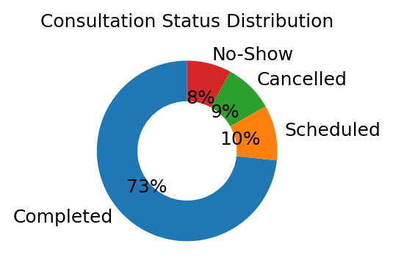
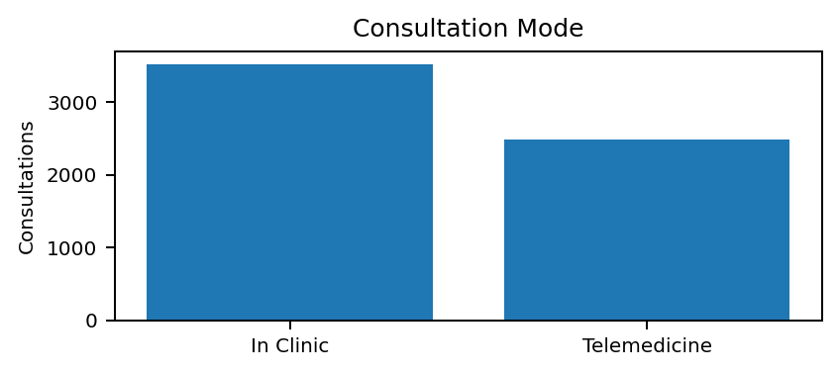
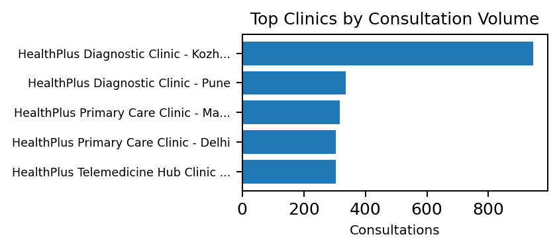
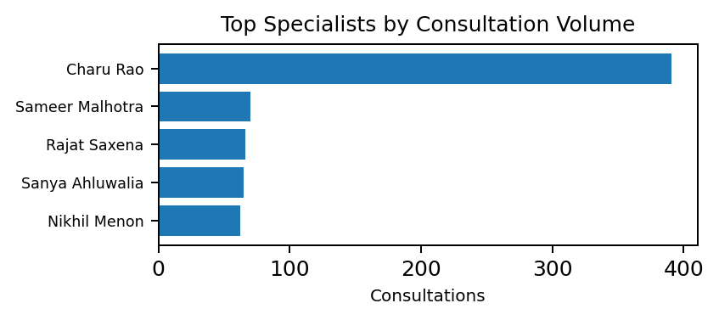
Member & Consultation Analytics
Total Members
2,500
Total Consultations
6,000
Average Consultations per
Member
2.64
Completed Consultations
4,400
Consultation Status Distribution — Donut
Consultation Mode — Column
Top Clinics by Consultation Volume — Bar
Top Specialists by Consultation Volume — Bar
HealthPlus Care | Healthcare Analytics 11

Slide 12
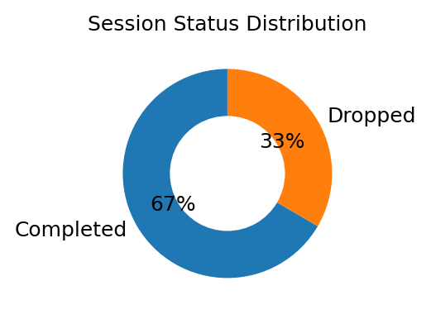
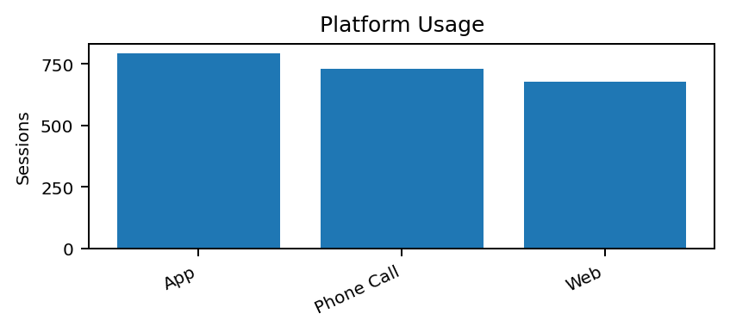
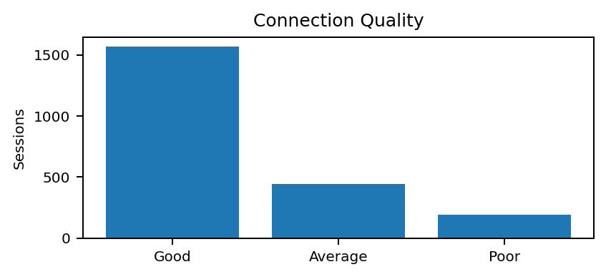
Telemedicine Performance
Total Telemedicine Sessions
2,200
Telemedicine Completion Rate
66.59%
Average Session Duration
21.43 min
Session Status — Donut
Platform Usage — Bar
Connection Quality — Column
Average Session Duration — KPI
21.43 min
Calculated from valid session start/end timestamps
HealthPlus Care | Healthcare Analytics 12

Slide 13
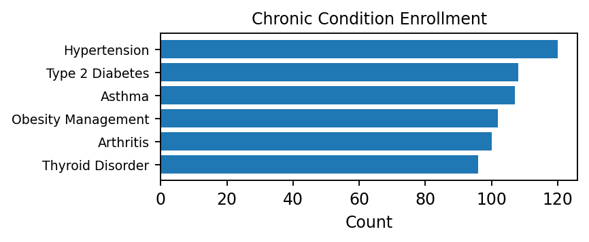
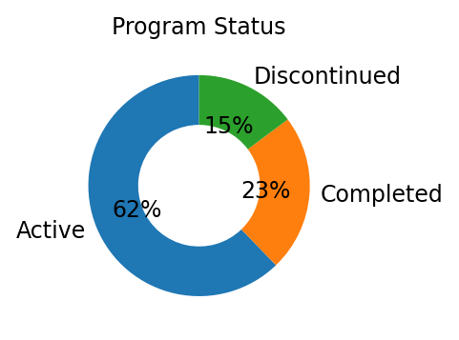
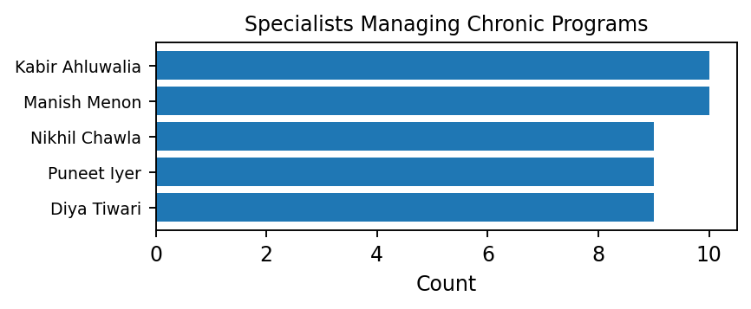
Chronic Care Program Analytics
Total Chronic Care Programs
900
Active Chronic Care Programs
560
Chronic Condition Enrollment — Bar
Program Status — Donut
Specialists Managing Chronic Programs — Bar
Active / Completed / Discontinued
Active | 560
Completed | 207
Discontinued | 133
HealthPlus Care | Healthcare Analytics
13

Slide 14
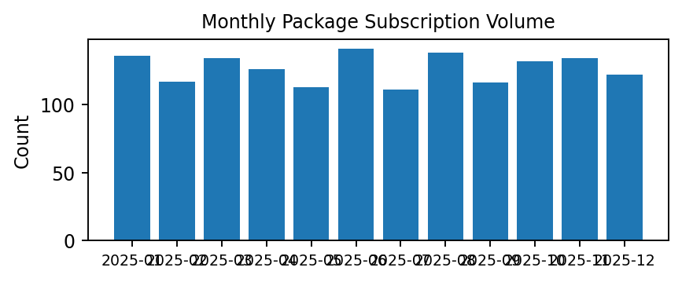
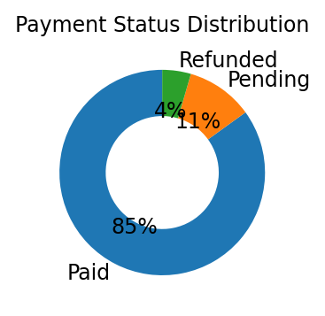
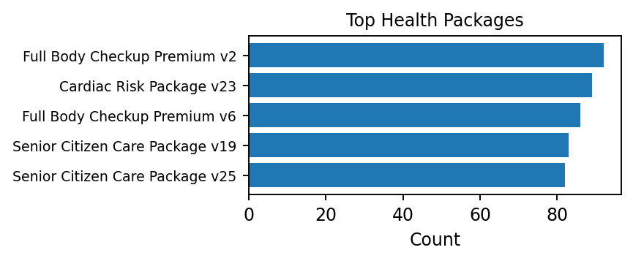
Health Package & Subscription Analytics
Total Package Subscriptions
3,000
Paid Subscription Rate
84.97%
Active / Expired Subscriptions
273 / 2,727
94 expiring in next 30 days
Package Subscription Volume — Bar
Payment Status Distribution — Donut
Top Health Packages — Bar
Expiring Subscriptions — Next 30 Days
Expiring subscriptions | 94
Paid | 2549
Pending | 316
Refunded | 135
HealthPlus Care | Healthcare Analytics
14

Slide 15
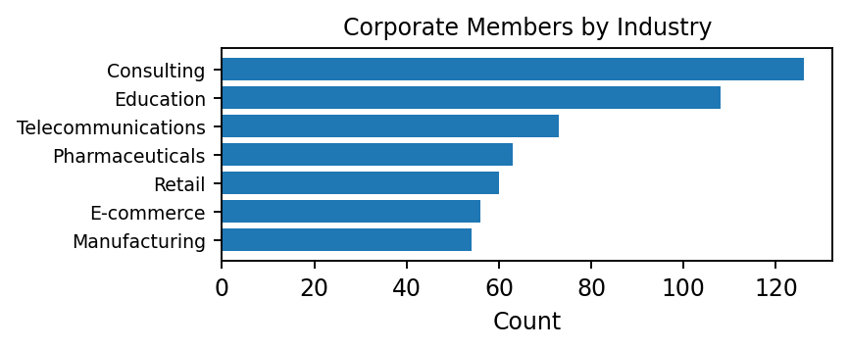
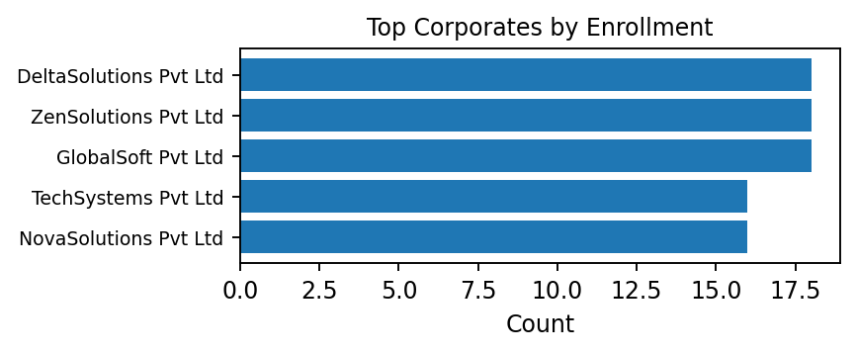
Corporate Healthcare Engagement
Total Corporates
60
Total Corporate Members
615
Corporate Members by Industry — Bar
Top Corporates by Enrollment — Bar
Corporate Participation — KPI
24.60%
615 corporate members / 2,500 total members
Leading Corporate Industries
Consulting | 126
Education | 108
Telecommunications | 73
Pharmaceuticals | 63
Retail | 60
E-commerce | 56
HealthPlus Care | Healthcare Analytics
15

Slide 16
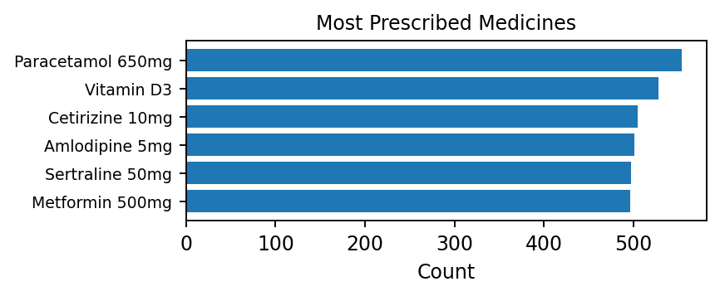
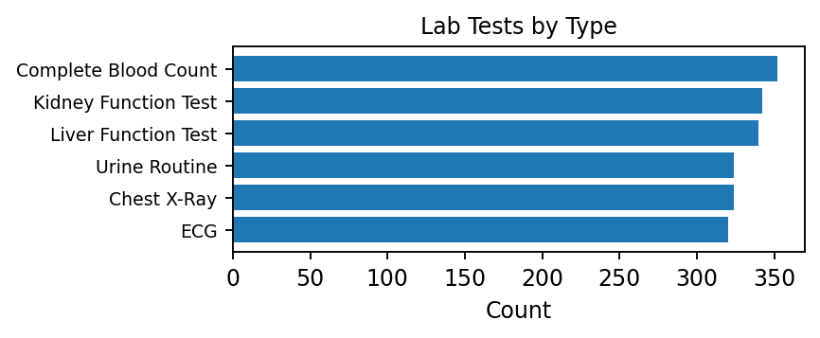
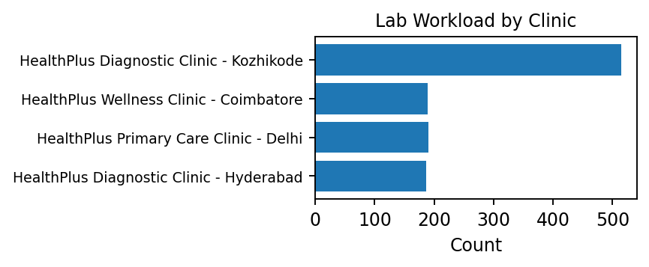
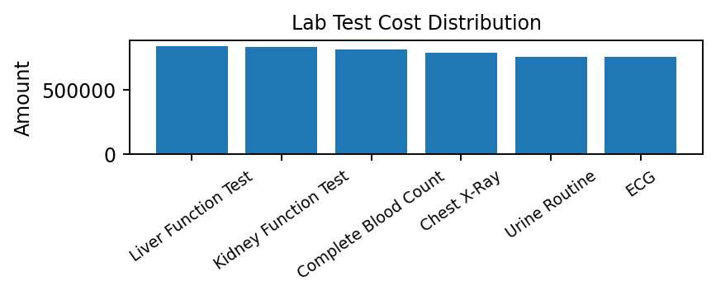
Prescription & Laboratory Analytics
Total Lab Tests
3,500
Total Lab Test Cost
₹8.23M
₹8,225,442.15
Average Lab Test Cost
₹2,350.13
Most Prescribed Medicines — Bar
Lab Tests by Type — Bar
Lab Workload by Clinic — Bar
Lab Test Cost Distribution — Column
HealthPlus Care | Healthcare Analytics
16

Slide 17
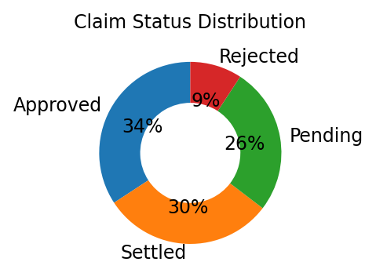
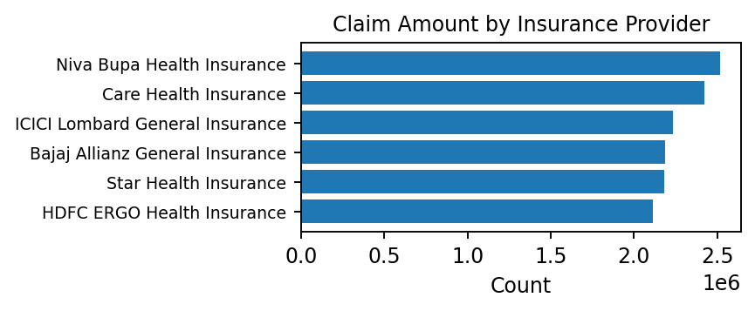
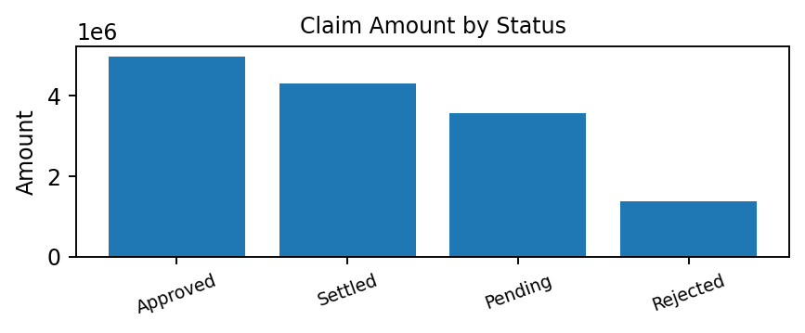
Insurance Claims Analytics
Total Claim Amount
₹14.24M
₹14,242,052.26
Approved Claim Amount
₹4.98M
₹4,983,465.96
Claim Status Distribution — Donut
Claim Amount by Insurance Provider — Bar
Approved vs Rejected vs Pending — Column
Claim Count by Status
Approved | 616
Settled | 547
Pending | 471
Rejected | 166
HealthPlus Care | Healthcare Analytics
17

Slide 18
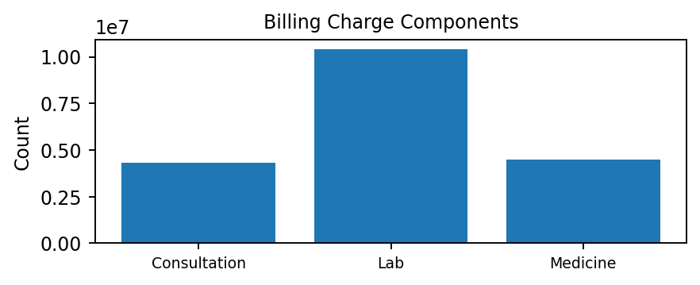
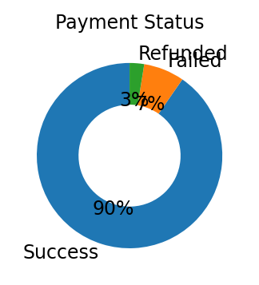
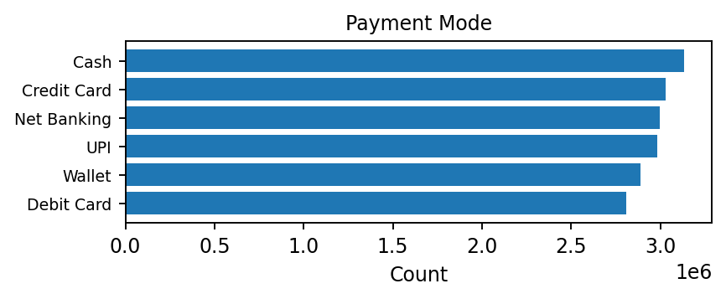
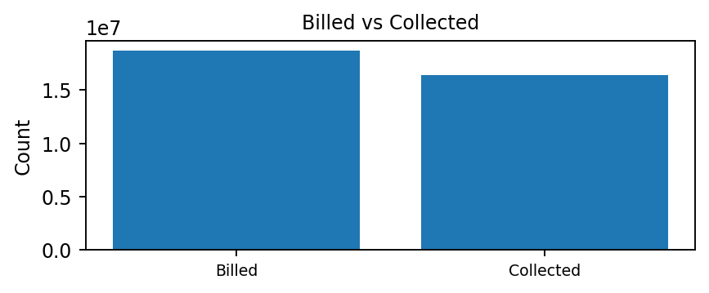
Financial Performance
Total Billed Amount
₹18.69M
Total Successful Payment
₹16.90M
Total Refunded Amount
₹0.46M
Net Collection Amount
₹16.43M
Billing Charge Components — Column
Payment Status — Donut
Payment Mode — Bar
Billed vs Collected — Column
Collection Gap — KPI
₹2,257,446.75
Collection rate: 87.92%
Financial Snapshot
Billed | ₹18,690,854.89
Net Collected | ₹16,433,408.14
HealthPlus Care | Healthcare Analytics
18

Slide 19
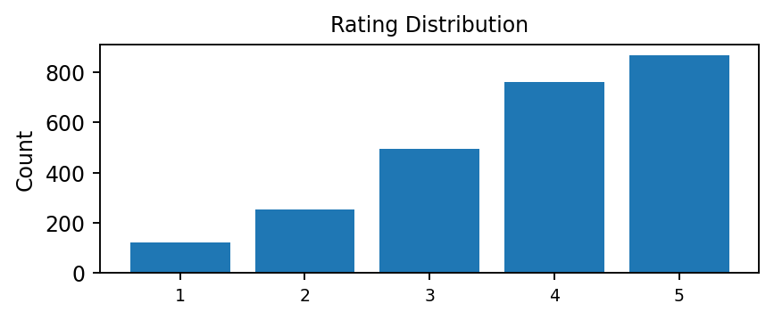
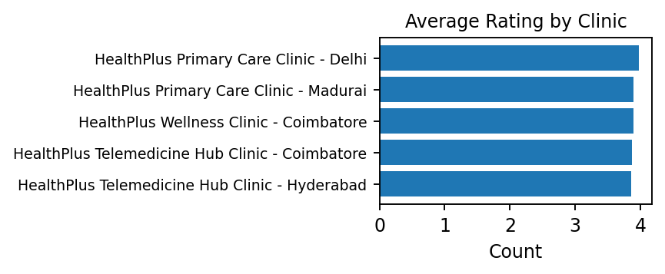
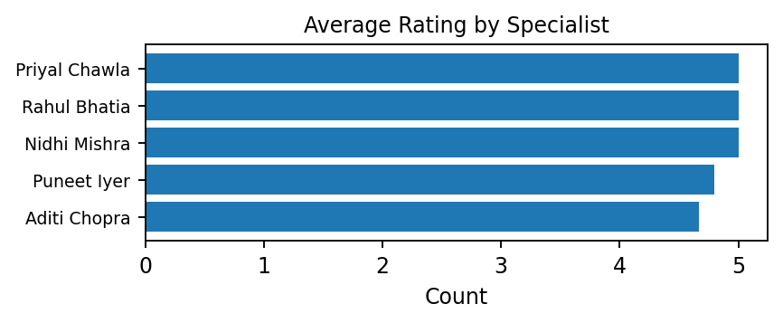
Member Experience Analytics
Average Feedback Rating
3.80 / 5
Total Feedback Responses
2,500
Positive Feedback Rate
65.12%
Rating Distribution — Column
Average Rating by Clinic — Bar
Average Rating by Specialist — Bar
Members with Consultations but No Feedback — KPI
866
Members with at least one consultation and no feedback record
HealthPlus Care | Healthcare Analytics
19

Slide 20
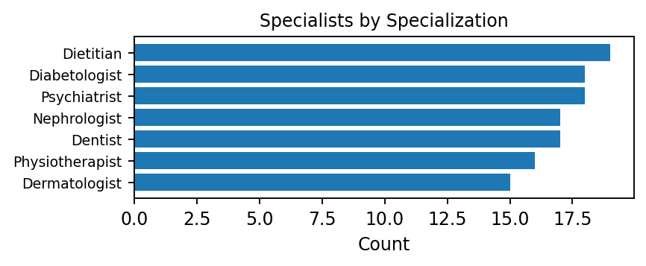
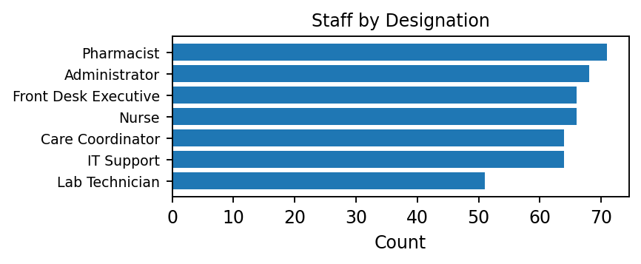
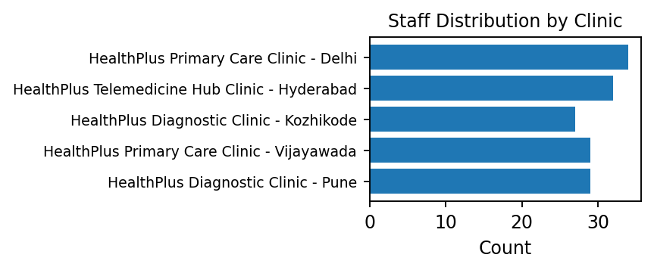
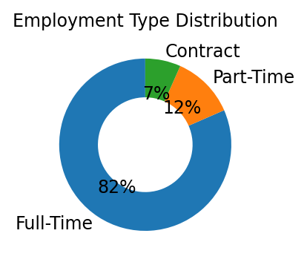
Workforce & Clinic Operations
Total Specialists
220
Total Staff
450
Average Staff Salary
₹56,155
Staff per Clinic
25.0
Specialists by Specialization — Bar
Staff by Designation — Bar
Staff Distribution by Clinic — Bar
Employment Type Distribution — Donut
Workforce Snapshot
Full-Time | 367
Part-Time | 53
Contract | 30
HealthPlus Care | Healthcare Analytics
20

Slide 21
Key Business Questions Answered
01
Which clinics have the highest consultation activity?
02
Which specialists handle the highest workload?
03
Which specializations are most active?
04
What are the most common reasons for visits?
05
How much healthcare activity occurs through telemedicine?
06
Which chronic conditions have the highest enrollment?
07
Which health packages have the highest subscriptions?
08
How active is corporate healthcare participation?
09
Which medicines are most frequently prescribed?
10
What is the total laboratory cost?
11
Which insurance providers have the highest claim amounts?
12
What is the total billed and collected amount?
13
What is the collection gap?
14
Which clinics have weaker feedback performance?
15
Which members have consultations but no feedback?
HealthPlus Care | Healthcare Analytics 21

Slide 22
Advanced SQL Analysis
CTEs
Multi-step analytical logic
Window Functions
ROW_NUMBER() • RANK() • LAG() • LEAD()
Aggregations
SUM() • AVG() • COUNT()
Joins
INNER • LEFT • RIGHT JOIN
Business Applications
Rank specialists • Compare clinics • Analyze payment trends
HealthPlus Care | Healthcare Analytics 22

Slide 23
Clinic Performance Opportunity Analysis
ACTIVITY
High healthcare activity
FINANCIAL
Weak financial indicators
EXPERIENCE
Lower-than-average experience
CLINIC PERFORMANCE OPPORTUNITY
Activity + Financial Performance + Member Experience
• Use actual SQL output to identify qualifying clinics.
• Do not invent clinic names or performance values.
HealthPlus Care | Healthcare Analytics 23

Slide 24
Key Business Insights
Insights must be supported by actual SQL outputs.
Service Utilization
Consultation patterns • Clinic workload • Specialist workload
Digital Healthcare
Telemedicine adoption • Session quality • Completion
Financial
Billing • Collection • Collection gap
Member Experience
Feedback rating • Positive feedback • Coverage
Corporate & Chronic Care
Corporate participation • Chronic care • Package adoption
HealthPlus Care | Healthcare Analytics 24

Slide 25
Business Recommendations
Recommendations should be linked to actual findings.
1. Improve low-performing clinic operations
2. Optimize specialist workload distribution
3. Improve telemedicine session quality
4. Increase health package adoption
5. Strengthen chronic care engagement
6. Improve payment collection
7. Reduce collection gaps
8. Improve feedback participation
9. Optimize laboratory service utilization
10. Strengthen corporate healthcare engagement
HealthPlus Care | Healthcare Analytics 25

Slide 26
Project Outcome
Data
Clean
Validate
Analyze
Measure
Understand
Improve
• Structured healthcare database
• Clean and validated data
• Reusable SQL KPI queries
• Business-oriented analytics
• Financial and member-experience measurement
• Healthcare utilization analysis
• Actionable decision support
HealthPlus Care | Healthcare Analytics 26

Slide 27
Technology Stack
Database
MySQL
Analytics
SQL
Data Source
CSV / Excel
Visualization
Power BI
• Relational healthcare database
• SQL-based business analysis and KPI queries
• CSV/Excel source data
• Power BI for dashboard visualization
HealthPlus Care | Healthcare Analytics 27

Slide 28
End-to-End Project Architecture
CSV Dataset
Data Validation
Power BI Dashboard
MySQL Database
SQL Business Analysis
Business Insights
Data Cleaning
KPI Queries
Decision Support
HealthPlus Care | Healthcare Analytics 28

Slide 29
Conclusion
HealthPlus Care Healthcare Analytics transforms healthcare service, member,
financial and experience data into meaningful business
insights using SQL and structured analytics.
Service Visibility
Better understanding of healthcare utilization
Financial Monitoring
Improved billing and collection visibility
Member Engagement
Stronger analysis of packages and care programs
Decision Support
Data-driven operational decisions
HealthPlus Care | Healthcare Analytics 29

Slide 30
THANK YOU
HealthPlus Care
Healthcare Service Utilization, Financial Performance & Member Experience Analytics

