Slide 1
AEROHOME
MANUFACTURING ANALYTICS
Manufacturing Performance, Quality, Procurement & Operational Intelligence
PLATFORM
Power BI
DATA
Excel
MODEL
DAX
OUTPUT
BI Dashboard
Manufacturing Data Analytics & Business Intelligence Dashboard

Slide 2
Project Overview
FOUNDATION
• AeroHome Manufacturing is analyzed using an integrated data analytics approach.
• The project covers production, plants, products, machines, quality, downtime, energy, procurement, suppliers, materials, operators, and shifts.
• Power BI converts operational data into interactive business intelligence dashboards for management review.
Raw Data
Data Cleaning
Data Modeling
DAX Measures
Power BI Dashboard
Business Insights
Recommendations
AeroHome Manufacturing Analytics
2

Slide 3
Business Problem
FOUNDATION
01
Production performance across plants
02
Production shortfall vs plan
03
Quality defects & rework
04
Machine downtime
05
Energy consumption
06
Procurement spending
07
Supplier delivery delays
08
Material cost & dependency
09
Operator & shift performance
10
Centralized management reporting
AeroHome Manufacturing Analytics
3

Slide 4
Project Objectives
FOUNDATION
1
Measure production performance
2
Monitor plant-level productivity
3
Analyze defects and quality
4
Monitor machine downtime
5
Track energy consumption
6
Analyze procurement spending
7
Evaluate supplier performance
8
Identify material & supply-chain risks
9
Analyze operator & shift performance
10
Provide actionable recommendations
AeroHome Manufacturing Analytics
4

Slide 5
Data & Analytics Overview
FOUNDATION
Production
Plants
Products
Machines
Downtime
Quality
Procurement
Suppliers
Raw Materials
Operators
Shifts
AeroHome Manufacturing Analytics
5

Slide 6
Data Model
DATA
dim_date
dim_plants
dim_suppliers
FACT LAYER
Production
dim_products
dim_materials
dim_machines
dim_operators
BRIDGE
bridge_bill_of_materials
Single-direction filtering helps avoid ambiguous relationship paths.
AeroHome Manufacturing Analytics
6

Slide 7
Data Preparation & Cleaning
DATA
STEP 01
Remove duplicates
STEP 02
Handle blanks / nulls
STEP 03
Standardize text
STEP 04
Trim spaces
STEP 05
Validate dates
STEP 06
Validate numeric fields
STEP 07
Validate IDs & keys
STEP 08
Standardize categories
STEP 09
Validate supplier/product data
STEP 10
Create analytical columns
Raw Data
Power Query
Clean Data
Data Model
AeroHome Manufacturing Analytics
7

Slide 8
Key Performance Indicators
ANALYTICS
Production
Quality
• Total Planned Units
• Total Produced Units
• Production Achievement %
• Production Shortfall
• Total Defects
• Defect Rate
• Rework Rate
• Units Inspected
Operations
Finance
• Total Downtime
• Total Downtime Hours
• Average Downtime
• Energy Consumed
• Total Procurement Spend
• Product Unit Cost
• Potential Unit Margin
• Estimated Defect Cost Exposure
Procurement
Materials & Workforce
• Purchase Order Volume
• On-Time Delivery Rate
• Average Lead Time
• Supplier Rating
• Materials Used
• Materials per Product
• High-Cost Materials
• Active Operators
AeroHome Manufacturing Analytics
8

Slide 9
DAX Measures & Business Calculations
ANALYTICS
Total Production
Defect Rate
SUM(
fact_production[quantity_produced]
)
DIVIDE(
[Total Defects],
[Total Produced Units],
0
)
Production Achievement
Energy per Unit
DIVIDE(
[Total Produced Units],
[Total Planned Units],
0
)
DIVIDE(
[Total Energy Consumed],
[Total Produced Units],
0
)
Estimated Defect Cost Exposure
SUMX(
fact_production,
fact_production[quantity_defective]
* RELATED(dim_products[unit_cost])
)
AeroHome Manufacturing Analytics
9

Slide 10
Power BI Dashboard Architecture
DASHBOARD
PAGE 01
Executive Overview
PAGE 02
Production &
Plant Performance
PAGE 03
Machine & Downtime
Analysis
PAGE 04
Quality Analysis
PAGE 05
Operational Efficiency
PAGE 06
Finance & Cost Analysis
PAGE 07
Procurement & Supplier
Performance
PAGE 08
Materials & Supply
Chain Risk
PAGE 09
Operator & Shift
Performance
AeroHome Manufacturing Analytics
10

Slide 11
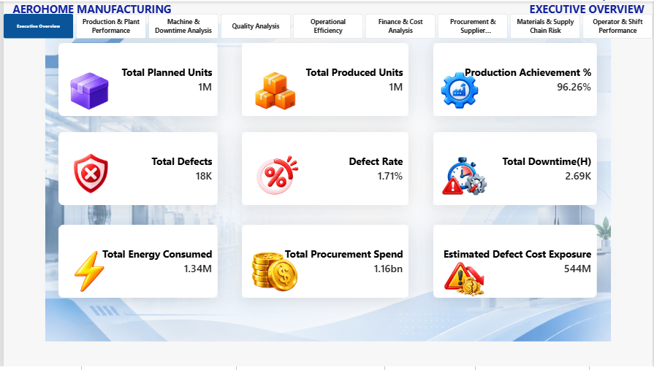
Executive Overview
DASHBOARD
Planned Units
~1M
Produced Units
~1M
Achievement
96.26%
Defects
~18K
Defect Rate
1.71%
Downtime
~2.69K h
Energy
~1.34M kWh
Procurement
~1.16bn
AeroHome Manufacturing Analytics
11

Slide 12
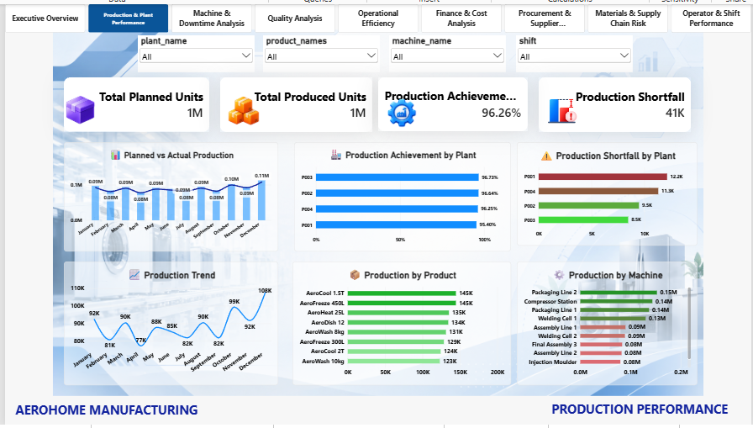
Production & Plant Performance
DASHBOARD
Achievement
96.26%
Shortfall
~41K
P003
96.73%
P002
96.64%
P004
96.25%
P001
95.40%
AeroHome Manufacturing Analytics
12

Slide 13
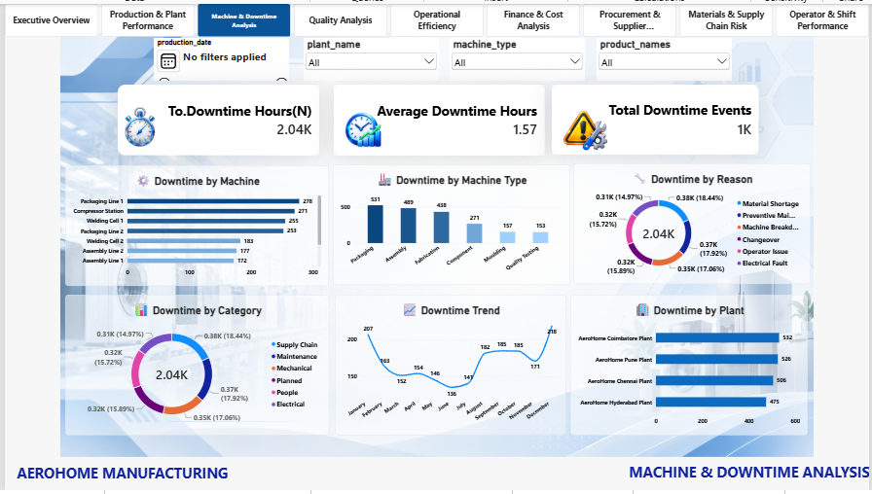
Machine & Downtime Analysis
DASHBOARD
Downtime
~2.04K h
Avg Downtime
1.57 h
Events
~1K
Dec
218
Mar
152
Oct
185
AeroHome Manufacturing Analytics
13

Slide 14
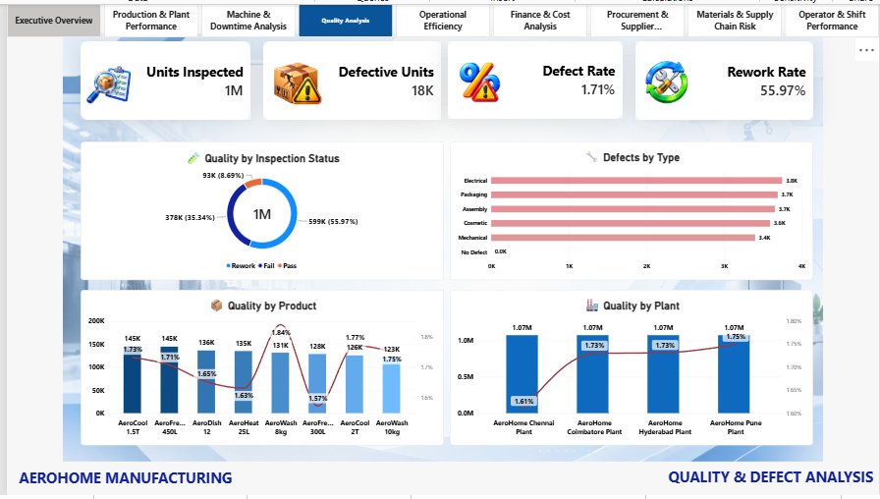
Quality & Defect Analysis
DASHBOARD
Inspected
~1M
Defective
~18K
Defect Rate
1.71%
Rework
55.97%
Rework
~599K
Pass
~378K
Fail
~93K
AeroHome Manufacturing Analytics
14

Slide 15
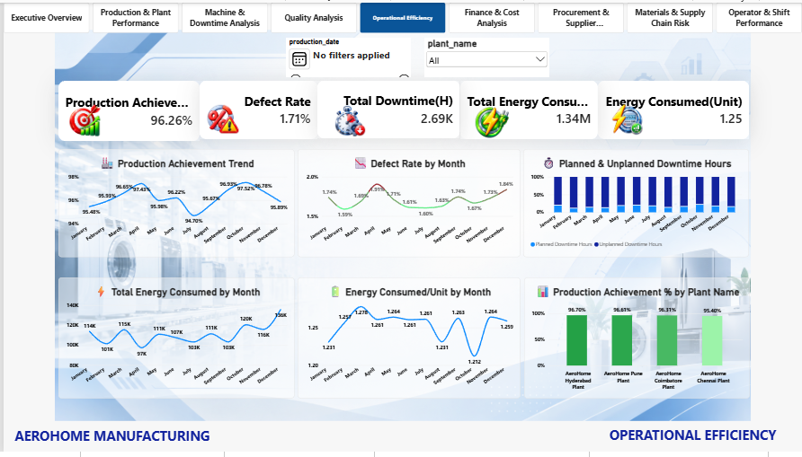
Operational Efficiency
DASHBOARD
Achievement
96.26%
Defect Rate
1.71%
Downtime
~2.69K h
Energy
~1.34M kWh
Energy / Unit
1.25
AeroHome Manufacturing Analytics
15

Slide 16
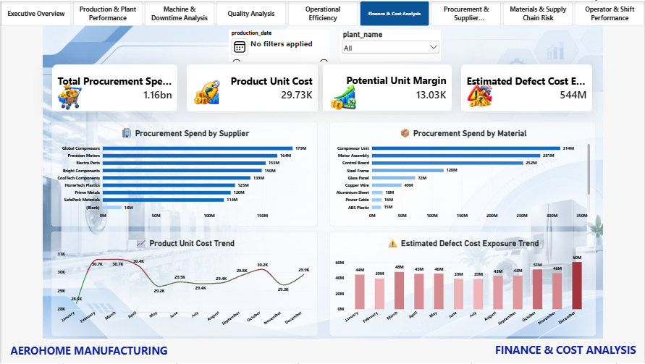
Finance & Cost Analysis
DASHBOARD
Procurement
~1.16bn
Unit Cost
29.73K
Potential Margin
13.03K
Defect Exposure
~544M
AeroHome Manufacturing Analytics
16

Slide 17
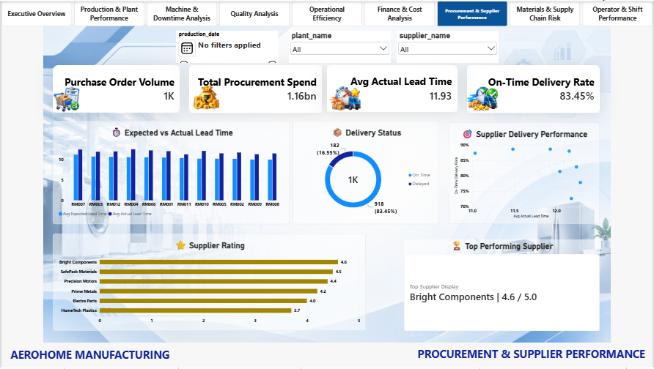
Procurement & Supplier Performance
DASHBOARD
PO Volume
~1K
Procurement
~1.16bn
Actual Lead
11.93 days
On-Time
83.45%
On-Time
~918
Delayed
~182
Top Supplier
Bright Components 4.6/5
AeroHome Manufacturing Analytics
17

Slide 18
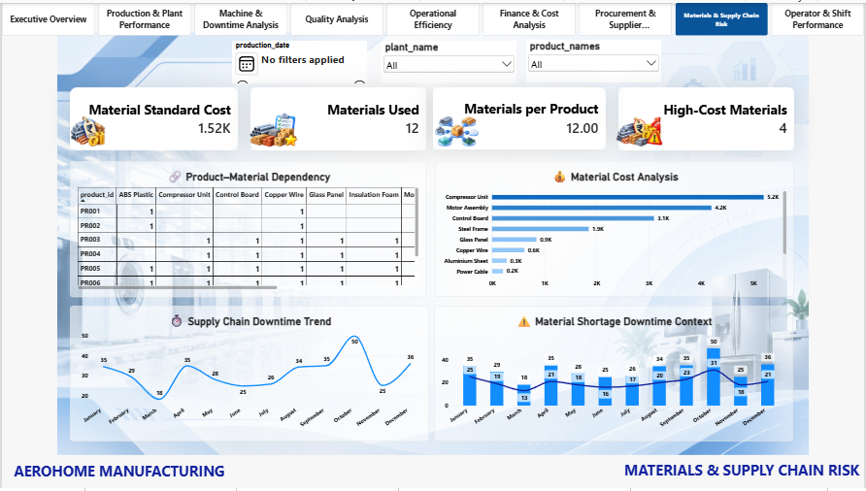
Materials & Supply Chain Risk
DASHBOARD
Materials Used
12
Materials / Product
12.00
High-Cost
4
Std. Cost
~1.52K
Compressor Unit
~5.2K
Motor Assembly
~4.2K
Control Board
~3.1K
AeroHome Manufacturing Analytics
18

Slide 19
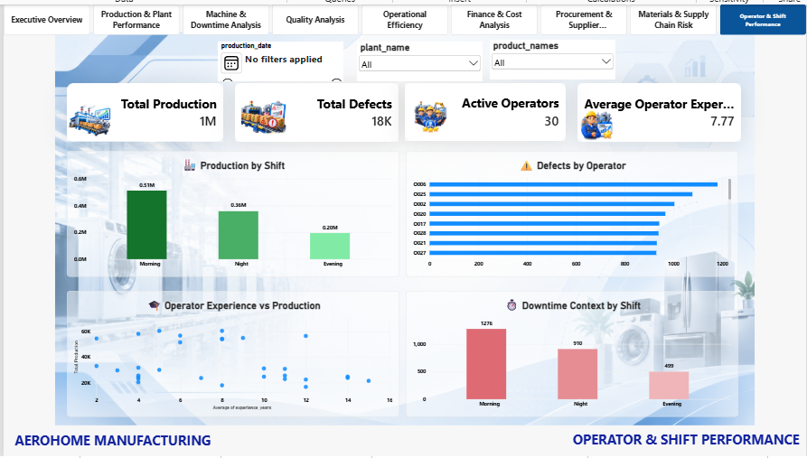
Operator & Shift Performance
DASHBOARD
Production
~1M
Defects
~18K
Operators
30
Avg Experience
7.77 years
Morning
~0.51M
Night
~0.36M
Evening
~0.20M
AeroHome Manufacturing Analytics
19

Slide 20
Cross-Dashboard Business Insights
INSIGHTS
INSIGHT 01
Production achievement is 96.26%, with a 41K-unit shortfall.
INSIGHT 02
Defect rate is 1.71%, with a 55.97% rework rate.
INSIGHT 03
Total downtime is 2.69K hours, requiring operational review.
INSIGHT 04
Energy consumption is 1.34M kWh, at 1.25 kWh per unit.
INSIGHT 05
Procurement spend is 1.16bn, concentrated in key materials and
suppliers.
INSIGHT 06
Estimated defect cost exposure is 544M, not a confirmed loss.
INSIGHT 07
Supplier on-time delivery is 83.45%, indicating room for improvement.
INSIGHT 08
Morning shift leads in production and has the highest displayed downtime.
INSIGHT 09
High-cost materials increase both cost and supply-chain exposure.
INSIGHT 10
Quality, downtime, energy, procurement, and production should be
evaluated together.
AeroHome Manufacturing Analytics
20

Slide 21
Key Business Recommendations
RECOMMENDATIONS
Production
Quality
• Investigate the ~41K-unit shortfall; review P001 and monthly production fluctuations.
• Investigate Electrical, Packaging, and Assembly defects; review the 55.97% displayed rework rate.
Operations
Finance
• Analyze downtime by machine, plant, shift, and reason; monitor energy per unit with output.
• Review high-spend materials and the ~544M estimated defect cost exposure.
Procurement
Materials
• Improve the 83.45% on-time delivery rate and investigate delayed purchase orders.
• Monitor high-cost materials and supply-chain downtime patterns.
Workforce
• Investigate Morning-shift downtime and operator-level defect patterns.
AeroHome Manufacturing Analytics
21

Slide 22
Priority Action Plan
RECOMMENDATIONS
01
Production shortfall &
plant performance
02
Defect rate & rework reduction
03
Estimated defect cost exposure
04
Supplier delivery & procurement
05
Material cost &
supply-chain risk
06
Operator & shift efficiency
Problem
Analysis
Action
Business Benefit
AeroHome Manufacturing Analytics
22

Slide 23
Expected Business Impact
IMPACT
Operational Benefits
Business Benefits
• Improved production achievement
• Reduced production shortfall
• Lower defect rate
• Reduced rework
• Lower downtime
• Better energy efficiency
• Improved supplier delivery
• Better procurement visibility
• Reduced material risk
• Improved operator utilization
• Faster management decisions
AeroHome Manufacturing Analytics
23

Slide 24
CONCLUSION
AeroHome Manufacturing Analytics provides a centralized Power BI-based view of production, quality, operations, finance, procurement, supply chain, and workforce performance.
• The dashboard converts operational data into actionable business intelligence.
• The analysis identifies performance gaps and cost exposures.
• Cross-functional KPI analysis supports better decision-making.
• Continuous monitoring can help improve productivity, quality, cost control, and operational efficiency.
THANK YOU
AEROHOME MANUFACTURING ANALYTICS

