Slide 1
NOVITECH
MANUFACTURING
ANALYTICS
Production, Quality, Finance, Operational Efficiency & Supply Chain Analytics
MICROSOFT POWER BI
BUSINESS INTELLIGENCE
MANUFACTURING
End-to-End
Data Analytics Project
NOVITECH MANUFACTURING | POWER BI ANALYTICS 01

Slide 2
Project Overview
Centralized Power BI analytics for manufacturing management
Novitech Manufacturing operates multiple plants and produces different products using raw materials purchased from external suppliers.
The solution integrates manufacturing and procurement data into a centralized analytical environment for management visibility.
Production
Quality
Operations
Output and production activity
Defective production and quality loss
Downtime, energy, operators and shifts
Finance & Cost
Procurement
Supply Chain
Cost exposure and procurement spend
Purchase orders, delays and lead time
Material dependencies and supplier risk
NOVITECH MANUFACTURING | POWER BI ANALYTICS 02

Slide 3
Business Problem
Why a centralized analytical solution is required
Novitech Manufacturing lacks a centralized view of operational and financial performance.
MANAGEMENT VISIBILITY GAPS
BUSINESS IMPACT
• Production output is distributed across datasets.
• Defective production and quality-loss areas are not easily visible.
• Downtime and energy efficiency require consolidated analysis.
• Procurement spending and supplier performance need comparison.
• Raw-material dependency creates potential supply-chain exposure.
• Limited understanding of operational efficiency.
• Difficulty identifying cost exposure.
• Delayed visibility into procurement issues.
• Difficulty identifying shared critical materials.
• Need for a single management dashboard.
NOVITECH MANUFACTURING | POWER BI ANALYTICS 03

Slide 4
Core Business Question
The central analytical question driving the project
“Where is Novitech Manufacturing losing operational efficiency and carrying financial exposure, and what production or supply-chain factors are contributing to those risks?”
Operational Efficiency
Financial Exposure
Supply Chain Risk
Production • defects • downtime • energy
Procurement • cost • potential margin context
Dependencies • suppliers • delays • lead time
NOVITECH MANUFACTURING | POWER BI ANALYTICS 04

Slide 5
Project Objectives
Business questions translated into measurable analytical objectives
1
Analyze production performance
2
Identify quality issues
3
Analyze downtime
4
Measure energy efficiency
5
Compare operator and shift performance
6
Analyze procurement spending
7
Analyze product cost exposure
8
Analyze supplier performance
9
Identify raw-material dependencies
10
Identify supply-chain risks
NOVITECH MANUFACTURING | POWER BI ANALYTICS 05

Slide 6
Dataset & Data Model
Fact, dimension and bridge tables supporting end-to-end analysis
TABLE
TABLE
FACT TABLES
dim_plants
dim_raw_materials
fact_production_runs
fact_purchase_orders
TABLE
TABLE
dim_products
dim_suppliers
TABLE
TABLE
dim_operators
bridge_bill_of_materials
Supports production, quality, cost, procurement, supplier and product-material dependency analysis.
NOVITECH MANUFACTURING | POWER BI ANALYTICS 06

Slide 7
Data Cleaning & Power Query
Data preparation workflow before analytical modeling
RAW DATA
→
VALIDATION
→
CLEANING
→
STANDARDIZATION
→
TRANSFORMATION
→
POWER BI MODEL
Validation & cleaning checks
Operational field checks
• Data type validation
• Null and blank investigation
• Duplicate checking
• Categorical value standardization
• Quantity, cost and price validation
• Downtime validation
• Energy validation
• Lead-time validation
• Rating validation
• Date validation and cleaning documentation
NOVITECH MANUFACTURING | POWER BI ANALYTICS 07

Slide 8
DAX Measures & KPI Framework
Core measures used across the seven dashboard pages
Total Production
Total Defects
Defect Rate
Total Production Runs
Total Downtime
Average Downtime per Run
Total Energy
Energy per Unit
Total Procurement Spend
Total Purchase Orders
Delayed Orders
Delay Rate
Average Lead Time
Potential Unit Margin
Estimated Defect Cost Exposure
Estimated Production Cost Context
Potential Production Value Context
NOVITECH MANUFACTURING | POWER BI ANALYTICS 08

Slide 9
Key Business Calculations
Transparent KPI logic for management interpretation
Procurement Spend
Defect Rate
Quantity Ordered × Unit Price
Total Defects ÷ Total Production
Potential Unit Margin
Estimated Defect Cost Exposure
Target Price − Unit Cost
Defective Quantity × Product Unit Cost
Estimated Production Cost Context
Potential Production Value Context
Quantity Produced × Product Unit Cost
Quantity Produced × Target Price
These calculations provide analytical context and must be interpreted within the dataset limitations.
NOVITECH MANUFACTURING | POWER BI ANALYTICS 09

Slide 10
Power BI Dashboard Structure
Seven interactive pages covering the full analytical scope
01
02
03
04
Executive Overview
Production & Plant Performance
Quality & Operational Efficiency
Finance & Cost Analysis
05
06
07
Procurement & Supplier Performance
Raw Materials & Supply Chain Risk
Operator & Shift Performance
NOVITECH MANUFACTURING | POWER BI ANALYTICS 10

Slide 11
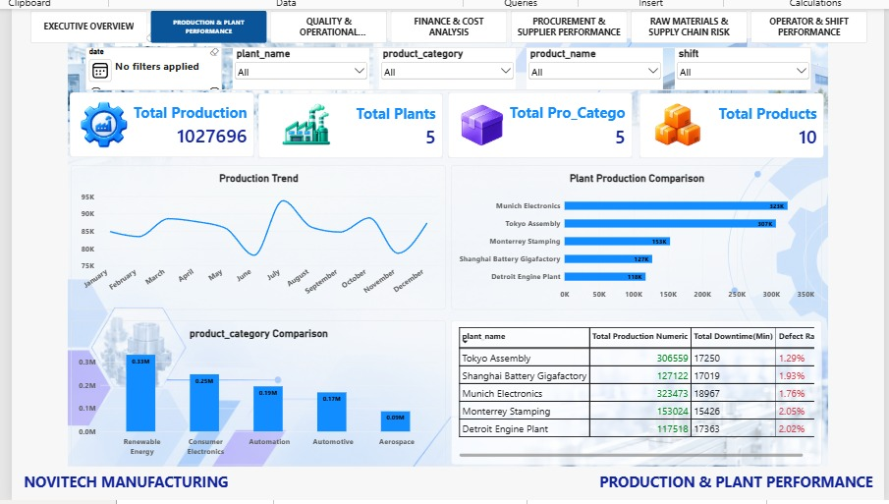
Dashboard Page 1 — Executive Overview
Power BI dashboard view and key observations
KEY OBSERVATIONS
• Total production: 1,027,696 units across 5 plants and 10 products.
• Total defects: 17,609 units; overall defect rate: 1.71%.
• Total procurement spend: 21.54M with 171 delayed orders.
• Estimated defect cost exposure: 20.96M.
NOVITECH MANUFACTURING | POWER BI ANALYTICS 11

Slide 12
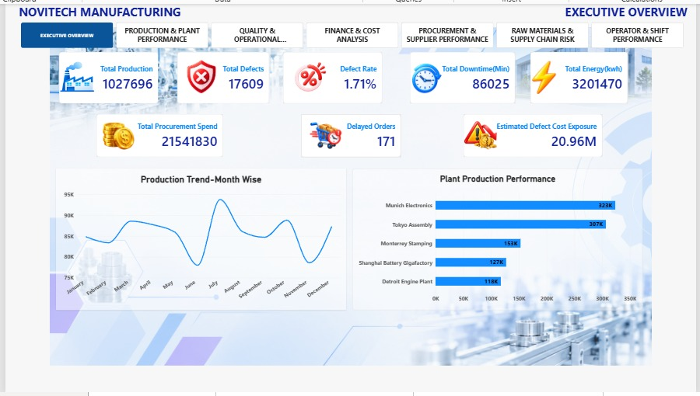
Dashboard Page 2 — Production & Plant Performance
Power BI dashboard view and key observations
KEY OBSERVATIONS
• Munich Electronics: approximately 323K production.
• Tokyo Assembly: approximately 307K.
• Monterrey Stamping: approximately 153K.
• Production varies across months and plants.
NOVITECH MANUFACTURING | POWER BI ANALYTICS 12

Slide 13
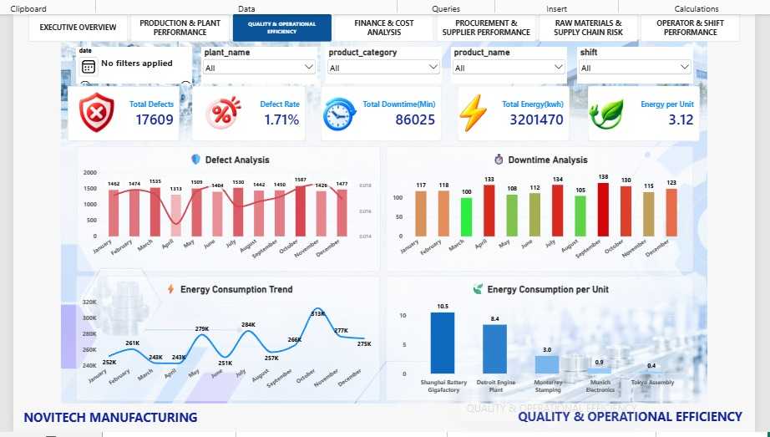
Dashboard Page 3 — Quality & Operational Efficiency
Power BI dashboard view and key observations
KEY OBSERVATIONS
• Total defects: 17,609; defect rate: 1.71%.
• Total downtime: 86,025 minutes.
• Total energy: 3,204,470 kWh; energy per unit: 3.12.
• Shanghai Battery Gigafactory shows the highest displayed energy-per-unit value.
NOVITECH MANUFACTURING | POWER BI ANALYTICS 13

Slide 14
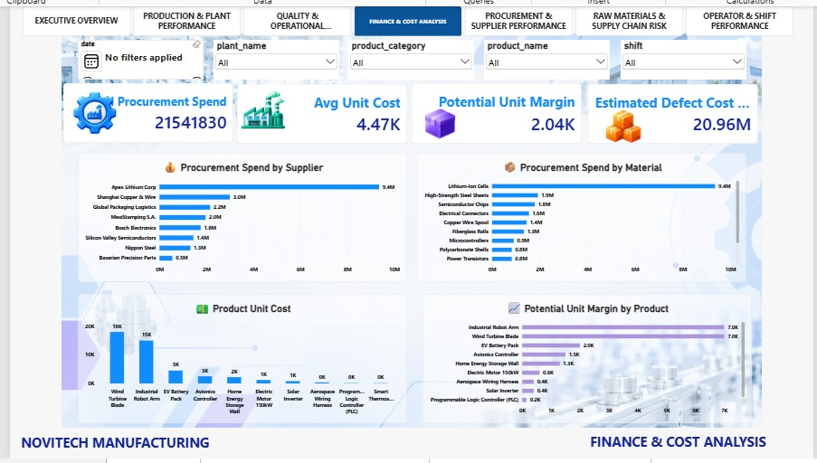
Dashboard Page 4 — Finance & Cost Analysis
Power BI dashboard view and key observations
KEY OBSERVATIONS
• Procurement spend: 21.54M; average unit cost: 4.47K.
• Potential unit margin: 2.04K; estimated defect cost exposure: 20.96M.
• Apex Lithium Corp: approximately 9.4M procurement spend.
• Lithium-Ion Cells: approximately 9.4M procurement spend.
Note: Potential Unit Margin is not actual profit.
NOVITECH MANUFACTURING | POWER BI ANALYTICS 14

Slide 15
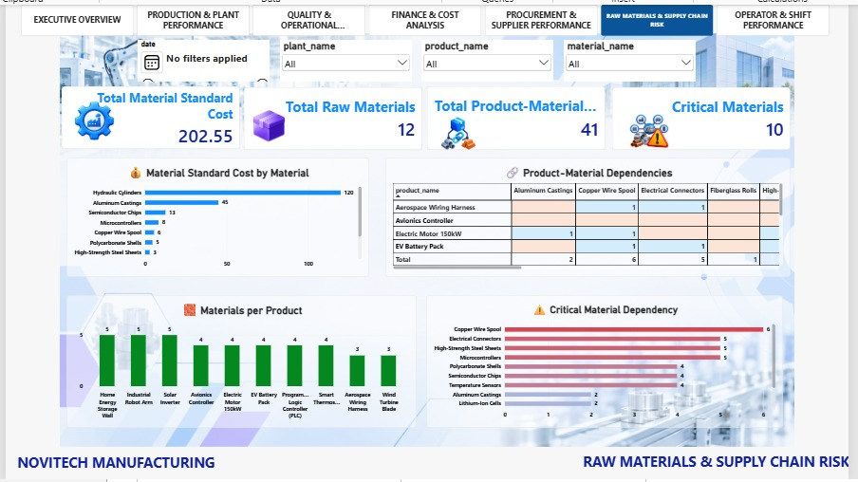
Dashboard Page 5 — Procurement & Supplier Performance
Power BI dashboard view and key observations
KEY OBSERVATIONS
• Approximately 2K purchase orders are displayed.
• Delay rate: 10.69%; average lead time: 9.84.
• Average supplier rating: 3.67.
• Global Packaging Logistics: 18.63% displayed delay rate.
NOVITECH MANUFACTURING | POWER BI ANALYTICS 15

Slide 16
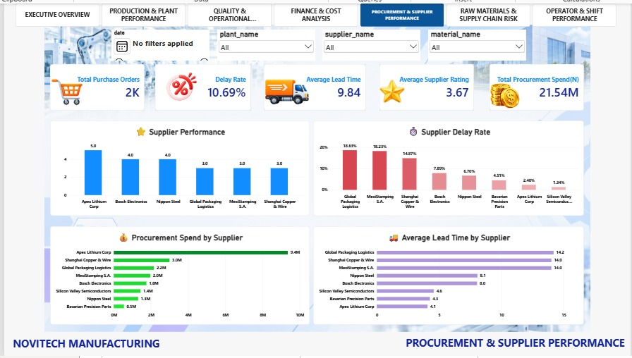
Dashboard Page 6 — Raw Materials & Supply Chain Risk
Power BI dashboard view and key observations
KEY OBSERVATIONS
• 12 raw materials and 41 product-material dependency records.
• 10 materials identified as critical by the project measure.
• Copper Wire Spool has the highest displayed dependency count: 6.
• Electrical Connectors, High-Strength Steel Sheets and Microcontrollers each show 5.
Shared materials can create supply-chain exposure when dependency is high.
NOVITECH MANUFACTURING | POWER BI ANALYTICS 16

Slide 17
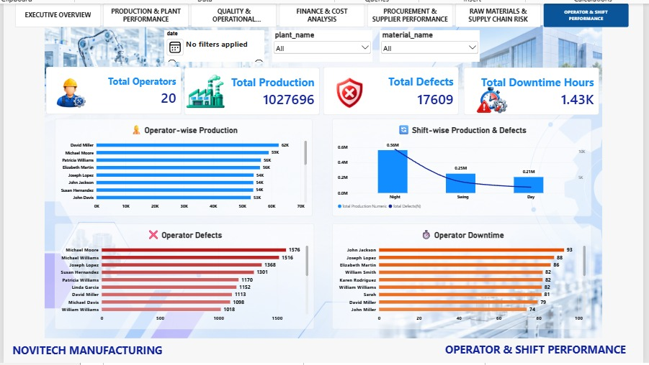
Dashboard Page 7 — Operator & Shift Performance
Power BI dashboard view and key observations
KEY OBSERVATIONS
• 20 operators are covered.
• Night shift: approximately 0.56M production.
• David Miller: approximately 62K visible production.
• Michael Moore: approximately 1,576 visible defects; John Jackson: approximately 93 visible downtime hours.
NOVITECH MANUFACTURING | POWER BI ANALYTICS 17

Slide 18
Key Business Insights
Cross-dashboard observations supported by the project data
INSIGHT 1
INSIGHT 2
Production is concentrated in Munich Electronics and Tokyo Assembly.
Energy-per-unit performance differs substantially across plants.
INSIGHT 3
INSIGHT 4
Procurement spending is concentrated among major suppliers and materials.
Some suppliers show comparatively high delay rates.
INSIGHT 5
INSIGHT 6
Material dependency is concentrated in several shared materials.
Defects, downtime and energy should be analyzed together for operational efficiency.
NOVITECH MANUFACTURING | POWER BI ANALYTICS 18

Slide 19
Business Recommendations
Actions for management review based on observed patterns
Supplier delays
Energy efficiency
Review suppliers with comparatively high displayed delay rates.
Investigate plants with higher displayed energy-per-unit values.
Quality & cost
Material risk
Analyze defects alongside estimated defect-cost exposure.
Monitor high-dependency raw materials and shared materials.
Operator & shift
Procurement concentration
Review defect and downtime patterns by operator and shift.
Monitor high-spend suppliers and materials.
These are management review priorities; the dashboard alone does not establish root causes.
NOVITECH MANUFACTURING | POWER BI ANALYTICS 19

Slide 20
KPI Definitions
Standard definitions used in the analytical solution
KPI | Definition
Total Production | Total quantity produced
Total Defects | Total defective units
Defect Rate | Total Defects ÷ Total Production
Procurement Spend | Quantity Ordered × Unit Price
Delay Rate | Delayed Orders ÷ Total Orders
Potential Unit Margin | Target Price − Unit Cost
Estimated Defect Cost Exposure | Defective Quantity × Unit Cost
Energy per Unit | Total Energy ÷ Production
NOVITECH MANUFACTURING | POWER BI ANALYTICS 20

Slide 21
Analytical Assumptions
Rules used to interpret the supplied data and KPI calculations
ASSUMPTION 1
ASSUMPTION 2
Calculations are based on the supplied datasets.
Procurement spend follows Quantity Ordered × Unit Price.
ASSUMPTION 3
ASSUMPTION 4
Potential Unit Margin follows Target Price − Unit Cost.
Estimated defect cost follows Defective Quantity × Product Unit Cost.
ASSUMPTION 5
ASSUMPTION 6
Product-material dependency follows the supplied BOM relationship.
KPI results depend on the quality and completeness of source data.
NOVITECH MANUFACTURING | POWER BI ANALYTICS 21

Slide 22
Financial Limitations & Interpretation
Important boundaries for management and project presentation
DATASET LIMITATION
TERMINOLOGY TO PRESERVE
The dataset does NOT contain actual sales transactions.
Potential Margin ≠ Actual Profit
• Actual revenue cannot be calculated.
• Actual profit cannot be calculated.
• Actual discounts and returns are unavailable.
• Tax information is unavailable.
• Customer-level sales data is unavailable.
Potential Production Value ≠ Actual Revenue
Estimated Defect Cost ≠ Confirmed Scrap/Rework Cost
Estimated Production Cost ≠ Accounting COGS
NOVITECH MANUFACTURING | POWER BI ANALYTICS 22

Slide 23
Project Success Criteria
Completion criteria aligned with the project requirements
✓
✓
✓
Data cleaned and transformed
Relationships validated
KPIs correctly calculated
✓
✓
✓
Financial terminology correctly used
Dashboard pages address business problems
Insights supported by dashboard data
✓
✓
✓
Operational areas identified
Cost exposure identified
Supply-chain risk areas identified
NOVITECH MANUFACTURING | POWER BI ANALYTICS 23

Slide 24
Final Project Deliverables
What is included in the completed Novitech Manufacturing solution
Power Query
01
Data Model
02
DAX Measures
03
Dashboard
04
Cleaned and transformed data
Validated fact-dimension model
Operational, quality, financial and supply-chain KPIs
Seven-page interactive Power BI report
Insights
05
Recommendations
06
Documentation
07
Evidence-based findings
Business actions
Assumptions, KPI definitions and limitations
NOVITECH MANUFACTURING | POWER BI ANALYTICS 24

Slide 25
CONCLUSION
NOVITECH
MANUFACTURING
ANALYTICS
The Novitech Manufacturing Power BI solution provides an integrated analytical view of production, quality, operational efficiency, finance, procurement, supplier performance and supply-chain risk. The dashboard enables management to monitor operational performance, understand cost exposure, identify procurement and material dependencies, and support data-driven business reviews.
POWER BI ANALYTICS
DATA-DRIVEN DECISIONS
Thank You
NOVITECH MANUFACTURING | POWER BI ANALYTICS 25

