Slide 1
Introduction to Docker
By Seetaram

Slide 2
Agenda
Why docker?
What is docker and container?
Container vs VM
Container vs Image
Docker Installation
Docker commands
Port mapping
Volume mapping
Build docker image

Slide 3
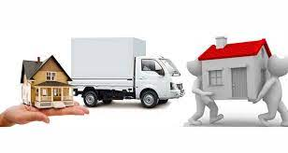
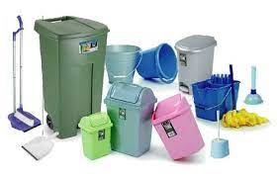

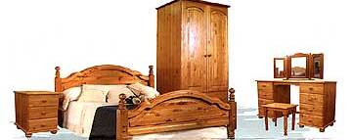
Why Docker?
House shifting example
Notes:
Take an example of house shifting from house A to house B. There can be several items that needs to be shifted. While shifting we might miss some items, or misplace some of them. Later we have to struggle to find them when they are needed. Packers & Movers.

Slide 4
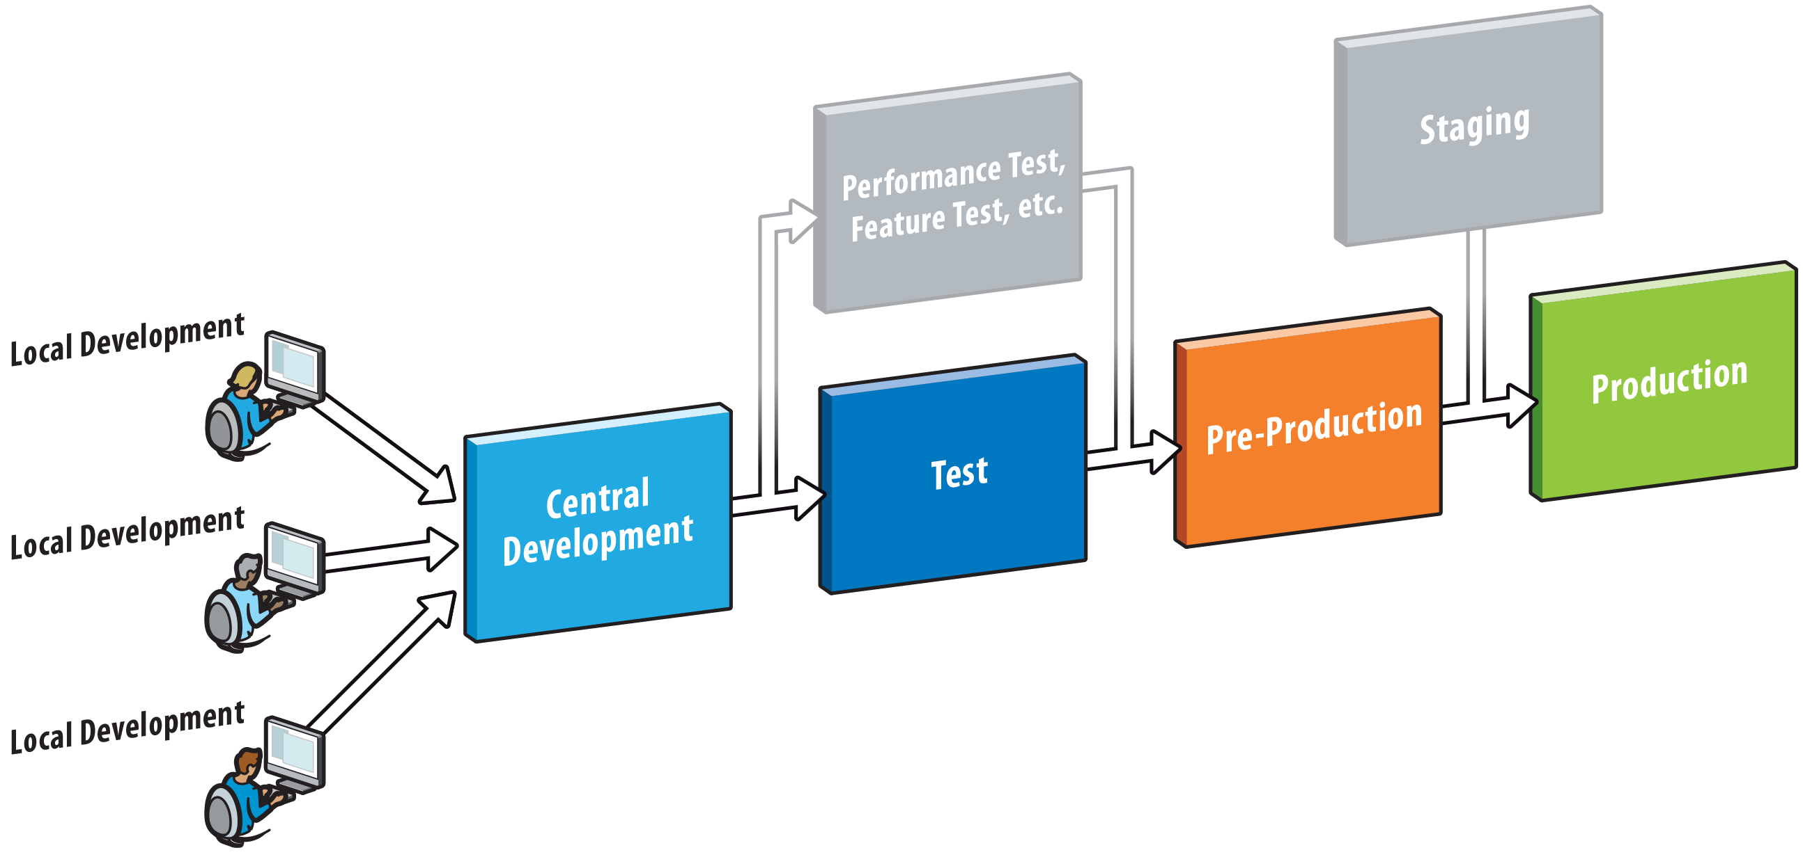
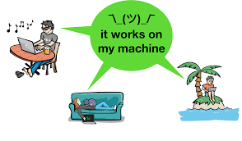
Continued..
How can I move my application from Environment to another?
Notes:
Similarly application setup done in the Dev environment with several components when moved to higher environments such as Test, UAT, etc might not work

Slide 5
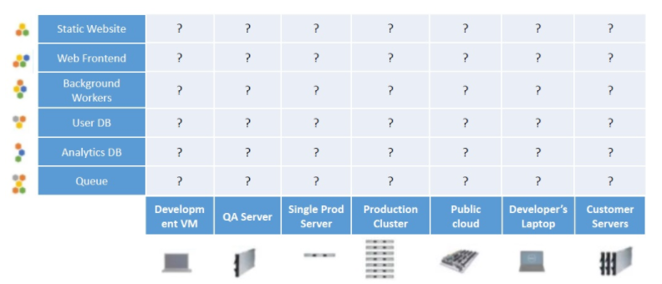
Why do we need docker?
Notes:
Matrix from Hell

Slide 6
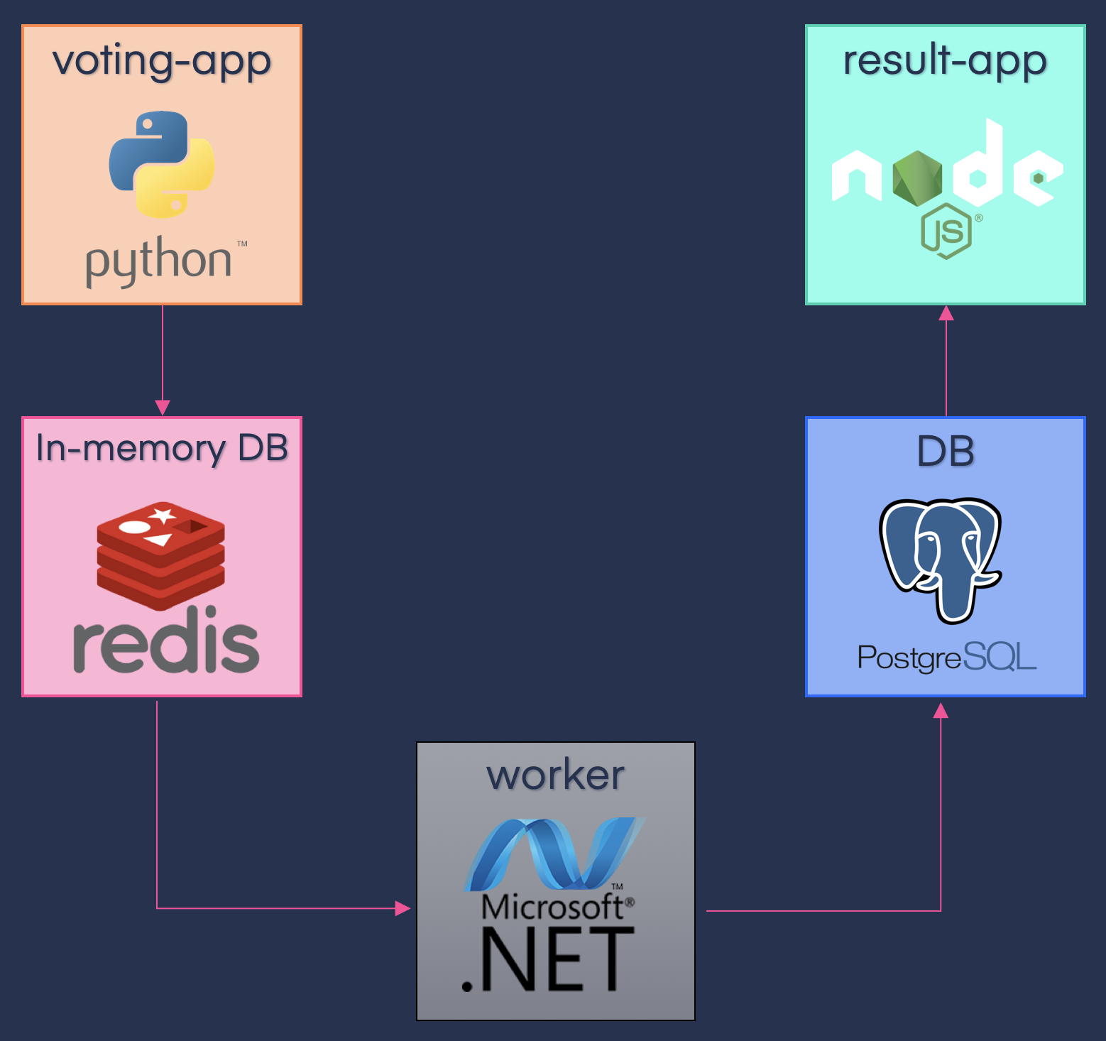
Voting App Example

Slide 7
Benefits for – Dev & Admins
Developers | Administrators / DevOps
Build once & Run Anywhere | Configure once and run anything
Clean, safe, portable runtime environment for the application | Makes entire lifecycle more efficient, consistent, and repeatable
Run each app in its isolated container | Eliminate inconsistencies between Dev, Test, Prod environments
Automate testing, integration, packaging, and anything that can be scripted | Significantly improves Continuous integration and continuous deployment process
Reduce/eliminate compatibility issues on different platforms | Containers being lightweight addresses cost, performance, deployment and portability issues

Slide 8
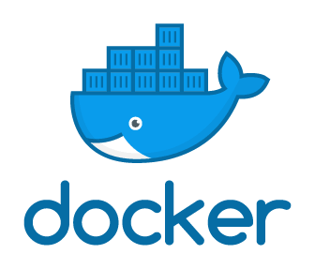
What is Docker?
Software platform for building applications based on containers
Software framework for building, running, and managing containers on servers and the cloud.
Notes:
Docker is an open platform for developing, shipping & running distributed applications, whether on laptops, data center VMs or cloud.
Docker provides the ability to package and run an application in a loosely isolated environment called a container

Slide 9
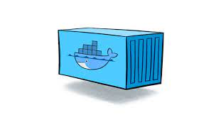
What is Container?
Small and lightweight execution environments
Make shared use of the operating system kernel
Run in isolation from one another

Slide 10
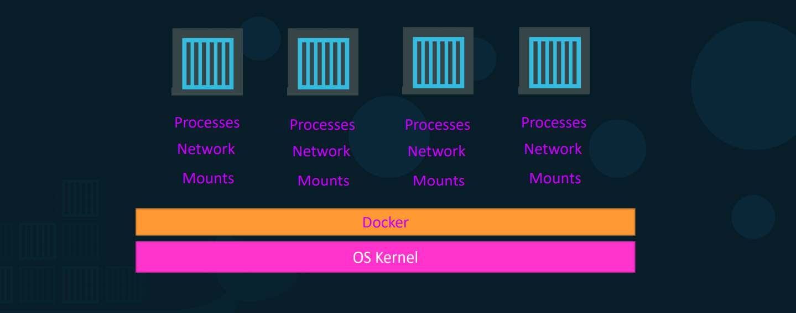
Continued..

Slide 11
Run Sample Application (without docker)
Complexity of Application deployment
Sample Application: https://github.com/shopizer-ecommerce/shopizer
E-commerce application
Clone code from github
Follow application deployment guide
Run the application
Deployment:
Install Java, Maven, IntelliJ Idea/Eclipse
Run: cd shopizer -- mvnw clean install
Run Application: http://localhost:8080/

Slide 12
Continued..
If we have to try:
Python application
Node JS application
Dot Net application
We need to do the setup from scratch

Slide 13
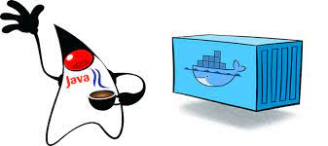
Docker Example
Install docker on laptop
Run docker command
docker run -p 80:8080 shopizerecomm/shopizer:latest
Go to http://localhost:8080/
Application up and running
Run MySQL docker container
Learn easily

Slide 14
Container vs VM
Containers are not mini VMs
They are just Processes
Limited to what resources they can access (file paths, running processes, etc)
Exit when process stops

Slide 15
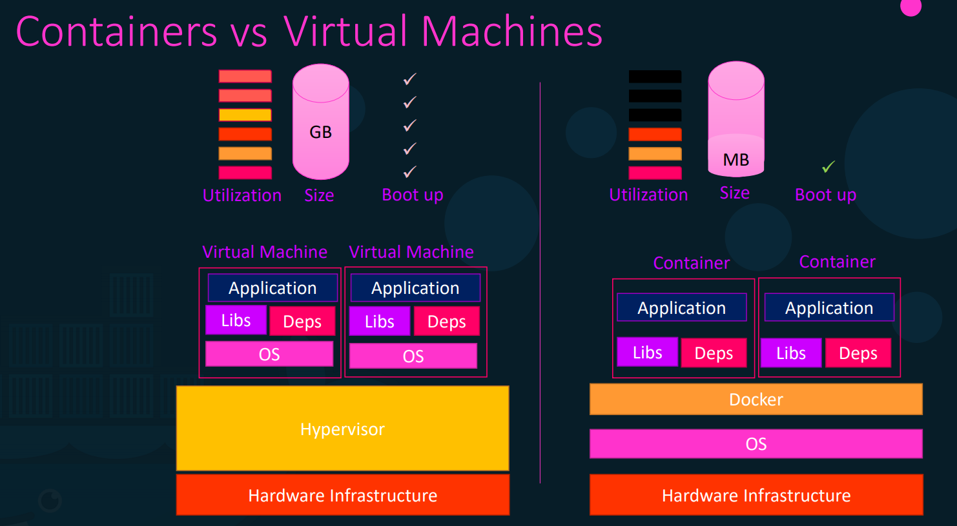
Continued..

Slide 16
Image vs Container
An Image is the application we want to run
A Container is an instance of that image running as a process
You can have many containers running off the same image
In this lecture our image will be the Nginx web server
Docker's default image "registry" is called Docker Hub
(hub.docker.com)

Slide 17
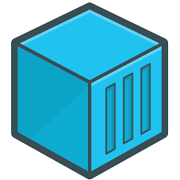
Continued..
Container - 1
Docker Image
Package / Template / Plan
Container - 2
Container - 3

Slide 18
Docker Installation
Install docker
Windows Laptop → Install Oracle VM VirtualBox/VMware Workstation Player → Install Ubuntu → Install Docker
OR
Windows Laptop → Install Docker Desktop on Windows

Slide 19
Docker commands
Docker Run
List docker containers
Running containers
All containers
Docker run hello-world
This command will → pull the image from docker hub if not present in the local and then runs the container
Docker run –d nginx
Runs the nginx container in detached mode

Slide 20
Continued..
List docker containers:
Only running containers
All containers
Stop/Start a container
Using name
Using ID
Docker ps
This will list all the running containers (if any)
Docker stop {docker_Id}
Use docker ps to list all the containers → and then use the id to stop the container
Docker stop {docker_name}
Uses the name of the docker to stop
Docker ps –a
This will list all the containers in the local
Docker start {docker_name}
Starts an existing container which is already stopped

Slide 21
Some more Commands
Remove container:
List and remove images:
Docker rm {name or id}
Use docker ps –a command to find the name or id of the container to be removed and then use the docker rm command to remove the container
Docker images
Lists the images
Docker rmi {image name or id}
Remove the image

Slide 22
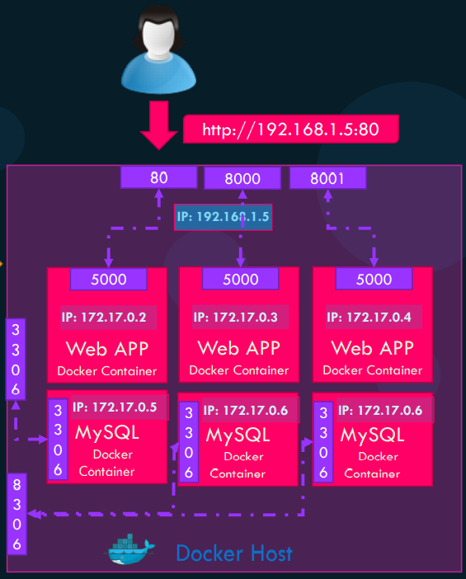
Port Mapping
Port mapping: host:container
Docker inspect {image_id/name}
To see the IP of the container – networks segment
Docker run –d –p 80:80 nginx
-d runs in detached mode
-p → port mapping left side port is → host port
Right side port is container port
Go to http://localhost:80 to see the sample page

Slide 23
Run MySql Container and connect
docker run --name test-mysql -p 3306 -e MYSQL_ROOT_PASSWORD=Seetarampass -d mysql
Connect to MySql container:
docker exec -it test-mysql mysql -u root -p
After creation of the data in the mysql → stop the container
Start the container again
Connect to the container and check the data, whether it exists?
Create some data in this database:
Create a database
Create some tables
Data???

Slide 24
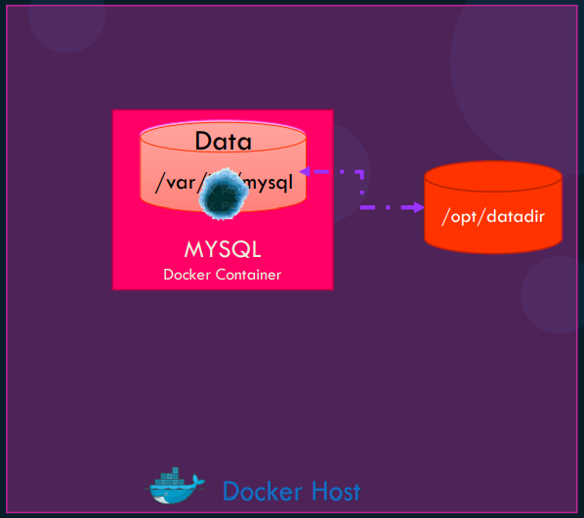
Volume Mapping
docker run --name test-mysql -p 3306 -e MYSQL_ROOT_PASSWORD=Seetarampass -d -it -v /opt/datadir:/var/lib/mysql mysql
Check this volume mapping using docker inspect command → mounts section
Verify the volume mapping by adding some data → stop and restart the container → data created should be available

Slide 25
Build Docker Image
Sample application using python Flask framework
Steps to deploy:
OS like Ubuntu
Update apt repo
Install dependencies using apt
Install python dependencies using pip
Copy source code to location → /opt
Run the web server using FLASK command

Slide 26
Create Docker File
Create a file → name it as → Dockerfile
Insert commands
Dockerfile → Instruction Argument format
All instructions will be in CAPITAL letters
Examples:
FROM
RUN
COPY
ENTRYPOINT
Notes:
FROM command specifies the operating to be used. Every docker file must start with FROM command and has to tell which is the base image to be used for the docker image. RUN command tells the command to be run on the base image. COPY command copies the files from local system to the container

Slide 27
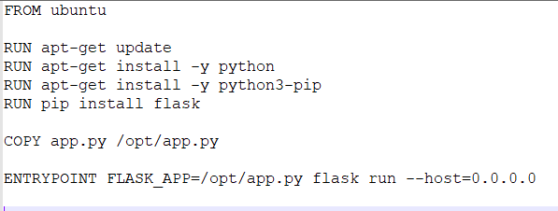
Copy source file
Go to https://github.com/mmumshad/simple-webapp-flask
Copy app.py to local folder
Write Docker file:

Slide 28
Build Image and Run
docker build . -t sample-webapp
Once the image is built, run the below command:
docker run -p 9090:5000 sample-webapp
Go to browser: http://localhost:9090

