Slide 1
Lending Club Case Study
Group Details :
Karthick Chetti – Group Facilitator
Anirudh KVC - Collaborator

Slide 2
Business Objective & Approach
Objectives:
Understanding the driving factors behind loan default thereby aiming to reduce credit loss
Data Driven inferences to prevent charging off for a potential loan applicant
Approach:
Data Understanding
Data Cleaning
Selecting Key Features for EDA
Univariate & Segmented Univariate Analysis
Bivariate Analysis
Conclusions & Recommendations

Slide 3
Data Understanding
Data Cleaning
Selecting Key Features for EDA
Univariate & Segmented Univariate Analysis
Bivariate Analysis
Conclusions & Recommendations
Understanding the meaning of variables with the help of data dictionary
Trying to group the variables and understanding their relevance:
Demographic variables (details about the person ex. state)
Loan variables(details about the current loan ex. int_rate)
Applicant credit profile(details about the past credit lines and credibility ex. delinq_2_years)
Target variable is loan status
Assumption : For our objective, the customers with loan status as Current are not important for the study, since we want to analyze the driving factors for the completed loans

Slide 4
Data Understanding
Data Cleaning
Selecting Key Features for EDA
Univariate & Segmented Univariate Analysis
Bivariate Analysis
Conclusions & Recommendations
Removing Redundant Columns
Total Number of Columns initially in the loan dataset = 111
Having more than 50% missing values in them (Removed 57 columns)
Removing Columns with same values which are redundant for analysis (Removed 8 columns)
Removing Columns with either 0s or missing values in them (Removed 3 columns)
Output - 43 statistically meaningful columns highlighted
4. Checking missing values & imputing data
It is observed that within the selected columns for analysis, emp_length column has about 2.7% missing values from total values.
Missing data is within 5%, we chose to impute rather than deleting those rows
Since it’s a categorical variable, it is imputed by the mode of the column which was 10+ years
Output : Selected dataset has no missing values
2. Identifying most relevant data features
Based on business judgement and data understanding, these columns can help us identify the trends for customer charge-off
5. Checking outliers and removing them
For the numeric data columns, box plots were plotted to understand the distribution and outliers.
Other than dti, rest of the columns showed outliers
It was removed using standard outlier limits but Q1 & Q3 were taken at 10 & 90 percentile respectively to minimize the deletion of data points
3. Data manipulation
It is observed that interest rate column has % and is read as string. We used string manipulation to remove % and convert them into float values

Slide 5
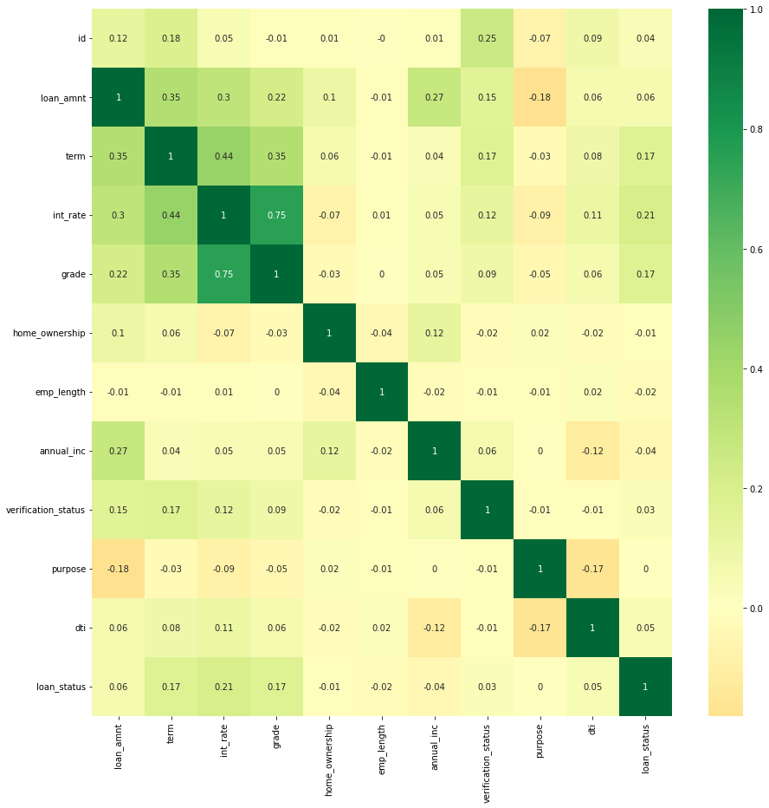
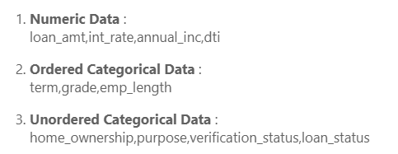
Data Understanding
Data Cleaning
Selecting Key Features for EDA
Univariate & Segmented Univariate Analysis
Bivariate Analysis
Conclusions & Recommendations
Correlation coefficient depicted by R
The categorical variables are encoded with numbers for each category to check correlation
As the input features are not highly correlated among themselves (i.e. R < 0.9) the selected input features can be taken for the EDA analysis
Amongst the variables, loan_amnt, term, int_rate & grade are show some positive correlation amongst them, with grade and int_rate being the most correlated (R=0.75)
Key Features Selected for EDA

Slide 6
Data Understanding
Data Cleaning
Selecting Key Features for EDA
Univariate & Segmented Univariate Analysis
Bivariate Analysis
Conclusions & Recommendations
Data Driven Metrics
Business Driven Metric :
Lending club would not be interested in exact number of years of experience of the employee, so employee length is categorized as <1 year(New employees), 1-3, 3-6, 6-9 years( Different experience groups), >10 years(Most experienced employees)
Data Driven Metric:
The numeric variables are binned into certain categories to aid better analysis of numeric variables such as loan_amnt, int_rate, annual income and dti. (Ex. int_rate is binned into categories like 5-10%(low), 10-15%(medium),15-20%(high) etc. to derive insights on the derived groups of interest rates

Slide 7
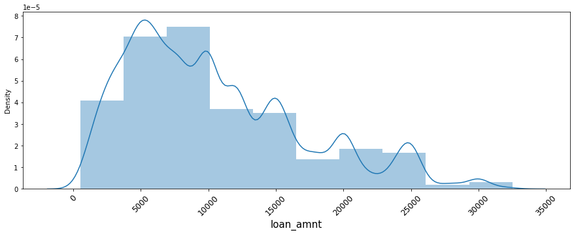
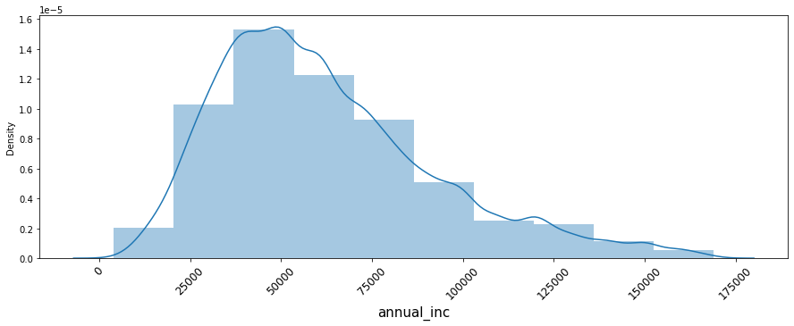
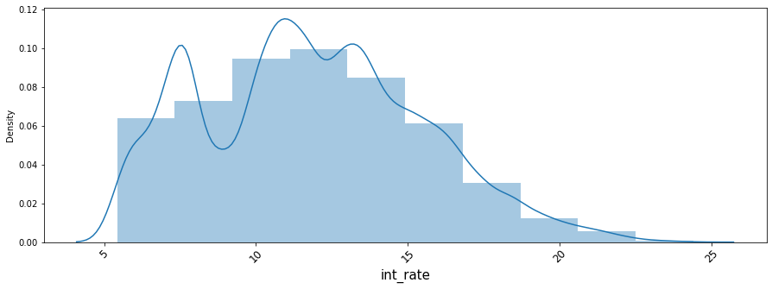
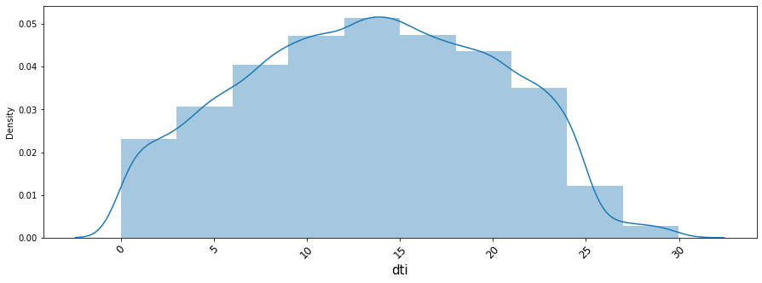
Data Understanding
Data Cleaning
Selecting Key Features for EDA
Univariate & Segmented Univariate Analysis
Bivariate Analysis
Conclusions & Recommendations
Univariate Analysis – Numeric Variables
Most of the people prefer loan amount ranging from 4000 to 10000. The median of loan amount is 9200
The median of annual income is 56100. It follows a near normal distribution which is right-skewed
The average interest rate is 11.8 %. As the interest rate increases beyond 15%, number of customers taking loans reduces significantly
The average dti ratio is 13.38. The dti ratio is almost following normal distribution with peak near to 14 dti

