Slide 1

Lending Club Case Study
Group Details :
Karthick Chetti – Group Facilitator
Anirudh KVC - Collaborator

Slide 2
Business Objective & Approach
Objectives:
Understanding the driving factors behind loan default thereby aiming to reduce credit loss
Data Driven inferences to prevent charging off for a potential loan applicant
Approach:
Data Understanding
Data Cleaning
Selecting Key Features for EDA
Univariate & Segmented Univariate Analysis
Bivariate Analysis
Conclusions & Recommendations

Slide 3
Data Understanding
Data Cleaning
Selecting Key Features for EDA
Univariate & Segmented Univariate Analysis
Bivariate Analysis
Conclusions & Recommendations
Understanding the meaning of variables with the help of data dictionary
Trying to group the variables and understanding their relevance:
Demographic variables (details about the person ex. state)
Loan variables(details about the current loan ex. int_rate)
Applicant credit profile(details about the past credit lines and credibility ex. delinq_2_years)
Target variable is loan status
Assumption : For our objective, the customers with loan status as Current are not important for the study, since we want to analyze the driving factors for the completed loans. The analysis is carried out only for Fully Paid and Charged Off Customers

Slide 4
Data Understanding
Data Cleaning
Selecting Key Features for EDA
Univariate & Segmented Univariate Analysis
Bivariate Analysis
Conclusions & Recommendations
Removing Redundant Columns
Total Number of Columns initially in the loan dataset = 111
Having more than 50% missing values in them (57 columns)
Removing Columns with same values (8 columns)
Removing Columns with either 0s or missing values in them (3 columns)
Removing descriptive columns (6 columns)
Output - 37 statistically meaningful columns highlighted
4. Checking missing values & imputing data
It is observed that within the selected columns for analysis, emp_length column has about 2.7% missing values from total values.
Missing data is within 5%, we chose to impute rather than deleting those rows
Since it’s a categorical variable, it is imputed by the mode of the column which was 10+ years
Output : Selected dataset has no missing values
2. Identifying most relevant data features
Based on business judgement and data understanding, these columns can help us identify the trends for customer charge-off
5. Checking outliers and removing them
For the numeric data columns, box plots were plotted to understand the distribution and outliers.
Other than dti, rest of the columns showed outliers
It was removed using standard outlier limits but Q1 & Q3 were taken at 10 & 90 percentile respectively to minimize the deletion of data points
3. Data manipulation
String manipulation is used to remove % from interest rate and convert them from string to float values, similarly in earliest credit line, we are interested in years, so we extracted years from dates

Slide 5
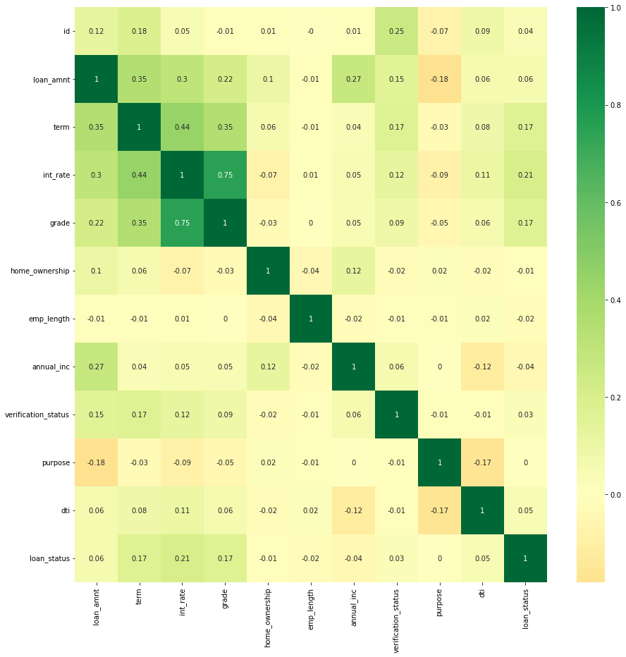
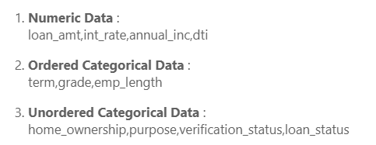
Data Understanding
Data Cleaning
Selecting Key Features for EDA
Univariate & Segmented Univariate Analysis
Bivariate Analysis
Conclusions & Recommendations
Correlation coefficient depicted by R
The categorical variables are encoded with numbers for each category to check correlation
As the input features are not highly correlated among themselves (i.e. R < 0.9) the selected input features can be taken for the EDA analysis
Amongst the variables, loan_amnt, term, int_rate & grade are show some positive correlation amongst them, with grade and int_rate being the most correlated (R=0.75)
Key Features Selected for EDA

Slide 6
Data Understanding
Data Cleaning
Selecting Key Features for EDA
Univariate & Segmented Univariate Analysis
Bivariate Analysis
Conclusions & Recommendations
Data Driven Metrics
Business Driven Metric :
Lending club would not be interested in exact number of years of experience of the employee, so employee length is categorized as <1 year(New employees), 1-3, 3-6, 6-9 years( Different experience groups), >10 years(Most experienced employees)
Data Driven Metric:
The numeric variables are binned into certain categories to aid better analysis of numeric variables such as loan_amnt, int_rate, annual income and dti. (Ex. int_rate is binned into categories like 5-10%(low), 10-15%(medium),15-20%(high) etc. to derive insights on the derived groups of interest rates
Type Driven Metric:
In the earliest credit line column, we are interested in years, so we extracted years from dates and then binned them in groups of 10 years to analyze their impact on loan status

Slide 7
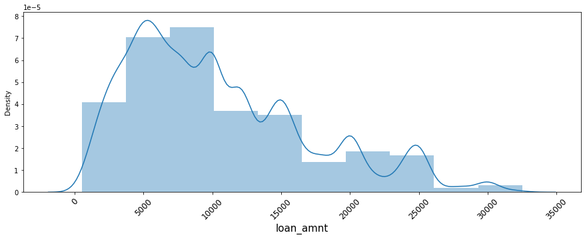
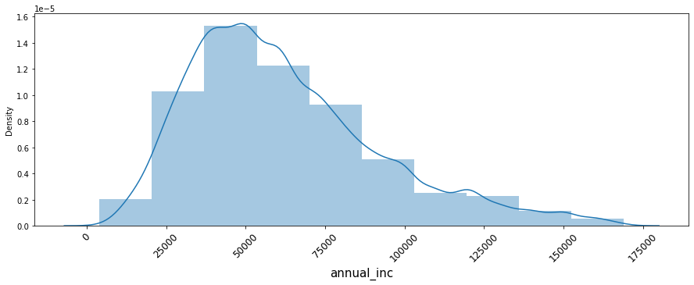
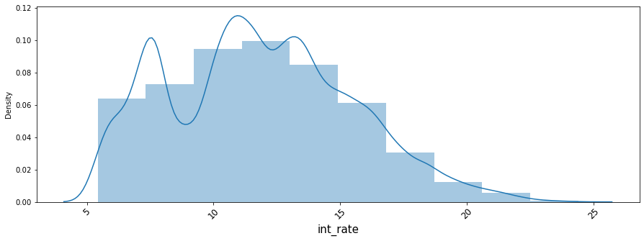
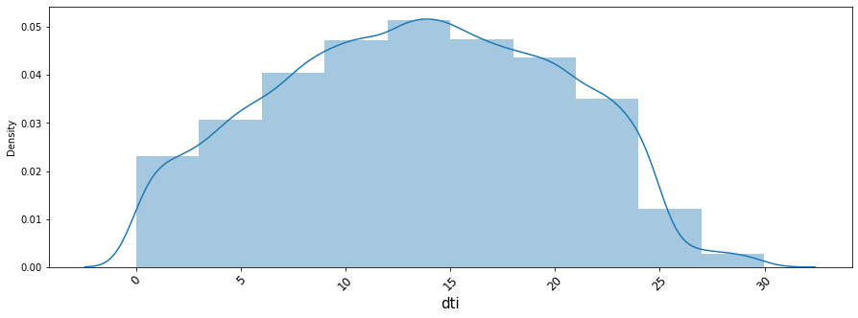
Data Understanding
Data Cleaning
Selecting Key Features for EDA
Univariate & Segmented Univariate Analysis
Bivariate Analysis
Conclusions & Recommendations
Univariate Analysis – Numeric Variables
Loan Amount
Annual Income
Most of the people prefer loan amount ranging from 4000 to 10000. The median of loan amount is 9200
The median of annual income is 56100. It follows a near normal distribution which is right-skewed
Debt to income ratio
Interest Rate
The average interest rate is 11.8 %. As the interest rate increases beyond 15%, number of customers taking loans reduces significantly
The average dti ratio is 13.38. The dti ratio is almost following normal distribution with mean near to 14 dti

Slide 8
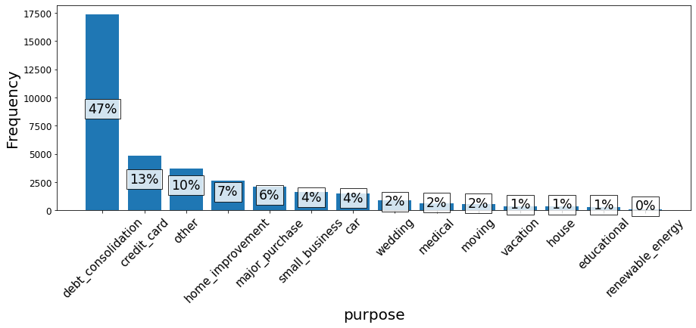
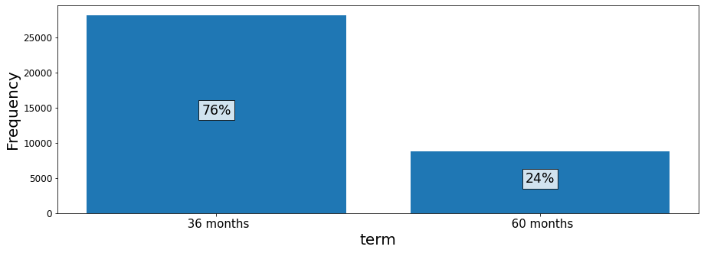
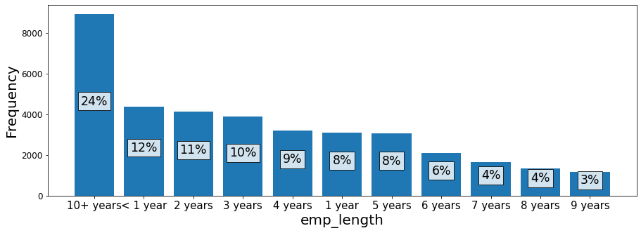
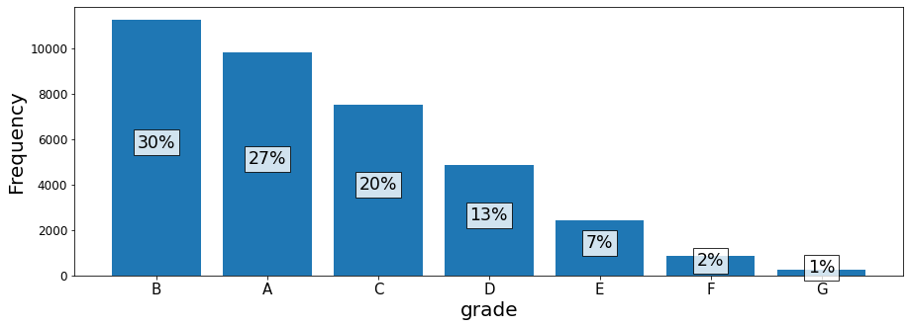
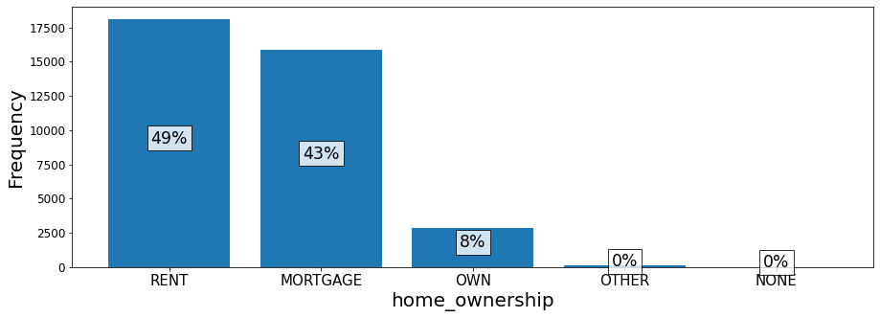
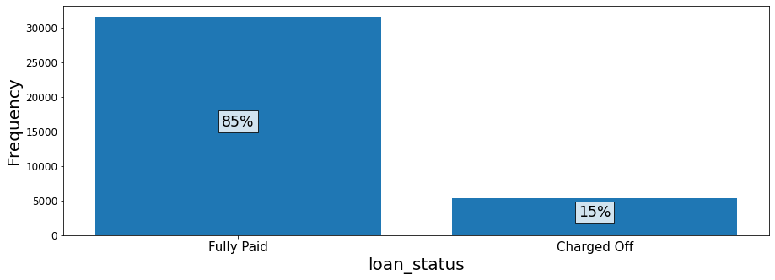
Data Understanding
Data Cleaning
Selecting Key Features for EDA
Univariate & Segmented Univariate Analysis
Bivariate Analysis
Conclusions & Recommendations
About three quarters of the customers prefer 36 months of loan duration
About a quarter of loans are taken by customers having 10+ years of experience
Around half of the customers take loans for debt consolidation
About 80% of the customers take loans in grades A,B & C
About 90% of the people who have taken the loan are on rent & mortgage
About 85% of the loans are fully paid, charge off percentage is 15%, this leads to credit loss

Slide 9
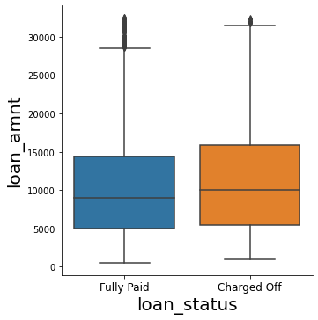
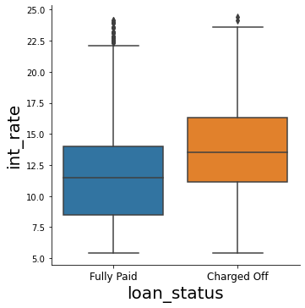
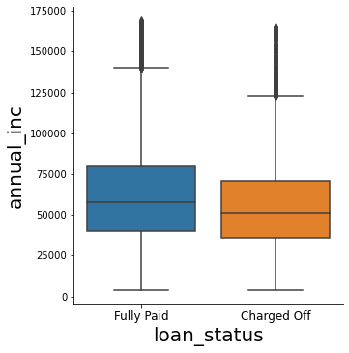
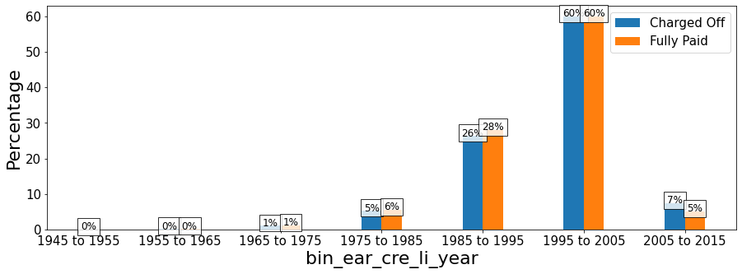
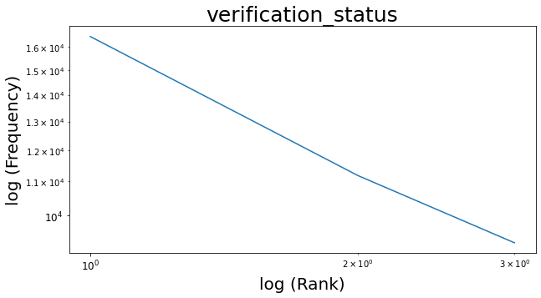
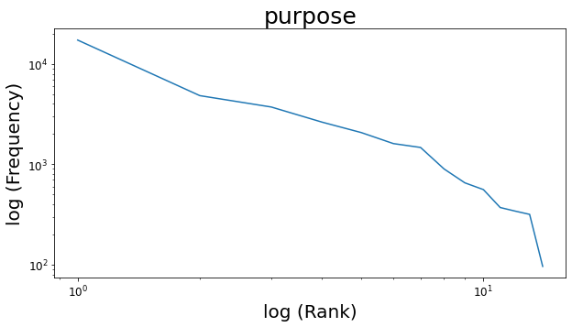
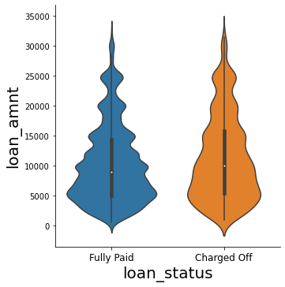
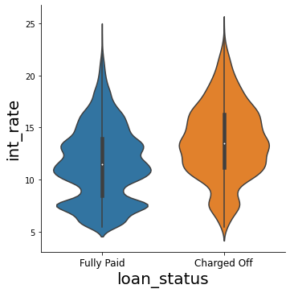
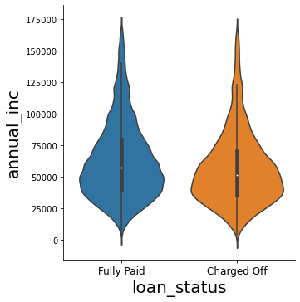
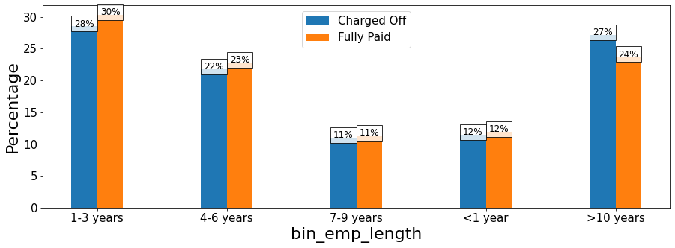
Data Understanding
Data Cleaning
Selecting Key Features for EDA
Univariate & Segmented Univariate Analysis
Bivariate Analysis
Conclusions & Recommendations
Segmented Univariate – Numeric Variables
Univariate Analysis – Unordered Categorical
Segmented Univariate –Driven Metrics
Median of ➔ | Loan Amount | Interest Rate | Annual income | dti
Fully Paid | 9000 | 11.48 | 57700 | 13.34
Charged Off | 10000 | 13.49 | 51200 | 14.35
From the rank vs frequency plots it can be inferred that verification status follow power law distribution & purpose follows near power law dist.
People who have opened credit lines from 1995-2000 have taken about 60% loans, however new customers(earliest credit line 2005-2015) have charged off more than fully paid the loan, they might be risky
Charged off customers take more loan amount, have more interest rate on loan, have more debt to income ratio and have less annual income than fully paid customers
Segmented Univariate – Numeric Variables
Creating plots for categorical variables
Segmented Univariate –Driven Metrics
The plots have been made considering:
The percentages of total fully-paid or charged off instead of frequency
This is done to scale down the plot and understand the difference between them
We are not using frequency as the y axis scale because data is biased towards fully paid customers (which is expected for a lending company)
Fully paid loan amounts are majorly rounded in multiples of 5000(ex. 15k,20k)
Fully paid customers take loans at interest rates of 6-7% and 10-15% while charged off loan interest rates are majorly more than 10%
For employees with experience more than 10 years the percentage of charged off customers is higher than fully paid, so giving loans to such employees might be risky

Slide 10
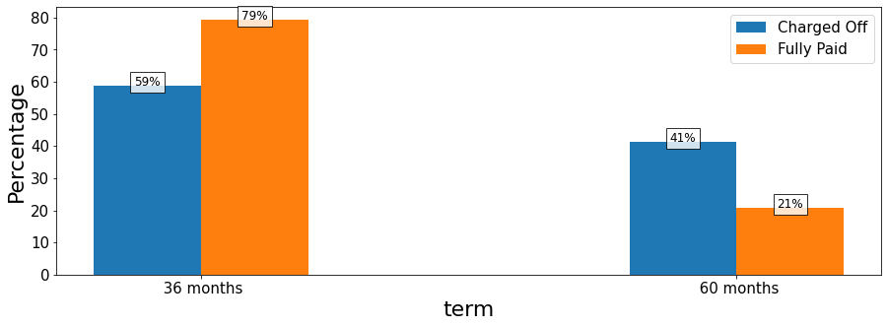
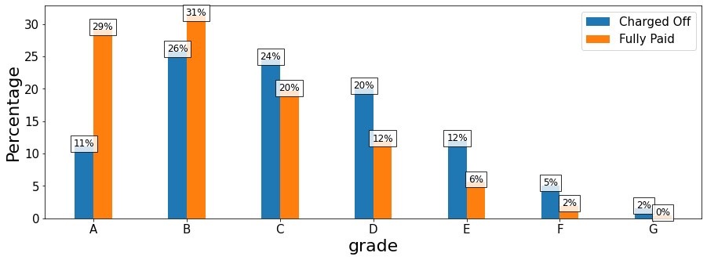
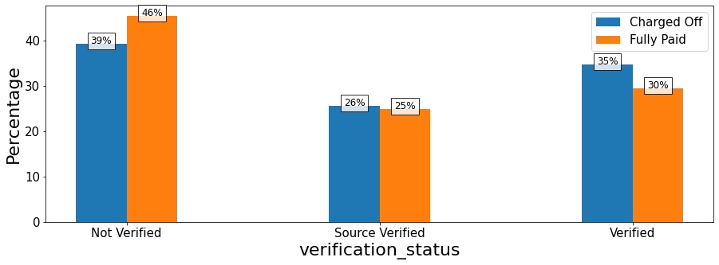
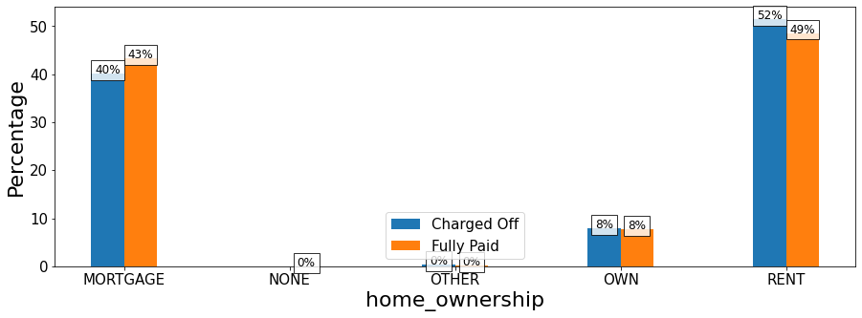
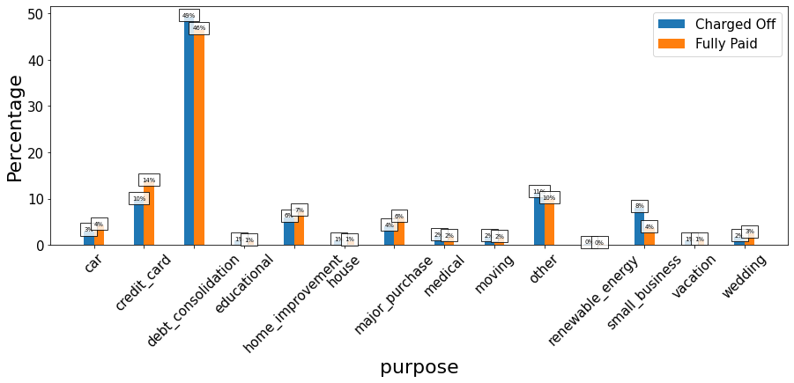
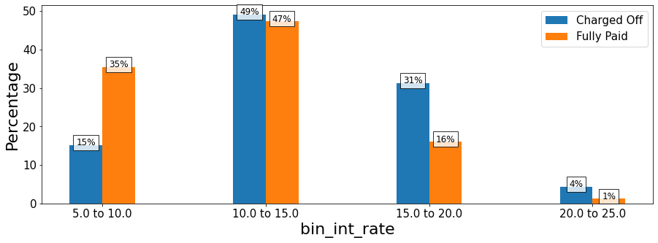
Data Understanding
Data Cleaning
Selecting Key Features for EDA
Univariate & Segmented Univariate Analysis
Bivariate Analysis
Conclusions & Recommendations
Charged off customers are significantly higher than fully paid for 60 months term, making 5 years loan tenure a risky option
A,B grades have % fully paid more than % charged off where as the trend is opposite from grade C to G, making it risky loan grades
The % of charged off customers are high for verified applications compared to fully paid, logically this should have lower charged off
Customers who have a rented house are risky because they data shows that this category has more charged off than fully paid customers
Customers taking loans for debt consolidation and small business have high percentage of charged off customers compared to fully paid
For interest rates greater than 10%, the percentage of charged off customers is more than that of fully paid with 15-25% being most risky interest rates

Slide 11
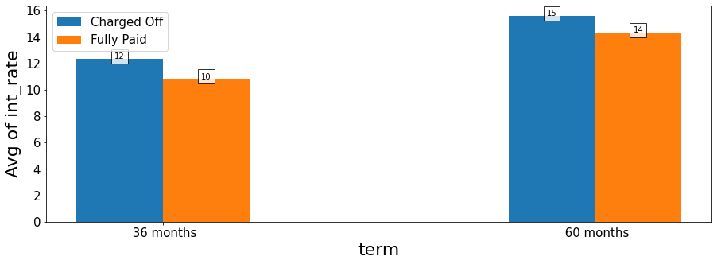
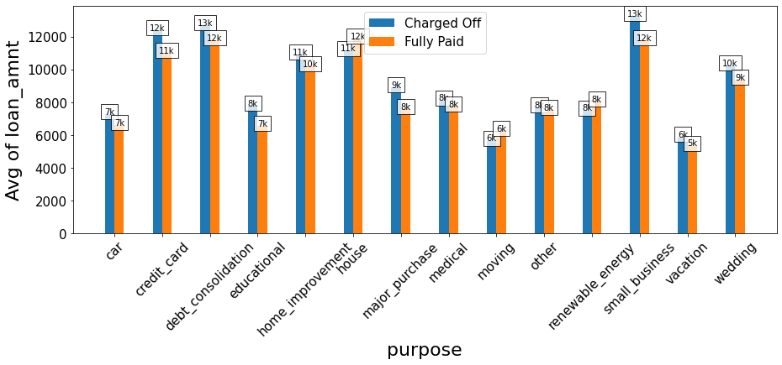
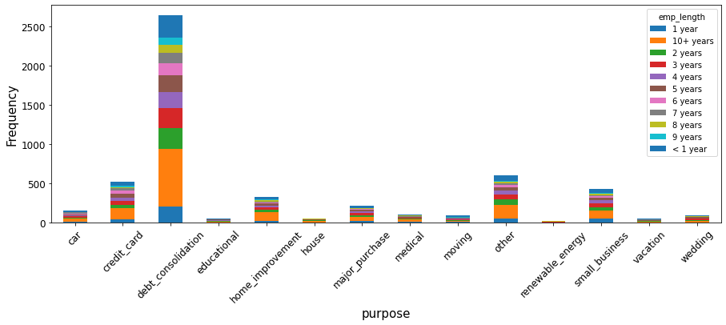
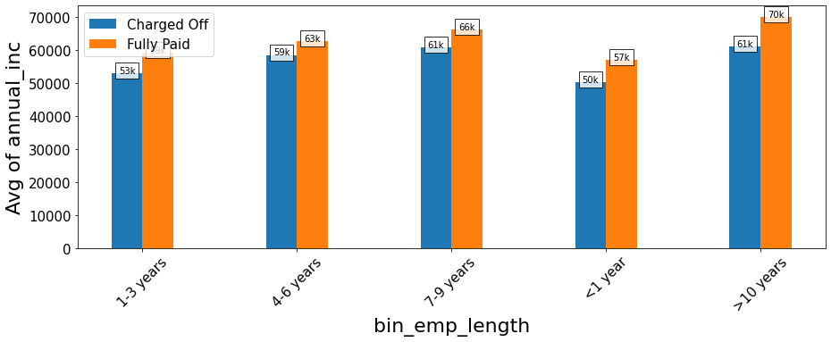
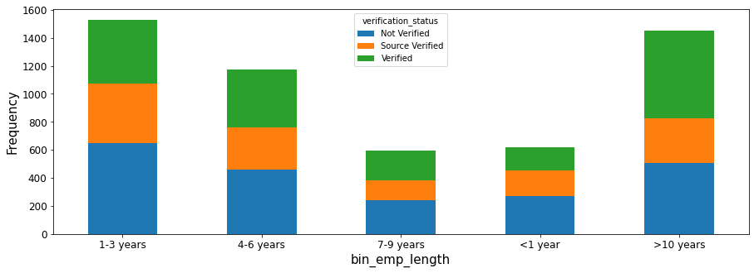
Data Understanding
Data Cleaning
Selecting Key Features for EDA
Univariate & Segmented Univariate Analysis
Bivariate Analysis
Conclusions & Recommendations
The average interest rate for 60 months is more than that of 36 months for all customers and it is the highest(15%) for charged off customers taking loans for 60 months
Most of the charged off employees with more than 10 years of experience take loans for debt consolidation
The average loan amount is higher for small business, debt consolidation and credit card - LC should be more cautious in offering loans for these purposes
To further analyze the major reasons for charge off with the help of bivariate analysis, we focus our analysis on only charged off customers
For charged off customers with experience less than equal to 1 year, most of them have not verified documents while those with more than 10 years experience have verified documents
For employees having more than 10 years experience, the average annual income of the fully paid customers is 70,000 while for charged off customers it is 61,000

Slide 12
Data Understanding
Data Cleaning
Selecting Key Features for EDA
Univariate & Segmented Univariate Analysis
Bivariate Analysis
Conclusions & Recommendations

Slide 13
Data Understanding
Data Cleaning
Selecting Key Features for EDA
Univariate & Segmented Univariate Analysis
Bivariate Analysis
Conclusions & Recommendations
The major factors for charging off loans are
1) Loan amount
2) Annual income
3) Interest rate
4) dti
5) term
6) Emp_length
7) Purpose
8) Earliest Credit Line

