Slide 1


Audio-visual noise removal in speech using a binary mask: exploiting correlations between lip contours and modulation envelopes
Arun Palghat Udayashankar

Slide 2
Acknowledgements
Peter Jacobs - Mentor
Tracy Petrie - Discussions
John Condon - Behavioral Testing
Nick Preiser - Office mate
Navid Resalat - Office mate + discussions
Gabrielle Saunders (NCRAR) - Project conception
Meghan Stansell - Marking words in sentences
Funding: Career Development Award (CDA-1) C7693M to Peter Jacobs from the Dept. of Veterans Affairs

Slide 3
Statement of the Problem
28 Million People in U.S. Suffer From Hearing Impairment
1 in 5 over age 70 are both legally blind and have hearing deficits (dual-sensory impaired)
Current Hearing Aid Technology is Unsatisfactory
Amplification & Filtering is Primary Solution
Directional microphones & binaural devices also used
Speech in noise still a major problem
No solutions for dual-sensory impaired patients

Slide 4
No shortage of noise removal options
Current methods for noise removal in hearing aids
Directional microphones
Adaptive microphone arrays
Adaptive filtering
Envelope modulation filters
Atlas et al, 2005, Souza et al. 2005
Spectral subtraction

Slide 5
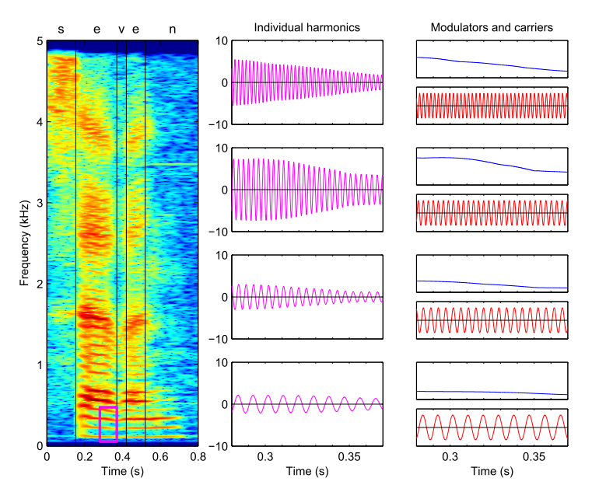
Modulation filtering
Steven Schimmel, University of Washington

Slide 6
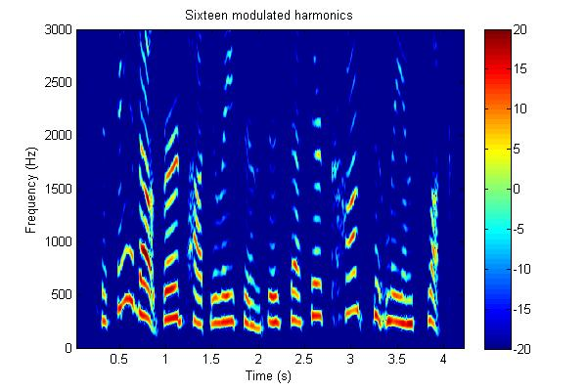

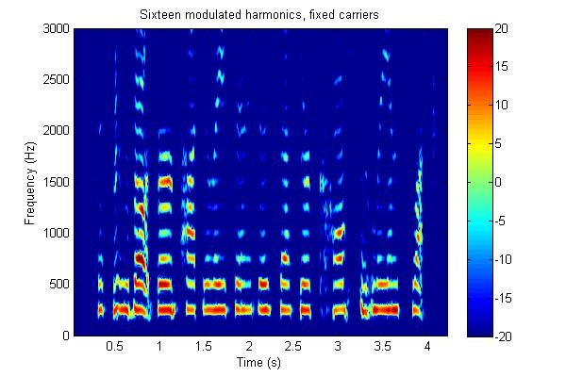
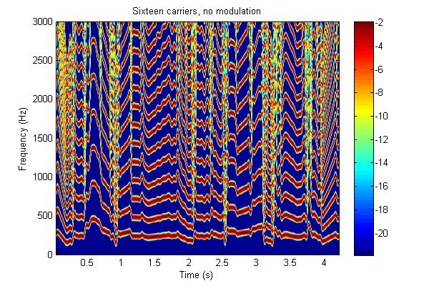
Modulators are important for speech intelligibility!
Sixteen modulated harmonics
Sixteen modulators with fixed carriers
Sixteen carriers only
http://isdl.ee.washington.edu/projects/modulationtoolbox
Notes:
Present the clean signal first, show a cartoon of each condition (i.e. modulator + carrier, modulator alone, carrier alone)

Slide 7
Noise Removal Methods Envelope modulation
Envelope modulation filtering
Atlas et al. 2005
Carrier detect
BP Filt 1
Env Detect
Smooth envelope
X
BP Filt 1
BP Filt 2
In
…
Σ
Out
BP Filt N

Slide 8
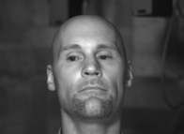
Evidence supporting use of visual information
People comprehend 50 - 60% more when presented visual + auditory information compared with auditory alone
Visual cues not used in hearing aid noise removal algorithms

Slide 9
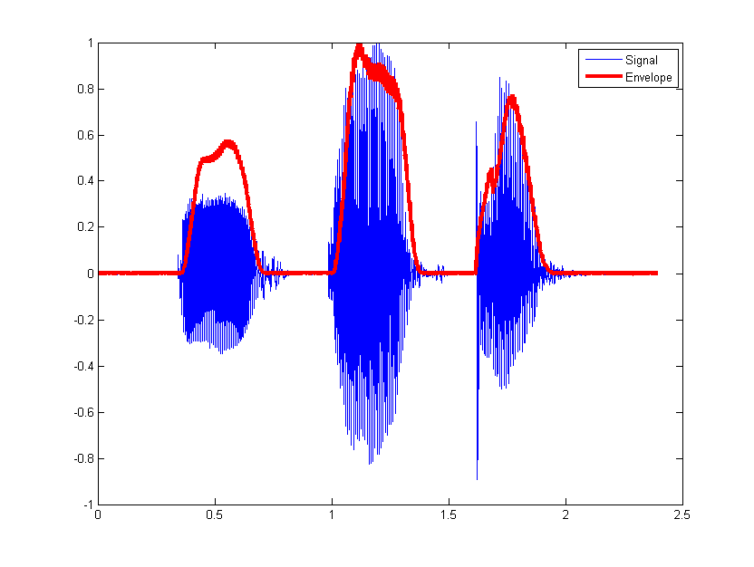
Lip height vs. modulation envelope
2
3
4
1
5
8
6
7
9

Slide 10
Research Questions
Do lip contours correlate with modulation envelopes
Simple sounds
Words
Sentences
If so, can we substitute modulation envelopes with lip contours to improve speech quality in noisy environments
Can visual cues such as lip contours improve classical acoustic noise removal signal processing algorithms
Voice activity detection (VAD)
Multi-band VAD
Notes:
Animate each question so that viewer can be introduced to them one at a time.

Slide 11
Prior work on audio visual noise removal
Consonant vowel recognition scores improve in an automated classifier and perceptual tests by including visual features
Girin, Schwartz and Gang (2001)
Target speech source separation can be improved by using video features
Sodoyer, Girin et al. 2004
Single band voice activity detection using Audio+ Video better than Audio alone
Sodoyer et al. 2009
Nobody has integrated video features in a multiband VAD speech processing algorithm.

Slide 12
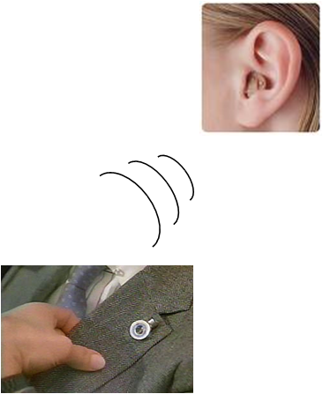
Proposed futuristic system
Hearing aid receives the video features wirelessly
Video camera wirelessly sends data
Mounted on lapel…
eye-glasses (Google glass)

Slide 13
Recording the audio visual corpus
Revised speech-in-noise (RSPIN) data corpus
Two speakers recorded (audio and visual) of face in anechoic chamber
Video recorded using 96 fps Basler black-and-white camera
Audio recorded using LYNX2B sound card, 24-bit resolution
Introduce white noise at different signal-to-noise ratios during post-processing

Slide 14
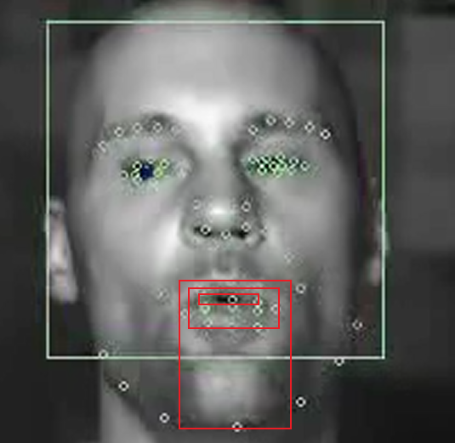
Facial Feature Extraction
Visual feature (β_{v}) extraction – 66 visual features around mouth, eyes, chin, nose and cheeks
Visual features include
Height of outer lips
Height of inner lips
Width of mouth
Height of upper-lip to chin
Ellipse parameters fit to the outer lips
Change in features over time

Slide 15
Audio feature extraction
Speech at desired SNR
.. 25 bands
Sub-band filtering, envelope extraction
Correlation with lip height
Notes:
Subbands illustration

Slide 16
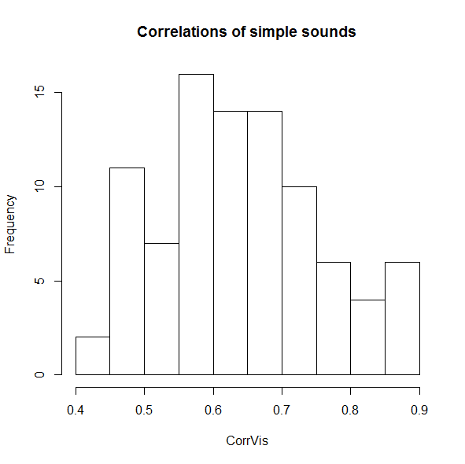
Simple sounds: R= 0.64 +/- 0.12 (N=90)
Modulation envelope
Lip height
Udayashankar et al. ARO 2014
R value
Notes:
Graphic showing mod env for simple sounds

Slide 17
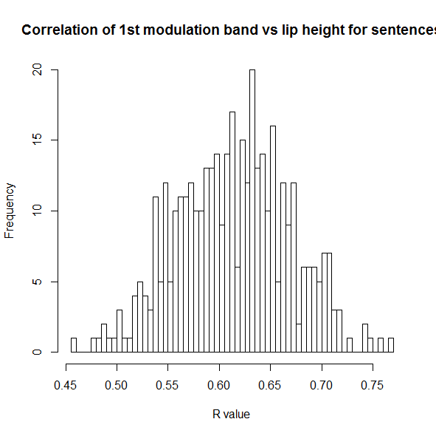
Sentences: R = 0.38 +/- 0.07 (N=400)
Modulation envelope
Lip height
R^2 value
Notes:
ARO reference; reverse histogram with the envelope and lip height

Slide 18
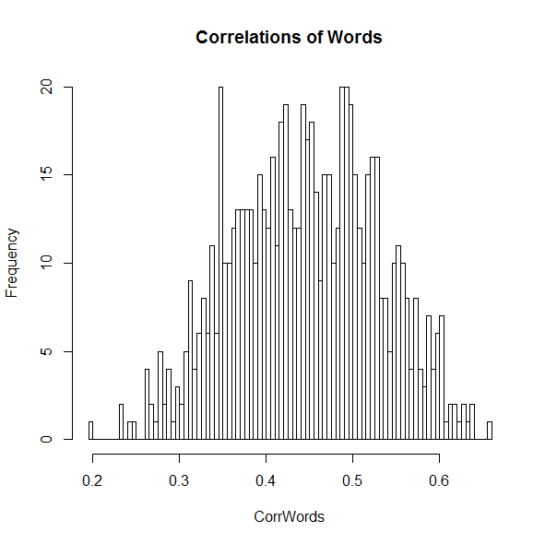
Words: R = 0.45 +/- 0.08 (N = 727)
Modulation envelope
Lip height
R value
Notes:
Add graphic showing mod envelope of a word

Slide 19
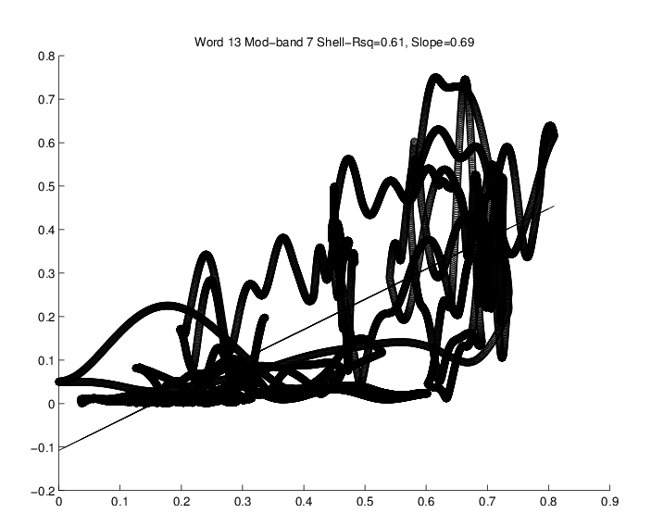

Correlations between lip height and modulation envelope
Normalized magnitude of modulation envelope
Normalized magnitude of Lip height
Notes:
Take out the information about swapping mod env with lips. Talk about that under research question 2.

Slide 20
Summary : Lip contours vs. modulation envelopes
Do lip contours correlate with modulation envelopes?
Yes, sentences, words and simple sounds’ modulation envelopes showed good correlations with lip height, increasing in that order.
Notes:
Summary

Slide 21
Research question 2: substitution of lip contours with modulation envelopes
Extract lip contour
Extract audio modulation envelopes for 16 bands
Maintain carrier for all bands
Replace modulation envelopes for lip contours
All envelopes replaced
Just lowest frequency envelopes
Notes:
Summary

Slide 22
Summary for research question 2
Despite the good correlation between lip height and modulation envelopes, swapping out the latter for the former does not lead to intelligible speech
Notes:
Summary

Slide 23
Research question 3: Improvement of Voice Activity Detection (VAD)
Can visual cues such as lip contours improve classical acoustic noise removal signal processing algorithms
Multiband voice activity detection (VAD)
Kim and Loizou, J Acoust Soc Am. 2009 Sep; 126(3)
An algorithm that improves speech intelligibility in noise for normal-hearing listeners.
Notes:
Summary

Slide 24
Voice Activity Detection
Front end to hearing aid noise removal
Several other applications of VAD in addition to hearing aid algorithms
VOIP telephony
Speaker recognition algorithms
We are doing multi-band VAD
Using Audio features
Using Video features
Using Audio and Video features
Notes:
Summary

Slide 25
Multiband VAD using a spectro-temporal binary mask
Amplitude
Samples
Frequency
Time (s)
Frequency band
Frame
Notes:
Add the raw speech signal, then the spectrogram of the speech signal, then show the binary mask

Slide 26
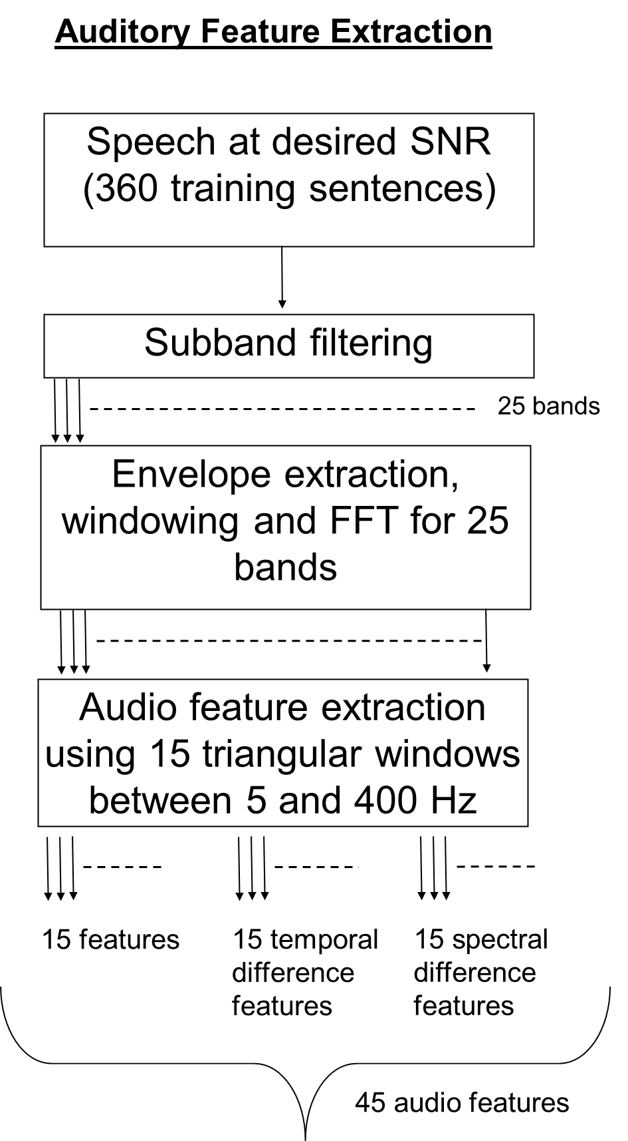
400

Slide 27
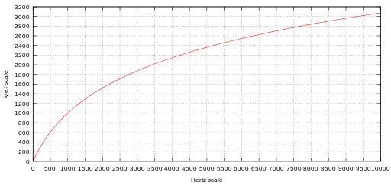
Sub-band filtering
Map of pitch perception vs. frequency in Hertz
As frequency in Hz increases, it takes a larger increase in Hz to perceive a higher pitch
Due to the non-linear representation of frequencies in the cochlea
3 .
.
20 .
Notes:
Add title to this slide, making it consistent with Audio Feature Extraction slide.

Slide 28
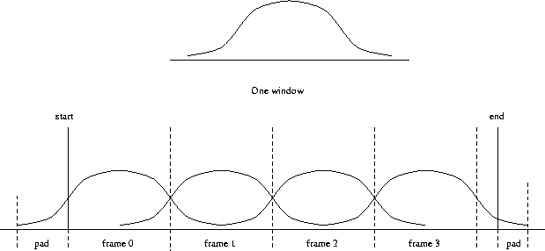
Envelope extraction and windowing
Notes:
Put in a figure for envelope extraction

Slide 29
Features as sums under triangular filters
FFT magnitude of each frame
*
....................
1 2 3 ………………………………………… 14 15

Slide 30
Video Features
Lip height (LH): mean(2-8,3-7,4-6)
Lip Width (LW): 1-5
Std(LH) across 5 frames
Std(LW) across 5 frames
2
3
4
1
5
8
6
7
9

Slide 31
Classification: Overview
Oracle generation
Training phase
Evaluation phase
AV-Speech at desired SNR (400 training sentences)
AV-Speech at desired SNR (400 test sentences)
Speech at 5 dB SNR (400 sentences)
Subband filtering, windowing and feature extraction
Subband filtering, windowing and feature extraction
Subband filtering
Train binary classifier
Remove noise using binary mask
Ideal binary mask (Oracle for the classifier)
Apply model to predict binary mask
Reassemble bands into clean speech
Evaluate using statistical and listening tests.
Notes:
Have this animate in from left to right

Slide 32
Oracle generation
Speech
Noise
Subband filtering, envelope and framing of speech
Subband filtering, envelope and framing of noise
Compute SNR for each frame
Is SNR > threshold
N
Noise
Y
Signal
Notes:
flow chart

Slide 33
Oracle: example
SNR (dB)
MASK (binary)

Slide 34
Training phase
Extract auditory features from “noised” speech files
Train binary classifier
Produce statistical model
Extract Oracle from clean speech
Notes:
Train a linear classifier (linear regression) and a nonlinear model (GMM)

Slide 35
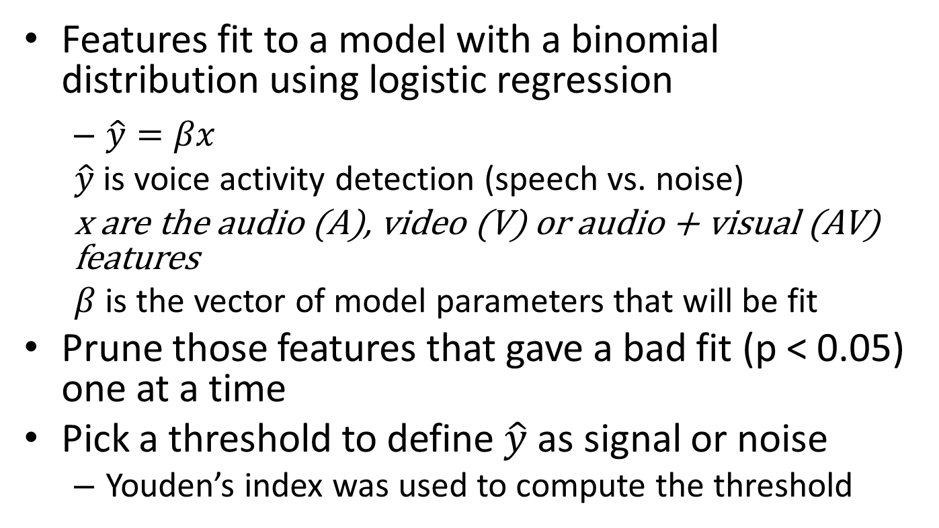
Training phase: Linear regression model
Features fit to a model with a binomial distribution using logistic regression
$\hat{y}=βx$
$\hat{y}$ is voice activity detection (speech vs. noise)
x are the audio (A), video (V) or audio + visual (AV) features
$β$ is the vector of model parameters that will be fit
Prune those features that gave a bad fit (p < 0.05) one at a time
Pick a threshold to define $\hat{y}$ as signal or noise
Youden’s index was used to compute the threshold

Slide 36
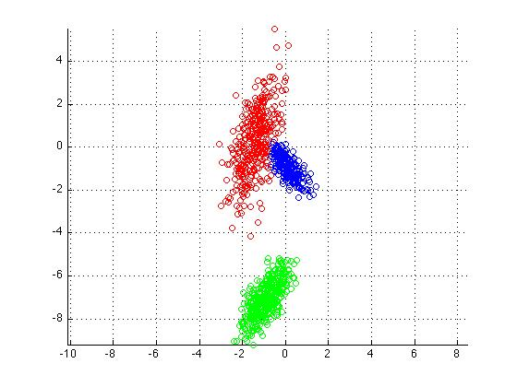
Training phase: Gaussian mixture model: model definition
D- dimension of feature vector
45 For Audio
4 For Video
49 For Audio + Video
C -
p – probability density function
These get fit during GMM training
{μ – mean D*N, Σ – covariance D*D*N; α – mixture weight 1*N}
N_{max} = 2D
N = number of mixture weights
N_{max} = max no. of mixture weights
Example: D=2, N=3
Notes:
Check all definitions!

Slide 37
Training: Greedy expectation maximization
Different from regular EM, you start with just 1 component.
Add in additional components by searching for optimal parameters one component at a time.
Optimize the parameters; add one more ..
Not dependent on initialization unlike simple EM.
Neural Computation, 5(2):469–485, Feb 2003.

Slide 38
Training: Bayesian Classifier
Two Gaussian Mixture Models to model the distribution of feature vectors in each class (noise and signal)
Bayesian classifier to compute probability of the signal belonging to each class
Priors = number of feature vectors belonging to the class/ total no of feature vectors (FV)
(Prior_{Signal}*p(FV|signal)) vs (Prior_{noise}*p(FV|noise))

Slide 39
Testing phase
Extract auditory features from “noised” speech files to be tested
Use statistical model to predict binary MASK
(linear or non-linear)
Clean up speech files using predicted MASK
Extract Oracle from clean speech
Compute confusion matrix (percent correct for a given class)
Listening test
Notes:
Train a linear classifier (linear regression) and a nonlinear model (GMM)

Slide 40
Performance assessment
Compare VAD accuracy
A, V, and A+V
Receiver operator characteristic analysis
Confusion matrix of classifier
Intelligibility test
TBD

Slide 41
Multiband VAD: Area under the curve for linear model (0 dB, white noise)
Notes:
Keep colors the same

Slide 42
GMMBayes: classification accuracy
0 dB -8 dB

Slide 43
-8 dB, white noise
Notes:
Change the ordering, highlight visual processing alone..

Slide 44
Summary of results
This is the first attempt to create a multiband voice activity detector using audio and visual features
Multiband voice activity detector confirms results of single band voice activity detector using a linear model.
For the same features and SNR, the non-linear model targets noise much more effectively than the linear model
In previous studies, the GMM-Bayes model has been show to be effective with audio features alone in removing noise at -5 dB SPL and specific to the noise type.
Combining video features with audio features provided an improvement in classification of signal than using audio features alone in the non-linear model.
Video features alone in the non-linear model are able to remove noise as effectively as using audio features alone at negative SNR.

Slide 45
Thank you ☺
Github.com/puarun/AVproject

Slide 46
Future directions
Listening tests of models with and without video features
Train and test models on:
Other noise types: cafeteria, babble
Same model with multiple noise types
Multiple speakers

Slide 47
END
Thank you for the opportunity to present my work to the department. ☺
Please sign up if you would like to volunteer for our listening tests.
Open for comments/ discussion

Slide 48
Results: single band VAD
As SNR drops, the value of incorporating visual features can be observed
SNR = -6 dB, Cafeteria noise
A+V
V
A
Jacobs et al. IHCON 2012

Slide 49
Linear regression: classification accuracy
0 dB SPL -8 dB SPL

Slide 50
Mixture model example
Colors : mixtures (3)
Two features
Mu (2*3)
Sigma (2*2*3)
Gaussian mixture model
Feat 2
Feat 1

Slide 51
Example : GLM at -8dB, white noise

Slide 52
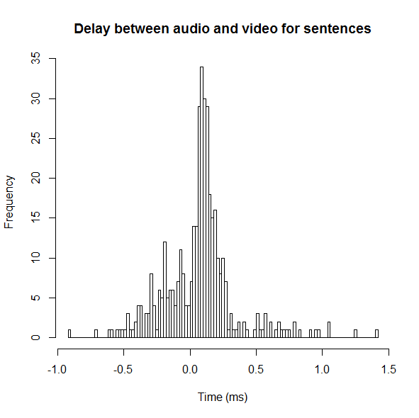
Delay between audio and video

Slide 53
Previous work: GMM Bayes
Model specific to SNR (0 , -5 dB) and noise type (babble, speech shaped, factory)
Very efficient at removing noise
Results from behavioral test of models trained on a specific noise type come close to the IDBM
Shown to be very efficient at -5 dB SNR without video features
JASA Vol. 126 (3), Sep. 2003

Slide 54
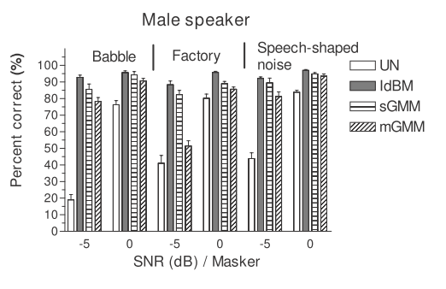

Slide 55



Linear 0 dB SPL

Slide 56




GMMB 0dB SPL

Slide 57
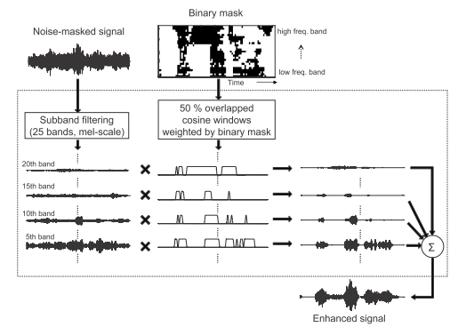
Testing: Audio reconstruction
J. Acoust. Soc. Am. 126 (3) , September 2009

Slide 58
Confusion matrix
Predicted
0 1
90 | 10
20 | 80
Actual
1 0

Slide 59
Linear model results: 0 dB -8 dB

