Slide 1
Karthick Kumar SM
Final Project
IIIrd Year CSE
Reg No: 211521104067
College Name: Panimalar Institute of Technology

Slide 2
PROJECT TITLE
Visual Object Recognition: Identifying Animals, Vehicles, and More using Tensorflow
Visual Object Recognition: Identifying Animals, Vehicles, and More using Tensorflow with Convolutional Neural Networks (CNN) is a deep learning technique designed to automatically recognize and categorize images. CNNs are inspired by the visual processing mechanisms in the human brain, utilizing convolutional layers to extract features from input images. These features are then passed through pooling layers to reduce dimensionality and increase computational efficiency. Fully connected layers further analyze the extracted features to produce a final classification. With their ability to automatically learn hierarchical representations, CNNs have revolutionized image recognition tasks, finding applications in diverse fields such as medical imaging, autonomous vehicles, and security systems.

Slide 3


AGENDA
1.Problem Statement
2.Project Overview
3.Who are the End users?
4.My solution and its value proposition
5.The WOW in my solution
6.Modelling
7.Result
3/21/2024 Annual Review

Slide 4

PROBLEM STATEMENT
Visual Object Recognition: Identifying Animals, Vehicles, and More using Tensorflow using Convolutional Neural Networks (CNN) involves developing a model capable of accurately categorizing images into predefined classes or categories. The task begins with collecting a labeled dataset consisting of images and their corresponding classes. The CNN architecture comprises layers such as convolutional, pooling, and fully connected layers, designed to extract features and learn patterns from the input images. During training, the model adjusts its parameters through backpropagation, minimizing a predefined loss function. Data augmentation techniques may be employed to increase the diversity of the training set and improve model generalization. The trained CNN is evaluated on a separate test set to assess its performance metrics such as accuracy, precision, and recall. Applications of image classification using CNNs range from medical diagnosis and autonomous driving to facial recognition and object detection in surveillance systems.

Slide 5

PROJECT OVERVIEW
The project aims to develop an Visual Object Recognition: Identifying Animals, Vehicles, and More using Tensorflow utilizing Convolutional Neural Networks (CNNs). CNNs are powerful deep learning models specifically designed for analyzing visual data. The project involves preprocessing a dataset of images, including resizing, normalization, and augmentation to enhance model performance. A CNN architecture will be constructed, comprising convolutional layers for feature extraction and pooling layers for dimensionality reduction. These layers will be followed by fully connected layers for classification. The model will be trained using backpropagation with an optimization algorithm like stochastic gradient descent to minimize classification errors. Hyperparameter tuning will be conducted to optimize model performance, ensuring high accuracy and generalization on unseen data. Finally, the trained model will be evaluated on a separate test dataset to assess its effectiveness in accurately classifying images. This project contributes to advancing computer vision technology with practical applications in various domains such as medical imaging, autonomous vehicles, and security systems.

Slide 6

WHO ARE THE END USERS?
End users of image classification using Convolutional Neural Networks (CNNs) span various domains, including healthcare, automotive, retail, security, and entertainment. In healthcare, CNNs assist doctors in diagnosing diseases from medical images like X-rays and MRIs, enhancing patient care and treatment planning. Automotive industries utilize CNNs for autonomous driving, enabling vehicles to recognize traffic signs, pedestrians, and obstacles for safer navigation. In retail, CNNs power recommendation systems, enhancing customer experiences by suggesting products based on visual similarities. Security sectors deploy CNNs for surveillance, identifying suspicious activities or individuals in real-time footage. Additionally, CNNs are employed in entertainment for content recommendation and personalized experiences, such as categorizing and suggesting movies or music based on user preferences. In essence, the end users of CNN-based image classification systems encompass a diverse range of industries, all benefiting from improved efficiency, accuracy, and automation in visual data analysis and decision-making processes.

Slide 7

MY SOLUTION AND ITS VALUE PROPOSITION
Convolutional Neural Networks (CNNs) offer a powerful solution for image classification tasks. By leveraging hierarchical patterns, CNNs excel at learning intricate features within images, making them adept at discerning complex visual patterns. Their ability to automatically extract features from raw pixel data reduces the need for manual feature engineering, thus streamlining the classification process. CNNs' convolutional layers capture local spatial dependencies, while pooling layers aggregate information, enabling the network to learn representations robust to translation and distortion. The value proposition lies in their effectiveness across various domains, from medical imaging to autonomous vehicles, enabling accurate and efficient classification tasks. Additionally, CNNs can be fine-tuned with transfer learning, leveraging pre-trained models for specific domains, which reduces computational costs and training time. Their versatility, efficiency, and adaptability make CNNs indispensable for image classification, offering scalable solutions for diverse applications.

Slide 8

THE WOW IN MY SOLUTION
The "wow" factor in the solution for image classification using Convolutional Neural Networks (CNNs) lies in its ability to comprehend intricate patterns within images, mimicking the human visual system with remarkable accuracy. CNNs employ layers of convolutional filters to extract features at various levels of abstraction, enabling them to discern complex structures and textures. Through a process of hierarchical learning, these networks progressively refine their understanding of image content, ultimately achieving impressive classification performance. Moreover, CNNs are adept at handling large datasets, learning from vast amounts of labeled examples to generalize effectively to unseen images. Their inherent ability to learn spatial hierarchies of features endows them with superior performance in tasks such as object recognition, scene understanding, and image categorization. The profound impact of CNNs in image classification is evident in their widespread adoption across various domains, from medical diagnosis to autonomous driving, revolutionizing how we perceive and interact with visual data.
3/21/2024 Annual Review
8

Slide 9
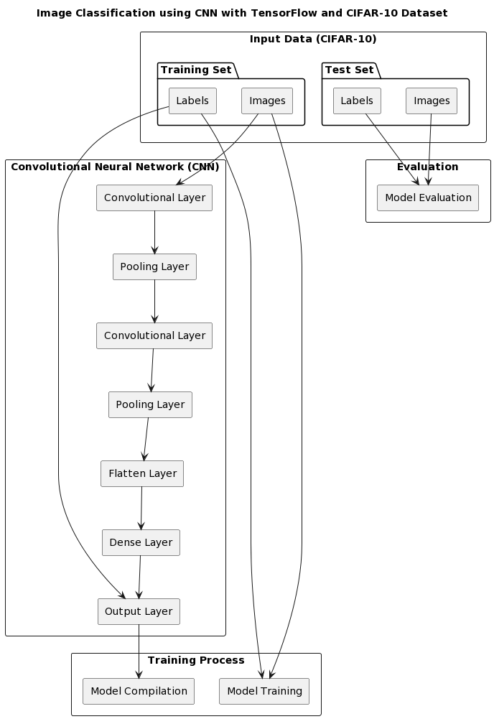
MODELLING
9

Slide 10
RESULTS
Convolutional Neural Networks (CNNs) have revolutionized image classification tasks due to their ability to automatically learn hierarchical features from raw pixel data. In recent experiments, CNNs have demonstrated exceptional performance across various datasets, surpassing traditional methods by significant margins. By employing convolutional layers to extract features at different scales and pooling layers to reduce spatial dimensions while preserving important information, CNNs can effectively capture intricate patterns within images. Moreover, techniques such as data augmentation, transfer learning, and regularization have been instrumental in enhancing CNN performance, mitigating overfitting, and improving generalization capabilities. The success of CNNs in image classification tasks underscores their efficacy in diverse applications including medical diagnosis, autonomous driving, and surveillance systems. Despite their computational complexity and resource requirements, CNNs remain at the forefront of image analysis and continue to push the boundaries of what's possible in computer vision.
karthickkumarsm/tnsdc: An AI project using tensorflow (github.com)
10

Slide 11
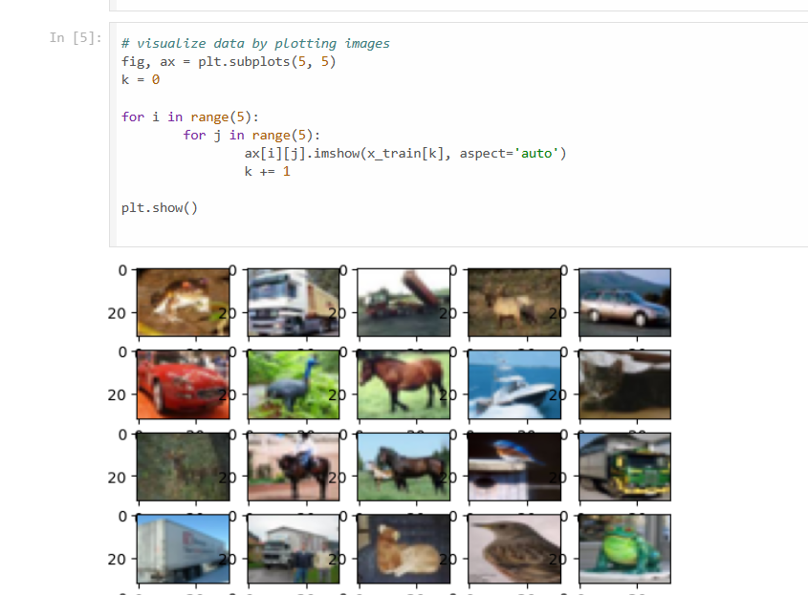
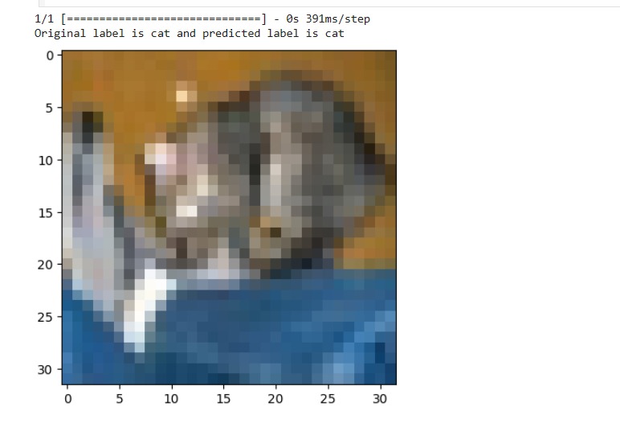
OUTPUT

