Slide 1

Templesite Website
Submitted by:-
Karthick raja M
Sethu pathi M
Vignesh B

Slide 2
Introduction:-
First we are going to see what are the languages used in this project.
How the languages are used in this project.
The project is to create a static website for temples in Tamil Nadu.
To know about the temple culture of Tamil Nadu.

Slide 3

What is HTML?
HTML stands for Hyper Text Markup Language
HTML is the standard markup language for creating Web pages
HTML describes the structure of a Web page
HTML consists of a series of elements
HTML elements tell the browser how to display the content
HTML elements label pieces of content such as "this is a heading", "this is a paragraph", "this is a link", etc.

Slide 4
What is an HTML Element?
An HTML element is defined by a start tag, some content, and an end tag:
<tagname> Content goes here... </tagname>
The HTML element is everything from the start tag to the end tag:
<h1>My First Heading</h1>
<p>My first paragraph.</p>
Some HTML elements have no content (like the <br> element). These elements are called empty elements. Empty elements do not have an end tag!.

Slide 5
What is CSS?
CSS stands for Cascading Style Sheets
CSS describes how HTML elements are to be displayed on screen, paper, or in other media
CSS saves a lot of work. It can control the layout of multiple web pages all at once
External style sheets are stored in CSS files

Slide 6
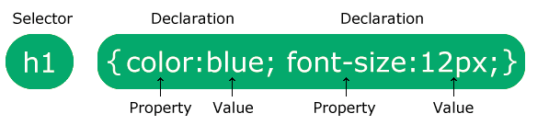
CSS Syntax :
The selector points to the HTML element you want to style.
The declaration block contains one or more declarations separated by semicolons.
Each declaration includes a CSS property name and a value, separated by a colon.
Multiple CSS declarations are separated with semicolons, and declaration blocks are surrounded by curly braces.

Slide 7
The languages used for :
HTML used to view the content.
CSS used to display the content attractive , readable and to design the whole page.
External CSS is used in this project.

Slide 8
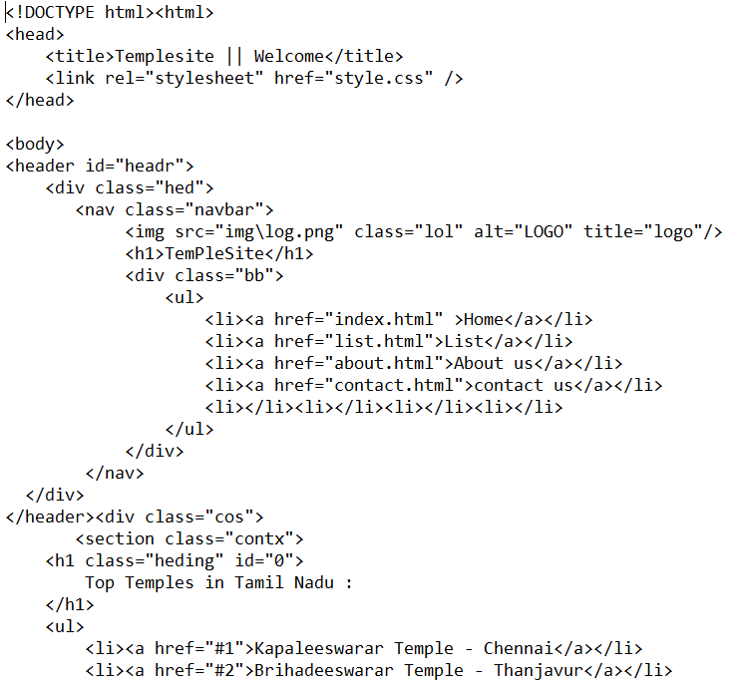
Project’s coding :

Slide 9
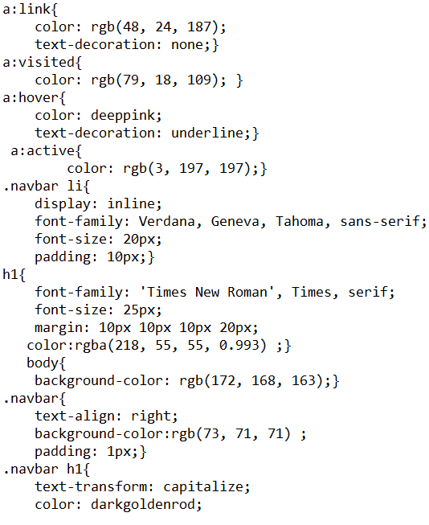

Slide 10
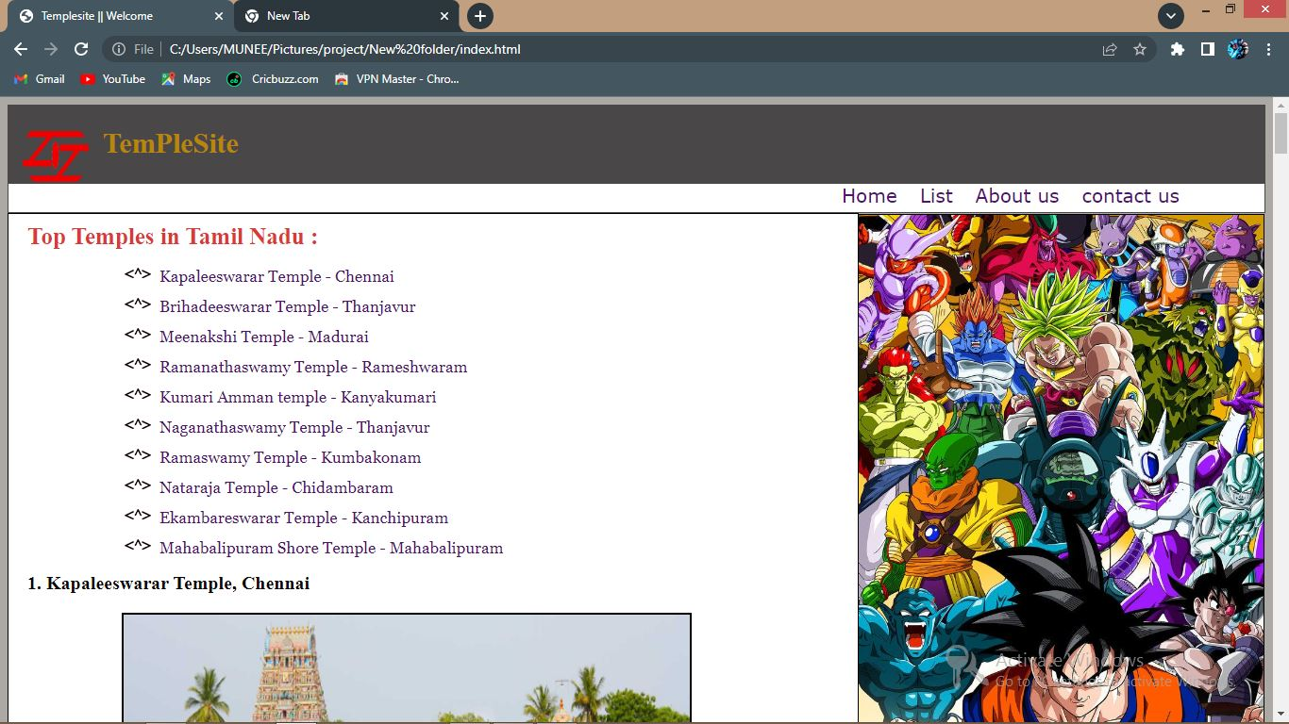
Output of the project :

Slide 11

Thank you for hearing us out !!!

