Slide 1
Autonomous Smart Parking System (ASPS)
IBM Naan Mudhalvan-Group 2
Internet Of Things(IOT)
5113: Kingston Engineering College
By:
Naveen Moses D | au511321106017 | naveenmosesdinesh@gmail.com
Karthick V | au511321106014 | karthicksparrow201@gmail.com
T.N.Uthrakumar | autle-02ece | uthrakumar608@gmail.com
Sanjay Kumar S | au511321106020 | sanjaysivakumar0910@gmail.com

Slide 2
CONTENTS
SLOT ALLOCATION AND BOOKING
Introduction
Flow chart
Components
AUTOMATIC PARKING
Introduction
Flow chart
Components

Slide 3
01
SLOT ALLOCATION AND BOOKING

Slide 4
INTRODUCTION
Slot booking in a smart parking system is a feature that allows users to reserve parking spaces in advance, ensuring a more convenient and efficient parking experience. Here's an overview of how slot booking can be implemented in a smart parking system.
This feature allows the user is able to identify an empty space/slot in parking space and book the slot in advance of approx. 30 mins, which can be done using mobile apps or software. The main criteria for booking is to make sure the user is within a kilometre from the booked slot.

Slide 5
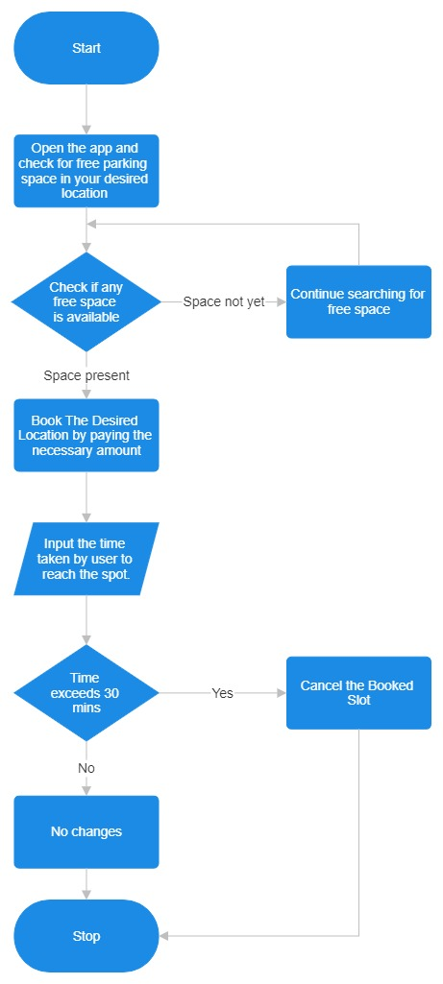
WORKING FLOW CHART

Slide 6
User Registration
Users need to register and create an account in the smart parking system's mobile app or website.
Finding Available Parking Slots
Users can check the availability of parking slots in real-time through the app or website.
The system should provide information about the location, number of available slots, and pricing.
Selecting a Parking Slot
Users can select an available parking slot based on their preferences, such as proximity to their destination or budget.
Booking a Slot
Once a user selects a parking slot, they can proceed to book it.
The system should allow users to choose the place and slot.

Slide 7
Payment
Users need to make a payment for the reserved parking slot. This can be done through various payment methods, such as credit/debit cards, mobile wallets, or prepaid parking credits
Confirmation
After a successful payment, users should receive a confirmation with details of their booking, including a QR code or booking ID.
Entry and Exit
To access the parking facility, users can scan the QR code or present the booking ID at the entry gate.
The system should track entry and exit times to calculate the parking duration.
Extensions and Cancellations
Users may have the option to extend their parking duration if needed, provided there are available slots.
Cancellation policies should be in place, allowing users to cancel their bookings with a refund if they change their plans.

Slide 8
Real-time Updates
The system should continuously update slot availability in real-time to account for cancellations or early departures.
Notifications
Users can receive notifications reminding them of their upcoming booking or when their parking time is about to expire.
Overstay Alerts
Users should be notified if they exceed their booked parking time, and additional charges may apply.
Reporting and Analytics
The smart parking system can generate reports and analytics to help parking facility managers optimize slot allocation, pricing, and overall operations.

Slide 9
Integration with Navigation
Integration with navigation apps can provide users with directions to their reserved parking spot within the facility.
Security
The system should ensure the security of user data and payment information.

Slide 10
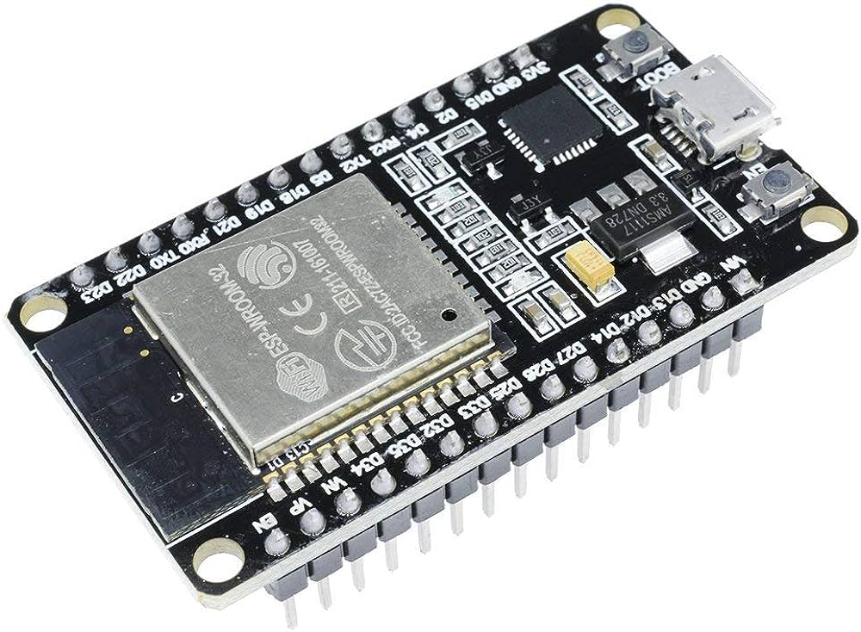
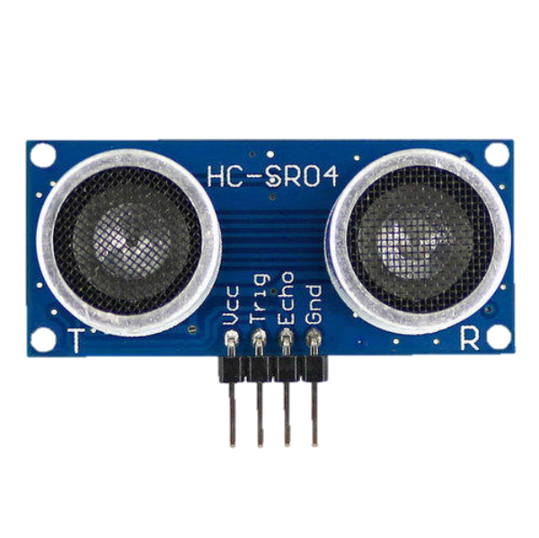
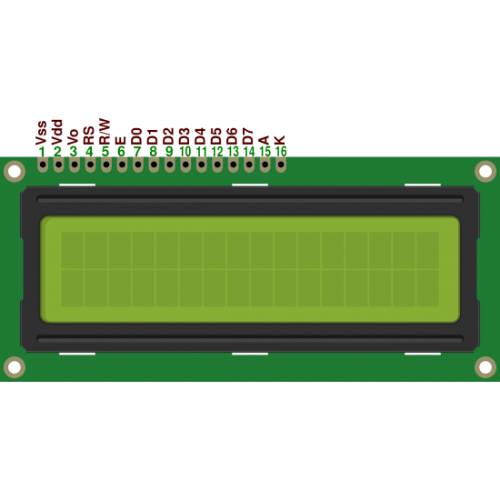
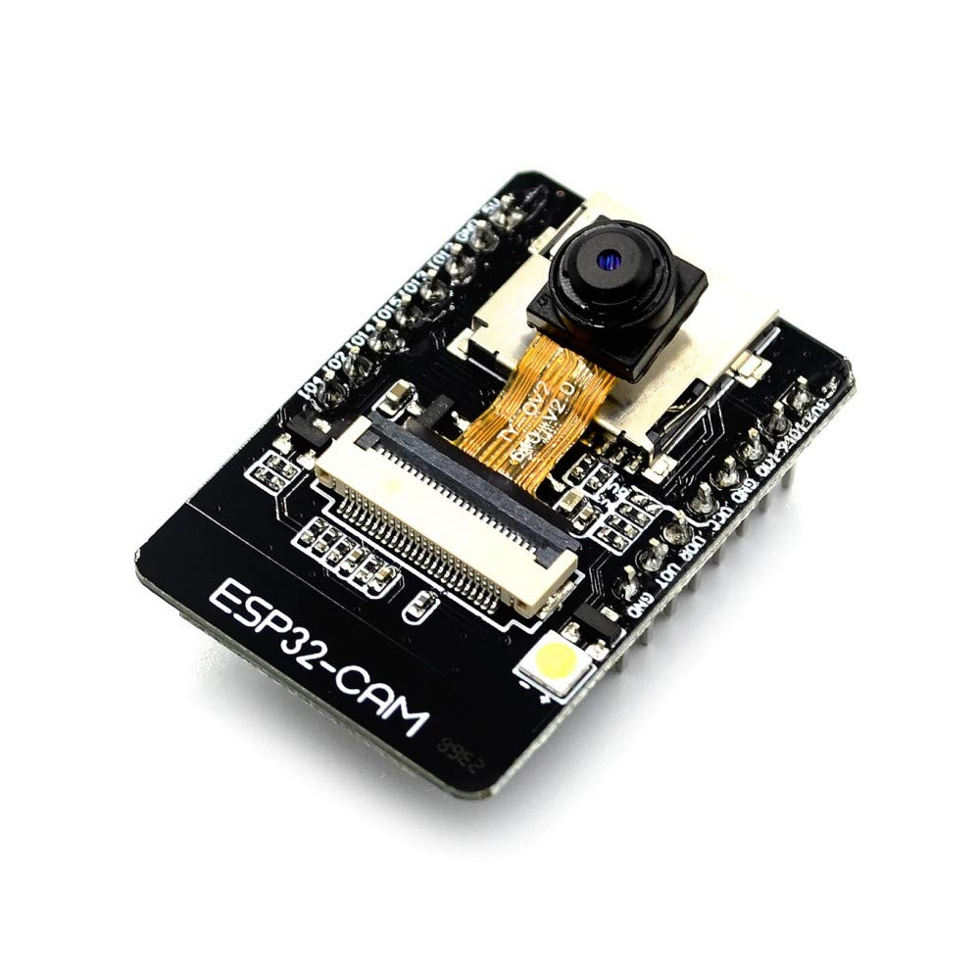
Components
ESP 32
ULTRASONIC SENSOR
16 x 2 LCD display
Camera Module

Slide 11
02
AUTOMATIC PARKING

Slide 12
INTRODUCTION
Automatic car parking, also known as automated valet parking or autonomous parking, is a technology that enables a vehicle to park itself without the need for human intervention. This technology uses a combination of sensors, cameras, computer vision, artificial intelligence (AI), and advanced control systems to navigate, manoeuvre, and park a car safely and accurately.

Slide 13
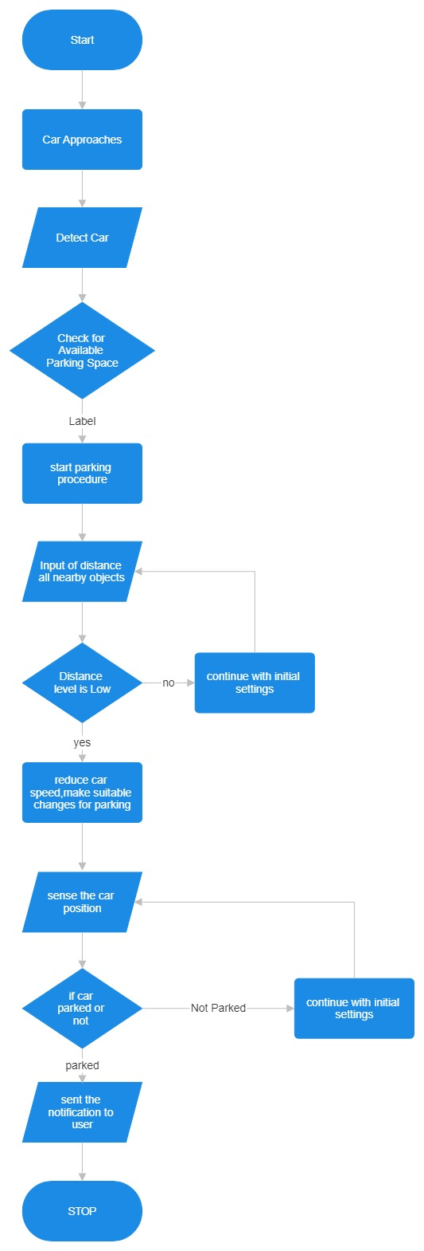
WORKING FLOW CHART

Slide 14
Vehicle Detection
When a driver arrives at a location equipped with automatic car parking, the vehicle's sensors and cameras scan the surroundings to detect obstacles, other vehicles, and available parking spaces
Mapping and Path Planning
The onboard computer system creates a map of the parking area and identifies suitable parking spaces based on the vehicle's size and the available spaces. It also plans the optimal path to the selected parking spot.
Vehicle Control
The car's autonomous driving system takes control of acceleration, steering, braking, and other necessary functions to safely navigate the vehicle to the chosen parking space. It uses real-time sensor data to make adjustments and avoid obstacles.
Parking Manoeuvres
The vehicle performs precise manoeuvres, including parallel parking, perpendicular parking, or diagonal parking, depending on the available parking space and the driver's preferences.

Slide 15
Monitoring and Safety
Throughout the parking process, the system continuously monitors the vehicle's surroundings, detecting any unexpected obstacles or changes in the environment. It can halt the parking process if necessary to ensure safety.
Parking Completion
Once the vehicle reaches the desired parking spot, it stops, aligns itself properly within the space, and engages the parking brake

Slide 16
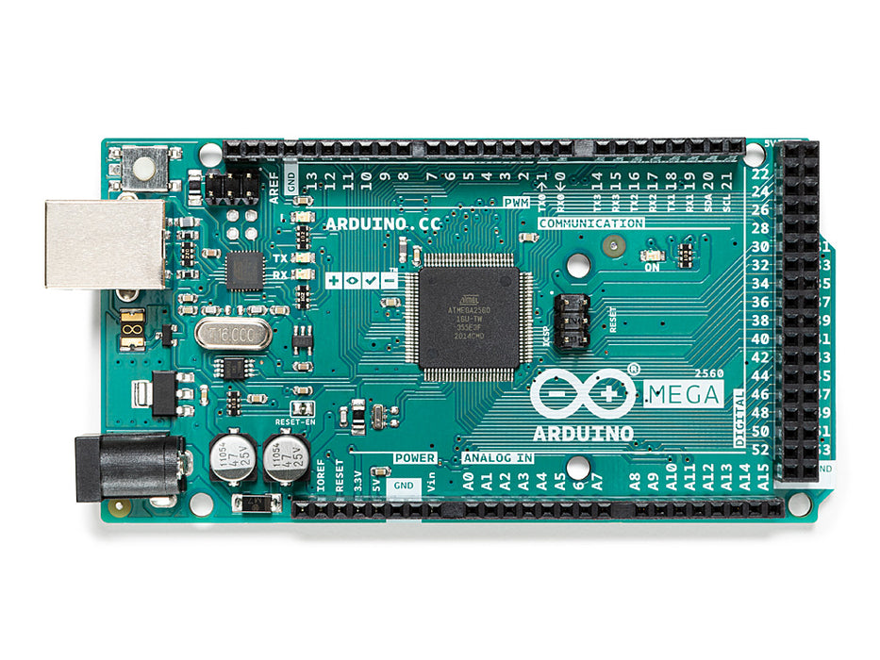
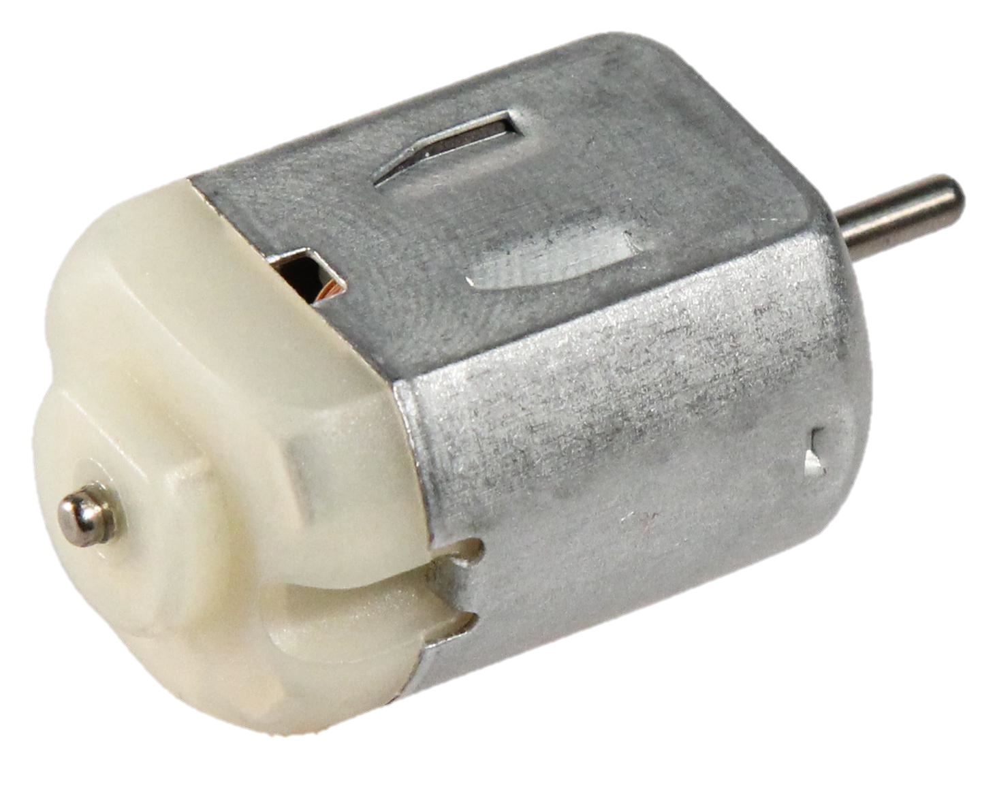
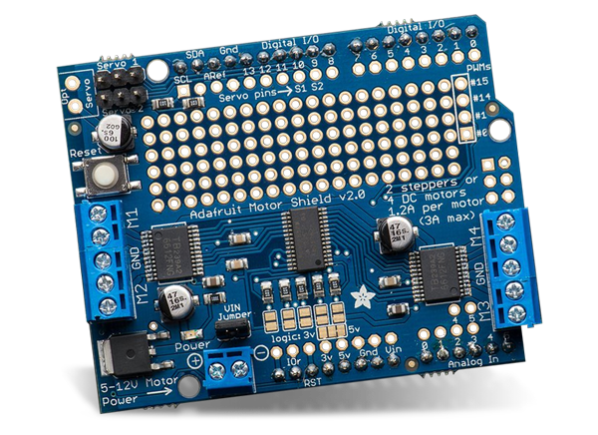
Components
Arduino Mega
ULTRASONIC SENSOR
Dc Motor
Adafruit Motor Shield

