Slide 1
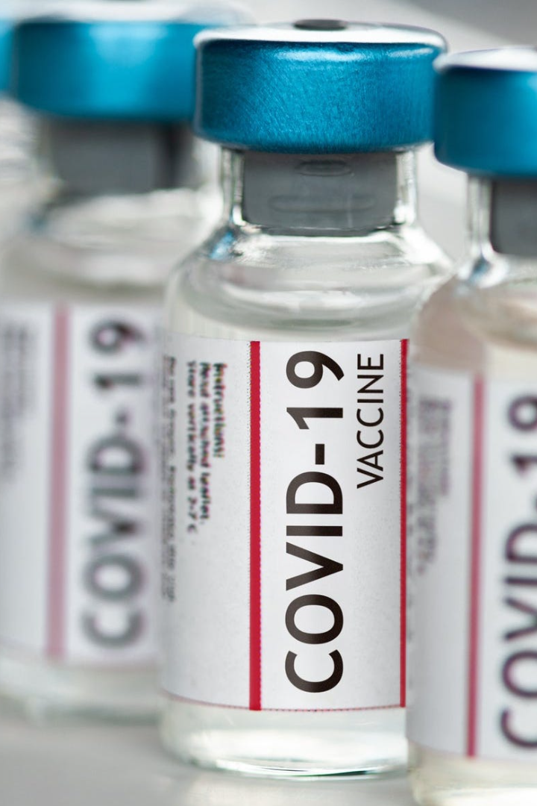
COVID-19 Vaccines Analysis
The COVID-19 pandemic has ravaged the world, claiming millions of lives and leaving untold devastation in its wake. In this presentation, we will explore the different types of vaccines against this disease - their mechanisms, efficacy, and the role they play in controlling the spread of the virus.

Slide 2
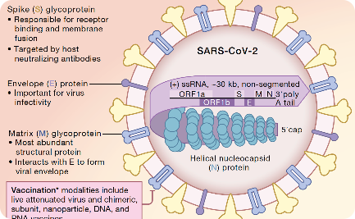
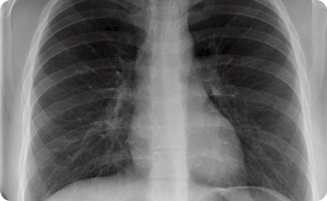
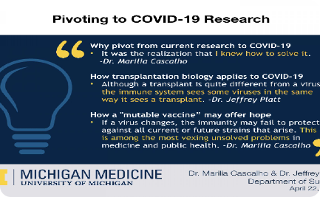
The Anatomy of COVID-19
Molecular Structure
Effects on the Body
Global Research
COVID-19 is a highly infectious disease caused by the SARS-CoV-2 virus. S protein is responsible for viral entry into the host cell.
The virus attacks the respiratory system and can cause severe lung damage, pneumonia and other systemic complications.
Scientists are working around the clock to develop effective vaccines and treatment options for patients with severe coronavirus disease.

Slide 3
The Types of COVID-19 Vaccines
mRNA Vaccines
Vector Vaccines
Vaccines developed by Pfizer-BioNTech and Moderna that use a small piece of genetic code from the virus to trigger an immune response.
Vaccines developed by AstraZeneca and Johnson & Johnson that use a harmless virus to introduce a piece of COVID-19 genetic code.
Inactivated or Attenuated Vaccines
Protein-Based Vaccines
Traditional vaccine technology used by Sinovac and Bharat Biotech that use weakened or dead virus to stimulate an immune response.
Vaccines being developed by Novavax and Sanofi that contain viral proteins to stimulate an immune response.

Slide 4
Vaccine Efficacy and Safety
1
Efficacy Rates
The effectiveness of vaccines varies, with some showing efficacy rates of over 90% in preventing COVID-19.
Side Effects
2
The most common side effects of COVID-19 vaccines include pain and swelling at the injection site, body aches, and fever.
3
Long-Term Studies
Studies are ongoing to evaluate the long-term safety and efficacy of the COVID-19 vaccines.

Slide 5
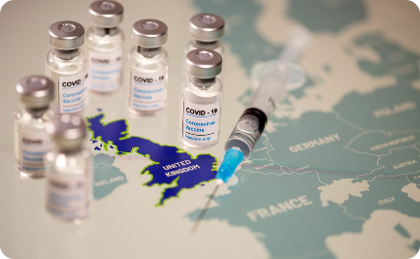
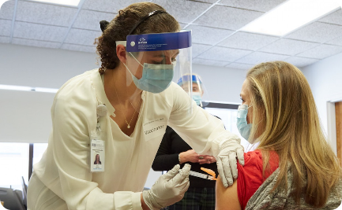
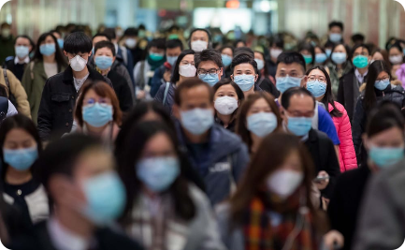
Global Vaccination Efforts
Distribution of Vaccines
Healthcare Workers
Mask-Wearing and Vaccines
Vaccine distribution has been slow in many countries due to limitations in production, supply, and logistical challenges.
Healthcare workers have been at the forefront of vaccination efforts globally, tirelessly working towards the goal of immunizing communities.
Vaccines are a crucial tool in controlling the spread of COVID-19, but they do not replace the need for continued mask-wearing and social distancing.

Slide 6

The Road Ahead
1
Booster Shots
2
International Collaboration
3
Long-Term Virus Control
Booster shots are being studied and could become necessary to keep up immunity against new variants.
International cooperation and coordination will be vital to ensuring equitable distribution of vaccines and controlling the spread of COVID-19 worldwide.
It is unlikely that COVID-19 will be eradicated, but through continued vaccination efforts, public education, and policy measures, we can aim for long-term control and reduce its impact on society.

Slide 7
Beyond COVID-19
Virus Prevention
Public Health Awareness
Healthcare Preparedness
The development of COVID-19 vaccines has also paved the way for advancements in virus prevention and treatment strategies.
The pandemic has highlighted the importance of public health measures such as vaccination, hand hygiene, and respiratory etiquette.
The global response to COVID-19 showed the need for increased preparedness and investment in healthcare infrastructure and research.

Slide 8
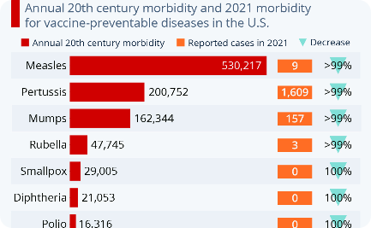

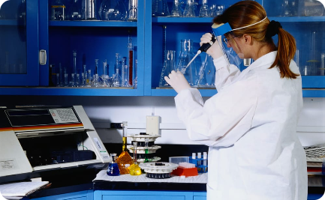
The Importance of Vaccines
Impact of Vaccines
Healthy Communities
Research and Innovation
Vaccines are one of the most effective public health interventions in preventing and controlling infectious diseases, saving millions of lives every year.
Vaccines not only protect individuals but also contribute to building healthy communities and strengthening global health systems.
Through continued research and innovation, we can work towards developing new and more effective vaccines for a wide range of diseases.

