Slide 1



World Risk Index Prediction using Machine Learning

Slide 2

Learning Objectives
To understand and clean real-world datasets (World Risk Index).
To apply ML algorithms for disaster risk classification.
To evaluate the model using accuracy, classification report, and confusion matrix.
To deploy the trained ML model for predictions
GOAL
Source :
www.freepik.com/

Slide 3
Tools and Technology used
1. Programming Language – Python
Python is widely used in Machine Learning because it is simple, easy to read, and has many libraries for data analysis and ML.
In your project, Python was used for data cleaning, model building, and deployment.
2. Libraries
Pandas – Used to load the dataset (world_risk_index.csv), handle missing values, and manage data in table format (DataFrames).
NumPy – Used for numerical operations and working with arrays (e.g., converting input into a NumPy array for prediction).
Scikit-learn – The main Machine Learning library.
Used for splitting dataset into train/test,
Training the Random Forest Classifier,
Evaluating performance with accuracy, confusion matrix, and classification report.
Pickle – Used to save the trained ML model (rf_model.pkl) and label encoder (label_encoder.pkl) so that predictions can be made later without retraining the model.
3. Deployment – Saved ML Model (rf_model.pkl)
After training the Random Forest model, it was saved using Pickle.
This allows you to reuse the model anytime by loading it, instead of training again.
You also saved the Label Encoder (label_encoder.pkl) so the predicted class (like “High” or “Low”) can be correctly converted from numeric form back to text.

Slide 4
Methodology
Data Collection – Importing world_risk_index.csv
Data Preprocessing – Handling missing values, encoding categorical data
Feature Selection – Exposure, Vulnerability, Susceptibility, Coping Capacity, Adaptive Capacities, Year
Model Training – Random Forest Classifier
Model Evaluation – Accuracy, Classification Report, Confusion Matrix
Deployment – Saving and loading model using Pickle for predictions

Slide 5
Problem Statement:
The increasing occurrence of natural disasters such as floods, cyclones, and earthquakes poses a major risk to countries worldwide. The World Risk Index (WRI) provides a measure of disaster risk by considering factors like exposure, vulnerability, susceptibility, coping capacity, and adaptive capacity. However, analyzing and categorizing this data manually into risk levels such as low, medium, high, or very high is time-consuming, complex, and prone to human error. Policymakers and researchers require a faster, more reliable, and automated approach to predict the WRI category of a acountry. Hence, there is a need for a machine learning–based solution that can efficiently classify countries into risk categories and assist in better decision-making for disaster preparedness and management.

Slide 6
Solution:
Used World Risk Index dataset for disaster risk classification.
Selected important features: Exposure, Vulnerability, Susceptibility, Coping Capacity, Adaptive Capacity, Year.
Applied Random Forest Classifier to train the model.
Evaluated model performance using Accuracy, Classification Report, and Confusion Matrix.
Saved trained model (rf_model.pkl) and label encoder (label_encoder.pkl) using Pickle for deployment.
Automated prediction system helps categorize countries into WRI risk levels (Low, Medium, High, Very High).
Provides a fast, reliable, and scalable solution for policymakers and disaster management

Slide 7
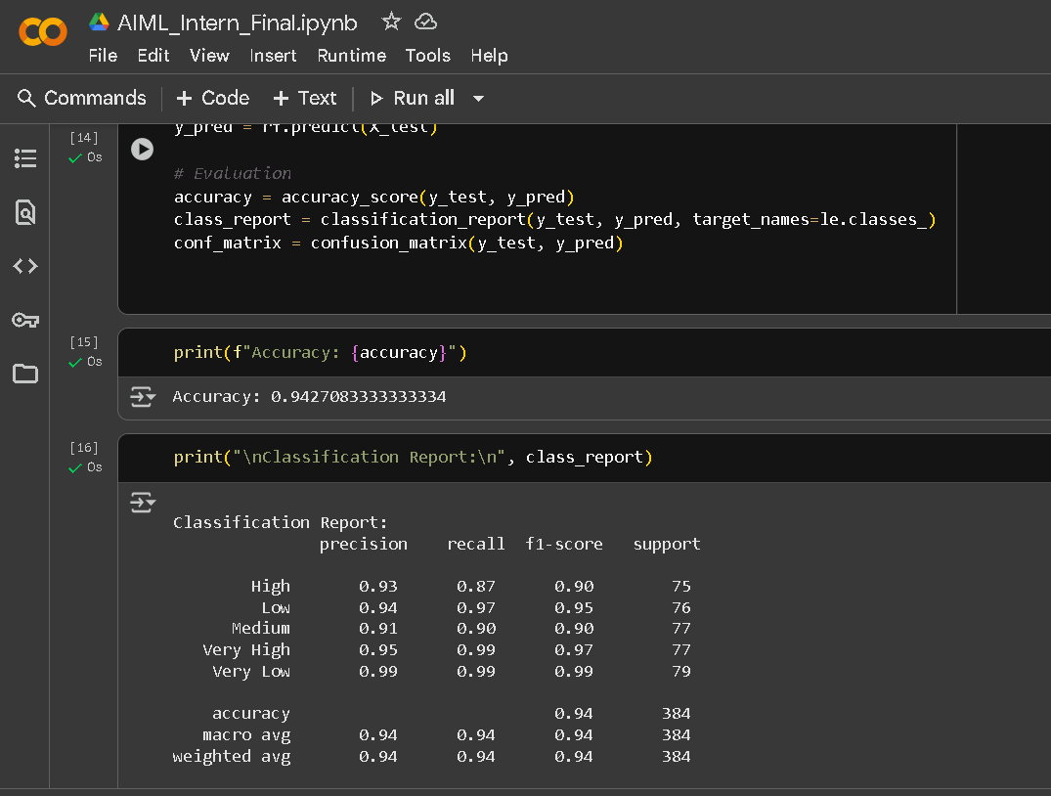
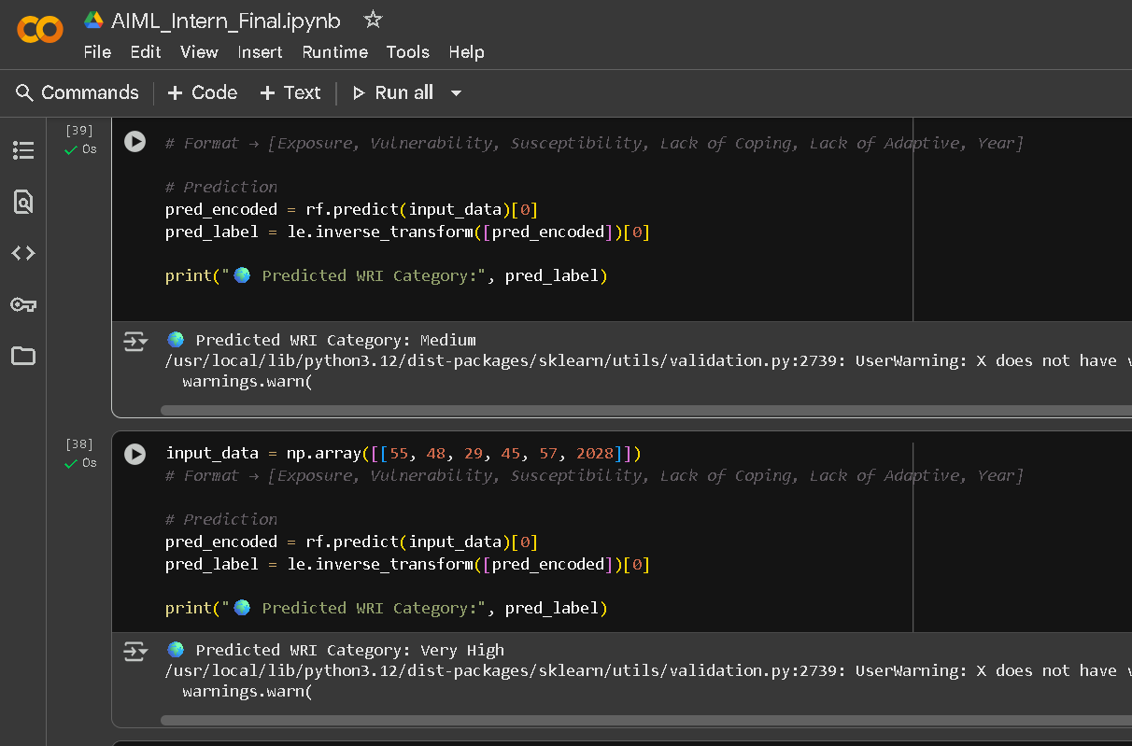
Screenshot of Output:

Slide 8
Conclusion:
This project successfully demonstrates the application of machine learning in predicting the World Risk Index (WRI) category of countries. By using features such as exposure, vulnerability, susceptibility, coping capacity, adaptive capacity, and year, the Random Forest Classifier achieved reliable performance in classifying disaster risk levels. The deployment of the model using Pickle ensures reusability and efficient predictions without the need for retraining. Overall, this automated system provides a fast, accurate, and scalable approach to support policymakers, researchers, and disaster management authorities in assessing global disaster risks and making informed decisions for preparedness and mitigation.

