Slide 1
KARTHICK S
Final Project
3/21/2024 Annual Review

Slide 2
Anime Face Generator using DCGAN
3/21/2024 Annual Review

Slide 3
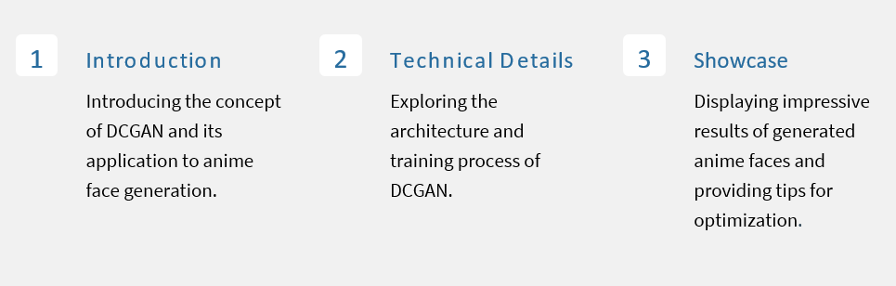


AGENDA
3/21/2024 Annual Review

Slide 4
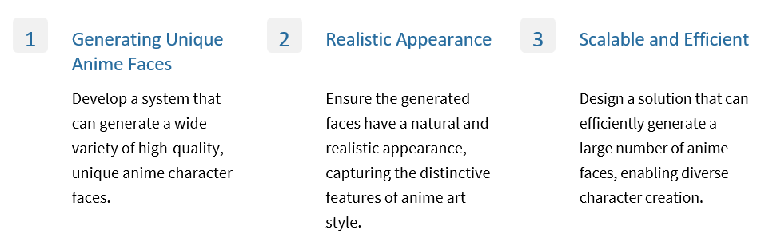

PROBLEM STATEMENT
3/21/2024 Annual Review

Slide 5
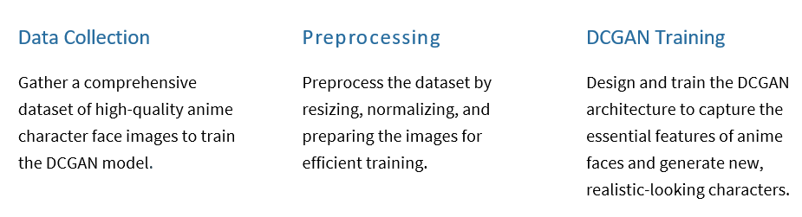

PROJECT OVERVIEW
3/21/2024 Annual Review

Slide 6

END USERS
The end users might include researchers, developers, and designers in the anime industry who can leverage the embeddings for various purposes, such as creating new characters, designing merchandise, or improving animation techniques. Additionally, the embeddings could potentially be utilized by enthusiasts and fans for creating fan art or developing anime-related content.
3/21/2024 Annual Review

Slide 7
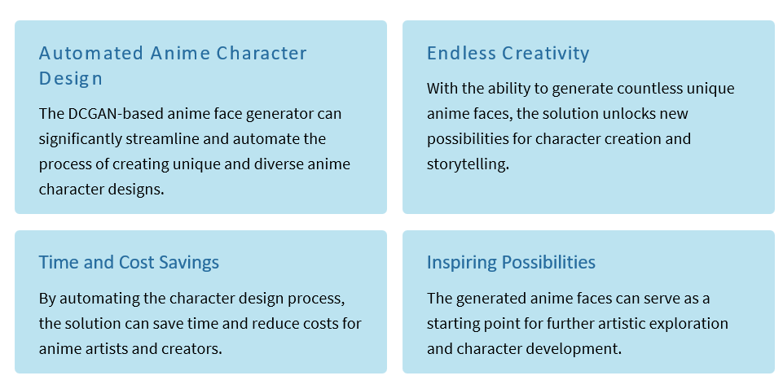
SOLUTION AND ITS VALUE PROPOSITION
3/21/2024 Annual Review

Slide 8
THE WOW FACTORS
The striking level of detail and realism achieved by the DCGAN-based anime face generator is sure to wow both artists and fans alike, elevating the overall quality and appeal of anime character designs. Its ability to generate anime faces that capture the essence of the art form is truly impressive and opens up endless possibilities for creativity and expression in the anime industry.
3/21/2024 Annual Review

Slide 9
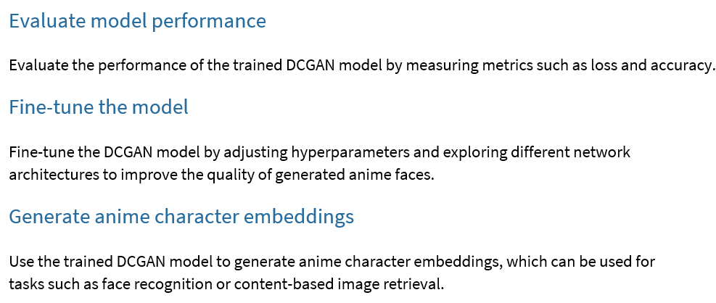
MODELLING
3/21/2024 Annual Review

Slide 10
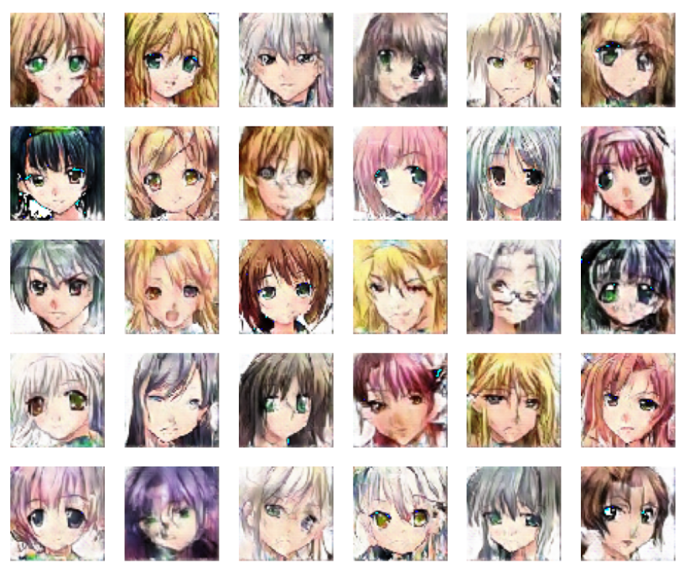
RESULTS
Demo Link
3/21/2024 Annual Review

