Slide 1

Digital Certificate
Verification System
Student Name:
KARTHICK S
Department:
AI&DS
College:
VSB ENGINEERING COLLEGE

Slide 2





Digital Certificate Verification System
Introduction
What is a Digital Certificate Verification System?
A Digital Certificate Verification System is an automated online platform that allows institutions to issue, manage, and validate academic or professional certificates securely using unique IDs, QR codes, and encrypted databases.
Prevents Forgery
Instant Validation
Eliminates fake certificate submissions with cryptographic validation
Real-time verification replaces slow, error-prone manual checks
Academic Integrity
Scalable & Efficient
Ensures credibility of educational achievements across institutions
Handles thousands of verifications simultaneously without delay

Slide 3



Digital Certificate Verification System
Problem Statement
Fake Certificates
Manual Verification Challenges
Time-Consuming Process
▸ Rising incidents of forged academic credentials
▸ Fraudulent certificates bypass manual inspection easily
▸ Significant damage to institutional reputation
▸ Physical verification requires significant human effort
▸ No centralized database for cross-checking
▸ Highly prone to human error and oversight
▸ Traditional methods take days or weeks to verify
▸ Organizations face bottlenecks during high-demand periods
▸ No real-time validation capability exists

Slide 4

Digital Certificate Verification System
Objectives
01
Digital Verification
Enable instant, automated verification of academic and professional certificates via unique IDs and QR codes.
02
Reduce Certificate Fraud
Eliminate the use of forged credentials through secure encrypted certificate storage and real-time validation.
03
Improve Security
Implement multi-layer security using admin authentication, database encryption, and access control.
04
Increase Efficiency
Replace time-consuming manual processes with an automated platform accessible 24/7 by employers and institutions.
05
Centralized Management
Provide a single dashboard for admins to upload, manage, search, and audit all certificate records.

Slide 5
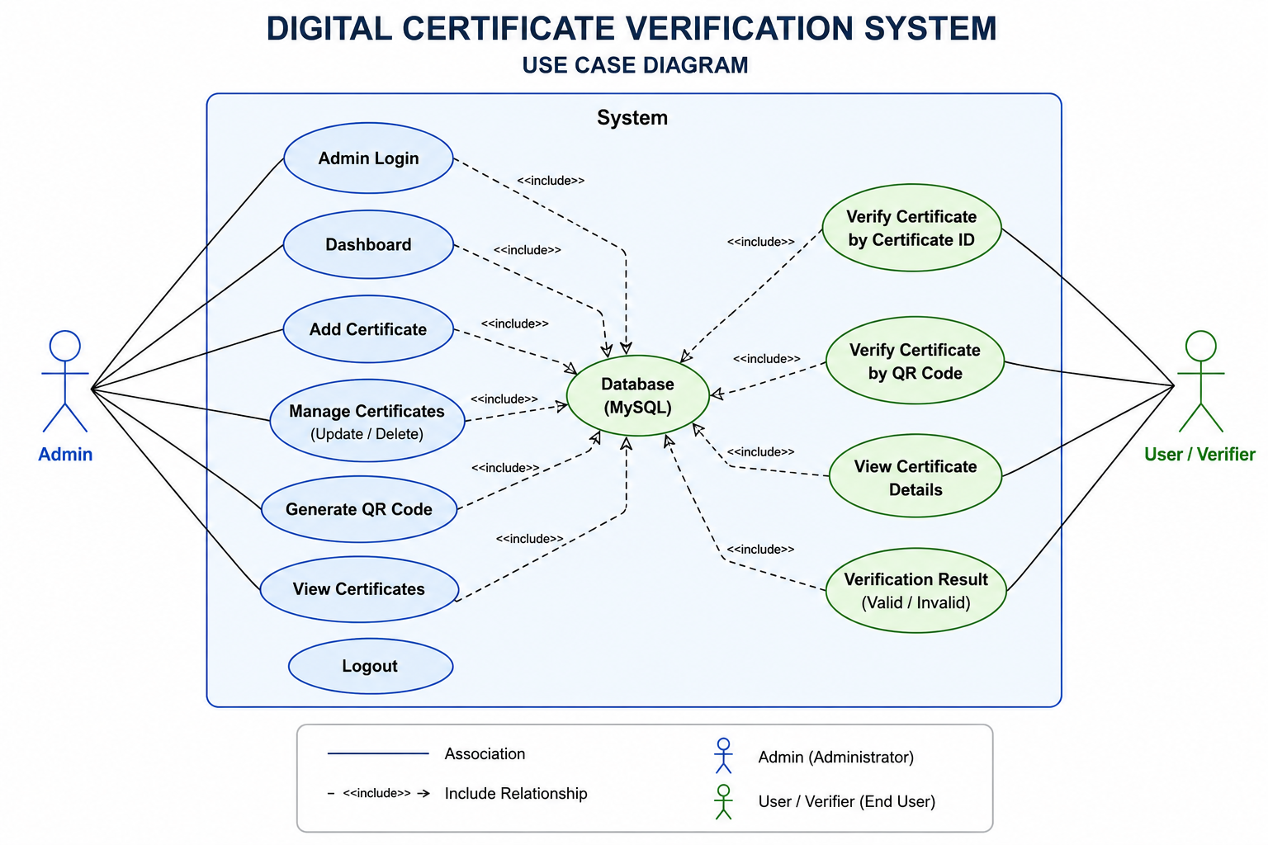
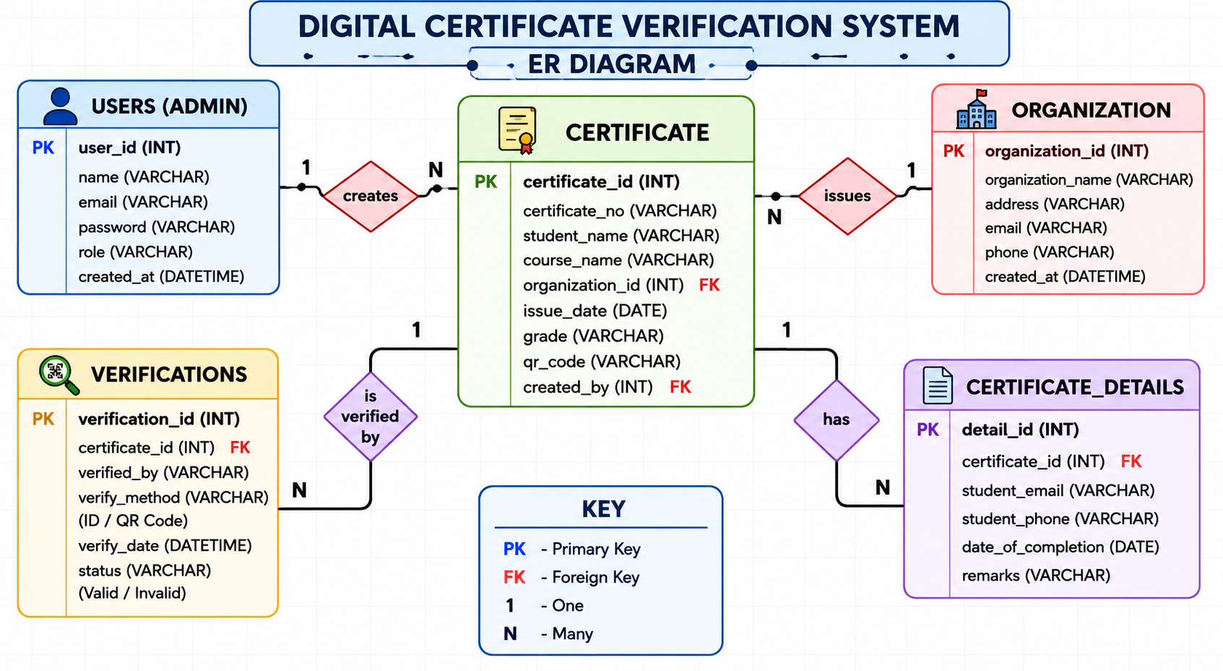
Digital Certificate Verification System
USE CASE AND ER DIAGRAM

Slide 6






Digital Certificate Verification System
Proposed System
Secure Certificate Upload
QR Code Generation
Public Verification Portal
Admins upload verified certificates with student details, department info, and unique identifiers into a centralized database.
Each certificate receives a unique QR code linking to the verification record — scannable by any device instantly.
Employers and institutions can verify any certificate by entering the certificate ID or scanning the QR code.
Encrypted Database
Email Verification
Role-Based Access
All certificate records are stored in a MySQL database with secure access controls and full audit logging.
Automated email alerts notify students and admins upon certificate issuance, verification attempts, and status changes.
Separate admin and user roles ensure only authorized personnel can manage or modify certificate records.

Slide 7




Digital Certificate Verification System
System Architecture
Admin Module
Student/User Module
Verification Module
Login, upload, manage
certificates & records
Search, scan QR code,
view certificate status
Validate certificate ID,
return result
Database
MySQL · Student Records
Certificate Data · Verification Logs

Slide 8
Digital Certificate Verification System
Technologies Used
Frontend
Backend
▸ HTML5 – Structure & layout
▸ CSS3 – Responsive styling
▸ JavaScript – Dynamic interactions
▸ PHP – Server-side scripting
▸ Session management
▸ Form processing & routing
Database
Additional
▸ MySQL – Data storage
▸ Relational schema design
▸ Stored procedures & queries
▸ QR Code – Certificate linking
▸ Email Verification – SMTP
▸ MD5 / SHA Encryption

Slide 9




Digital Certificate Verification System
Modules
01 Admin Login
Secure authentication for admin panel with session management and access control.
02 Certificate Upload
Admin uploads certificate details along with student data and document files.
03 Certificate Management
Edit, view, delete, and audit all certificate records from a centralized dashboard.
04 Verification Portal
Public portal for anyone to verify certificate authenticity by ID or QR code scan.
05 User Search & Validation
Real-time search and instant validation result display with detailed certificate info.

Slide 10
Digital Certificate Verification System
Database Design
tbl_admin
tbl_students
admin_id (PK)
student_id (PK)
username
full_name
password (hashed)
course
email
year_of_passing
created_at
email
tbl_certificates
tbl_verification_logs
cert_id (PK)
log_id (PK)
student_id (FK)
cert_id (FK)
cert_number
verified_by
issue_date
timestamp
qr_code_path
result

Slide 11

Digital Certificate Verification System
Workflow
1
2
3
4
Admin Uploads Certificate
QR Code Generated
User Queries Certificate
System Validates
Admin logs in and uploads certificate with student info to the system
System auto-generates unique QR code and certificate ID for the record
User enters certificate ID or scans QR code on verification portal
Backend queries database and returns verified or invalid status

Slide 12




Digital Certificate Verification System
Advantages
Fast Verification
Secure & Reliable
Prevents Forgery
Instant results compared to days-long manual checking processes.
Encrypted database with access controls prevents unauthorized changes.
Unique QR codes and IDs are nearly impossible to replicate falsely.
Easy Record Management
Accessible Anywhere
Audit Trail
Centralized dashboard for full CRUD operations on all certificates.
Web-based portal accessible from any device — desktop or mobile.
Every verification attempt is logged with timestamp and outcome.

Slide 13


Digital Certificate Verification System
Future Enhancements
Blockchain Integration
AI-Based Fraud Detection
Mobile Application
▸ Immutable certificate storage on a decentralized blockchain
▸ Eliminates any possibility of data tampering or deletion
▸ Uses smart contracts for auto-issuance and validation
▸ Industry-ready for cross-institution verification
▸ Machine learning model trained on certificate patterns
▸ Automatically flags suspicious or anomalous records
▸ Continuous learning from new fraud attempts
▸ Reduces manual review workload significantly
▸ Dedicated Android & iOS app for instant QR scanning
▸ Push notifications for issuance and verification events
▸ Offline certificate viewing with sync capabilities
▸ Biometric admin login for enhanced security

Slide 14
Digital Certificate Verification System
Conclusion
Project Summary
The Digital Certificate Verification System provides a robust, automated, and secure solution to eliminate fraudulent credentials. By combining PHP-MySQL backend, QR code technology, and email verification, the system delivers instant, reliable certificate validation while reducing institutional overhead significantly.
For Educational Institutions
For Employers & Organizations
For Students
✓ Eliminate fake degree fraud permanently
✓ Centralized and auditable certificate registry
✓ Reduce administrative workload by up to 80%
✓ Instant background verification in seconds
✓ Confident hiring decisions backed by data
✓ No dependency on physical document checks
✓ Digital credentials always accessible online
✓ Share verifiable proof of achievement globally
✓ Secure personal record management

Slide 15

Thank You!
Digital Certificate Verification System
Presented by: KARTHICK S | Dept. AI & DS | VSB ENGINEERING COLLEGE

