Slide 1

Analysis of lead time and predictive modelling of potential delay
(Take home task)
Applicant Name : Karthick Sundar Coimbatore Krishnaraaj
Submission date : 26/05/2024
E-mail : ckkarthicksundar@gmail.com

Slide 2

Agenda
Problem statement & Data explanation
Exploratory Data Analysis (EDA) & Pre-processing
Task 1: Identifying happy customers
Task 2: Whom and when to notify delays
Task 3 (Bonus): Predicting likelihood of future delays in new booking
Technical design for deployment of prediction model (Bonus)
Code walkthrough
Conclusion & Future work

Slide 3

Problem Statement & Data Explanation

Slide 4

Problem Statement
Mission:
As a digital transport business DigiHaul is specializes in managing, consolidating, and integrating data from both
Carries and Shippers to provide a seamless end-t-end logistics service
- Shippers book shipments on the DiguHaul platform, specifying collection and delivery time windows, locations, and required vehicle types
Carriers: accept jobs and schedule collection
DigiHaul’s driver app: facilitates real-time tracking via GPS (contingent on carrier permissions for logging)
Task 1: (Operational KPI)
KPI: On-time collection and delivery
What percentage of shipments met the on-time delivery threshold (no later than 30 minutes past the scheduled window) from October 1st to December 31st, 2023?
Task 2: (Time delay notifications)
KPI: Timely communication of potential delays to shippers
Identify which shippers should be automatically notified about the delays and when thy should be notified
Task 3: (Predictive)
Predict the likelihood of delays for shipments listed in “New_bookings.csv” dataset

Slide 5


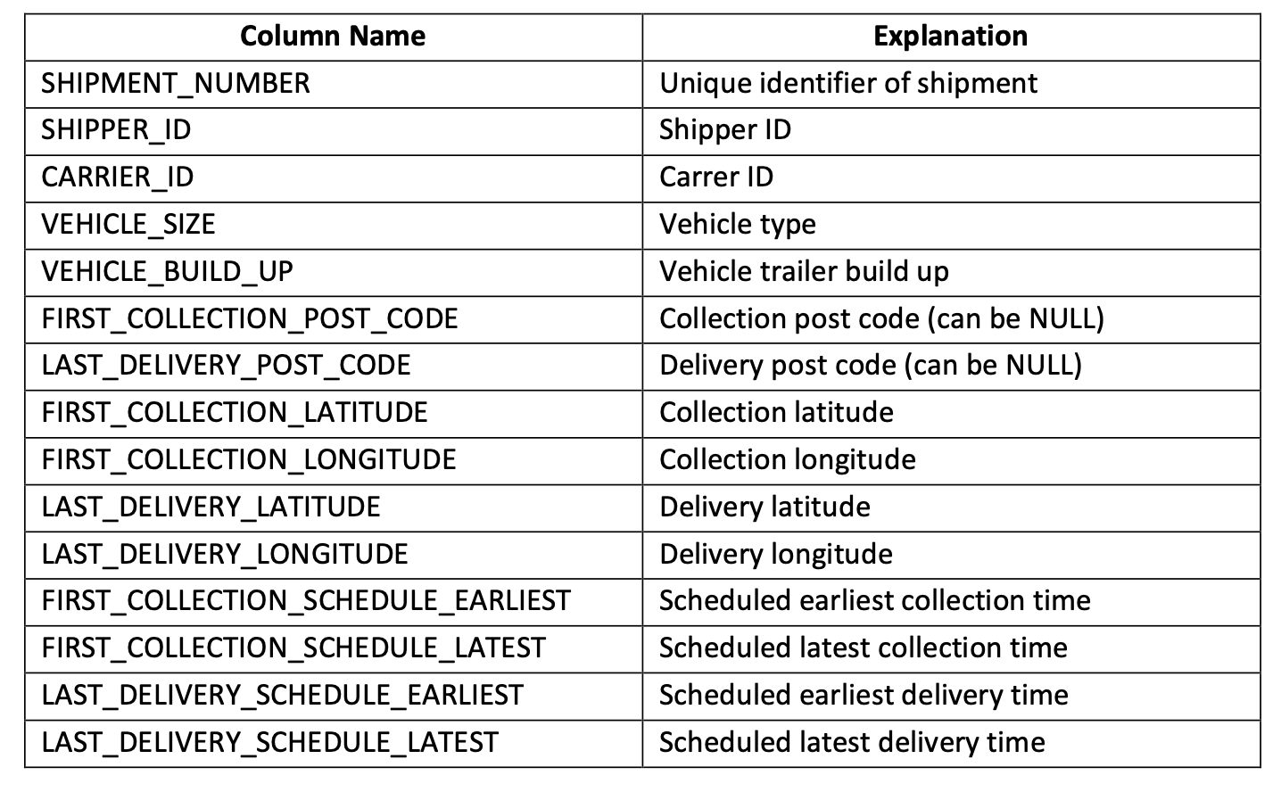
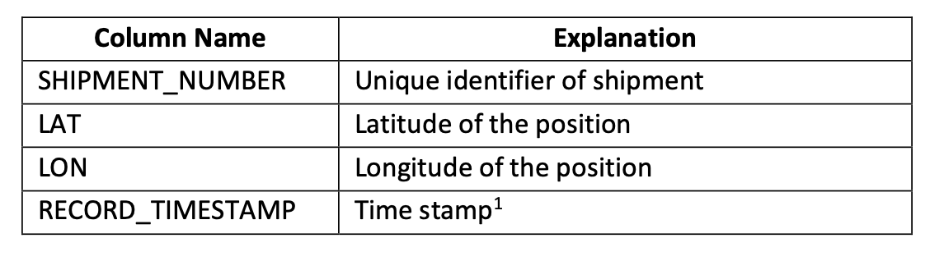

Data explanation
GPS data
Shipment data
New booking data

Slide 6
Exploratory Data Analysis & Pre-processing

Slide 7
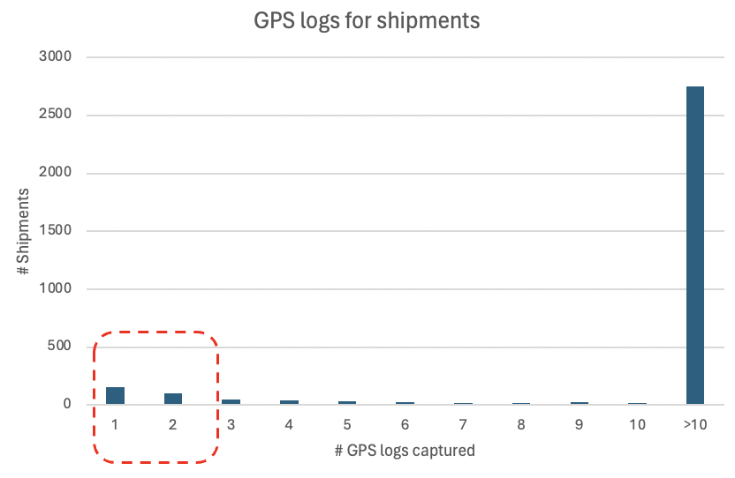
Key findings & summary metrics from GPS and shipment data
GPS data
Shipment data
GPS logs are nothing but capturing latitude and longitude details of the carrier’s location
GPS logs are not always consistently logged for every shipment
1 or 2 logs hinders the analysis to identify the delay in delivery time and also to dive deep into potential delay in live tracking to notify shippers
49 total shippers have made road haulage
3245 shipments are carried out
Shipments done between 1st Oct 2023 to 31st Dec 2023 are 3238
4 different vehicle size:
Tractor
3.5T van
7.5T rigid
18T rigid
26T rigid
13 different vehicle buildup types are used
Pre-processing is done on “Timestamp” format to comply with python understandable format

Slide 8
Task 1: Identifying happy shippers

Slide 9

Date period filter & extracting delivery time from GPS data and assumptions
Date filter
Delivery profiling
Collection
Advanced delivery
On collection time
On delivery time
On-time delivery
+30 mins
Delivery deadline
Since collection time might not always convey the number of successful delivery completion within the set date filter, it makes more sense to consider all delivery completed in the date range (1st oct 2023 to 31st deck 2023)
Late delivery

Slide 10


Challenges in inconsistent GPS logging
Delivery profiling
Incomplete logs which is of no use
Complete logs till delivery deadline
Complete or incomplete logs post delivery deadline indicate POTENTIAL DELAY
1 or 2 logs
+30 mins

Slide 11
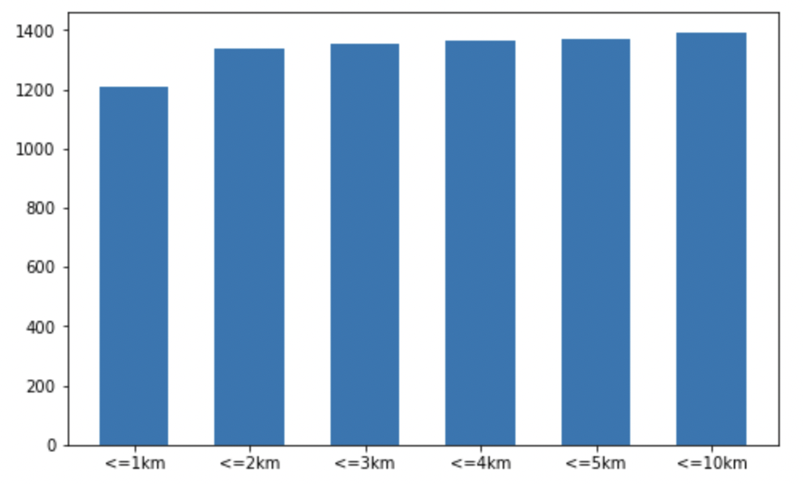
Distance calculation to determine the destination reach details from GPS data
Haversine distance/Google direction API is used to gather additional information – distance & eta
Distance with destination proximity?
Advanced delivery
Shipment delivered?
Latest log for each shipment
Heuristic: Distance<2kms & Time<=threshold time
GPS logs
On-time delivery
Time left to reach destination vs threshold time
Late delivery
- Advanced delivery + on-time delivery = 1333
- Total shipments = 3236 (after removing shipments with incomplete logs, incomplete data and date filter)
% of on-time delivery shipments -> 1333/3236 = 50.04%

Slide 12
Task 2: To whom & when to notify delays

Slide 13

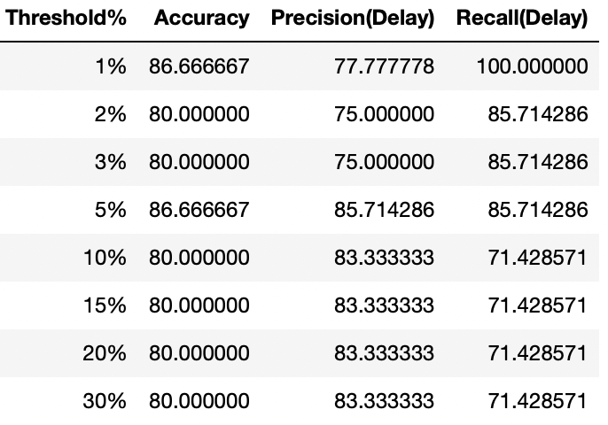
Process flow to solve the delay notification problem
Additional data source: Google direction API is used to gather additional information – distance & eta
Yes
Send notification
Analysis to find the time threshold (x% of total time) to allow as time difference between actual time and google maps ETA, for every GPS log
Heuristic:
(Actual time left by GPS log) – (Google ETA) < 5% of total time estimated?
Shipment + GPS data
Estimated distance
&
ETA
Google direction API
Check heuristic on next GPS log
No
100% coverage using the heuristic-> 84% accuracy (on 5% deviation events in late delivery) + 16% (less than 5% deviation events in late delivery )

Slide 14
Task 3: Predicting likelihood of future delays

Slide 15






Classification of new shipment booking as potential delay expected or not
Data cleaning & Processing
Shipment data
Model files
Prediction
Feature engineering
Train test split
ML classification algorithm
New booking.csv
Stage 1
Stage 2
Stage 3

Slide 16
Technical steps in feature engineering & Model building
The problem statement is treated as a binary classification, since the target variable chosen is delay? (1) or no-delay(0)
List of pre-processing steps to convert text to numeric values are,
Categorical variables – there is no natural ordering in the variables so -> one-hot encoding
Continuous variables – Min-max scaling to bring them all to same dimensions
Additional attributes extracted:
Day of week
Part of day
Week number in a month
Distance estimate to destination
Time estimate to destination
The data is split into Train-test split: 66.66% for training and 33.33% for test

Slide 17
Future work extensions
Different classification algorithms (Decision tree, random forest, Boosted trees, SVM etc)
Deep neural networks for classification
Ensemble approach like max-voting or stacking
Hyper-parameter tuning with grid search can help us to pick the right parameters which delivers the highest success metric
Cross-validation is employed to avoid restricting the performance measure to one single split
Additional data attributes that could be potentially used:
Weather information for the day in the travel route
Traffic information expected in the route
Diversions or re-route information
No of other collection or deliveries included in the travel

Slide 18




High level design for model deployment
Cloud infrastructure (AWS/GCP/Azure)
Docker container
Model development/retrain
End point creation
Inference store
Data warehouse
Deploy
Notification service
Model monitoring
(MLFlow/weights&biases/Neptune.ai)
Event trigger/time trigger (like AWS lambda)
Local Model development/retrain
push
Build image

Slide 19





Programming tools
Python
Python Machine learning library
Google direction API
Microsoft Excel
Presentation

Slide 20
Potential computing resources
Local machine configuration (Dev/Test):
OS: Mac OS Monterey
Processor: M1
RAM: 16GB
Storage: 250GB
Free cloud computation (Dev/Test):
Google Collaboratory
CPU, GPU and TPU support
Subject to availability
Cloud computation (Dev/Test/Deploy):
Amazon EC2 instances based on required
Cost as per AWS pricing
Will opt for this only in case of big data not handled by previous two options

Slide 21
Code walkthrough

Slide 22
Conclusion

Slide 23

Conclusion
Task 1: Identifying happy customers
Task 2: To whom and when to notify delay
Task 3: Likelihood estimation of future delays on new booking dataset
Presentation explaining all the analysis and findings
High level design for model deployment
Use additional data sources in the analysis
Code with all best PEP8 standards of python

Slide 24
Thank you

