Slide 1

Chain Super King (CSK)
Marketplace Solution
Code Gladiators 2019
Babu
Karthik

Slide 2
Executive Summary
Marketplace Solution is a distributed ledger system which enables cattle and cow milk trading business in a trustable manner using Blockchain immutable features through which the history of cattle and cow milk have been maintained for farmers and Dairy companies to review before they trade.
This solution address the challenges faced in the cattle trading market and create a trust between the farmers ( Buyer and seller) and the Dairy Companies.
This system also keeps the history of the cattle health certificate record which is verified by government authorized veterinary doctors and that enables the trading business more trustable.

Slide 3
Marketplace Solution
Marketplace solution based on distributed ledger technology to sell or purchase cattle. The stakeholders involved in the marketplace solution are as mentioned below –
(1) Farmers - Seller / Buyer of cattle, (2) Veterinarians - Confirms the health certificate of the cattle uploaded by farmers, (3) Government - Provides digital identity of the farmers with digital signature.

Slide 4
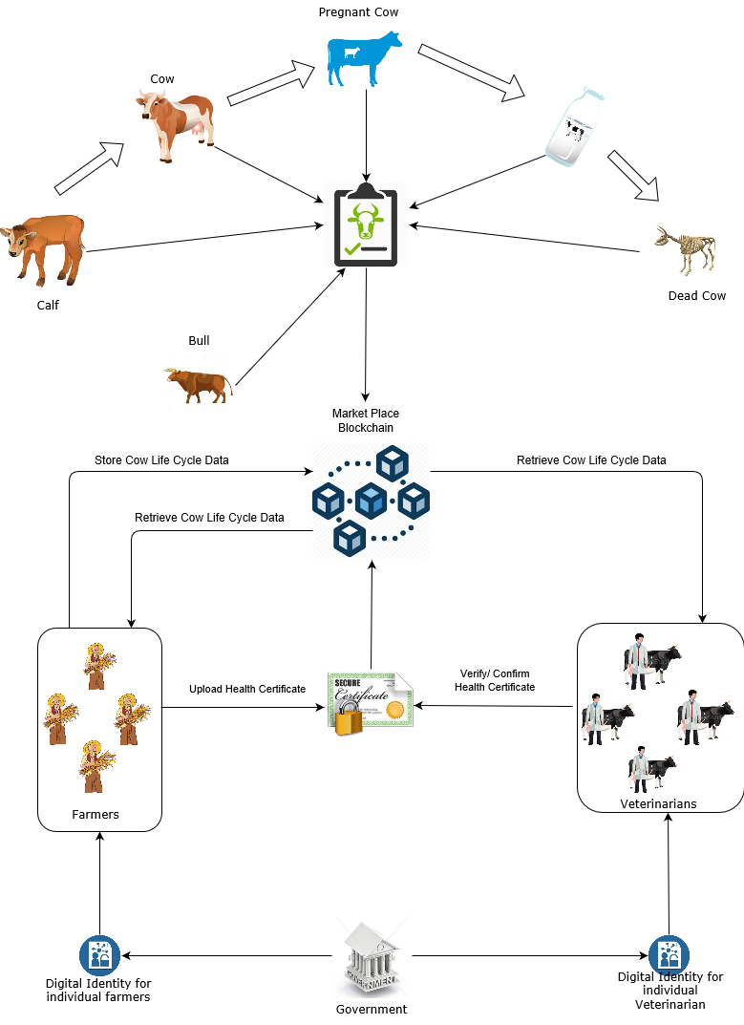
Immutable Animal Registration and Lifecycle Maintenance

Slide 5
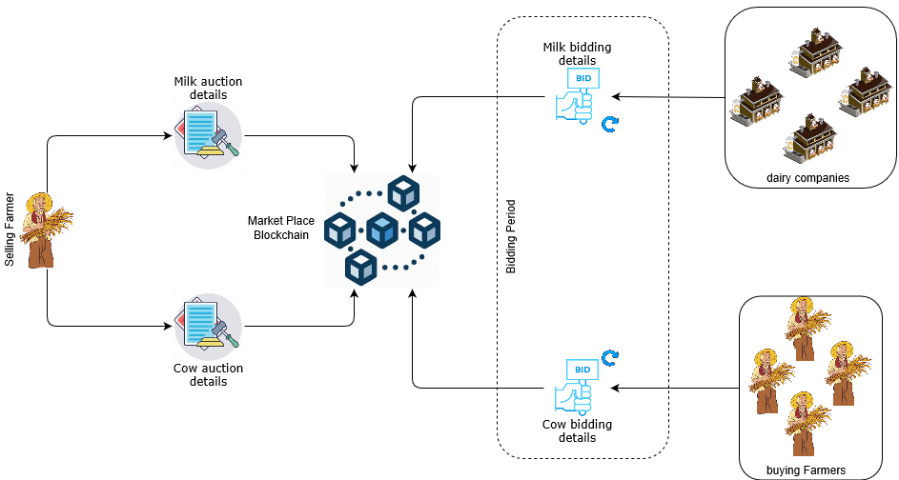
Cattle and Cow Milk Auction

Slide 6
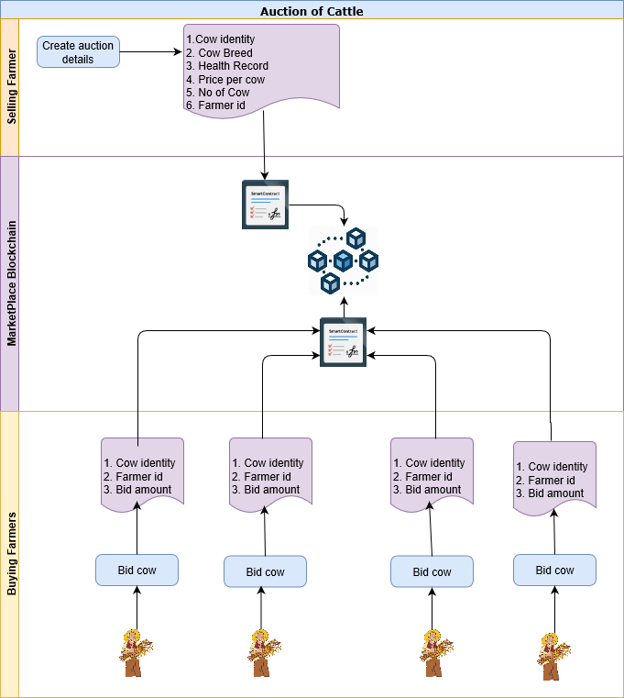
Cattle and Cow Milk Auction

Slide 7
Demonstration of fairness in Trade
Seller has authority to eliminate the buyer from participating in the trading based on the rating.
Certificate uploaded by farmer will be analyzed by ML algorithm against IoT data and then it forwards for authorization to the Veterinarian
If any former found doing unfair trading, their certificate will be moved to CRL (Certificate Revocation List)

Slide 8
Unfair Trade Practices (UTP) in Dairy
In Contract content
Dairy company has favourable contract cancellation norms than farmers
No security for farmers if the dairy company fails to fulfill the contract
Unilateral price set by the Dairy company
During contract execution
Dairy company fails or refuse to collect the milk
Dairy company didn’t follow the agreed payment process
Farmer fail to fulfill the accepted quality/quantity of milk

Slide 9
Auction metrics for ML model
To identify fair Farmers (Sellers)
No of Auction
Average Rating <=3
Average Rating >= 3
Auction success rate
Average no of bidders
Number of rejected certificates
To identify fair auction
Buyer Rating
Success Status
No of bidders

Slide 10
Approach
Actors | Method Name | Approach
Cattle Life Cycle Management
Farmer | RegisterFarmer RegisterCow UpdateCowStatus | Farmer coming into Blockchain network should get register themselves with Government Provided Digital Id and also farmer should register there COW details. Farmer can update the status of the cow periodically on checkup and upload the health certificate accordingly
Veterinary | RegisterDoctor VerifyCowHealth | Veterinary Doctor who has been authorized to verify and approve the Cow health certificate enrolls into blockchain network. Once Farmer registers cow in the network with Heath certificate, the Govt. approved Veterinary Doctor will review the certificate and provide the status check result.
Auction of Cattle
Farmer | AddCowSaleListing | If the Farmer wants to sell the cow, he can add the cow to Sale Listing and schedule a time period to make bidding, by which at the highest bidder can own the cow. The initial price will be set by the Farmer(seller).
 | MakeBid | Other Farmers can make bid to buy the cow.
 | CloseBidding | After the scheduled time completes bidding gets stop and the Farmer with highest Bid gets the ownership of the cow.
 | GetFeedback | After every Auction the Blockchain system will ask for feedback about seller from buyer, which will be sent to Machine learning system and it provides a rating to the seller.

Slide 11
Technology Stack
In PoC : ( To provide the model solution quickly )
Hyperledger Fabric
Hyperledger Composer
Angular JS
In Actual Implementation:
Hyperledger Fabric
SmartContract using (NodeJS, Java Script )
Fabric SDK
AngularJS

Slide 12
Why our team is the best!
CSK team has one Product Owner and one Blockchain technical expert. Success of a complete solution is when the solution undergo technical verification as well as business verification and validations.
CSK done both with some limitations on this PoC.

Slide 13
Associated attachments/ files
Please find below source code archive which contains,
Hyperledger Composer Source code
Angular UI source code
Fabric setup tools
Marketplace Smart Contract
https://github.com/karthicktm/Market-Place/blob/master/market-place-contract.zip
Marketplace UI
https://github.com/karthicktm/Market-Place/blob/master/market-place-ui.zip

Slide 14
Thank you

Slide 15
Appendix

Slide 16
Possible Improvements
More validations and verifications on identity check and Health certificate
Out of the box thinking like
selling dead cow meat and skin
Monitoring Cow health through IoT sensors
Machine Learning on cow milk extract from each stages of cow.
More business logics in Smart Contract to refine the solution.

