Slide 1
PANDAS

Slide 2
WHAT IS PANDAS
Pandas is used for data manipulation, analysis and cleaning. Python pandas is well suited for different kinds of data, such as:
Tabular data with heterogeneously-typed columns
Ordered and unordered time series data
Arbitrary matrix data with row & column labels
Unlabelled data
Any other form of observational or statistical data sets
INSTALL PANDAS
pip install pandas
conda install pandas
simply import it by typing:
import pandas as pd

Slide 3
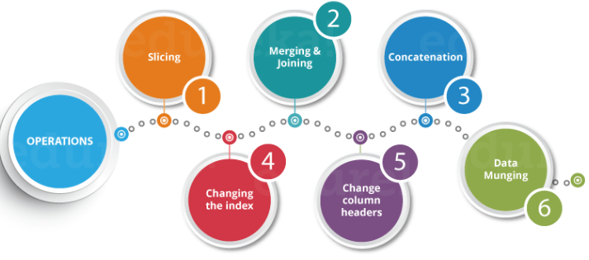
Python Pandas Operations
Using Python pandas, you can perform a lot of operations with series, data frames, missing data, group by etc. Some of the common operations for data manipulation are listed below:

Slide 4
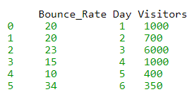
Slicing the Data Frame
In order to perform slicing on data, you need a data frame.
data frame is a 2-dimensional data structure and a most common pandas object. So first, let’s create a data frame.
import pandas as pd
XYZ_web= {'Day':[1,2,3,4,5,6], "Visitors":[1000, 700,6000,1000,400,350], "Bounce_Rate":[20,20, 23,15,10,34]}
df= pd.DataFrame(XYZ_web)
print(df)

Slide 5
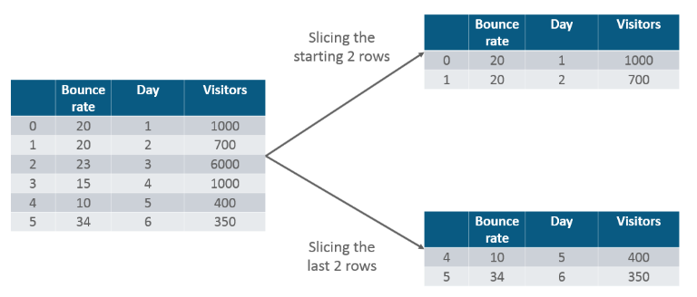
The code above will convert a dictionary into a pandas Data Frame along with index to the left. Now, let us slice a particular column from this data frame. Refer the image below:
TASK:DISPLAY FIRST TWO LINES ALONE.

Slide 6
Merging & Joining
In merging, you can merge two data frames to form a single data frame. You can also decide which columns you want to make common. first we will create three data frames, which has some key-value pairs and then merge the data frames together. Refer the code below:
import pandas as pd
df1= pd.DataFrame({ "HPI":[80,90,70,60],"Int_Rate":[2,1,2,3],"IND_GDP":[50,45,45,67]}, index=[2001, 2002,2003,2004])
df2=pd.DataFrame({ "HPI":[80,90,70,60],"Int_Rate":[2,1,2,3],"IND_GDP":[50,45,45,67]}, index=[2005, 2006,2007,2008])
merged= pd.merge(df1,df2)
print(merged)

Slide 7
Merge as single column
dummy_data1 = {
'id': ['1', '2', '3', '4', '5'],
'Feature1': ['A', 'C', 'E', 'G', 'I'],
'Feature2': ['B', 'D', 'F', 'H', 'J']}
df1 = pd.DataFrame(dummy_data1, columns = ['id', 'Feature1', 'Feature2'])
Df1
dummy_data2 = {
'id': ['1', '2', '6', '7', '8'],
'Feature1': ['K', 'M', 'O', 'Q', 'S'],
'Feature2': ['L', 'N', 'P', 'R', 'T']}
df2 = pd.DataFrame(dummy_data2, columns = ['id', 'Feature1', 'Feature2'])
Df2
df_merge_col = pd.merge(df1,df2,on='id')
df_merge_col

Slide 8
joining
df1 = pd.DataFrame({"Int_Rate":[2,1,2,3], "IND_GDP":[50,45,45,67]}, index=[2001, 2002,2003,2004])
df2 = pd.DataFrame({"Low_Tier_HPI":[50,45,67,34],"Unemployment":[1,3,5,6]}, index=[2001, 2003,2004,2004])
joined= df1.join(df2)
print(joined)

Slide 9
Concatenation
Concatenation basically glues the dataframes together. You can select the dimension on which you want to concatenate. For that, just use “pd.concat” and pass in the list of dataframes to concatenate together. Consider the below example.
df1 = pd.DataFrame({"HPI":[80,90,70,60],"Int_Rate":[2,1,2,3], "IND_GDP":[50,45,45,67]}, index=[2001, 2002,2003,2004])
df2 = pd.DataFrame({"HPI":[80,90,70,60],"Int_Rate":[2,1,2,3],"IND_GDP":[50,45,45,67]}, index=[2005, 2006,2007,2008])
concat= pd.concat([df1,df2])
print(concat)

Slide 10
Change the index
let us create a dataframe with some key value pairs in a dictionary and change the index values.
import pandas as pd
df= pd.DataFrame({"Day":[1,2,3,4], "Visitors":[200, 100,230,300], "Bounce_Rate":[20,45,60,10]})
df.set_index("Day", inplace= True)
print(df)

Slide 11
Change the Column Headers
Let us take the same example, where we will change the column header from “Visitors” to “Users”.
import pandas as pd
df = pd.DataFrame({"Day":[1,2,3,4], "Visitors":[200, 100,230,300], "Bounce_Rate":[20,45,60,10]})
df = df.rename(columns={"Visitors":"Users"})
print(df)

Slide 12
Data Munging
In Data munging, you can convert a particular data into a different format. For example, if you have a .csv file, you can convert it into .html or any other data format as well.
import pandas as pd
country= pd.read_csv("D:UsersAayushiDownloadsworld-bank-youth-unemploymentAPI_ILO_country_YU.csv",index_col=0)
country.to_html('edu.html')
Once you run this code, a HTML file will be created named “edu.html”. You can directly copy the path of the file and paste it in your browser which displays the data in a HTML format.

Slide 13
For reference
https://bitbucket.org/hrojas/learn-pandas/src/master/
http://pandas.pydata.org/pandas-docs/stable/getting_started/tutorials.html

