Slide 1

Big Data

Slide 2
Spark
Spark is an-open source computational framework that, like MapReduce, processes and analyzes huge amounts of data using commodity servers. MapReduce is on its way out in many places, with Spark increasingly becoming the go-to processing framework in Hadoop environments.
Four things set Spark apart from its predecessor:
Speed, ease of use, a general purpose framework and built-in sophisticated analytical capabilities.
Spark’s API lets developers create distributed applications that make use of a cluster’s resources without having to know all the low-level details about how to allocate the cluster’s resources among the various applications.
Spark started as a research project in 2009, and its creators started the company named Databricks to promote and commercialize Spark.

Slide 3
Spark
Spark was explicitly designed to overcome the inefficiency of the MapReduce model in performing interactive and iterative computations.
Spark supports a wide variety of workloads, including batch processing, streaming, business intelligence, graphs and machine learning.
You can run Spark on clusters of thousands of nodes (the largest known Spark cluster has 8,000 nodes).
In large clusters, Spark has successfully worked with multiple petabytes of data.
In a Hadoop cluster, Spark and MapReduce can be used side-by-side to provide distributed data processing.
We can run Spark on the same nodes as we run MapReduce, with YARN managing both processing frameworks, or we can dedicate some of the nodes in a Hadoop cluster exclusively to Spark.

Slide 4
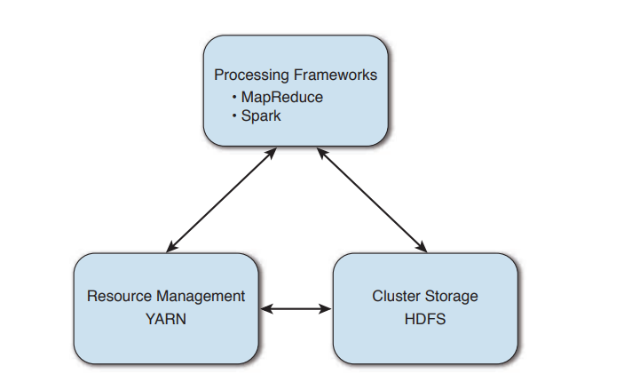
Spark
Demerits of Map Reduce
Programmability: MapReduce requires several chaining steps to perform certain workloads.
MapReduce writes intermediate data to disk between each computational step. This makes it quite inefficient for applications such as interactive analytics and iterative algorithms to reuse the data. Most machine learning algorithms tends to be iterative by design, making multiple passes over the same data.

Slide 5
Benefits of Spark over MapReduce
Speed
Hadoop is based on the idea that processing should move to where the data is, and Spark adds more power to this basic idea by processing data in memory and using execution plans to organize its work.
Some of the reasons for Spark’s speed superiority over Hadoop MapReduce include the following:
Use of memory for data storage. (Unlike MapReduce, which uses memory purely for computation, Spark uses it for both computing and for data storage during application processing.)
Less expensive shuffle.
Fewer I/O synchronization barriers.
We can write Spark applications in Scala, Python or Java

Slide 6
Spark’s Advanced Execution Engine
Spark uses a much more sophisticated job execution engine than MapReduce. MapReduce has limited optimization capabilities, as it always creates a DAG with the same two stages—map and reduce—for all jobs.
If you want to perform advanced computation using complex algorithms, you need to split the job into multiple jobs and sequentially execute each of the jobs.
With Spark, unlike in MapReduce, you aren’t limited to two stages per job, you can have any number of stages you want. Instead of splitting complex algorithms into multiple jobs, you can run jobs with multiple stages. This is a huge difference, leading to several optimizations not possible with MapReduce.
Since Spark is aware that a job has multiple stages it uses this information to optimize the job execution—for example, by minimizing the shuffling of data and disk I/O.

Slide 7
Spark’s In Memory Computation
I/O latency, which is the delay in transferring data from disk to memory, is always a significant component of the total job execution time.
A MapReduce job often reads and writes data from and to disk multiple times in the course of its execution. You can implement the same job in Spark where it reads just once from disk.
Once it reads the data, Spark caches the data in memory for further processing steps, thus minimizing disk I/O. Since reading from memory is at least 100 times faster than reading from disk, performance is increased dramatically.
Spark is used for
Batch processing
Interactive analysis
Stream processing
Machine learning
Graph computing

Slide 8
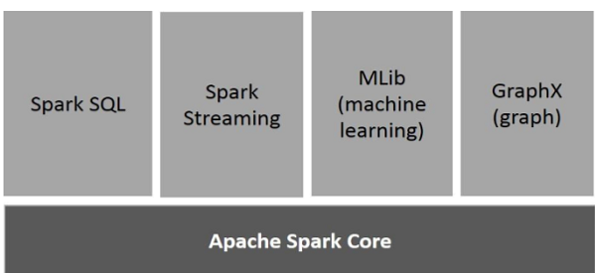
Components of Spark
Apache Spark Core
Spark Core is the underlying general execution engine for spark platform that all other functionality is built upon. It provides In-Memory computing and referencing datasets in external storage systems.
Spark SQL
Spark SQL is a component on top of Spark Core that introduces a new data abstraction called SchemaRDD, which provides support for structured and semi-structured data.

Slide 9
Components of Spark
Spark Streaming
Spark Streaming leverages Spark Core's fast scheduling capability to perform streaming analytics. It ingests data in mini-batches and performs RDD (Resilient Distributed Datasets) transformations on those mini-batches of data.
MLlib (Machine Learning Library)
MLlib is a distributed machine learning framework above Spark because of the distributed memory-based Spark architecture. Spark MLlib is nine times as fast as the Hadoop disk-based version of Apache Mahout (before Mahout gained a Spark interface).
GraphX
GraphX is a distributed graph-processing framework on top of Spark. It provides an API for expressing graph computation that can model the user-defined graphs by using Pregel abstraction API. It also provides an optimized runtime for this abstraction.

Slide 10
Resilient Distributed Datasets
Resilient Distributed Datasets (RDD) is a fundamental data structure of Spark. It is an immutable distributed collection of objects. Each dataset in RDD is divided into logical partitions, which may be computed on different nodes of the cluster.
RDDs can contain any type of Python, Java, or Scala objects, including user-defined classes. Formally, an RDD is a read-only, partitioned collection of records. RDDs can be created through deterministic operations on either data on stable storage or other RDDs. RDD is a fault-tolerant collection of elements that can be operated on in parallel.
There are two ways to create RDDs − parallelizing an existing collection in your driver program, or referencing a dataset in an external storage system, such as a shared file system, HDFS, HBase, or any data source offering a Hadoop Input Format.
Spark makes use of the concept of RDD to achieve faster and efficient MapReduce operations.

Slide 11
Data Sharing using Spark RDD
Data sharing is slow in MapReduce due to replication, serialization, and disk IO. Most of the Hadoop applications, they spend more than 90% of the time doing HDFS read-write operations.
Recognizing this problem, researchers developed a specialized framework called Apache Spark.
The key idea of spark is Resilient Distributed Datasets (RDD); it supports in-memory processing computation. This means, it stores the state of memory as an object across the jobs and the object is sharable between those jobs. Data sharing in memory is 10 to 100 times faster than network and Disk.

Slide 12
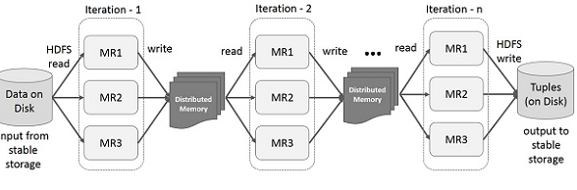
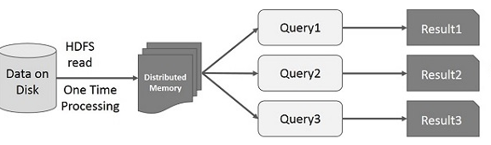
Data Sharing using Spark RDD
Iterative Operations on Spark RDD
It will store intermediate results in a distributed memory instead of Stable storage (Disk) and make the system faster.
Interactive Operations on Spark RDD

Slide 13
/etc/hosts
MASTER-IP master
SLAVE01-IP slave01
SLAVE02-IP slave02
……………………..
Spark Installation
$ tar –zxf spark-2.4.1-bin-hadoop2.7.tgz
$ sudo mv spark-2.4.1-bin.-hadoop2.7 spark
$ sudo mv spark /opt/
$ sudo chown –R hadoop:hadoop /opt/spark
$ sudo chmod –R 755 /opt/spark
Configure ssh
ssh-keygen -t rsa -P “”
Copy the content of .ssh/id_rsa.pub (of master) to .ssh/authorized_keys (of all the slaves as well as master)
sudo apt-get install scala
vi .bashrc
export JAVA_HOME=<path-of-Java-installation> (eg: /usr/lib/jvm/java-7-oracle/)
export SPARK_HOME=<path-to-the-root-of-your-spark-installation>
(eg: /opt/spark/)
export PATH=$PATH:$SPARK_HOME/bin
Create the log and tmp directories for Spark.
$ sudo mkdir –p /var/log/spark
$ sudo chown –R Hadoop:Hadoop /var/log/spark
$ sudo mkdir /tmp/spark

Slide 14
Spark Installation
Edit spark-env.sh
Now edit configuration file spark-env.sh (in $SPARK_HOME/conf/) and set following parameters:
Note: Create a copy of template of spark-env.sh and rename it:
cp spark-env.sh.template spark-env.sh
$cd /opt/spark
$ sudo mv spark/conf/* /etc/spark
$ sudo ln –s /etc/spark conf

Slide 15
Spark Installation
Finally, configure Spark to work with Hadoop and also to use its new log and
tmp directories that is created in the previous step.
$ cd /etc/spark
vi spark-env.sh
export HADOOP_CONF_DIR=/opt/hadoop/etc/hadoop
export YARN_CONF_DIR=/opt/mycompany/hadoop/etc/hadoop
export SPARK_LOG_DIR=/var/log/spark
export SPARK_WORKER_DIR=/tmp/spark"
export JAVA_HOME=<path-of-Java-installation> (eg: /usr/lib/jvm/java-7-oracle/)
export SPARK_WORKER_CORES=8

Slide 16
Spark Installation
Include slaves
/etc/slaves
slave01
slave02
Apache Spark has been installed successfully on Master, now deploy Spark on all the Slaves.
Install Spark On Slaves
Setup Prerequisites on all the slaves.
Run following steps on all the slaves (or worker nodes):
scp /etc/hosts to all slaves.
scp /etc/slaves to all nodes…
Install Java.
Install Scala.
Copy setups from master to all the slaves:
Create tarball of configured setup
tar czf spark.tar.gz spark-2.4.0-bin-hadoop2.7
Run this command on Master
Copy the configured tarball on all the slaves
scp spark.tar.gz slave0?:~
Un-tar configured spark setup on all the slaves :tar xzf spark.tar.gz

Slide 17
Spark Installation
Now Start the daemons on the Cluster
Start Spark Cluster (On Master)
Start Spark Services
sbin/start-all.sh
Check whether services have been started: Check daemons on Master
jps
Master
Check daemons on Slaves
jps
Worker
Spark Web UI
Spark Master UI
Browse the Spark UI to know about worker nodes, running application, cluster resources.
http://MASTER-IP:8080/
Spark application UI
http://MASTER-IP:4040/
Stop the Cluster
sbin/stop-all.sh

Slide 18
Spark
Now that the installation is complete, test it by running a local pyspark interpreter:
Spark Shell
Spark provides an interactive shell − a powerful tool to analyze data interactively. It is available in either Scala or Python language. Spark’s primary abstraction is a distributed collection of items called a Resilient Distributed Dataset (RDD). RDDs can be created from Hadoop Input Formats (such as HDFS files) or by transforming other RDDs.
$ spark-shell
Key Spark Files
Spark’s installation directories include the following:
bin contains the executable files such as the program that starts the Spark shell.
core, streaming and others contain the source code for the major Spark components.
examples contains useful Spark standalone jobs you can use to learn Spark.

Slide 19
Spark Run Modes
Local Mode
The local mode uses just a single server and so is a non-distributed mode. When running Spark locally you can run it with a single worker thread or with multiple worker threads. The local mode is really just for development and testing.
Cluster Mode
A cluster manager is an external service that helps acquire resources on a cluster.
There are three types of clusters on which Spark can be run:
Spark standalone cluster
Apache Mesos: This is the original platform that was supported by Spark and is not as commonly used as the next alternative, YARN.
Hadoop YARN: Spark can be run side by side with other application frameworks such as MapReduce and Impala.
Regardless of which cluster manager you use, a Spark application works the same, since the applications don’t care about how you manage the cluster—the Spark API is quite independent of the cluster manager you choose to use.

Slide 20
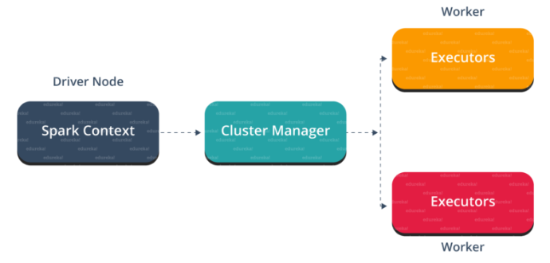
Architecture of the Standalone Cluster Manager
The standalone cluster manager uses worker and master processes to perform computations.
The worker process manages the computing resources such as CPU/RAM on each of a cluster’s nodes. The master node pools the resources and allocates them to competing applications.
Spark application that you deploy on a standalone cluster manger uses the following
entities:
Driver program: This is the main Spark application that consists of the data processing logic.
Executor: This is a JVM process that runs on each worker node and processes the jobs that the driver program submits.
Task: A task is a subcomponent of a data processing job.
Note
A Spark application and the driver program are used as synonyms for each other.

Slide 21
Spark
What actually happens when we execute code through Spark?
How does Apache Spark run on our cluster?
The Architecture of a Spark Application
The high level components of a Spark application include
the Spark driver,
the Spark executors and
the Cluster Manager.
The Spark driver is really the process that is in the driver seat of your Spark Application. It controls the execution of a Spark application and maintains all of the state of the Spark cluster, which includes the state and tasks of the executors.
The driver must interface with the cluster manager in order to get physical resources and launch executors.
To put this in simple terms, this process is just a process on a physical machine that is responsible for maintaining the state of the application running on the cluster.

Slide 22
Spark
The Architecture of a Spark Application
The high level components of a Spark application include
the Spark driver,
the Spark executors and
the Cluster Manager.
The Spark executors are the processes that perform the tasks assigned by the Spark driver.
They have one responsibility, take the tasks assigned to them by the driver, run them and report back their state and results.
Each Spark Application will have its own separate executor processes.
Cluster Manager
This is responsible for maintaining a cluster of machines that will run your Spark Application.
Cluster managers have their own ‘driver’ and ‘worker’ abstractions, but the difference is that these are tied to physical machines rather than processes.

Slide 23
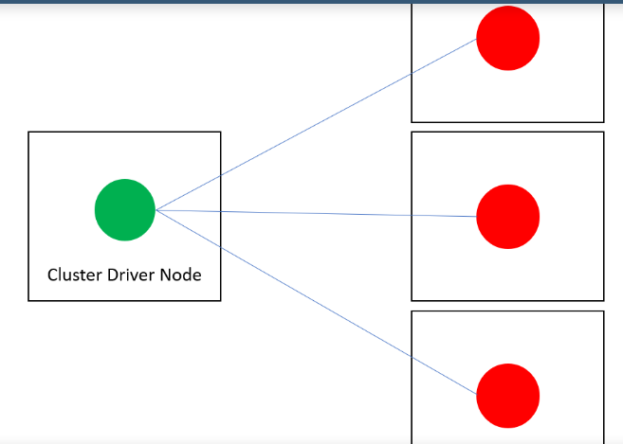

Spark
The Architecture of a Spark Application
Execution Modes
Cluster Mode,
Client Mode and
Local Mode.
In cluster mode, A user submits a pre-complied JAR to the cluster manager.
The cluster manager then launches the driver process on a worker node inside the cluster, in addition to the executor processes.
The cluster manager is responsible for maintaining all Spark Application related processes.

Slide 24
Spark
Client mode is almost the same as cluster mode, however the Spark driver remains on the client machine that submitted the application.
This means that the client machine is responsible for maintaining the Spark driver process and the cluster manager maintains the executor processes.
Local mode is very different from both cluster and client modes. Local mode runs the entire Spark Application on a single machine and it achieves parallelism through threads on that single machine.
We use this mode as a way to learn Spark, test applications or just experiment with Spark.

Slide 25
Spark
The Life cycle of a Spark Application outside of Spark
Submit an actual application in the form of a pre-complied JAR or library.
Execute code on your local machine and make a request to the cluster manager driver node.
Spark driver starts process and the cluster manager places the driver onto a node in the cluster.
The client then executes the process and the application starts running on the cluster.
./bin/spark-spark submit --class <main-class> --master <master-url> --deploy-mode cluster --conf <key>=<value> <application-jar>
Once the driver process has been placed on the cluster, it begins running our code.
This should include a SparkSession that initializes a Spark cluster.
SparkSession will communicate with the cluster manager, asking it to launch Spark executor processes across our cluster.
The number of executors and relevant configurations are set by the user via command-line arguments in the original spark-submit call.

Slide 26
Spark
The Life cycle of a Spark Application outside of Spark
We now have a Spark Cluster that will execute our code.
The driver and the workers will communicate with each other to execute our code and move the data around.
Each worker will be scheduled with tasks by the driver and will respond with the status of those tasks whether they failed or not.
After a Spark Application finishes, the driver process exits with either the task succeeding or failing.
The Cluster Manager will then shut down the executors in that Spark cluster for the driver and we can see whether the Spark Application failed or succeeded by asking the cluster manager.

Slide 27
Spark
Apache Spark is shipped with an interactive shell/scala prompt, as the spark is developed in Scala.
Using the interactive shell we will run different commands (RDD transformation/action) to process the data.
The command to start the Apache Spark Shell: $bin/spark-shell
$ spark-shell
Create a new RDD
Read File from local filesystem and create an RDD.
scala> val data = sc.textFile(“data.txt”)
Note: sc is the object of SparkContext
b) Create an RDD through Parallelized Collection
scala> val no = Array(1, 2, 3, 4, 5, 6, 7, 8, 9, 10)
scala> val noData = sc.parallelize(no)
c) From Existing RDDs
scala> val newRDD = no.map(data => (data * 2))
Number of Items in the RDD
scala> data.count()

Slide 28
Spark
$ spark-shell
Filter Operation
scala> val DFData = data.filter(line => line.contains(“NIELIT”))
Transformation and Action together
For complex requirements, we can chain multiple operations together like filter transformation and count action together:
scala> data.filter(line => line.contains(“NIELIT")).count()
Read the first item from the RDD
To read the first item from the file, you can use the following command:
scala> data.first()
Read the first 5 item from the RDD
To read the first 5 item from the file, you can use the following command:
scala> data.take(5)

Slide 29
Spark
RDD Partitions
An RDD is made up of multiple partitions, to count the number of partitions:
scala> data.partitions.length
Note: Minimum no. of partitions in the RDD is 2 (by default). When we create RDD from HDFS file then a number of blocks will be equals to the number of partitions.
Cache the file
Caching is the optimization technique. Once we cache the RDD in the memory all future computation will work on the in-memory data, which saves disk seeks and improve the performance.
scala> data.cache()
RDD will not be cached once you run above operation, you can visit the web UI:
http://localhost:4040/storage, it will be blank.
Let’s run some actions
scala> data.count(); scala> data.collect()
==➔ The Operation will be executed in Memory , thus faster.

Slide 30
Spark
Read Data from HDFS file
To read data from HDFS file we can specify complete hdfs URL like hdfs://IP:PORT/PATH
scala> var hFile = sc.textFile("hdfs://localhost or IP:9000/inp")
Spark WordCount Program in Scala
One of the most popular operations of MapReduce – Wordcount. Count all the words available in the file.
scala>val wc=hFile.flatMap(line=>line.split(“ ”)).map(word=>(word, 1)).reduceByKey(_ + _)
Read the result on console
scala> wc.take(5) ➔ It will display first 5 results
Write the data to HDFS file
scala> wc.saveAsTextFile("hdfs://localhost or :9000/out")

Slide 31
Spark on a Hadoop Cluster
scala>sc.textFile("hdfs://192.168.1.145:9000/user/hadoop/input/wordcount.txt"). flatMap(
_.split("\\W+")).map( w => (w,1)). reduceByKey( (a,b) => (a+b)).foreach(println)
The following steps show how to download the zipped files in the gzip format (.gz) and load them into HDFS.
1. Download the files:
$ wget –r ftp://ftp.ncdc.noaa.gov/pub/data/noaa/
2. Load the downloaded data into HDFS:
$ hdfs dfs –put ftp.ncdc.noaa.gov/pub/data/noaa weather/
3. Start the Spark shell and load the data for the year 1919 into an RDD:
scala> val weatherFileRDD = sc.wholeTextfiles
("hdfs://localhost:9000/user/hadoop/weather/1919")
4. To avoid recomputation each time you access it, you can cache the data in the RDD:
scala> val weatherRDD = weatherFileRDD.cache

Slide 32
Spark on a Hadoop Cluster
5. Load the first element of the data set:
scala> val firstElement = weatherRDD.first
6. Read the value for the first element of the RDD:
scala> val firstValue = firstElement._2
7. Split firstValue by lines:
scala> Val firstVals = firstValue.split(\\n)
8. Wind speed occupies positions 66-69 in the text of the weather data files.
You can find the wind speed by doing this:
scala> val windSpeed = firstVals.map(line => line.substring(65,69))
scala> windspeed.saveAsTextFile("hdfs://192.168.1.145:9000/user/hadoop/output")

Slide 33
Spark-Python
./pyspark
Apache Spark is written in Scala programming language.
To support Python with Spark, Apache Spark Community released a tool, PySpark. Using PySpark, you can work with RDDs in Python programming language also.
It is because of a library called Py4j that they are able to achieve this.
PySpark offers PySpark Shell which links the Python API to the spark core and initializes the Spark context.
SparkContext is the entry point to any spark functionality. When we run any Spark application, a driver program starts, which has the main function and your SparkContext gets initiated here. The driver program then runs the operations inside the executors on worker nodes.
SparkContext uses Py4J to launch a JVM and creates a JavaSparkContext.

Slide 34
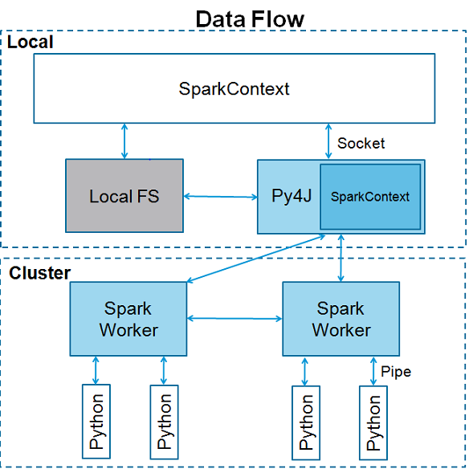

Spark-Python

Slide 35
Spark-Python
>>> textFile = spark.read.text("README.md")
>>>textFile.count()
>>> textFile.first() # First row in this DataFrame
>>> linesWithSpark = textFile.filter(textFile.value.contains("Spark"))
>>> textFile.filter(textFile.value.contains("Spark")).count()
# How many lines contain "Spark"?
>>>from pyspark.sql.functions import *
>>> textFile.select(size(split(textFile.value, "\s+"))
.name("numWords")).agg(max(col("numWords"))).collect()
>>> wordCounts = textFile.select(explode(split(textFile.value, "\s+"))
.alias("word")).groupBy("word").count()
##Here, we use the explode function in select, to transform a Dataset of lines to a
Dataset of words, and then combine groupBy and count to compute the per-word
counts in the file as a DataFrame of 2 columns: “word” and “count”.

Slide 36
Spark-Python
To collect the word counts in our shell, we can call collect:
>>>wordCounts.collect()
Caching
Spark also supports pulling data sets into a cluster-wide in-memory cache. This is very useful when data is accessed repeatedly.
>>> linesWithSpark.cache()
>>> linesWithSpark.count()

Slide 37
Spark-Python
-------------SimpleApp.py-------------
from pyspark.sql import SparkSession
logFile = “$SPARK_HOME/README.md"
# Should be some file on your system
spark = SparkSession.builder.appName("SimpleApp").getOrCreate()
logData = spark.read.text(logFile).cache()
numAs = logData.filter(logData.value.contains('a')).count()
numBs = logData.filter(logData.value.contains('b')).count()
print("Lines with a: %i, lines with b: %i" % (numAs, numBs))
spark.stop()
$python SimpleApp.py
We can run this application using the bin/spark-submit script:
# Use spark-submit to run your application
$ SPARK_HOME/bin/spark-submit --master local[4] SimpleApp.py

Slide 38
Spark-Python
For Scala and Java, use run-example:
./bin/run-example SparkPi
# For Python examples, use spark-submit directly:
./bin/spark-submit examples/src/main/python/pi.py
# For R examples, use spark-submit directly:
./bin/spark-submit examples/src/main/r/dataframe.R

Slide 39
Spark-Python
The following code block has the details of a PySpark class and the parameters, which a SparkContext can take.
class pyspark.SparkContext (
master = None,
appName = None,
sparkHome = None,
pyFiles = None,
environment = None,
batchSize = 0,
serializer = PickleSerializer(),
conf = None,
gateway = None,
jsc = None,
profiler_cls = <class 'pyspark.profiler.BasicProfiler'>
)
Master − 192.168.1.145
appName − Name of your job.
sparkHome − Spark installation directory.
pyFiles − The .zip or .py files to send to the cluster.
Environment − Worker nodes environment variables.
batchSize − Set 1 to disable batching, 0 to automatically choose the batch size based on object sizes, or -1 to use an unlimited batch size.
……..

Slide 40
Spark-Python
Among the above parameters, master and appname are mostly used. The first two lines of any PySpark program looks as shown below −
from pyspark import SparkContext
sc = SparkContext("local", "First App")
<<< logFile = "file:///opt/hadoop/spark/README.md"
<<< logData = sc.textFile(logFile).cache()
<<< numAs = logData.filter(lambda s: 'a' in s).count()
<<< numBs = logData.filter(lambda s: 'b' in s).count()
<<< print "Lines with a: %i, lines with b: %i" % (numAs, numBs)
Lines with a: 62, lines with b: 30

Slide 41
Spark-Python
----------------------------------------firstapp.py----------------------------
from pyspark import SparkContext
logFile = "file://opt/hadoop/spark/README.md"
sc = SparkContext("local", "first app")
logData = sc.textFile(logFile).cache()
numAs = logData.filter(lambda s: 'a' in s).count()
numBs = logData.filter(lambda s: 'b' in s).count()
print "Lines with a: %i, lines with b: %i" % (numAs, numBs)
$SPARK_HOME/bin/spark-submit firstapp.py
Output: Lines with a: 62, lines with b: 30

Slide 42
RDD
At a high level, every Spark application consists of a driver program that runs the user’s main function and executes various parallel operations on a cluster.
The main abstraction Spark provides is a resilient distributed dataset (RDD), which is a collection of elements partitioned across the nodes of the cluster that can be operated on in parallel.
RDD stands for Resilient Distributed Dataset, these are the elements that run and operate on multiple nodes to do parallel processing on a cluster.
RDDs are immutable elements, which means once you create an RDD you cannot change it. RDDs are fault tolerant as well, hence in case of any failure, they recover automatically. You can apply multiple operations on these RDDs to achieve a certain task.
A second abstraction in Spark is shared variables that can be used in parallel operations. By default, when Spark runs a function in parallel as a set of tasks on different nodes, it ships a copy of each variable used in the function to each task.
Spark supports two types of shared variables: broadcast variables, which can be used to cache a value in memory on all nodes, and accumulators, which are variables that are only “added” to, such as counters and sums.

Slide 43
RDD
Spark applications in Python can either be run with the bin/spark-submit script which includes Spark at runtime, or by including it in your setup.py as:
install_requires=[
'pyspark=={site.SPARK_VERSION}'
]
If you wish to access HDFS data, you need to use a build of PySpark linking to your version of HDFS. Prebuilt packages are also available on the Spark homepage for common HDFS versions.
Finally, you need to import some Spark classes into your program. Add the following line:
from pyspark import SparkContext, SparkConf
PySpark requires the same minor version of Python in both driver and workers.

Slide 44
RDD
Initializing Spark
from pyspark import SparkContext, SparkConf
conf = SparkConf().setAppName(appName).setMaster(master)
sc = SparkContext(conf=conf)
$ ./bin/pyspark --master local[4] --py-files code.py
To apply operations on these RDD's, there are two ways −
Transformation and
Action

Slide 45
RDD
Transformation − These are the operations, which are applied on a RDD to create a new RDD. Filter, groupBy and map are the examples of transformations.
Action − These are the operations that are applied on RDD, which instructs Spark to perform computation and send the result back to the driver.

Slide 46
RDD
Let us see how to run a few basic operations using PySpark. The following code in a Python file creates RDD words, which stores a set of words mentioned.
------------------------------count.py---------------------------------------
from pyspark import SparkContext
sc = SparkContext("local", "count app")
words = sc.parallelize (
["scala", "java", "hadoop", "spark", "akka", "spark vs hadoop",
"pyspark", "pyspark and spark"]
)
counts = words.count()
print "Number of elements in RDD -> %i" % (counts)
----------------------------------------count.py-----------------------------------
$SPARK_HOME/bin/spark-submit count.py
Number of elements in RDD → 8

Slide 47
RDD
collect(); All the elements in RDD are returned….
------------------------------collect.py---------------------------------------
……….as previous………………
col1 = words.collect()
print "Elements in RDD -> %s" % (coll)
----------------------------------------count.py-----------------------------------
$SPARK_HOME/bin/spark-submit collect.py
Output:
Elements in RDD -> [
'scala',
'java',
'hadoop',
'spark',
'akka',
'spark vs hadoop',
'pyspark',
'pyspark and spark'
]
foreach(f)
Returns only those elements which meet the condition of the function inside foreach.
foreach.py
-------------
…..As in previous example……
def f(x): print(x)
fore = words.foreach(f)

Slide 48
RDD
filter(f)
Output:
Scala
java
hadoop
spark
akka
spark vs hadoop
pyspark
pyspark and spark
A new RDD is returned containing the elements, which satisfies the function inside the filter.
----------------------------------------filter.py-------------------------
from pyspark import SparkContext
sc = SparkContext("local", "Filter app")
words = sc.parallelize (
["scala", "java", "hadoop", "spark", "akka","spark vs hadoop",
"pyspark","pyspark and spark"]
)
words_filter = words.filter(lambda x: 'spark' in x)
filtered = words_filter.collect()
print "Fitered RDD -> %s" % (filtered)
$SPARK_HOME/bin/spark-submit filter.py
Output − The output for the above command is −
Fitered RDD -> [ 'spark', 'spark vs hadoop', 'pyspark', 'pyspark and spark']

Slide 49
RDD: map(f)
A new RDD is returned by applying a function to each element in the RDD. In the following example, we form a key value pair and map every string with a value of 1.
----------------------------------------map.py--------------------------------
from pyspark import SparkContext
sc = SparkContext("local", "Map app")
words = sc.parallelize (
["scala", "java", "hadoop", "spark", "akka","spark vs hadoop", "pyspark", "pyspark and spark"]
)
words_map = words.map(lambda x: (x, 1))
mapping = words_map.collect()
print "Key Value Pair -> %s" % (mapping)
$SPARK_HOME/bin/spark-submit map.py
Output − The output for the above command is −
Key Value Pair -> [ ('spark’,1), ( 'spark vs hadoop’,1),('pyspark’,1), ('pyspark and spark,1)]

Slide 50
RDD: reduce(f)
After performing the specified commutative and associative binary operation, the element in the RDD is returned.
----------------------------------------reduce.py---------------------------------------
from pyspark import SparkContext
from operator import add
sc = SparkContext("local", "Reduce app")
nums = sc.parallelize([1, 2, 3, 4, 5])
adding = nums.reduce(add)
print "Adding all the elements -> %i" % (adding)
----------------------------------------reduce.py---------------------------------------
$SPARK_HOME/bin/spark-submit reduce.py
Output − The output for the above command is −
Adding all the elements -> 15

Slide 51
RDD: join()
It returns RDD with a pair of elements with the matching keys and all the values for that particular key.
--------------------------join.py---------------------
from pyspark import SparkContext
sc = SparkContext("local", "Join app")
x = sc.parallelize([("spark", 1), ("hadoop", 4)])
y = sc.parallelize([("spark", 2), ("hadoop", 5)])
joined = x.join(y)
final = joined.collect()
print "Join RDD -> %s" % (final)
--------------------join.py---------------------------
Output:
Join RDD -> [
('spark', (1, 2)),
('hadoop', (4, 5))
]
$SPARK_HOME/bin/spark-submit join.py

Slide 52
RDD: cache()
Persist this RDD with the default storage level (MEMORY_ONLY). We can also check if the RDD is cached or not.
-------------cache.py----------
from pyspark import SparkContext
sc = SparkContext("local", "Cache app")
words = sc.parallelize (
["scala",
"java",
"hadoop",
"spark",
"akka",
"spark vs hadoop",
"pyspark",
"pyspark and spark"]
)
words.cache()
caching = words.persist().is_cached
print "Words got chached > %s" % (caching)
-----------------cache.py---------------
$SPARK_HOME/bin/spark-submit cache.py
Words got cached -> True

Slide 53
Broadcast & Accumulator
For parallel processing, Apache Spark uses shared variables. A copy of shared variable goes on each node of the cluster when the driver sends a task to the executor on the cluster, so that it can be used for performing tasks.
There are two types of shared variables supported by Apache Spark-
Broadcast
Accumulator
Broadcast
Broadcast variables are used to save the copy of data across all nodes. This variable is cached on all the machines and not sent on machines with tasks.
class pyspark.Broadcast (
sc = None,
value = None,
pickle_registry = None,
path = None
)
A Broadcast variable has an attribute called value, which stores the data and is used to return a broadcasted value.

Slide 54
Usage of Broadcast
----------------------------------------broadcast.py------------------
from pyspark import SparkContext
sc = SparkContext("local", "Broadcast app")
words_new = sc.broadcast(["scala", "java", "hadoop", "spark", "akka"])
data = words_new.value
print "Stored data -> %s" % (data)
elem = words_new.value[2]
print "Printing a particular element in RDD -> %s" % (elem)
---------------------broadcast.py-----------------------------
$SPARK_HOME/bin/spark-submit broadcast.py
Stored data -> [
'scala',
'java',
'hadoop',
'spark',
'akka'
]
Printing a particular element in RDD -> hadoop

Slide 55
Accumulator
Accumulator variables are used for aggregating the information through associative and commutative operations. For example, you can use an accumulator for a sum operation or counters (in MapReduce).
An Accumulator variable has an attribute called value that is similar to what a broadcast variable has. It stores the data and is used to return the accumulator's value, but usable only in a driver program.
--------------------accumulator.py-----------------
from pyspark import SparkContext
sc = SparkContext("local", "Accumulator app")
num = sc.accumulator(10)
def f(x):
global num
num+=x
rdd = sc.parallelize([20,30,40,50])
rdd.foreach(f)
final = num.value
print "Accumulated value is -> %i" % (final)
Accumulated value is -> 150

Slide 56
How to run Spark Application on local/cluster ?
PySpark - SparkConf
To run a Spark application on the local/cluster, we need to set a SparkConf.
class pyspark.SparkConf (
loadDefaults = True,
_jvm = None,
_jconf = None
)
Following are some of the most commonly used attributes of SparkConf −
set(key, value) − To set a configuration property.
setMaster(value) − To set the master URL.
setAppName(value) − To set an application name.
get(key, defaultValue=None) − To get a configuration value of a key.
setSparkHome(value) − To set Spark installation path on worker nodes.

Slide 57
How to run Spark Application on local/cluster ?
The following code block has the lines, when they get added in the Python file, it sets the basic configurations for running a PySpark application.
-------------------------------------------------------------------------------------------------------------
from pyspark import SparkConf, SparkContext
conf = SparkConf().setAppName("PySpark App").setMaster("spark://HadoopMaster:7077")
sc = SparkContext(conf=conf)
PySpark – SparkFiles
In Apache Spark, we can upload files using sc.addFile (sc is your default SparkContext) and get the path on a worker using SparkFiles.get.
Thus, SparkFiles resolve the paths to files added through SparkContext.addFile().
SparkFiles contain the following classmethods −
get(filename)
getrootdirectory()

Slide 58
How to run Spark Application on local/cluster ?
get(filename)
It specifies the path of the file that is added through SparkContext.addFile().
getrootdirectory()
It specifies the path to the root directory, which contains the file that is added through the SparkContext.addFile().
----------------------------------------sparkfile.py------------------------------------
from pyspark import SparkContext
from pyspark import SparkFiles
finddistance = "/opt/hadoop/examples/finddistance.R"
finddistancename = "finddistance.R"
sc = SparkContext("local", "SparkFile App")
sc.addFile(finddistance)
print "Absolute Path -> %s" % SparkFiles.get(finddistancename)
----------------------------------------sparkfile.py------------------------------------
$SPARK_HOME/bin/spark-submit sparkfiles.py
Absolute Path ->
/tmp/spark-f1170149-af01-4620-9805-f61c85fecee4/userFiles-641dfd0f-240b-4264-a650-4e06e7a57839/finddistance.R

Slide 59
Storage Level
StorageLevel decides how RDD should be stored. In Apache Spark, StorageLevel decides whether RDD should be stored in the memory or should it be stored over the disk, or both. It also decides whether to serialize RDD and whether to replicate RDD partitions.
Example
class pyspark.StorageLevel(useDisk, useMemory, useOffHeap, deserialized, replication = 1)
DISK_ONLY = StorageLevel(True, False, False, False, 1)
DISK_ONLY_2 = StorageLevel(True, False, False, False, 2)
MEMORY_AND_DISK = StorageLevel(True, True, False, False, 1)
MEMORY_AND_DISK_2 = StorageLevel(True, True, False, False, 2)
MEMORY_AND_DISK_SER = StorageLevel(True, True, False, False, 1)
MEMORY_AND_DISK_SER_2 = StorageLevel(True, True, False, False, 2)
MEMORY_ONLY = StorageLevel(False, True, False, False, 1)
MEMORY_ONLY_2 = StorageLevel(False, True, False, False, 2)
MEMORY_ONLY_SER = StorageLevel(False, True, False, False, 1)
MEMORY_ONLY_SER_2 = StorageLevel(False, True, False, False, 2)
OFF_HEAP = StorageLevel(True, True, True, False, 1)

Slide 60
Storage Level
-----------------------------------storagelevel.py-------------------------------------
from pyspark import SparkContext
import pyspark
sc = SparkContext ("local", "storagelevel app")
rdd1 = sc.parallelize([1,2])
rdd1.persist( pyspark.StorageLevel.MEMORY_AND_DISK_2 )
rdd1.getStorageLevel()
print(rdd1.getStorageLevel())
$SPARK_HOME/bin/spark-submit storagelevel.py
Disk Memory Serialized 2x Replicated

Slide 61
Serialization
Serialization is used for performance tuning on Apache Spark. All data that is sent over the network or written to the disk or persisted in the memory should be serialized. Serialization plays an important role in costly operations.
PySpark supports custom serializers for performance tuning.
The following two serializers are supported by PySpark −
MarshalSerializer
Serializes objects using Python’s Marshal Serializer. This serializer is faster than PickleSerializer, but supports fewer datatypes.
class pyspark.MarshalSerializer
PickleSerializer
Serializes objects using Python’s Pickle Serializer. This serializer supports nearly any Python object, but may not be as fast as more specialized serializers.
class pyspark.PickleSerializer

Slide 62
Serialization
Example: MarshalSerializer.
--------------------------------------serializing.py-------------------------------------
from pyspark.context import SparkContext
from pyspark.serializers import MarshalSerializer
sc = SparkContext("local", "serialization app", serializer = MarshalSerializer())
print(sc.parallelize(list(range(1000))).map(lambda x: 2 * x).take(10))
sc.stop()
--------------------------------------serializing.py-------------------------------------
$SPARK_HOME/bin/spark-submit serializing.py
[0, 2, 4, 6, 8, 10, 12, 14, 16, 18]

Slide 63
RDD: map(f) & flatMap(f)
map returns RDD of equal number of elements while flatMap may not.
flatMap Filter out missing or incorrect data.
a.csv
1
2
3
-
4
-
5
map.py
from operator import *
def f(row):
try:
return float(row)
except Exception:
return 0
rdd = sc.textFile('a.csv').map(f)
print(rdd.count()) # 7
print(rdd.reduce(add)) # 15.0
flatmap.py
from operator import *
def f(row):
try:
return [float(row)]
except Exception:
return [ ]
rdd = sc.textFile('a.csv').flatMap(f)
print(rdd.count()) # 5
print(rdd.reduce(add)) # 15.0
****When you use flatMap, a "multi-dimensional" collection becomes "one-dimensional" collection.

Slide 64
RDD: map(f) & flatMap(f)
****When you use flatMap, a "multi-dimensional" collection becomes "one-dimensional" collection.
val array1d = Array ("1,2,3", "4,5,6", "7,8,9")
//array1d is an array of strings
val array2d = array1d.map(x => x.split(","))
//array2d will be : Array( Array(1,2,3), Array(4,5,6), Array(7,8,9) )
val flatArray = array1d.flatMap(x => x.split(","))
//flatArray will be : Array (1,2,3,4,5,6,7,8,9)

Slide 65
Launching Spark on YARN
Ensure HADOOP_CONF_DIR or YARN_CONF_DIR points to the directory which contains the (client side) configuration files for the Hadoop cluster.
./bin/spark-submit --class org.apache.spark.examples.SparkPi \
--master yarn \
--deploy-mode cluster \
--driver-memory 4g \
--executor-memory 2g \
--executor-cores 1 \
--queue thequeue \
examples/jars/spark-examples*.jar \
To launch a Spark application in client mode, do the same, but replace cluster with client.
spark-submit --master yarn --deploy-mode cluster SPARK_HOME/lib/pi.py 10

Slide 66
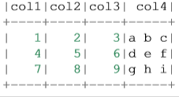
PROGRAMMING WITH RDDS
Create RDD
from pyspark.sql import SparkSession
spark = SparkSession .builder .appName("Python Spark create RDD example") .config("spark.some.config.option", "some-value").getOrCreate()
df = spark.sparkContext.parallelize([(1, 2, 3, 'a b c'), (4, 5, 6, 'd e f'), (7, 8, 9, 'g h i')]).toDF(['col1', 'col2', 'col3','col4’])
df.show()
Notes:
https://spark.apache.org/docs/latest/rdd-programming-guide.html#using-the-shell

