Slide 1
Abstraction

Slide 2
What is abstraction
Abstraction is a process of hiding the implementation details from the user. Оnly the functionality will be provided to the user. In Java, abstraction is achieved using abstract classes and interfaces.

Slide 3
All programming languages provide abstractions. It can be argued that the complexity of the problems you’re able to solve is directly related to the kind and quality of abstraction. An essential element of object-oriented programming is an abstraction. Humans manage complexity through abstraction. When you drive your car you do not have to be concerned with the exact internal working of your car(unless you are a mechanic). What you are concerned with is interacting with your car via its interfaces like steering wheel, brake pedal, accelerator pedal etc. Various manufacturers of car have different implementation of the car working but its basic interface has not changed (i.e. you still use the steering wheel, brake pedal, accelerator pedal etc to interact with your car). Hence the knowledge you have of your car is abstract.

Slide 4
A powerful way to manage abstraction is through the use of hierarchical classifications. This allows you to layer the semantics of complex systems, breaking them into more manageable pieces. From the outside, a car is a single object. Once inside, you see that the car consists of several subsystems: steering, brakes, sound system, seat belts, heating, cellular phone, and so on. In turn, each of these subsystems is made up of more specialized units. For instance, the sound system consists of a radio, a CD player, and/or a tape player. The point is that you manage the complexity of the car (or any other complex system)through the use of hierarchical abstractions.

Slide 5
An abstract class is something which is incomplete and you can not create an instance of the abstract class. If you want to use it you need to make it complete or concrete by extending it. A class is called concrete if it does not contain any abstract method and implements all abstract method inherited from abstract class or interface it has implemented or extended. By the way, Java has a concept of abstract classes, abstract method but a variable can not be abstract in Java.

Slide 6
Let's take an example of Java Abstract Class called Vehicle. When I am creating a class called Vehicle, I know there should be methods like start() and Stop() but don't know start and stop mechanism of every vehicle since they could have different start and stop mechanism e.g some can be started by a kick or some can be by pressing buttons.

Slide 7
The advantage of Abstraction is if there is a new type of vehicle introduced we might just need to add one class which extends Vehicle Abstract class and implement specific methods. The interface of start and stop method would be same.

Slide 8
package oopsconcept;
public abstract class VehicleAbstract { public abstract void start();
public void stop(){ System.out.println("Stopping Vehicle in abstract class");
}
} class TwoWheeler extends VehicleAbstract{ @Override //
public void start()
{ System.out.println("Starting Two Wheeler");
w
}
}
class FourWheeler extends VehicleAbstract{ @Override// public void start()
{
System.out.println("Starting Four Wheeler");
} }

Slide 9
package oopsconcept; public class VehicleTesting
{
public static void main(String[] args)
{
VehicleAbstract my2Wheeler = new TwoWheeler(); VehicleAbstract my4Wheeler = new FourWheeler(); my2Wheeler.start(); my2Wheeler.stop(); my4Wheeler.start(); my4Wheeler.stop();
}
}

Slide 10
Encapsulation

Slide 11
The whole idea behind encapsulation is to hide the implementation details from users. If a data member is private it means it can only be accessed within the same class. No outside class can access private data member (variable) of other class.
However if we setup public getter and setter methods to update (for example void setSSN(int ssn))and read (for example int getSSN()) the private data fields then the outside class can access those private data fields via public methods.
This way data can only be accessed by public methods thus making the private fields and their implementation hidden for outside classes. That’s why encapsulation is known as data hiding. .

Slide 12
Example of Encapsulation in Java
public class Mobile {
private String manufacturer;
private String operating_system;
public String model;
private int cost;
//Constructor to set properties/characteristics of object
Mobile(String man, String o,String m, int c)
{
this.manufacturer = man;
this.operating_system=o;
this.model=m;
this.cost=c;
} //Method to get access Model property of Object
public String getModel()
{
return this.model;
}
// We can add other method to get access to other properties
}

Slide 13
class EncapsulationDemo{
private int ssn;
private String empName;
private int empAge;
//Getter and Setter methods public int getEmpSSN()
{ return ssn;
}
public String getEmpName()
{
return empName;
}
public int getEmpAge()
{
return empAge;
}
public void setEmpAge(int newValue)
{
empAge = newValue;
}
public void setEmpName(String newValue)
{
empName = newValue;
}
public void setEmpSSN(int newValue)
{
ssn = newValue;
} }
public class EncapsTest{ public static void main(String args[])
{
EncapsulationDemo obj = new EncapsulationDemo();
obj.setEmpName("Mario"); obj.setEmpAge(32); obj.setEmpSSN(112233); System.out.println("Employee Name: " + obj.getEmpName()); System.out.println("Employee SSN: " + obj.getEmpSSN()); System.out.println("Employee Age: " + obj.getEmpAge()); } }

Slide 14
In above example all the three data members (or data fields) are private,which cannot be accessed directly. These fields can be accessed via public methods only. Fields empName, ssn and empAge are made hidden data fields using encapsulation technique of OOPs.

Slide 15
Interface and Abstract class

Slide 16
What is interface
An interface is just like Java Class, but it only has static constants and abstract method. Java uses Interface to implement multiple inheritance. A Java class can implement multiple Java Interfaces. All methods in an interface are implicitly public and abstract.

Slide 17
Syntax for Declaring Interface
interface {
//methods
}

Slide 18
To use an interface in your class, append the keyword "implements" after your class name followed by the interface name.
Example for Implementing Interface
class Dog implements Pet
interface RidableAnimal extends Animal, Vehicle

Slide 19
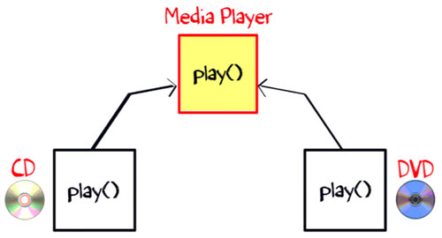
Why is an Interface required?
To understand the concept of Java Interface better, let see an example. The class "Media Player" has two subclasses: CD player and DVD player. Each having its unique implementation method to play music.

Slide 20
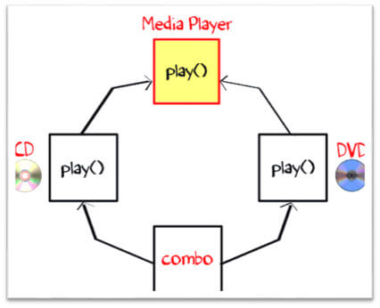
Another class "Combo drive" is inheriting both CD and DVD (see image below). Which play method should it inherit? This may cause serious design issues. And hence, Java does not allow multiple inheritance.

Slide 21
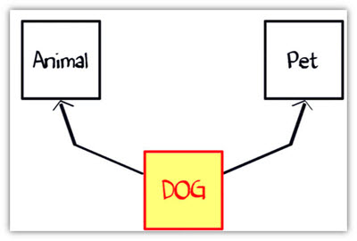
Now let's take another example of Dog.
Suppose you have a requirement where class "dog" inheriting class "animal" and "Pet" (see image below). But you cannot extend two classes in Java. So what would you do? The solution is Interface.

Slide 22
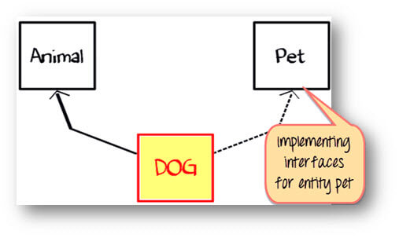
The rulebook for interface says,
An interface is 100% abstract class and has only abstract methods.
Class can implement any number of interfaces.
Class Dog can extend to class "Animal" and implement interface as "Pet".

Slide 23
Java Interface Example:
interface Pet
{
public void test();
}
class Dog implements Pet{
public void test()
{
System.out.println("Interface Method Implemented");
}
public static void main(String args[])
{
Pet p = new Dog();
p.test();
} }

Slide 24
Difference between Class and Interface
Class | Interface
In class, you can instantiate variable and create an object. | In an interface, you can't instantiate variable and create an object.
Class can contain concrete(with implementation) methods | The interface cannot contain concrete(with implementation) methods
The access specifiers used with classes are private, protected and public. | In Interface only one specifier is used- Public.

Slide 25
When to use Interface and Abstract Class?
Use an abstract class when a template needs to be defined for a group of subclasses
Use an interface when a role needs to be defined for other classes, regardless of the inheritance tree of these classes

Slide 26
Must know facts about Interface
A Java class can implement multiple Java Interfaces. It is necessary that the class must implement all the methods declared in the interfaces.
Class should override all the abstract methods declared in the interface
The interface allows sending a message to an object without concerning which classes it belongs.
Class needs to provide functionality for the methods declared in the interface.
All methods in an interface are implicitly public and abstract
An interface cannot be instantiated
An interface reference can point to objects of its implementing classes
An interface can extend from one or many interfaces. Class can extend only one class but implement any number of interfaces
An interface cannot implement another Interface. It has to extend another interface if needed.
An interface which is declared inside another interface is referred as nested interface
At the time of declaration, interface variable must be initialized. Otherwise, the compiler will throw an error.
The class cannot implement two interfaces in java that have methods with same name but different return type.

Slide 27
What is the use of interface in Java?
As mentioned above they are used for full abstraction. Since methods in interfaces do not have body, they have to be implemented by the class before you can access them. The class that implements interface must implement all the methods of that interface. Also, java programming language does not allow you to extend more than one class, However you can implement more than one interfaces in your class.

Slide 28
To access the interface methods, the interface must be "implemented" (kinda like inherited) by another class with the implements keyword (instead of extends). The body of the interface method is provided by the "implement" class:
// Interface interface Animal { public void animalSound(); // interface method (does not have a body) public void sleep(); // interface method (does not have a body) } // Pig "implements" the Animal interface class Pig implements Animal { public void animalSound() { // The body of animalSound() is provided here System.out.println("The pig says: wee wee"); }
public void sleep() { // The body of sleep() is provided here System.out.println("Zzz"); } } class MyMainClass { public static void main(String[] args) { Pig myPig = new Pig(); // Create a Pig object myPig.animalSound(); myPig.sleep(); } }

