Slide 1
Objects,Classes

Slide 2
What is object
An entity that has state and behavior is known as an object e.g. chair, bike, marker, pen, table, car etc. It can be physical or logical (tangible and intangible). The example of an intangible object is the banking system.

Slide 3
An object has three characteristics:
State: represents the data (value) of an object.
Behavior:represents the behavior (functionality) of an object such as deposit, withdraw, etc.
Identity: An object identity is typically implemented via a unique ID. The value of the ID is not visible to the external user. However, it is used internally by the JVM to identify each object uniquely.

Slide 4
For Example, Pen is an object. Its name is Reynolds; color is white, known as its state. It is used to write, so writing is its behavior.
An object is an instance of a class. A class is a template or blueprint from which objects are created. So, an object is the instance(result) of a class.

Slide 5
What is Class?
A class is an entity that determines how an object will behave and what the object will contain. In other words, it is a blueprint or a set of instruction to build a specific type of object.
class <class_name>{ field; method; }

Slide 6
Declaring/Creating Objects in a Single Step
ClassName objectReference = new ClassName();
Example:
Circle myCircle = new Circle();

Slide 7
Understand the concept of Java Classes and Objects with an example.
Let's take an example of developing a pet management system, specially meant for dogs. You will need various information about the dogs like different breeds of the dogs, the age, size, etc.
Next, list out the common behaviors of these dogs like sleep, sit, eat, etc. So these will be the actions of our software objects.

Slide 8
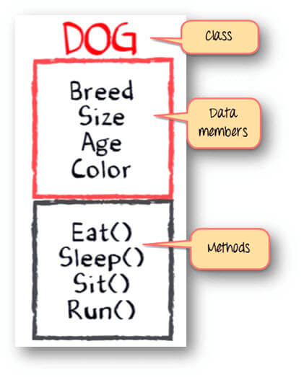
Class - Dogs
Data members or objects- size, age, color, breed, etc.
Methods- eat, sleep, sit and run.

Slide 9
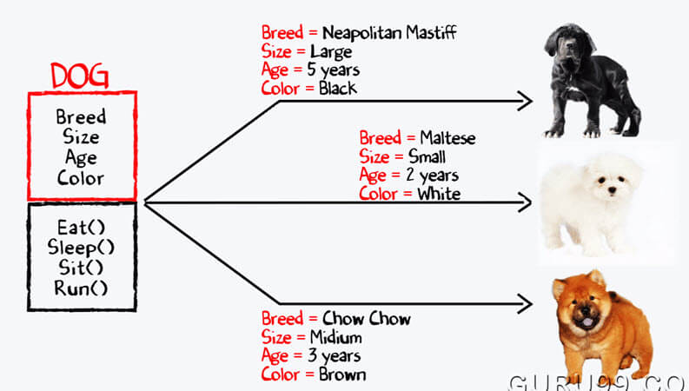
Now, for different values of data members (breed size, age, and color) in Java class, you will get different dog objects.

Slide 10
// Class Declaration public class Dog
{ // Instance Variables
String breed;
String size;
int age;
String color;
// method 1
public String getInfo()
{
return ("Breed is: "+breed+" Size is:"+size+" Age is:"+age+" color is: "+color);
}
public static void main(String[] args)
{
Dog maltese = new Dog();
maltese.breed="Maltese";
maltese.size="Small";
maltese.age=2;
maltese.color="white";
System.out.println(maltese.getInfo());
}
}

Slide 11
Differences between variables of primitive Data types and object types

Slide 12
Copying Variables of Primitive Data Types and Object Types

Slide 13
Garbage Collection
As shown in the previous figure, after the assignment statement c1 = c2, c1 points to the same object referenced by c2. The object previously referenced by c1 is no longer useful. This object is known as garbage. Garbage is automatically collected by JVM.

Slide 14
Garbage Collection, cont
TIP: If you know that an object is no longer needed, you can explicitly assign null to a reference variable for the object. The Java VM will automatically collect the space if the object is not referenced by any variable.

Slide 15
Accessing Objects
Referencing the object’s data:
objectReference.data
myCircle.radius
Invoking the object’s method:
objectReference.method
myCircle.findArea()

Slide 16
Arrays

Slide 17
Array in Java
An array is a group of like-typed variables that are referred to by a common name.
Arrays of any type can be created and may have one or more dimensions.
A specific element in an array is accessed by its index.
Arrays offer a convenient means of grouping related information.

Slide 18
Arrays
An array is an ordered list of values
The entire array
has a single name
Each value has a numeric index
0 1 2 3 4 5 6 7 8 9
scores
79 87 94 82 67 98 87 81 74 91
An array of size N is indexed from zero to N-1
This array holds 10 values that are indexed from 0 to 9

Slide 19
types
One dimensional Array
Multi Dimensional Array

Slide 20
One Dimensional array
A one-dimensional array is, essentially, a list of like-typed variables.
To create an array, you first must create an array variable of the desired type.
Syntax : type var-name[ ];
Example :
int a[10];
String[] attendance;

Slide 21
Declaring Arrays one dimensional arrays
dataType[] arrayName;
Eg: Double[] data;
dataType can be a primitive data type like: int, char, Double, byte etc. or an object (will be discussed in later chapters).
arrayName is an identifier.
Did we defined the array?
data = new Double[10];
Declaring and defining in one line
int[] age = new int[5];

Slide 22
Declared and defined the array
Eg:
class ArrayExample
{
public static void main(String[] args)
{
int[] age = new int[5];
System.out.println(age[0]);
System.out.println(age[1]);
System.out.println(age[2]);
System.out.println(age[3]);
System.out.println(age[4]);
}
}

Slide 23

How to initialize arrays in Java?
int[] age = {12, 4, 5, 2, 5};
class ArrayExample
{
public static void main(String[] args)
{
int[] age = {12, 4, 5, 2, 5};
for (int i = 0; i < 5; ++i)
{ System.out.println("Element at index " + i +": " + age[i]);
}
}
}

Slide 24
Output will be like
Element at index 0: 12
Element at index 1: 4
Element at index 2: 5
Element at index 3: 2
Element at index 4: 5

Slide 25
How to assign value to the specific numeric index
class ArrayExample
{ public static void main(String[] args)
{
int[] age = new int[5];
// insert 14 to third element
age[2] = 14;
// insert 34 to first element
age[0] = 34;
for (int i = 0; i < 5; ++i)
{ System.out.println("Element at index " + i +": " + age[i]);
}
}
}

Slide 26
Write a program to do sum and average of values stored in an array of type int.

Slide 27
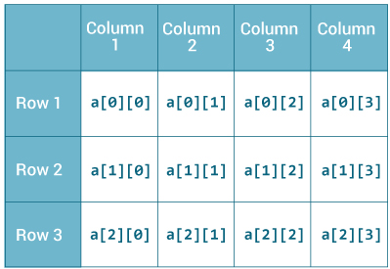
multidimensional arrays
multidimensional arrays are actually arrays of arrays.
int[][] a = new int[3][4]; //two dimensional array

Slide 28
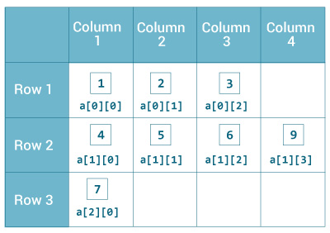
How to initialize a 2d array in Java?
int[][] a = { {1, 2, 3}, {4, 5, 6, 9}, {7}, };

Slide 29
class MultidimensionalArray
{
public static void main(String[] args)
{
int[][] a = { {1, 2, 3}, {4, 5, 6, 9}, {7}, }; System.out.println("Length of row 1: " + a[0].length);
System.out.println("Length of row 2: " + a[1].length);
System.out.println("Length of row 3: " + a[2].length);
}
}

Slide 30
Output will be:
Length of row 1: 3
Length of row 2: 4
Length of row 3: 1

Slide 31
Declaring three dimensional arrays
String[][][] personalInfo = new String[3][4][2];
Here, personalInfo is a 3d array that can hold maximum of 24 (3*4*2) elements of type String.

Slide 32
Initializing 3D array
int[][][] test = { { {1, -2, 3}, {2, 3, 4} }, { {-4, -5, 6, 9}, {1}, {2, 3} } };

Slide 33
Example program
class GFG {
public static void main(String[] args)
{
int[][][] arr = { { { 1, 2 }, { 3, 4 } }, { { 5, 6 }, { 7, 8 } } };
for (int i = 0; i < 2; i++)
for (int j = 0; j < 2; j++)
for (int z = 0; z < 2; z++)
System.out.println("arr[" + i
+ "]["
+ j + "]["
+ z + "] = "
+ arr[i][j][z]);
}
}

