Slide 1
Constructor

Slide 2
What is a Constructor
Constructor is a block of code that initializes the newly created object. A constructor resembles an instance method in java but it’s not a method as it doesn’t have a return type. In short constructor and method are different(More on this at the end of this guide). People often refer constructor as special type of method in Java.

Slide 3
Declaration of constructor
public class MyClass
{ //This is the constructor
MyClass()
{ }
..
}

Slide 4
How does a constructor work
To understand the working of constructor, lets take an example. lets say we have a class MyClass. When we create the object of MyClass like this:
MyClass obj = new MyClass()
The new keyword here creates the object of class MyClass and invokes the constructor to initialize this newly created object.

Slide 5
A simple constructor program in java
public class Hello
{
String name;
//Constructor
Hello()
{
this.name = “Nielit; //
}
public static void main(String[] args)
{
Hello obj = new Hello();
System.out.println(obj.name);
}
}
In this example we have used this keyword, which refers to the current object

Slide 6
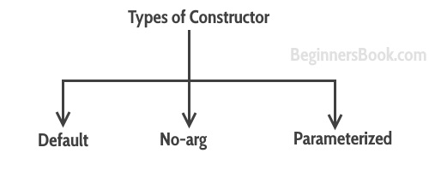
Types of Constructors

Slide 7
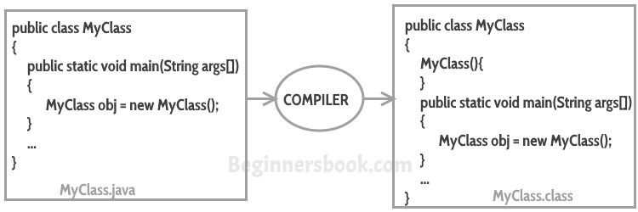
Default constructor
If you do not implement any constructor in your class, Java compiler inserts a default constructorinto your code on your behalf. This constructor is known as default constructor.

Slide 8
no-arg constructor:
Constructor with no arguments is known as no-arg constructor. The signature is same as default constructor, however body can have any code unlike default constructor where the body of the constructor is empty.
class Demo
{
public Demo() //creating constructor
{
System.out.println("This is a no argument constructor");
}
public static void main(String args[])
{
new Demo();
}
}

Slide 9
Parameterized constructor
Constructor with arguments(or you can say parameters) is known as Parameterized constructor.

Slide 10
In this example we have a parameterized constructor with two parameters id and name. While creating the objects obj1 and obj2 I have passed two arguments so that this constructor gets invoked after creation of obj1 and obj2.

Slide 11
Example1
public class Employee
{
int empId;
String empName;
//parameterized constructor with two parameters
Employee(int id, String name)
{
this.empId = id;
this.empName = name;
}
void info()
{
System.out.println("Id: "+empId+" Name: "+empName);
}
public static void main(String args[])
{
Employee obj1 = new Employee(10245,"Chaitanya");
Employee obj2 = new Employee(92232,"Negan");
obj1.info();
obj2.info();
}
}

Slide 12
example2
class Example2
{
private int var;
//default constructor
public Example2()
{
this.var = 10;
}
//parameterized constructor public Example2(int num)
{
this.var = num;
}
public int getValue()
{
return var;
}
public static void main(String args[])
{
Example2 obj = new Example2(); Example2 obj2 = new Example2(100); System.out.println("var is: "+obj.getValue()); System.out.println("var is: "+obj2.getValue());
}
}

Slide 13
What if you implement only parameterized constructor in class
class Example3
{
private int var;
public Example3(int num)
{
var=num;
}
public int getValue()
{
return var;
}
public static void main(String args[])
{
Example3 myobj = new Example3();
System.out.println("value of var is: "+myobj.getValue());
}
}

Slide 14
Output:It will throw a compilation error. The reason is, the statement Example3 myobj = new Example3() is invoking a default constructor which we don’t have in our program. when you don’t implement any constructor in your class, compiler inserts the default constructor into your code, however when you implement any constructor (in above example I have implemented parameterized constructor with int parameter), then you don’t receive the default constructor by compiler into your code.
If we remove the parameterized constructor from the above code then the program would run fine, because then compiler would insert the default constructor into your code.

Slide 15
Constructor Overloading
class A
{
int l,b;
A()
{
l=10; b=20;
}
A(int u,int v)
{
l=u; b=v;
}
int area()
{
return l*b;
}
}
class overconstructdemo
{
public static void main(String args[])
{
A a1=new A();
int r1=a1.area(); System.out.println("The area is: "+r1); A a2=new A(30,40);
int r2=a2.area(); System.out.println("The area is: "+r2); } }

Slide 16
Difference between Constructor and Method
The purpose of constructor is to initialize the object of a class while the purpose of a method is to perform a task by executing java code.
Constructors cannot be abstract, final, static while methods can be.
Constructors do not have return types while methods do.

