Slide 1
OOPs concepts in Java

Slide 2
Object-oriented programming System(OOPs) is a programming paradigm based on the concept of “objects” that contain data and methods.
The primary purpose of object-oriented programming is to increase the flexibility and maintainability of programs.
Object oriented programming brings together data and its behaviour(methods) in a single location(object) makes it easier to understand how a program works.
We will cover each and every feature of OOPs in detail so that you won’t face any difficultly understanding OOPs Concepts.

Slide 3
OOPs Concepts
What is an Object
What is a class
Constructor in Java
modifiers
Object Oriented Programming Features
Abstraction
Encapsulation
Inheritance
Polymorphism
Abstract Class and Methods
Interfaces in Java

Slide 4

What is an Object
Object: is a bundle of data and its behaviour(often known as methods).
Object: is a bundle of data and its behaviour(often known as methods).
Objects have two characteristics: They have states and behaviors.
Examples of states and behaviors Example 1: Object: House State: Address, Color, Area Behavior: Open door, close door

Slide 5
Characteristics of Objects:
Abstraction
Encapsulation
Message passing

Slide 6
Abstraction: Abstraction is a process where you show only “relevant” data and “hide” unnecessary details of an object from the user.
Encapsulation: Encapsulation simply means binding object state(fields) and behaviour(methods) together. If you are creating class, you are doing encapsulation.
Message passing A single object by itself may not be very useful. An application contains many objects. One object interacts with another object by invoking methods on that object. It is also referred to as Method Invocation. See the diagram below.

Slide 7
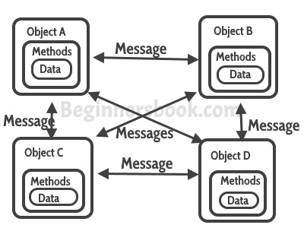

Slide 8
Class

Slide 9
What is class?
A class can be considered as a blueprint using which you can create as many objects as you like. For example, here we have a class Website that has two data members (also known as fields, instance variables and object states). This is just a blueprint, it does not represent any website, however using this we can create Website objects (or instances) that represents the websites. We have created two objects, while creating objects we provided separate properties to the objects using constructor.

Slide 10
Understand the concept of Java Classes and Objects with an example.
Let's take an example of developing a pet management system, specially meant for dogs. You will need various information about the dogs like different breeds of the dogs, the age, size, etc.
Next, list out the common behaviors of these dogs like sleep, sit, eat, etc. So these will be the actions of our software objects.

Slide 11
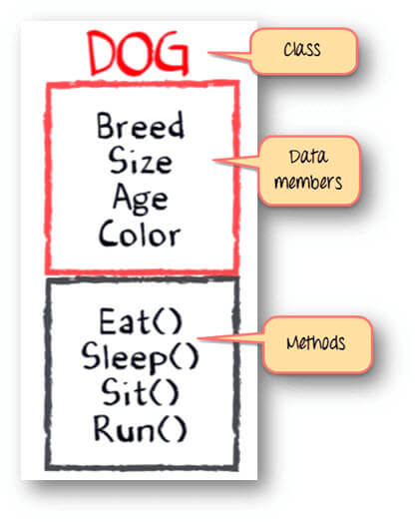
Class - Dogs
Data members or objects- size, age, color, breed, etc.
Methods- eat, sleep, sit and run.

Slide 12
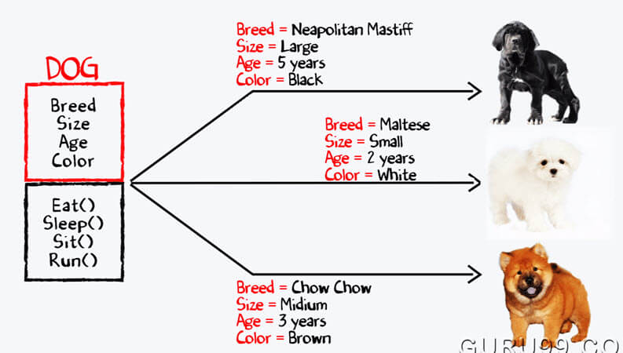
Now, for different values of data members (breed size, age, and color) in Java class, you will get different dog objects.

Slide 13
// Class Declaration public class Dog
{ // Instance Variables
String breed;
String size;
int age;
String color;
// method 1
public String getInfo()
{
return ("Breed is: "+breed+" Size is:"+size+" Age is:"+age+" color is: "+color);
}
public static void main(String[] args)
{
Dog maltese = new Dog();
maltese.breed="Maltese";
maltese.size="Small";
maltese.age=2;
maltese.color="white";
System.out.println(maltese.getInfo());
}
}

Slide 14
Constructor

Slide 15
What is a Constructor
Constructor is a block of code that initializes the newly created object. A constructor resembles an instance method in java but it’s not a method as it doesn’t have a return type. In short constructor and method are different(More on this at the end of this guide). People often refer constructor as special type of method in Java.

Slide 16
Declaration of constructor
public class MyClass
{ //This is the constructor
MyClass()
{ }
..
}

Slide 17
How does a constructor work
To understand the working of constructor, lets take an example. lets say we have a class MyClass. When we create the object of MyClass like this:
MyClass obj = new MyClass()
The new keyword here creates the object of class MyClass and invokes the constructor to initialize this newly created object.

Slide 18
A simple constructor program in java
public class Hello
{
String name;
//Constructor
Hello()
{
this.name = “Nielit; //
}
public static void main(String[] args)
{
Hello obj = new Hello();
System.out.println(obj.name);
}
}
In this example we have used this keyword, which refers to the current object

Slide 19
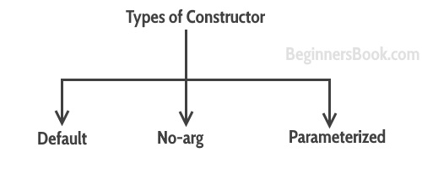
Types of Constructors

Slide 20
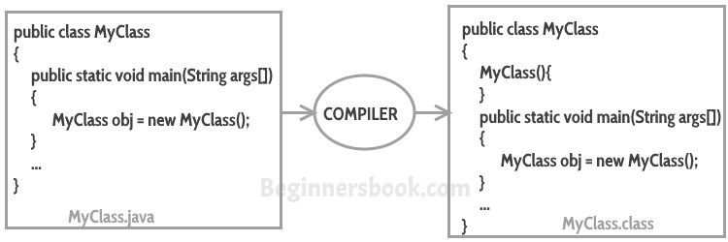
Default constructor
If you do not implement any constructor in your class, Java compiler inserts a default constructorinto your code on your behalf. This constructor is known as default constructor.

Slide 21
no-arg constructor:
Constructor with no arguments is known as no-arg constructor. The signature is same as default constructor, however body can have any code unlike default constructor where the body of the constructor is empty.
class Demo
{
public Demo() //creating constructor
{
System.out.println("This is a no argument constructor");
}
public static void main(String args[])
{
new Demo();
}
}

Slide 22
Parameterized constructor
Constructor with arguments(or you can say parameters) is known as Parameterized constructor.

Slide 23
In this example we have a parameterized constructor with two parameters id and name. While creating the objects obj1 and obj2 I have passed two arguments so that this constructor gets invoked after creation of obj1 and obj2.

Slide 24
Example1
public class Employee
{
int empId;
String empName;
//parameterized constructor with two parameters
Employee(int id, String name)
{
this.empId = id;
this.empName = name;
}
void info()
{
System.out.println("Id: "+empId+" Name: "+empName);
}
public static void main(String args[])
{
Employee obj1 = new Employee(10245,"Chaitanya");
Employee obj2 = new Employee(92232,"Negan");
obj1.info();
obj2.info();
}
}

Slide 25
example2
class Example2
{
private int var;
//default constructor
public Example2()
{
this.var = 10;
}
//parameterized constructor public Example2(int num)
{
this.var = num;
}
public int getValue()
{
return var;
}
public static void main(String args[])
{
Example2 obj = new Example2(); Example2 obj2 = new Example2(100); System.out.println("var is: "+obj.getValue()); System.out.println("var is: "+obj2.getValue());
}
}

Slide 26
What if you implement only parameterized constructor in class
class Example3
{
private int var;
public Example3(int num)
{
var=num;
}
public int getValue()
{
return var;
}
public static void main(String args[])
{
Example3 myobj = new Example3();
System.out.println("value of var is: "+myobj.getValue());
}
}

Slide 27
Output:It will throw a compilation error. The reason is, the statement Example3 myobj = new Example3() is invoking a default constructor which we don’t have in our program. when you don’t implement any constructor in your class, compiler inserts the default constructor into your code, however when you implement any constructor (in above example I have implemented parameterized constructor with int parameter), then you don’t receive the default constructor by compiler into your code.
If we remove the parameterized constructor from the above code then the program would run fine, because then compiler would insert the default constructor into your code.

Slide 28
Difference between Constructor and Method
The purpose of constructor is to initialize the object of a class while the purpose of a method is to perform a task by executing java code.
Constructors cannot be abstract, final, static while methods can be.
Constructors do not have return types while methods do.

Slide 29
Modifiers

Slide 30
The public keyword is an access modifier, meaning that it is used to set the access level for classes, attributes(fields of an object), methods and constructors.
Two types of modifiers
Access modifiers
Non-access modifiers

Slide 31
Access Modifiers
Visible to the package, the default. No modifiers are needed.
Visible to the class only (private).
Visible to the world (public).
Visible to the package and all subclasses (protected).

Slide 32
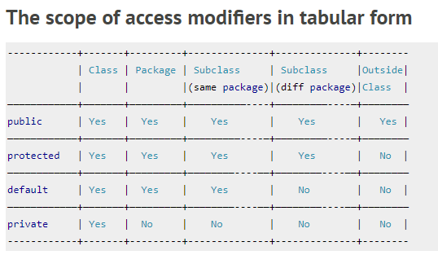
Java Packages & API. A package in Java is used to group related classes. Think of it as a folder in a file directory. We use packages to avoid name conflicts, and to write a better maintainable code.

Slide 33
public
public class Person {
public String fname = "John";
public String lname = "Doe";
public String email = "john@doe.com";
public int age = 24;
}
class MyClass {
public static void main(String[] args) {
Person myObj = new Person();
System.out.println("Name: " + myObj.fname + " " + myObj.lname);
System.out.println("Email: " + myObj.email);
System.out.println("Age: " + myObj.age);
}
}

Slide 34
private
public class Person {
private String fname = "John";
private String lname = "Doe";
private String email = "john@doe.com";
private int age = 24;
}
public class human{
public static void main(String[] args) {
Person myObj = new Person();
System.out.println("Name: " + myObj.fname + " " + myObj.lname);
System.out.println("Email: " + myObj.email);
System.out.println("Age: " + myObj.age);
}
}

Slide 35
protected
class Person {
protected String fname = "John";
protected String lname = "Doe";
protected String email = "john@doe.com";
protected int age = 24;
}
class Student extends Person {
private int graduationYear = 2018;
public static void main(String[] args) {
Student myObj = new Student();
System.out.println("Name: " + myObj.fname + " " + myObj.lname);
System.out.println("Email: " + myObj.email);
System.out.println("Age: " + myObj.age);
System.out.println("Graduation Year: " + myObj.graduationYear);
}
}

Slide 36
Default
class Person {
String fname = "John";
String lname = "Doe";
String email = "john@doe.com";
int age = 24;
public static void main(String[] args) {
Person myObj = new Person();
System.out.println("Name: " + myObj.fname + " " + myObj.lname);
System.out.println("Email: " + myObj.email);
System.out.println("Age: " + myObj.age);
}
}

Slide 37
Non –Access modifier
final | The class cannot be inherited by other classes (You will learn more about inheritance in the Inheritance chapter)
Static | The class cannot be used to create objects
Abstract | An abstract method belongs to an abstract class, and it does not have a body.

Slide 38
Final
If you don't want the ability to override existing attribute values, declare attributes as final:
public class MyClass { final int x = 10; final double PI = 3.14; public static void main(String[] args) { MyClass myObj = new MyClass(); myObj.x = 50; // will generate an error: cannot assign a value to a final variable myObj.PI = 25; // will generate an error: cannot assign a value to a final variable System.out.println(myObj.x); } }

Slide 39
Static
A static method means that it can be accessed without creating an object of the class, unlike public:
public class MyClass { // Static method static void myStaticMethod() { System.out.println("Static methods can be called without creating objects"); } // Public method public void myPublicMethod() { System.out.println("Public methods must be called by creating objects"); } // Main method public static void main(String[ ] args) { myStaticMethod(); // Call the static method // myPublicMethod(); This would output an error MyClass myObj = new MyClass(); // Create an object of MyClass myObj.myPublicMethod(); // Call the public method } }

Slide 40
OOPS Features

Slide 42
Abstract class

Slide 43
Abstract class in Java
A class which is declared as abstract is known as an abstract class. It can have abstract and non-abstract methods. It needs to be extended and its method implemented. It cannot be instantiated.

Slide 44
Points to Remember
An abstract class must be declared with an abstract keyword.
It can have abstract and non-abstract methods.
It cannot be instantiated.
It can have constructors and static methods also.
It can have final methods which will force the subclass not to change the body of the method.

Slide 45
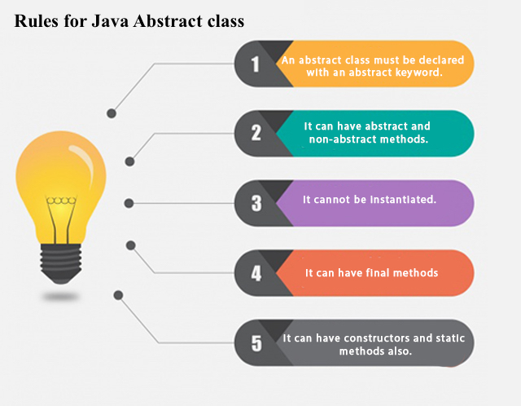

Slide 46
Abstract class declaration
abstract class Shape
{
// code
}
What are Abstract Methods?
An Abstract Method is a method that has just the method definition but does not contain implementation.

Slide 47
Why we need an abstract class?
Lets say we have a class Animal that has a method sound() and the subclasses of it like Dog, Lion, Horse, Cat etc. Since the animal sound differs from one animal to another, there is no point to implement this method in parent class. This is because every child class must override this method to give its own implementation details, like Lion class will say “Roar” in this method and Dog class will say “Woof”.
So when we know that all the animal child classes will and should override this method, then there is no point to implement this method in parent class. Thus, making this method abstract would be the good choice as by making this method abstract we force all the sub classes to implement this method( otherwise you will get compilation error), also we need not to give any implementation to this method in parent class.
Since the Animal class has an abstract method, you must need to declare this class abstract.
Now each animal must have a sound, by making this method abstract we made it compulsory to the child class to give implementation details to this method. This way we ensures that every animal has a sound.

Slide 48
Abstract class Example
//abstract parent class
abstract class Animal
{ /
/abstract method
public abstract void sound();
}
//Dog class extends Animal class
public class Dog extends Animal
{
public void sound()
{ System.out.println("Woof");
}
public static void main(String args[])
{
Animal obj = new Dog(); obj.sound();
}
}

