Slide 1
Introduction To Java Programming
You will learn about the process of creating Java programs and constructs for input, output, branching, looping, as well some of the history behind Java’s development.

Slide 2
Java Vs. Java Script
Java (this is what you need to know for this course)
  A complete programming language developed by Sun
  Can be used to develop either web based or stand-alone software
  Many pre-created code libraries available
  For more complex and powerful programs
Java Script (not covered in this course)
  A small language that’s mostly used for web-based applications (run through a web browser like Internet Explorer, Firefox, Safari, Chrome)
  Good for programming simple special effects for your web page e.g., roll-overs
  e.g., http://pages.cpsc.ucalgary.ca/~tamj/2005/231P/assignments/assignment4/index.html

Slide 3
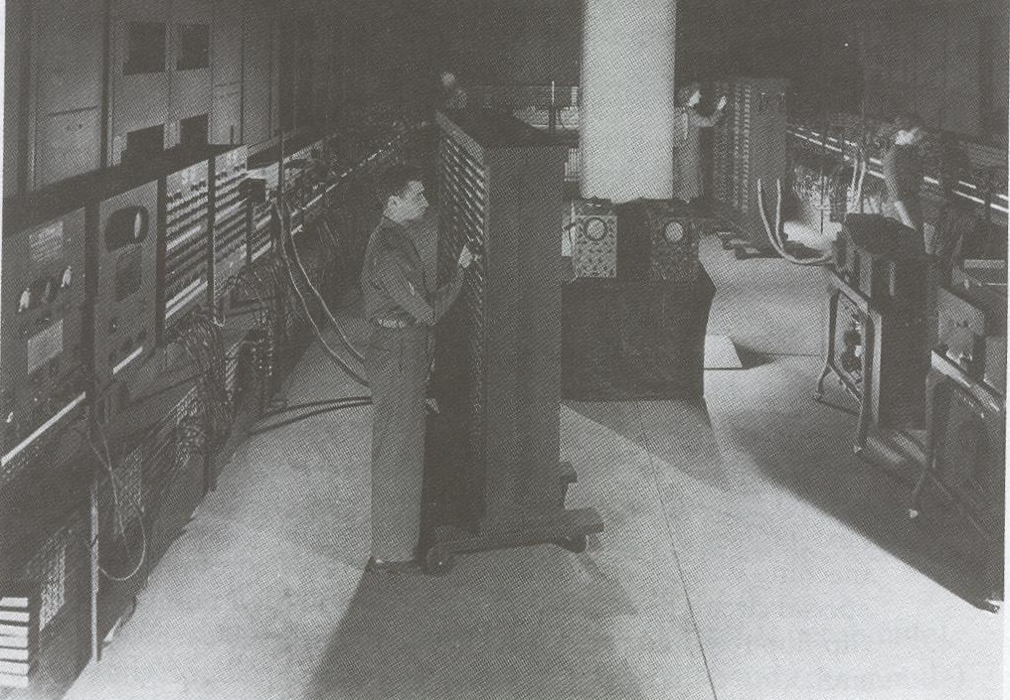
Java: History
Computers of the past

Slide 4
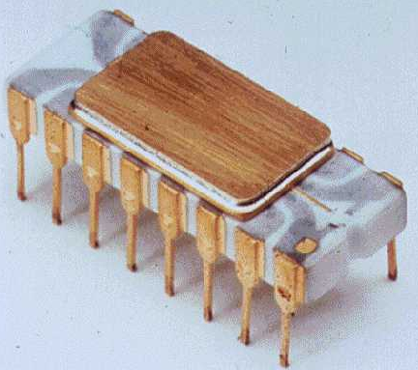
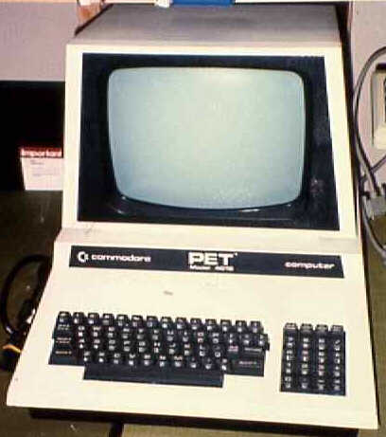
Java: History (2)
The invention of the microprocessor revolutionized computers
Intel microprocessor
Commodore Pet microcomputer

Slide 5
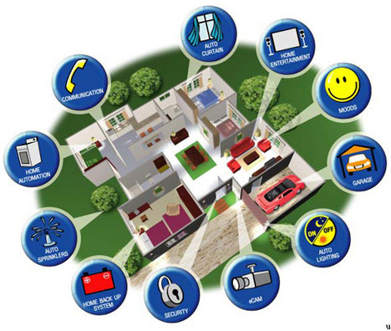
Java: History (3)
It was believed that the logical next step for microprocessors was to have them run intelligent consumer electronics

Slide 6
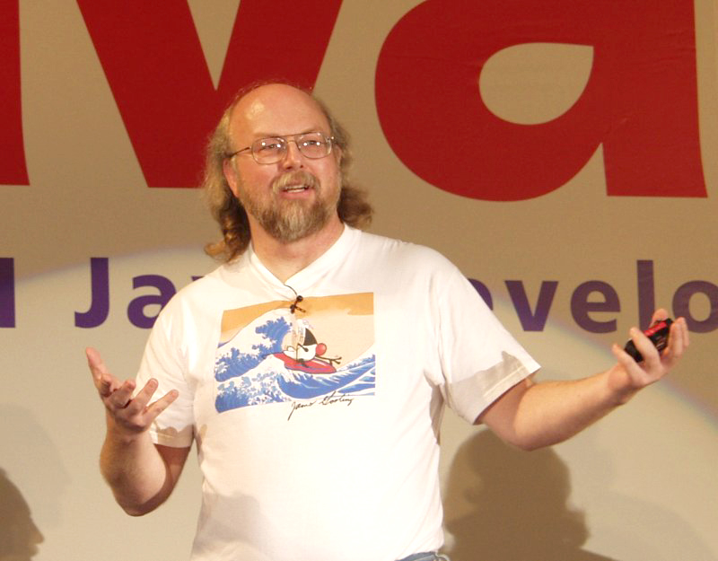
Java History (4)
Sun Microsystems funded an internal research project “Green” to investigate this opportunity.
  Result: A programming language called “Oak”
Blatant advertisement: James Gosling was a graduate of the U of C Computer Science program.
Wav file from “The Simpsons” © Fox, Image from the website of Sun Microsystems

Slide 7


Java History (5)
  Problem: There was already a programming language called Oak.
  The “Green” team met at a local coffee shop to come up with another name...
    Java!

Slide 8

Java: History (6)
The concept of intelligent devices didn’t catch on.
Project Green and work on the Java language was nearly canceled.

Slide 9


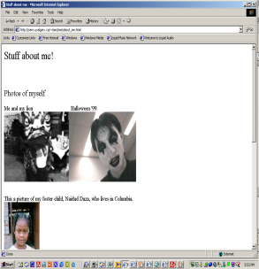

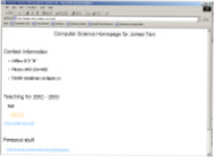
Java: History (7)
The popularity of the Internet resulted in Sun’s re-focusing of Java on computers.
Prior to the advent of Java, web pages allowed you to download only text and images.
Your computer at home running a web browser
Server containing a
web page
User clicks on a link
Images and text get downloaded

Slide 10
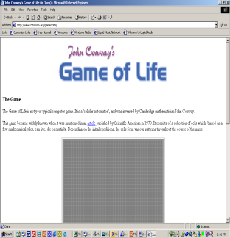
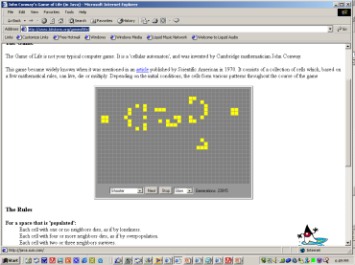
Java: History (8)
Java enabled web browsers allowed for the downloading of programs (Applets).
Java is still used in this context today:
  Facebook (older version)
  Hotmail (older version)
Your computer at home running a web browser
Server containing a web page
User clicks on a link
Java Applet downloaded
Java version of the Game of Life: http://www.bitstorm.org/gameoflife/
Online checkers: http://www.darkfish.com/checkers/index.html

Slide 11

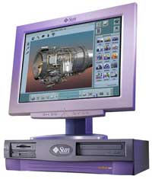
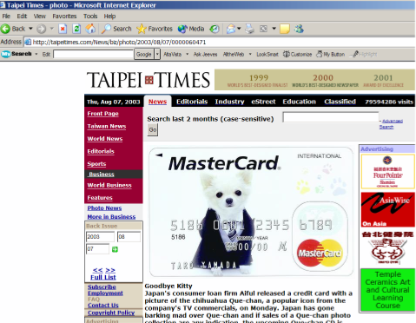

Java: Write Once, Run Anywhere
Consequence of Java’s history: platform-independence
Click on link to Applet
Mac user running Safari
Virtual machine translates byte code to
native Mac code and the Applet is run
Web page stored on Unix server
Byte code is downloaded
Windows user running Internet Explorer
Byte code (part of web page)

Slide 12
Java: Write Once, Run Anywhere
Consequence of Java’s history: platform-independent
Mac user running Safari
Web page stored on Unix server
Click on link to Applet
Byte code is downloaded
Windows user running Internet Explorer
Virtual machine translates byte code to
native Windows code and the Applet is run

Slide 13
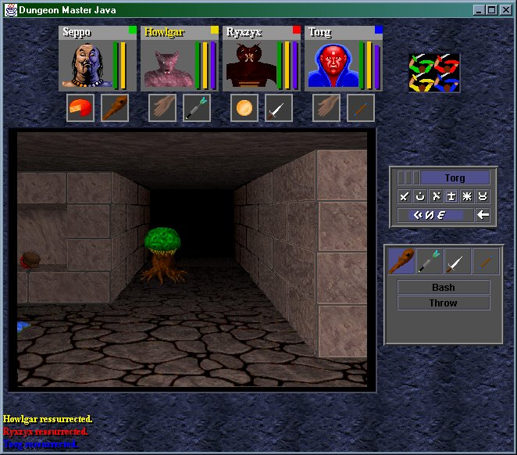

Java: Write Once, Run Anywhere (2)
But Java can also create standard (non-web based) programs
Dungeon Master (Java version)
http://homepage.mac.com/aberfield/dmj/
Kung Fu Panda 2: THQ
Examples of mobile Java games: http://www.mobilegamesarena.net

Slide 14
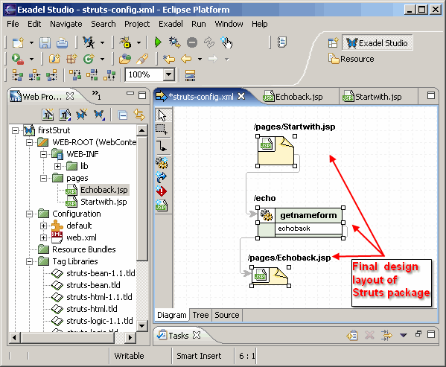
Java: Write Once, Run Anywhere (3)
Java has been used by large and reputable companies to create serious stand-alone applications.
Example:
  Eclipse¹: started as a programming environment created by IBM for developing Java programs. The program Eclipse was itself written in Java.
1 For more information: http://www.eclipse.org/downloads/

Slide 15
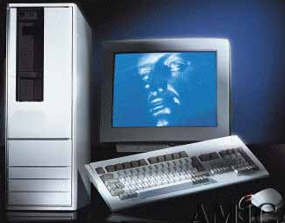
Compiled Programs With Different
Operating Systems
Windows compiler
Executable (Windows)
Computer program
Mac OS compiler
Executable (Mac)
UNIX compiler
Executable (UNIX)

Slide 16
A High Level View Of Translating/Executing Java Programs
Stage 1: Compilation
Filename.java
Java compiler (javac)
Filename.class
Java program
Java bytecode (generic binary)

Slide 17
A High Level View Of Translating/Executing Java Programs (2)
Stage 2: Interpreting and executing the byte code
Machine language instruction (UNIX)
Filename.class
Java interpreter (java)
Machine language instruction (Windows)
Java bytecode (generic binary)
Machine language instruction (Apple)

Slide 18
Which Java?
Java 6+ JDK (Java Development Kit), Standard Edition includes:
  JDK (Java development kit) – for developing Java software (creating Java programs.
  JRE (Java Runtime environment) – only good for running pre-created Java programs.
    Java Plug-in – a special version of the JRE designed to run through web browsers.
http://java.sun.com/javase/downloads/index.jsp

Slide 19
Location Of Online Examples For This Section
Course website:
  www.cpsc.ucalgary.ca/~tamj/219/examples/intro
UNIX directory:
  /home/219/examples/intro

Slide 20
Smallest Compilable And Executable Java Program
The name of the online example is: Smallest.java (Important note: file name matches the word after the keyword ‘class’)
public class Smallest
{
public static void main (String[] args)
{
}
}

Slide 21
Creating, Compiling And Running Java Programs On The Computer Science Network
Type it in with the text editor of your choice
Java program
filename.java
(Unix file)
Java compiler
javac
Java byte code
filename.class
(UNIX file)
To compile the program at the command line type "javac filename.java"
java
Java Interpreter
To run the interpreter, at the command line type "java filename"

Slide 22
Compiling The Smallest Java Program
Smallest.java
public class Smallest
{
public static void main (String[] args)
{
}
}
Type “javac Smallest.java”
javac
Smallest.class
(Java byte code)
10000100000001000 00100100000001001
: :

Slide 23

Running The Smallest Java Program
Smallest.class
(Java byte code)
10000100000001000 00100100000001001
: :
java
Type “java Smallest”
(Platform/Operating specific binary
10100111000001000 00100111001111001
: :

Slide 24
Running The Java Compiler At Home
After installing Java you will need to indicate to the operating system where the java compiler has been installed (‘setting the path’).
For details of how to set your path variable for your particular operating system try the Sun or Java website.
Example of how to set the path in Windows:
  http://java.sun.com/j2se/1.4.2/install-windows.html (see step 5)

Slide 25
Documentation / Comments
Multi-line documentation
  /* Start of documentation
  */ End of documentation
Documentation for a single line
  //Everything until the end of the line is a comment

Slide 26
Review: What Should You Document
Program (or that portion of the program) author
What does the program as a while do e.g., tax program.
What are the specific features of the program e.g., it calculates personal or small business tax.
What are it’s limitations e.g., it only follows Canadian tax laws and cannot be used in the US. In Canada it doesn’t calculate taxes for organizations with yearly gross earnings over $1 billion.
What is the version of the program
  If you don’t use numbers for the different versions of your program then consider using dates (tie versions with program features).

Slide 27
Important Note
Each Java instruction must be followed by a semi-colon!
General format
Instruction1;
Instruction2;
Instruction3;
: :
Examples
int num = 0;
System.out.println(num);
: :

Slide 28
Java Output
Format:
  System.out.print(<string or variable name one> + <string or variable name two>..);
  OR
  System.out.println(<string or variable name one> + <string or variable name two>..);
Examples (online program called “OutputExample1.java”)
public class OutputExample1
{
public static void main (String [] args)
{
int num = 123; // More on this shortly
  System.out.println("Good-night gracie!");
  System.out.print(num);
  System.out.println("num="+num);
  }
}

Slide 29
Output : Some Escape Sequences For Formatting
Escape sequence | Description
\t | Horizontal tab
\r | Carriage return
\n | New line
\” | Double quote
\\ | Backslash

Slide 30
Example Formatting Codes
Name of the online example: FormattingExample.java
  public class FormattingExample
  {
  public static void main (String [] args)
  {
  System.out.print("lol\tz\n");
  System.out.println("hello\rworld");
  System.out.println("\"Geek\" talk slash (\\) com");
  }
  }

Slide 31
Variables
Unlike Python variables must be declared before they can be used.
Variable declaration:
  Creates a variable in memory.
  Specify the name of the variable as well as the type of information that it will store.
  E.g. int num;
  Although requiring variables to be explicitly declared appears to be an unnecessary chore it can actually be useful for minimizing insidious logic errors.
Using variables
  Only after a variable has been declared can it be used.
  E.g., num = 12;

Slide 32
Declaring Variables: Syntax
Format:
  <type of information> <name of variable>;
Example:
  char myFirstInitial;
Variables can be initialized (set to a starting value) as they’re declared:
  char myFirstInitial = ‘j’;
  int age = 30;

Slide 33
Some Built-In Types Of Variables In Java
Type | Description
byte | 8 bit signed integer
short | 16 but signed integer
int | 32 bit signed integer
long | 64 bit signed integer
float | 32 bit signed real number
double | 64 bit signed real number
char | 16 bit Unicode character (ASCII and beyond)
boolean | 1 bit true or false value
String | A sequence of characters between double quotes ("")

Slide 34
Location Of Variable Declarations
public class <name of class>
{
public static void main (String[] args)
{
// Local variable declarations occur here
<< Program statements >>
: :
}
}

Slide 35
Style Hint: Initializing Variables
Always initialize your variables prior to using them!
  Do this whether it is syntactically required or not.
Example how not to approach:
  public class OutputExample1
  {
  public static void main (String [] args)
  {
  int num;
  System.out.print(num);
  }
  }
OutputExample1.java:7: error: variable num might not have been initialized
System.out.print(num);
^

Slide 36
Java Constants
Reminder: constants are like variables in that they have a name and store a certain type of information but unlike variables they CANNOT change. (Unlike Python this is syntactically enforced…hurrah!).
Format:
  final <constant type> <CONSTANT NAME> = <value>;
Example:
final int SIZE = 100;

Slide 37
Location Of Constant Declarations
public class <name of class>
{
public static void main (String[] args)
{
// Local constant declarations occur here (more later)
// Local variable declarations
< Program statements >>
: :
}
}

Slide 38
Why Use Constants?
They make your program easier to read and understand
  populationChange = (0.1758 – 0.1257) * currentPopulation;
  Vs.
  final float BIRTH_RATE = 17.58;
  final float MORTALITY_RATE = 0.1257;
  int currentPopulation = 1000000;
  populationChange = (BIRTH_RATE - MORTALITY_RATE) * currentPopulation;

Slide 39
Why Use Constants? (2)
It can make your program easier to maintain (update with changes).
  If the constant is referred to several times throughout the program, changing the value of the constant once will change it throughout the program.

Slide 40
Why Use Constants? (3)
final float BIRTH_RATE = 0.1758;
final float MORTALITY_RATE = 0.1257;
float populationChange = 0;
float currentPopulation = 1000000;
populationChange = (BIRTH_RATE - MORTALITY_RATE) * currentPopulation;
if (populationChange > 0)
System.out.println("Increase“)
System.out.println("Birth rate:“+ BIRTH_RATE + " Mortality rate:“ +
MORTALITY_RATE, " + Population change:“ + populationChange);
else if (populationChange < 0)
System.out.println("Decrease“);
System.out.println("Birth rate:“+BIRTH_RATE, “+Mortality rate:“+ MORTALITY_RATE
+"Population change:“+populationChange);
else
System.out.print("No change“);
System.out.print("Birth rate:“+BIRTH_RATE, “+Mortality rate:“+ MORTALITY_RATE+
"Population change:“+populationChange);

Slide 41
Why Use Constants? (4)
One change in the initialization of the constant changes all references to that constant.
final float BIRTH_RATE = 0.5;
final float MORTALITY_RATE = 0.1257;
float populationChange = 0;
float currentPopulation = 1000000;
populationChange = (BIRTH_RATE - MORTALITY_RATE) * currentPopulation;
if (populationChange > 0)
System.out.println("Increase“)
System.out.println("Birth rate:“+ BIRTH_RATE + " Mortality rate:“ +
MORTALITY_RATE, " + Population change:“ + populationChange);
else if (populationChange < 0)
System.out.println("Decrease“);
System.out.println("Birth rate:“+BIRTH_RATE, “+Mortality rate:“+ MORTALITY_RATE
+"Population change:“+populationChange);
else
System.out.print("No change“);
System.out.print("Birth rate:“+BIRTH_RATE, “+Mortality rate:“+ MORTALITY_RATE+
"Population change:“+populationChange);

Slide 42
Variable Naming Conventions In Java
Compiler requirements
  Can’t be a keyword nor can the names of the special constants: true, false or null be used
  Can be any combination of letters, numbers, underscore or dollar sign (first character must be a letter or underscore)
Common stylistic conventions
  The name should describe the purpose of the variable
  Avoid using the dollar sign
  With single word variable names, all characters are lower case
    e.g., double grades;
  Multiple words are separated by capitalizing the first letter of each word except for the first word
    e.g., String firstName = “James”;

Slide 43
Java Keywords
abstract | boolean | break | byte | case | catch | char
class | const | continue | default | do | double | else
extends | final | finally | float | for | goto | if
implements | import | instanceof | int | interface | long | native
new | package | private | protected | public | return | short
static | super | switch | synchronized | this | throw | throws
transient | try | void | volatile | while

Slide 44
Common Java Operators / Operator Precedence
Precedence level | Operator | Description | Associativity
1 | expression++ expression-- | Post-increment Post-decrement | Right to left
2 | ++expression --expression + - ! ~ (type) | Pre-increment Pre-decrement Unary plus Unary minus Logical negation Bitwise complement Cast | Right to left

Slide 45
Common Java Operators / Operator Precedence
Precedence level | Operator | Description | Associativity
3 | * / % | Multiplication Division Remainder/modulus | Left to right
4 | + - | Addition or String concatenation Subtraction | Left to right
5 | << >> | Left bitwise shift Right bitwise shift | Left to right

Slide 46
Common Java Operators / Operator Precedence
Precedence level | Operator | Description | Associativity
6 | < <= > >= | Less than Less than, equal to Greater than Greater than, equal to | Left to right
7 | = = != | Equal to Not equal to | Left to right
8 | & | Bitwise AND | Left to right
9 | ^ | Bitwise exclusive OR | Left to right

Slide 47
Common Java Operators / Operator Precedence
Precedence level | Operator | Description | Associativity
10 | | | Bitwise OR | Left to right
11 | && | Logical AND | Left to right
12 | || | Logical OR | Left to right

Slide 48
Common Java Operators / Operator Precedence
Precedence level | Operator | Description | Associativity
13 | = += -= *= /= %= &= ^= |= <<= >>= | Assignment Add, assignment Subtract, assignment Multiply, assignment Division, assignment Remainder, assignment Bitwise AND, assignment Bitwise XOR, assignment Bitwise OR, assignment Left shift, assignment Right shift, assignment | Right to left

Slide 49
Post/Pre Operators
The name of the online example is: Order1.java
public class Order1
{
public static void main (String [] args)
{
int num = 5;
System.out.println(num);
num++;
System.out.println(num);
++num;
System.out.println(num);
System.out.println(++num);
System.out.println(num++);
}
}

Slide 50
Post/Pre Operators (2)
The name of the online example is: Order2.java
public class Order2
{
public static void main (String [] args)
{
int num1;
int num2;
num1 = 5;
num2 = ++num1 * num1++;
System.out.println("num1=" + num1);
System.out.println("num2=" + num2);
}
}

Slide 51
Unary Operator/Order/Associativity
The name of the online example: Unary_Order3.java
public class Unary_Order3.java
{
public static void main (String [] args)
{
int num = 5;
float fl;
System.out.println(num);
num = num * -num;
System.out.println(num);
}
}

Slide 52
Accessing Pre-Created Java Libraries
It’s accomplished by placing an ‘import’ of the appropriate library at the top of your program.
Syntax:
  import <Full library name>;
Example:
  import java.util.Scanner;

Slide 53
Getting Text Input
You can use the pre-written methods (functions) in the Scanner class.
General structure:
import java.util.Scanner;
main (String [] args)
{
Scanner <name of scanner> = new Scanner (System.in);
<variable> = <name of scanner> .<method> ();
}
Creating a scanner object (something that can scan user input)
Using the capability of the scanner object (actually getting user input)

Slide 54
Getting Text Input (2)
The name of the online example: MyInput.java
  import java.util.Scanner;
  public class MyInput
  {
  public static void main (String [] args)
  {
  String str1;
  int num1;
  Scanner in = new Scanner (System.in);
  System.out.print ("Type in an integer: ");
  num1 = in.nextInt ();
  System.out.print ("Type in a line: ");
  in.nextLine ();
  str1 = in.nextLine ();
  System.out.println ("num1:" +num1 +"\t str1:" + str1);
  }
  }

Slide 55
Useful Methods Of Class Scanner¹
nextInt ()
nextLong ()
nextFloat ()
nextDouble ()
nextLine ();
1 Online documentation: http://java.sun.com/javase/6/docs/api/

Slide 56
Reading A Single Character
Text menu driven programs may require this capability.
Example:
  GAME OPTIONS
  (a)dd a new player
  (l)oad a saved game
  (s)ave game
  (q)uit game
There’s different ways of handling this problem but one approach is to extract the first character from the string.
Partial example:
  String s = "boo“;
  System.out.println(s.charAt(0));

Slide 57
Reading A Single Character
Name of the (more complete example): MyInputChar.java
import java.util.Scanner;
public class MyInputChar
{
public static void main (String [] args)
{
final int FIRST = 0;
String selection;
Scanner in = new Scanner (System.in);
System.out.println("GAME OPTIONS");
System.out.println("(a)dd a new player");
System.out.println("(l)oad a saved game");
System.out.println("(s)ave game");
System.out.println("(q)uit game");
System.out.print("Enter your selection: ");

Slide 58
Reading A Single Character (2)
selection = in.nextLine ();
System.out.println ("Selection: " + selection.charAt(FIRST));
}
}

Slide 59
Decision Making In Java
Java decision making constructs
  if
  if, else
  if, else-if
  switch

Slide 60
Decision Making: Logical Operators
Logical Operation | Python | Java
AND | and | &&
OR | or | ||
NOT | not, ! | !

Slide 61
Decision Making: If
Format:
if (Boolean Expression)
Body
Example:
if (x != y)
System.out.println("X and Y are not equal");
if ((x > 0) && (y > 0))
{
System.out.println("X and Y are positive");
}
Indenting the body of the branch is an important stylistic requirement of Java but unlike Python it is not enforced by the syntax of the language.
What distinguishes the body is either:
  A semi colon (single statement branch)
  Braces (a body that consists of multiple statements)

Slide 62
Decision Making: If, Else
Format:
if (Boolean expression)
Body of if
else
Body of else
Example:
if (x < 0)
System.out.println("X is negative");
else
System.out.println("X is non-negative");

Slide 63
Example Program: If-Else
Name of the online example: BranchingExample1.java
  import java.util.Scanner;
  public class BranchingExample1
  {
  public static void main (String [] args)
  {
  Scanner in = new Scanner(System.in);
  final int WINNING_NUMBER = 131313;
  int playerNumber = -1;
  System.out.print("Enter ticket number: ");
  playerNumber = in.nextInt();
  if (playerNumber == WINNING_NUMBER)
  System.out.println("You're a winner!");
  else
  System.out.println("Try again.");
  }
  }

Slide 64
If, Else-If
Format:
if (Boolean expression)
Body of if
else if (Boolean expression)
Body of first else-if
: : :
else if (Boolean expression)
Body of last else-if
else
Body of else

Slide 65
If, Else-If (2)
Name of the online example: BranchingExample.java
import java.util.Scanner;
public class BranchingExample2
{
public static void main (String [] args)
{
Scanner in = new Scanner(System.in);
int gpa = -1;
System.out.print("Enter letter grade: ");
gpa = in.nextInt();

Slide 66
If, Else-If (3)
if (gpa == 4)
System.out.println("A");
else if (gpa == 3)
System.out.println("B");
else if (gpa == 2)
System.out.println("C");
else if (gpa == 1)
System.out.println("D");
else if (gpa == 0)
System.out.println("F");
else
System.out.println("Invalid letter grade");
}
}

Slide 67
Branching: Common Mistakes
Recall that for single bodies: what lies between the closing bracket of the Boolean expression and the next semi-colon is the body.
  if (Boolean Expression)
  instruction;
  if (Boolean Expression) instruction;
  if (Boolean Expression)
  instruction1;
  Instruction2;
body
body
body

Slide 68
Branching: Now What Happens???
  if (Boolean Expression):
  instruction1;
  instruction2;

Slide 69
Alternative To Multiple Else-If’s: Switch
Format (character-based switch):
switch (character variable name)
{
case '<character value>':
Body
break;
case '<character value>':
Body
break;
:
default:
Body
}
1 The type of variable in the brackets can be a byte, char, short, int or long
Important! The break is mandatory to separate Boolean expressions (must be used in all but the last)

Slide 70
Alternative To Multiple Else-If’s: Switch (2)
Format (integer based switch):
switch (integer variable name)
{
case <integer value>:
Body
break;
case <integer value>:
Body
break;
:
default:
Body
}
1 The type of variable in the brackets can be a byte, char, short, int or long

Slide 71
Switch: When To Use/When Not To Use
Benefit (when to use):
  It may produce simpler code than using an if-elseif (e.g., if there are multiple compound conditions)

Slide 72
Switch: When To Use/When Not To Use (2)
Name of the online example: SwitchExample.java
  import java.util.Scanner;
  public class SwitchExample
  {
  public static void main (String [] args)
  {
  final int FIRST = 0;
  String line;
  char letter;
  int gpa;
  Scanner in = new Scanner (System.in);
  System.out.print("Enter letter grade: ");

Slide 73
Switch: When To Use/When Not To Use (3)
line = in.nextLine ();
letter = line.charAt(FIRST);
switch (letter)
{
case 'A':
case 'a':
gpa = 4;
break;
case 'B':
case 'b':
gpa = 3;
break;
case 'C':
case 'c':
gpa = 2;
break;

Slide 74
Switch: When To Use/When Not To Use (4)
case 'D':
case 'd':
gpa = 1;
break;
case 'F':
case 'f':
gpa = 0;
break;
default:
gpa = -1;
}
System.out.println("Letter grade: " + letter);
System.out.println("Grade point: " + gpa);
}
}

Slide 75
Switch: When To Use/When Not To Use (5)
When a switch can’t be used:
  For data types other than characters or integers
  Boolean expressions that aren’t mutually exclusive:
    As shown a switch can replace an ‘if-elseif’ construct
    A switch cannot replace a series of ‘if’ branches).
  Example when not to use a switch:
    if (x > 0)
    System.out.print(“X coordinate right of the origin”);
    If (y > 0)
    System.out.print(“Y coordinate above the origin”);
  Example of when not to use a switch:
    String name = in.readLine()
    switch (name)
    {
    }

Slide 76
Switch Example: Modified
What happens if all the ‘break’ instructions have been removed?

Slide 77
Loops
Python loops
  Pre-test loops: for, while
Java Pre-test loops
  For
  While
Java Post-test loop
  Do-while

Slide 78
While Loops
Format:
  while (Boolean expression)
  Body
Example:
int i = 1;
while (i <= 4)
{
// Call function
createNewPlayer();
i = i + 1;
}

Slide 79
For Loops
Format:
for (initialization; Boolean expression; update control)
Body
Example:
for (i = 1; i <= 4; i++)
{
// Call function
createNewPlayer();
i = i + 1;
}

Slide 80
Post-Test Loop: Do-While
Recall: Post-test loops evaluate the Boolean expression after the body of the loop has executed.
This means that post test loops will execute one or more times.
Pre-test loops generally execute zero or more times.

Slide 81
Do-While Loops
Format:
do
Body
while (Boolean expression);
Example:
char ch = 'A';
do
{
System.out.println(ch);
ch++;
}
while (ch <= 'K');

Slide 82
Contrasting Pre Vs. Post Test Loops
Although slightly more work to implement the while loop is the most powerful type of loop.
Program capabilities that are implemented with either a ‘for’ or ‘do-while’ loop can be implemented with a while loop.
Implementing a post test loop requires that the loop control be primed correctly (set to a value such that the Boolean expression will evaluate to true the first it’s checked).

Slide 83
Example: Post-Test Implementation
Name of the online example: PostTestExample.java
public class PostTestExample
{
public static void main (String [] args)
{
final int FIRST = 0;
Scanner in = new Scanner(System.in);
char answer;
String temp;
do
{
System.out.println("JT's note: Pretend that we play our game");
System.out.print("Play again? Enter 'q' to quit: ");
temp = in.nextLine();
answer = temp.charAt(FIRST);
} while ((answer != 'q') && (answer != 'Q'));
}
}

Slide 84
Example: Pre-Test Implementation
Name of the online example: PreTestExample.java
public class PreTestExample
{
public static void main (String [] args)
{
final int FIRST = 0;
Scanner in = new Scanner(System.in);
char answer = ' ';
String temp;
while ((answer != 'q') && (answer != 'Q'))
{
System.out.println("JT's note: Pretend that we play our game");
System.out.print("Play again? Enter 'q' to quit: ");
temp = in.nextLine();
answer = temp.charAt(FIRST);
}
}
}

Slide 85
Now What Happens???
import java.util.Scanner;
public class PreTestExample
{
public static void main (String [] args)
{
final int FIRST = 0;
Scanner in = new Scanner(System.in);
char answer = ' ';
String temp;
while ((answer != 'q') && (answer != 'Q'))
System.out.println("JT's note: Pretend that we play our game");
System.out.print("Play again? Enter 'q' to quit: ");
temp = in.nextLine();
answer = temp.charAt(FIRST);
}
}

Slide 86
Many Pre-Created Classes Have Been Created
Rule of thumb: Before writing new program code to implement the features of your program you should check to see if a class has already been written with the features that you need.
The Java API is Sun Microsystems's collection of pre-built Java classes:
  http://java.sun.com/javase/6/docs/api/

Slide 87
After This Section You Should Now Know
How Java was developed and the impact of it's roots on the language
The basic structure required in creating a simple Java program as well as how to compile and run programs
How to document a Java program
How to perform text based input and output in Java
The declaration of constants and variables
What are the common Java operators and how they work
The structure and syntax of decision making and looping constructs

