Slide 1

Presented by
Gopalakrishnan.S

Slide 2
Whenever you want to create a Web application or Mobile application
you need to store your data somewhere

Slide 3
So, we can store the data in Notepad or txt.
and also we can store it in
*txt
*doc
*db

Slide 4
*db - RDBMS, NoSql, Mongodb
MERN ---> MEN﻿
we didn't focus react or angular in db.

Slide 5
Data's can be like:
Name: Gopalakrishnan
Design: Technical
Sub_tech: true

Slide 6
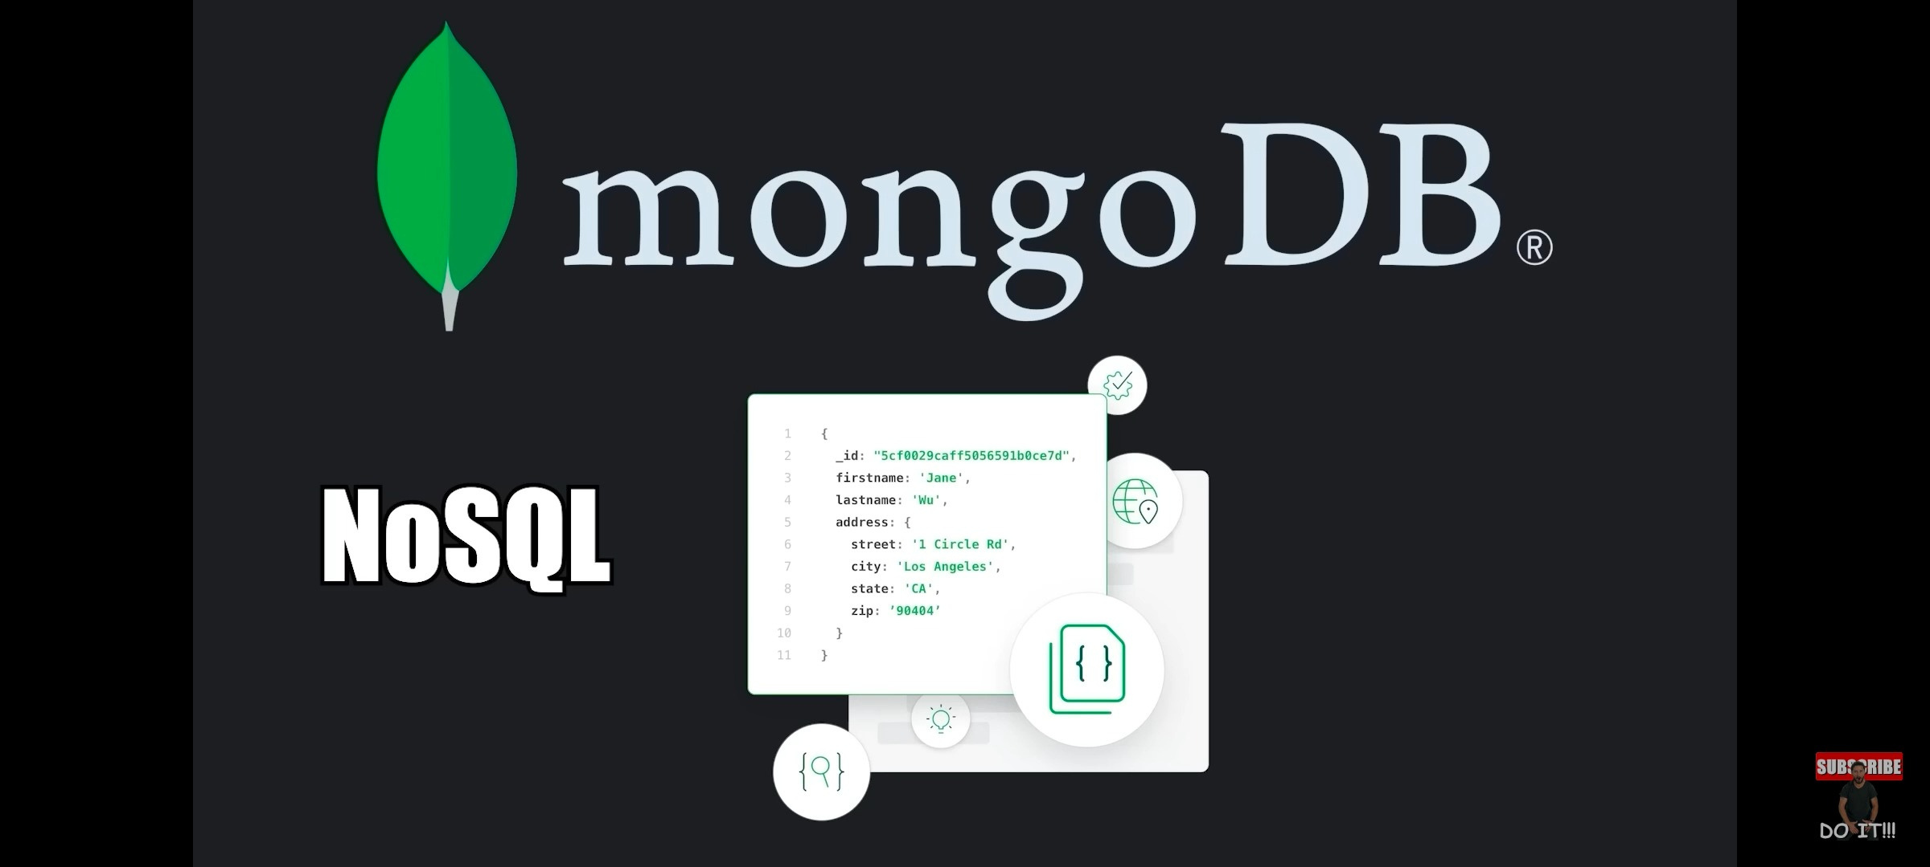
Mongodb is a NoSQL database management system

Slide 7
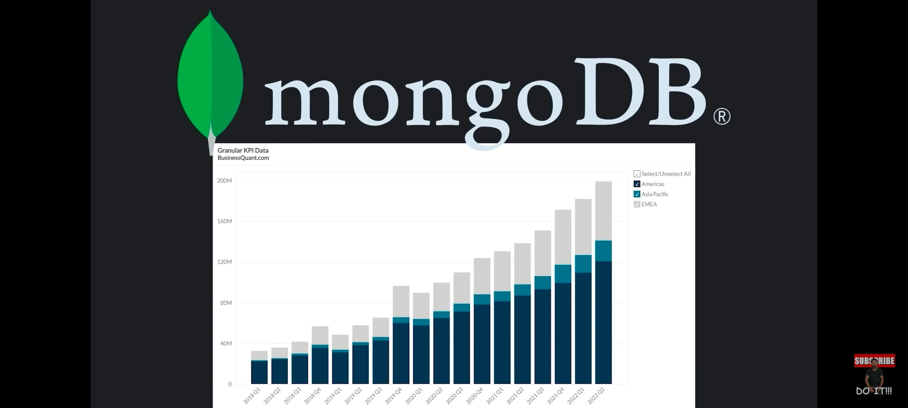
Mongodb is becoming a recently popular

Slide 8

NoSQL database can be there in different types and it's not contain any structured document.

Slide 9
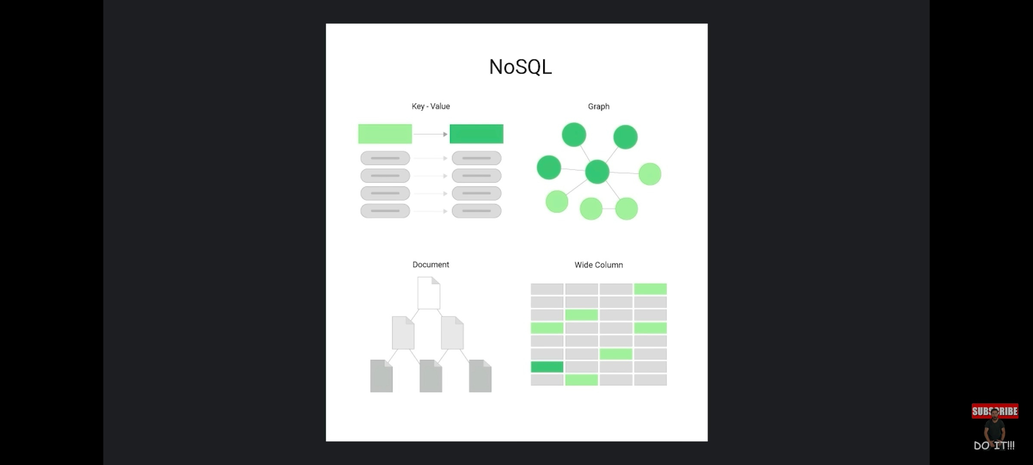
Like these

Slide 10
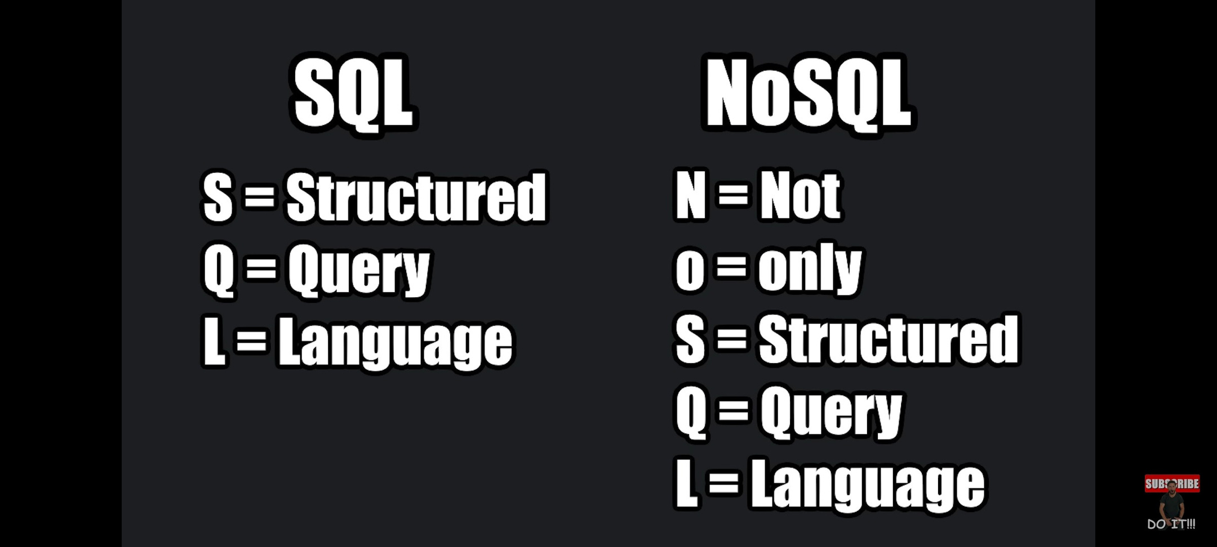

Slide 11
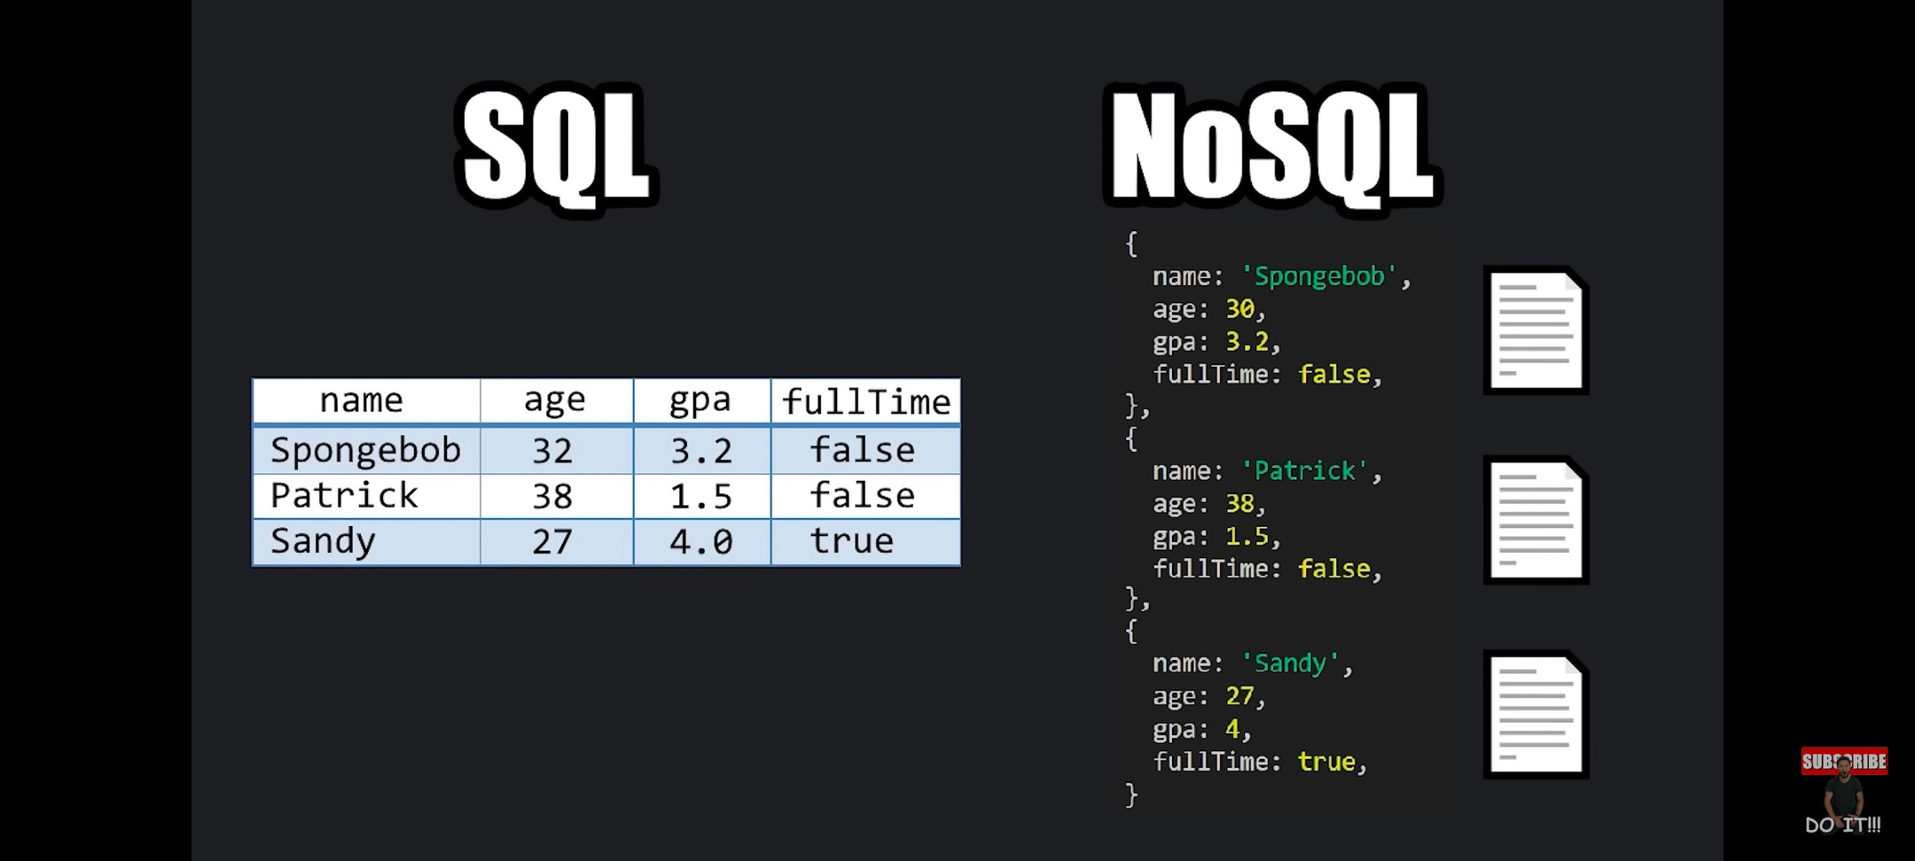

Slide 12
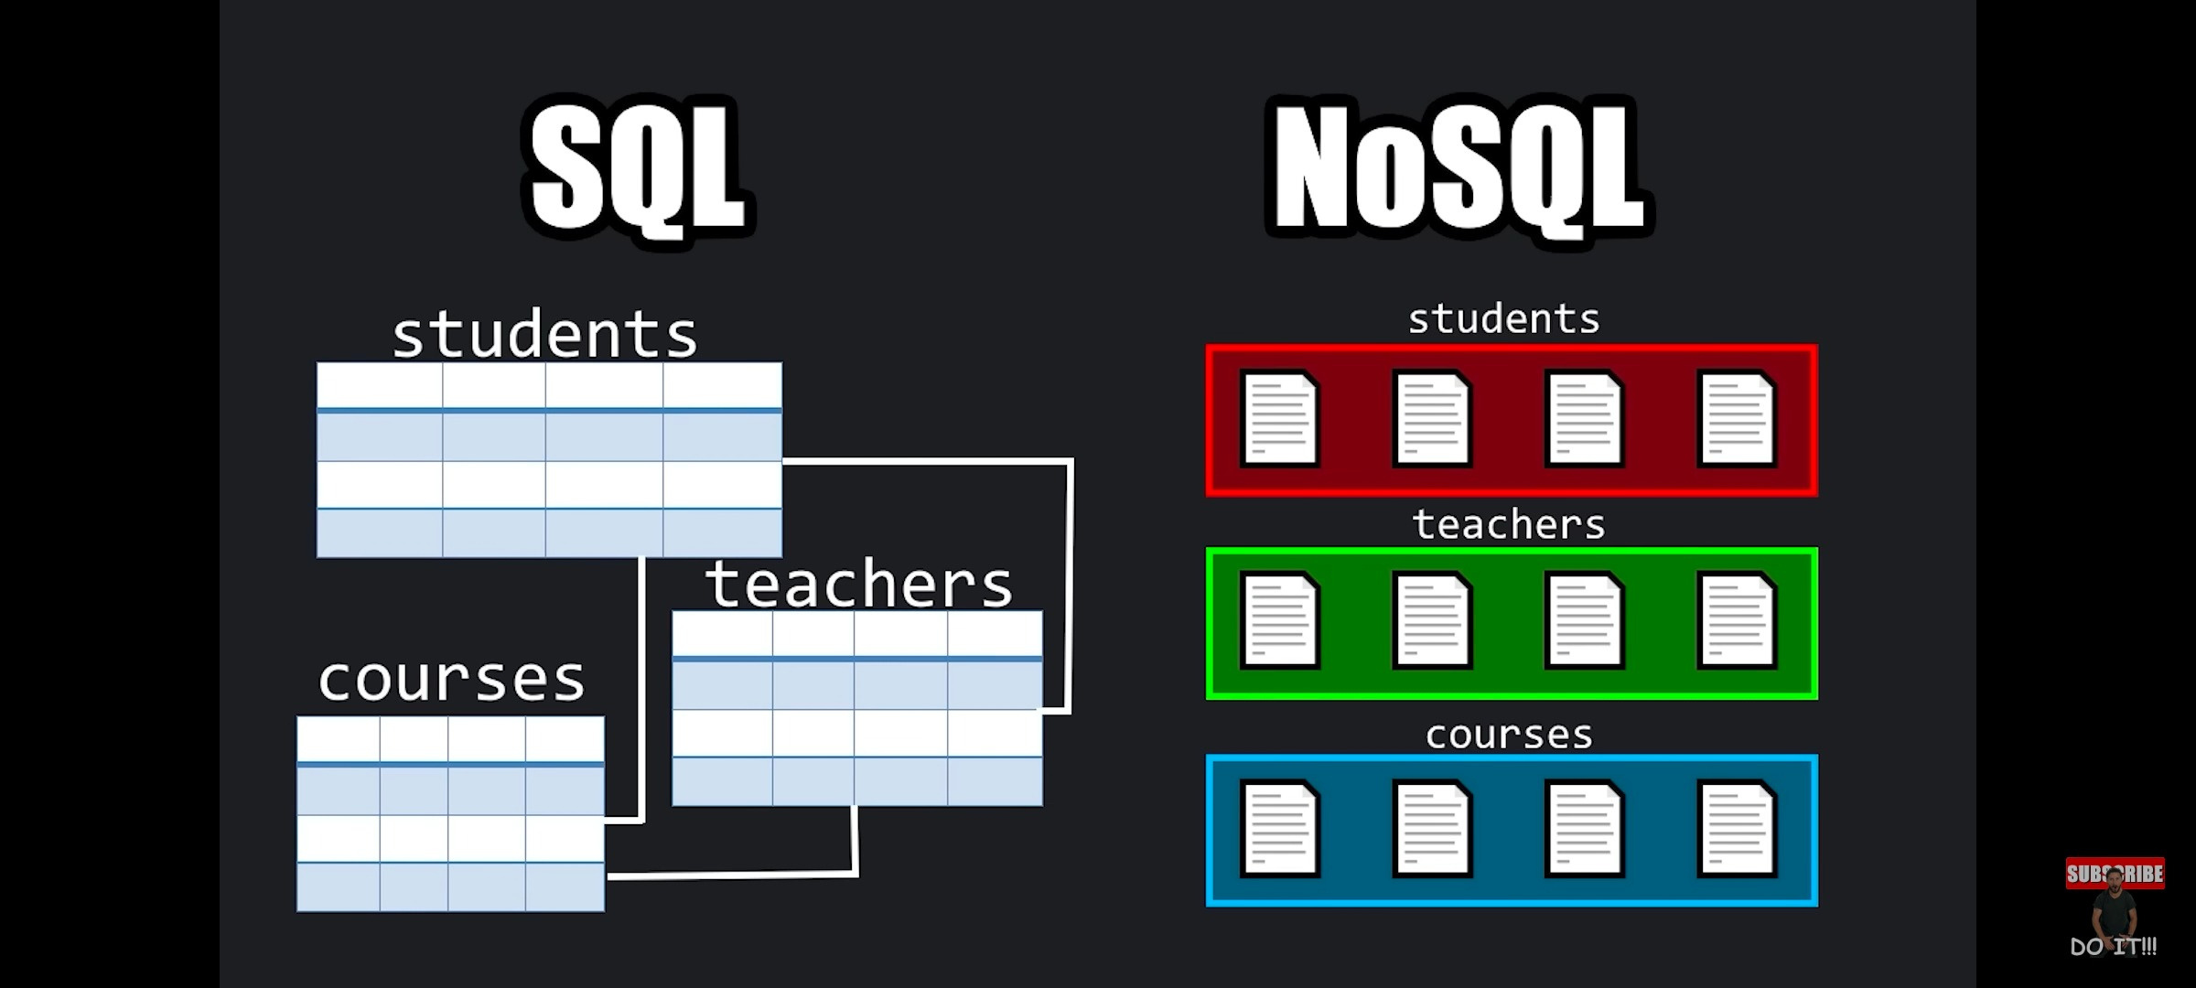

Slide 13
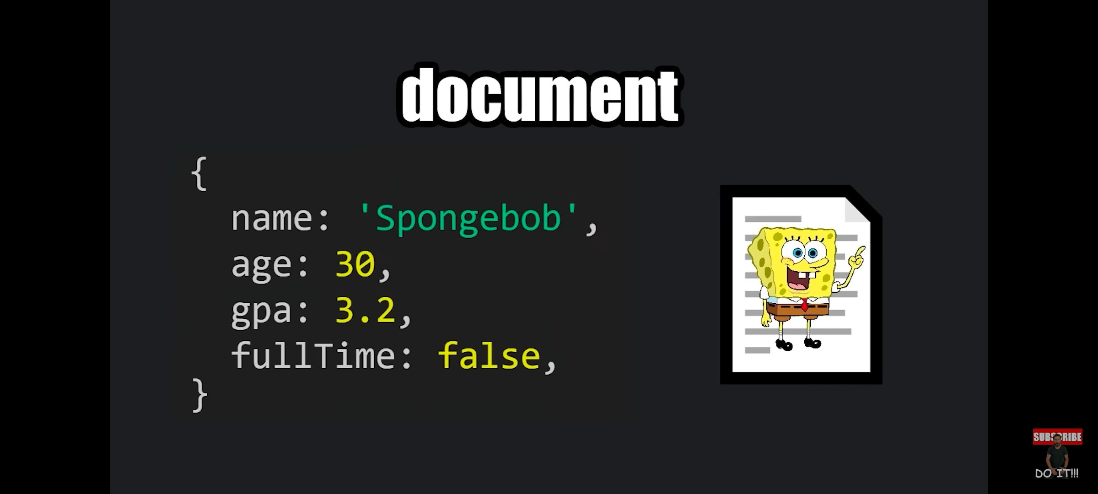
Normal document in NoSQL📄

Slide 14
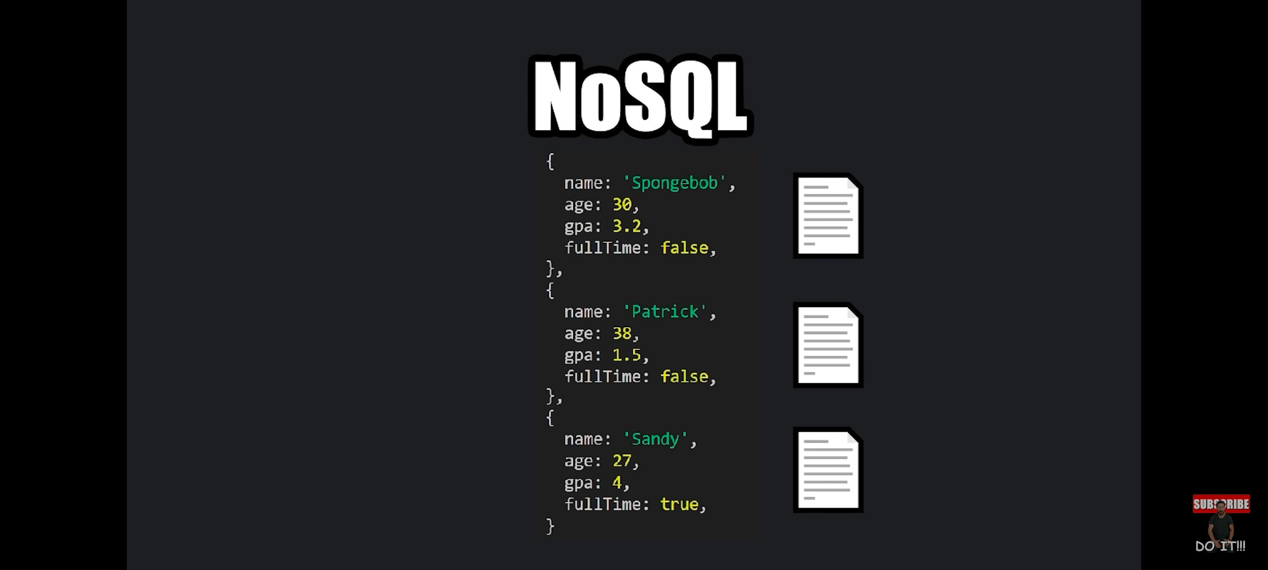

Slide 15
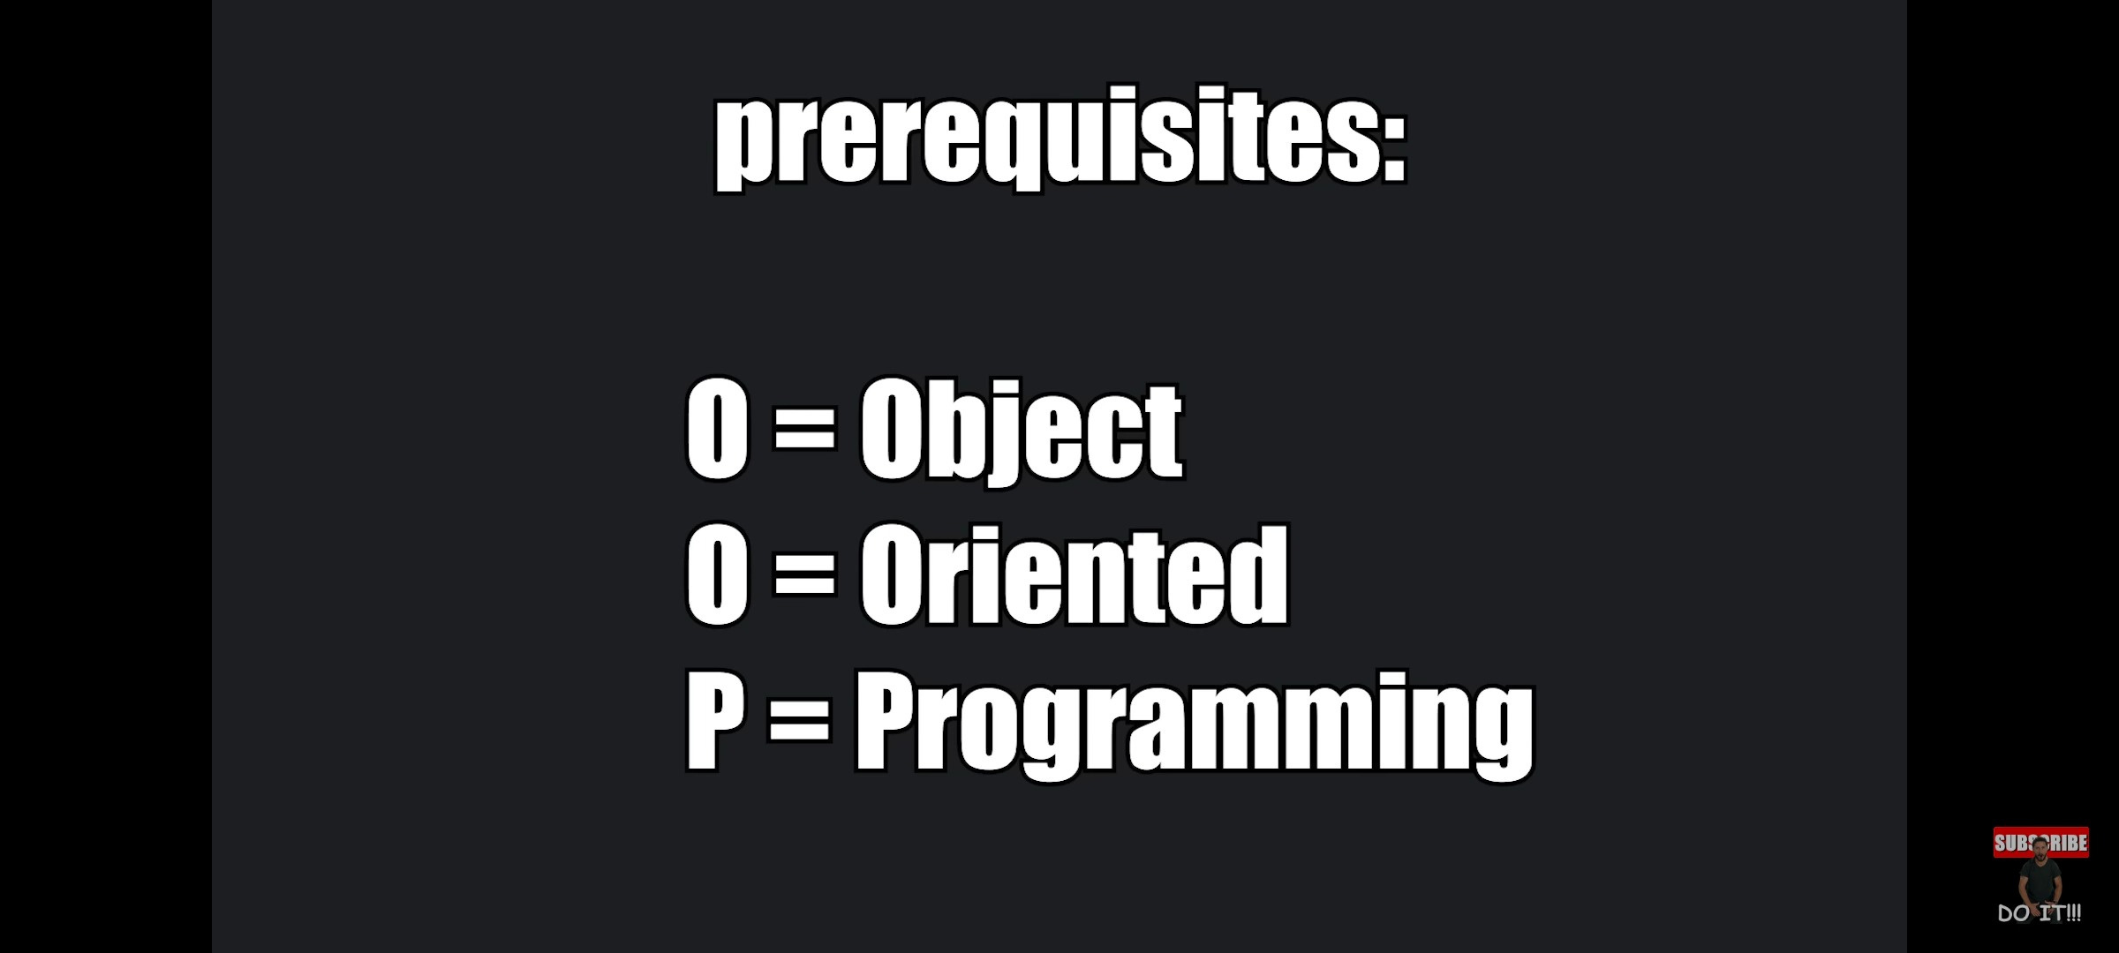

Slide 16
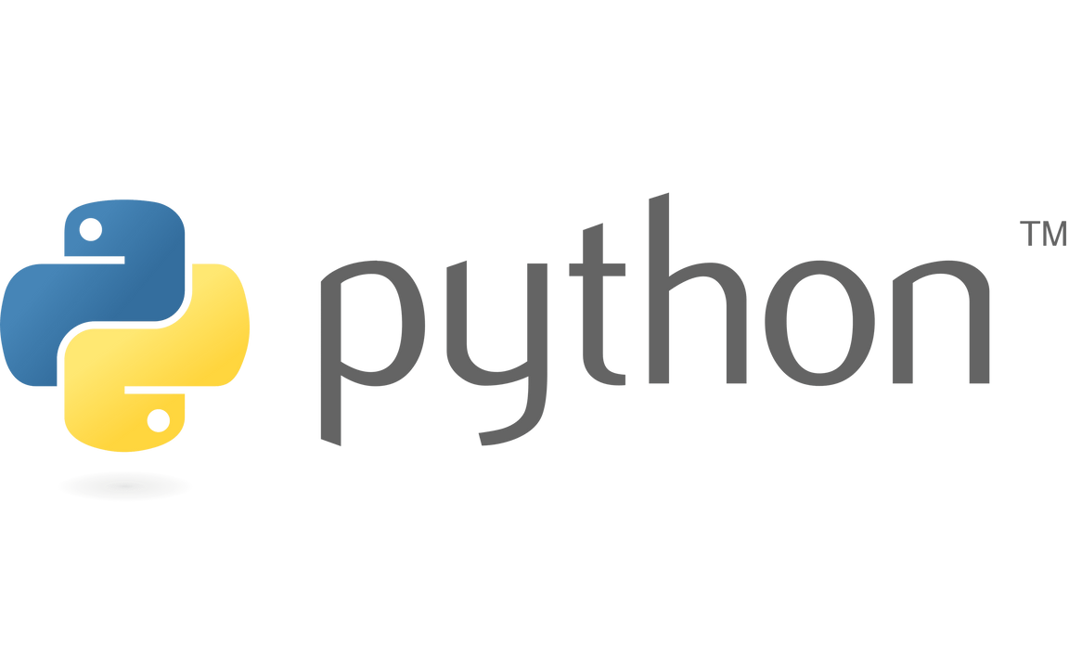


Prerequisites
You know atleast any one object oriented programming language

Slide 17
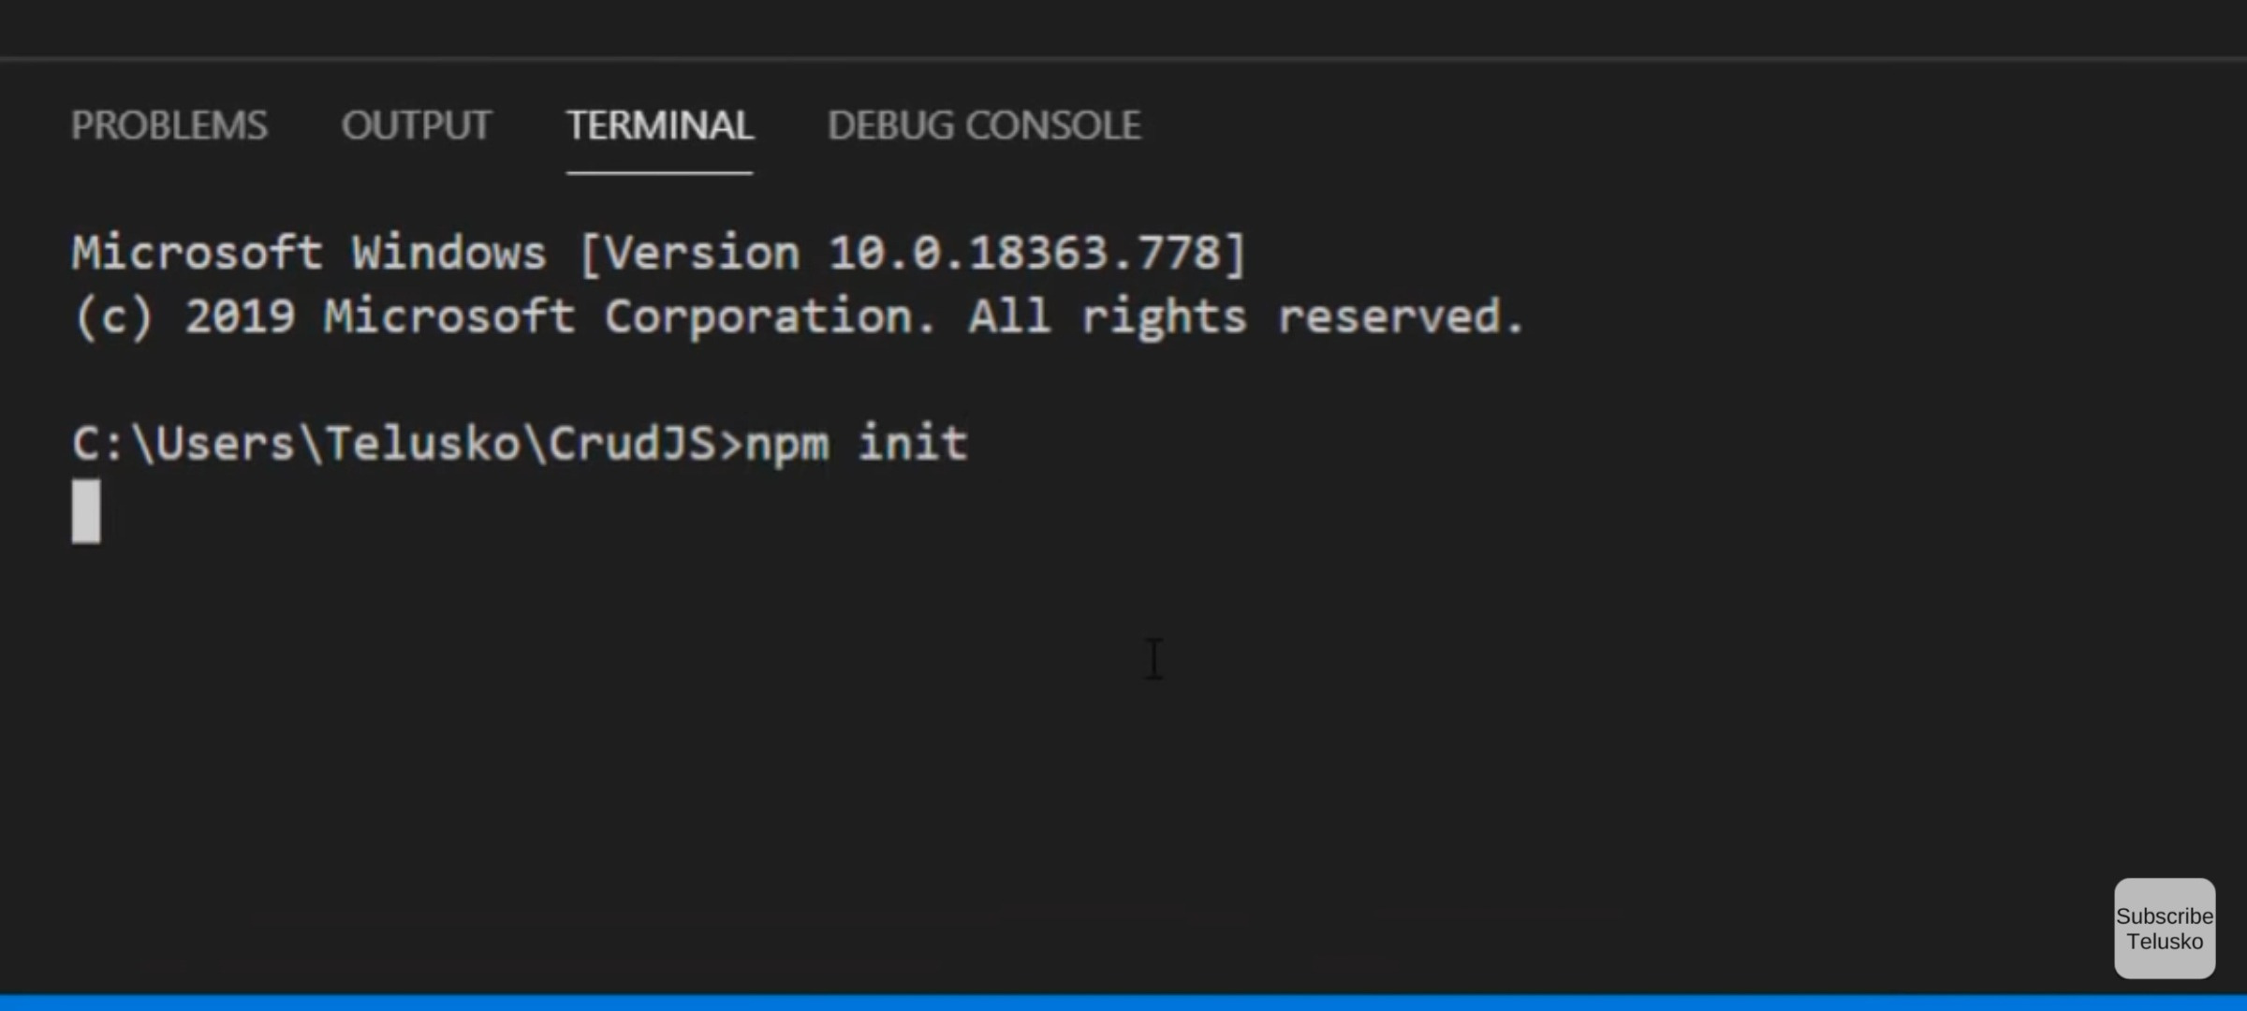

Slide 18
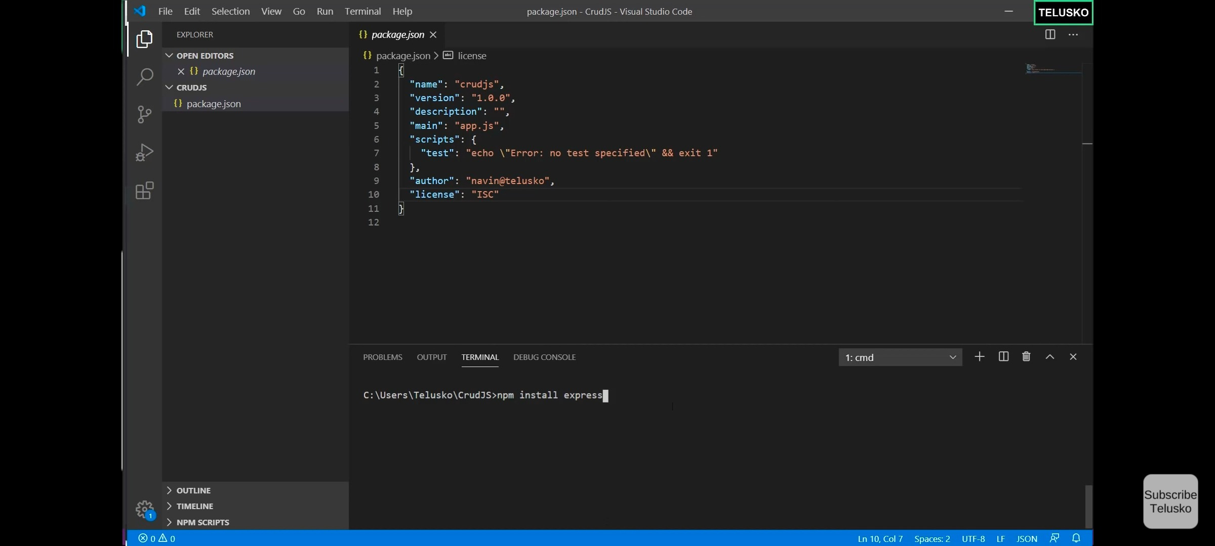
All your information will be there in package . Json

Slide 19
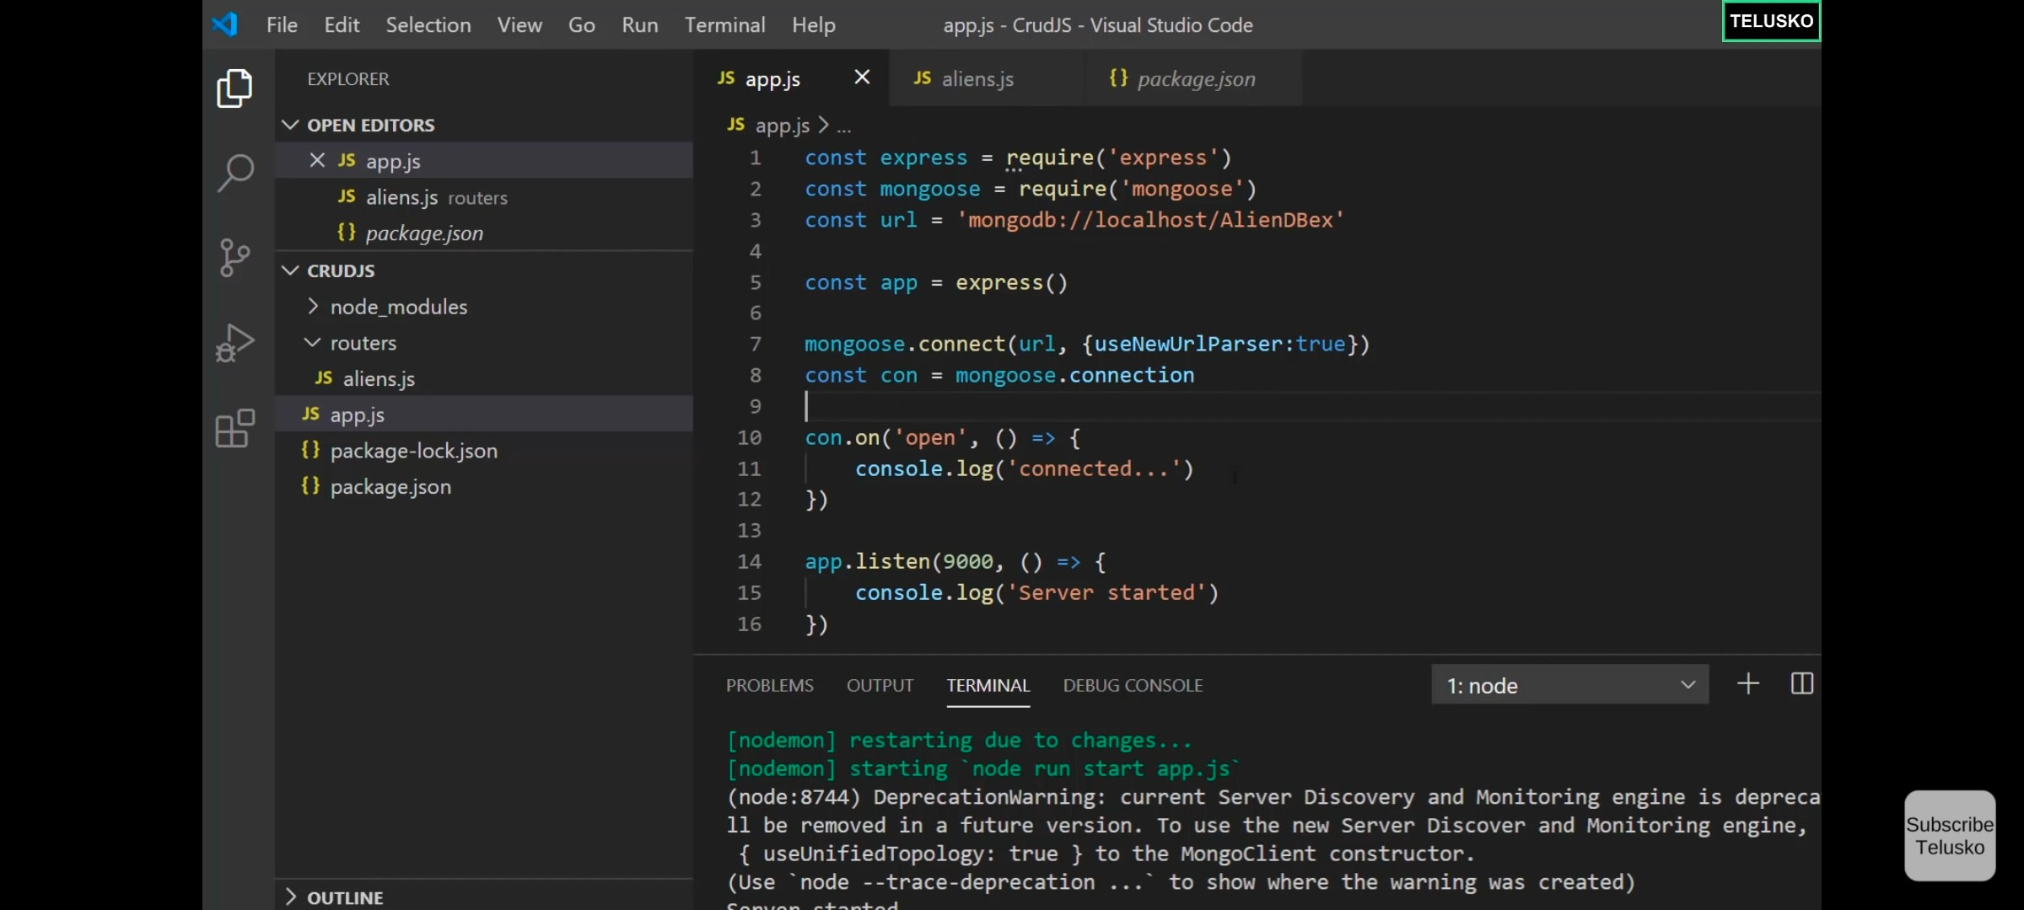
App.js

Slide 20
App.js

Slide 21
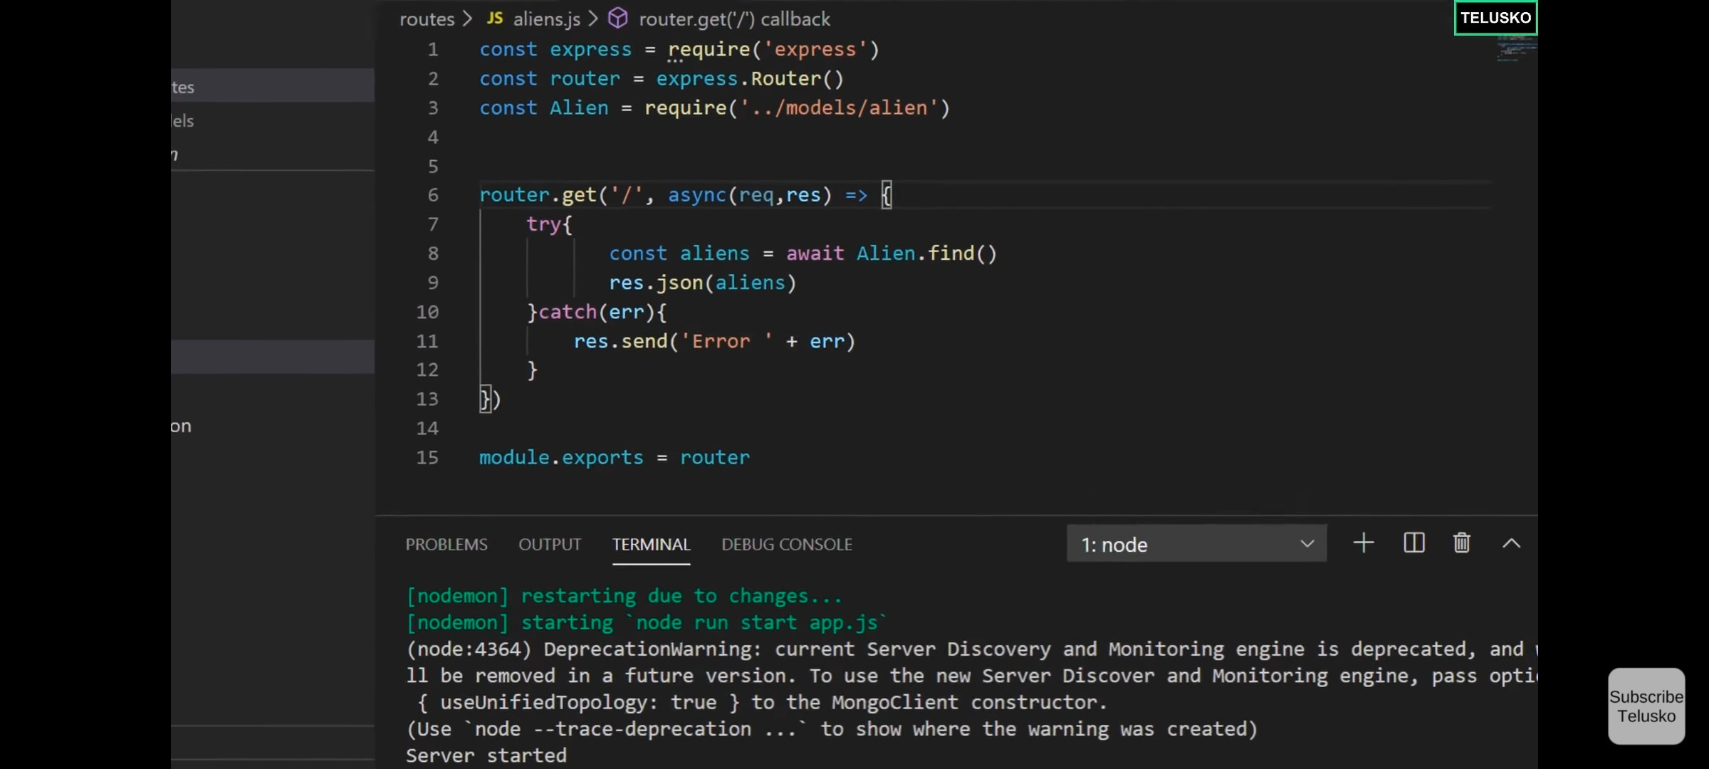
aliens.js import alien.js

Slide 22
Thank you
GOPALAKRISHNAN .S

