Slide 1
Blector
Electronic Voting using block chain (reference Implementation)
https://github.com/nvijaykarthik/block-chain-electronic-voting-reference-implementation-using-javascript
From : Vijaykarthik N

Slide 2
Blector Introduction
Blector is an electronic voting system , Developed using block chain technology as a reference implementation.
Block chain is a platform where we can implement different usecase.
Data once created cannot be tampered.
Electronic voting is one of the use case of block chain platform.
Blector is developed using Node , express and react js.

Slide 3
Block chain Overview
The blockchain is a decentralized database that records the data , it could be money transaction , Supply chain, Votes, assests etc.,
It consist of Block and chain , and entire data is synchronized accrossed the network
It could be public(bitcoin) and private (hosted in an organization)
=- New Txn -=
Mining
Proof Of work
Verification
BC Node N/W
BC Node N/W
BC Node N/W
Node
Node
Node
Node
Node
Node
Node
Node
Node
Add Txn to Pending Txn
and Broadcast to all nodes
Use Mining Algorithm to mine
the Txn and create a block then
add to the chain in local node ,
Broad Cast the chain to
All Mining Nodes
Verify the New chain and Update
the local chain with new one
Process Repeats

Slide 4
Block Chain Key terms
ADDRESS Used to receive and send transactions
BLOCKCHAIN Blockchains are distributed ledgers, secured by cryptography.
BLOCKS Transactions from the network fill blocks.
MINING & HASHING The process of trying to ‘solve’ the next block.
NODES A computer that possesses a copy of the blockchain and is working to maintain it.
SMART CONTRACTS Also known as a smart property, they are computer protocols that facilitate, verify, or enforce the negotiation
Public and Private Keys User Id and Password

Slide 5
Blector Architecture
Poll Booth
Poll Booth
Node
Node
PollBooth Manager
Poll Booth
Node
Poll Booth
Node
Node
Poll Booth
Node

Slide 6
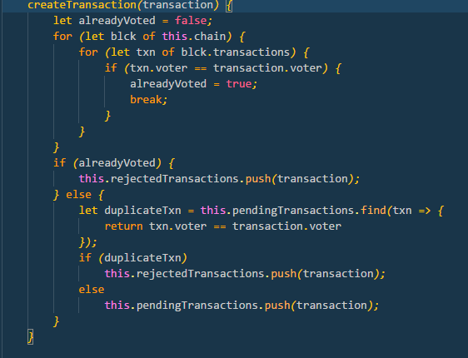
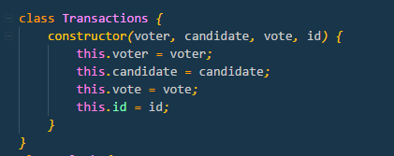
Transaction and Smart contract
Transaction
Transaction data is important param in the block chain
In Blector the transaction is just the voter , candidate ,vote count, ID ( to track the Txn )
Smart Contract
Smart contract is kind of protocol to accepts the transaction
In Blector , contract is to make sure the voter can cast his/her vote only once
For duplicate voting , send the transactions to rejected queue

Slide 7
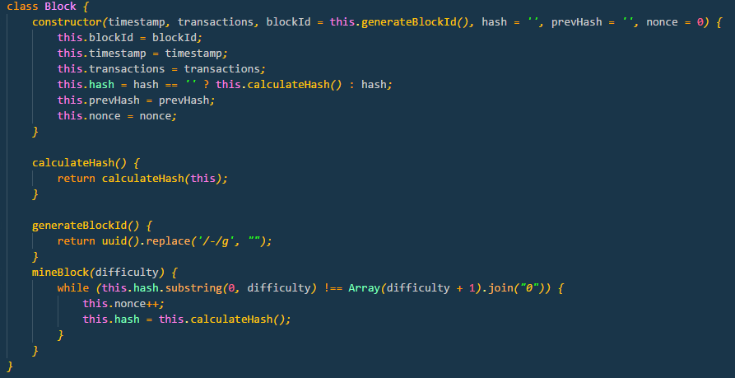
Block
A block is record of some or all of the most recent transactions that have not yet entered any prior blocks.
Block is like a page of a ledger or record book. Each time a block is 'completed', it gives way to the next block in the blockchain.
Block consist of important parameters like Timestamp, Transaction , Hash value , previous Hash value
It can also include other parameters based on the requirement
Blector
In Blector, Block has
Time stamp
Transactions
Hash
Previous hash
Nonce
Block id
Method to mine the block & calculate hash

Slide 8
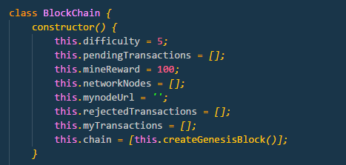
Chain
Chain in continuous growing block of records , where the data is tamper free
Chain include validation & update of local chain
Many operation on transactions ( based on requirement )
Blector
In Blector , chain consist of array of block , difficulty level, array of pending transaction , array of rejected transactions, nodes it connected, mine reward ( can be used if required) , my current transactions
Operations include
Creating transaction – validate the smart contract and create the txn
Validate and update the local chain
Check how many votes cast for the candidate
Check whether the voter already cast vote

Slide 9
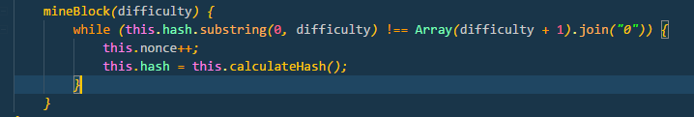
Mining & proof of work
Mining is a process of creating a block from the pending transaction and add to the chain.
Proof of work is to validate the chain and broadcast to the other nodes in the network.
Mining uses a custom or existing algorithm to create the block.
Creating a block means generating hash of the block ,
Generating the hash using the algorithm
Algorithm is simple to complex , usually SHA256
Blector
In Blector , Mining algorithm is simple .
Ie., you need to generate the hash until you get hash starts with 5 zero’s. ( 5 is defined in difficulty level)
Change the nonce to achieve the above hash value.

Slide 10
Distribution
Each important action in the blockchain will be notified to all the nodes in the netowork
The actions like
Creating transaction
Mining the block
Adding or removing the node etc.
Blector
In Blector , When voter cast the vote , it will be sent to all the nodes in NW.
Once the mining is done the chain is broadcasted .
Each node will validate the chain update or reject the chain.

Slide 11
Casting Vote
Once the voter cast the vote the vote is broadcasted to all the poll booths connected to the poll manager
The same voter cannot cast the vote again , it will go into rejected txn , in UI voter simply cannot cast the vote again
Blector will mine the block on user request.

Slide 12
Demonstration

Slide 13
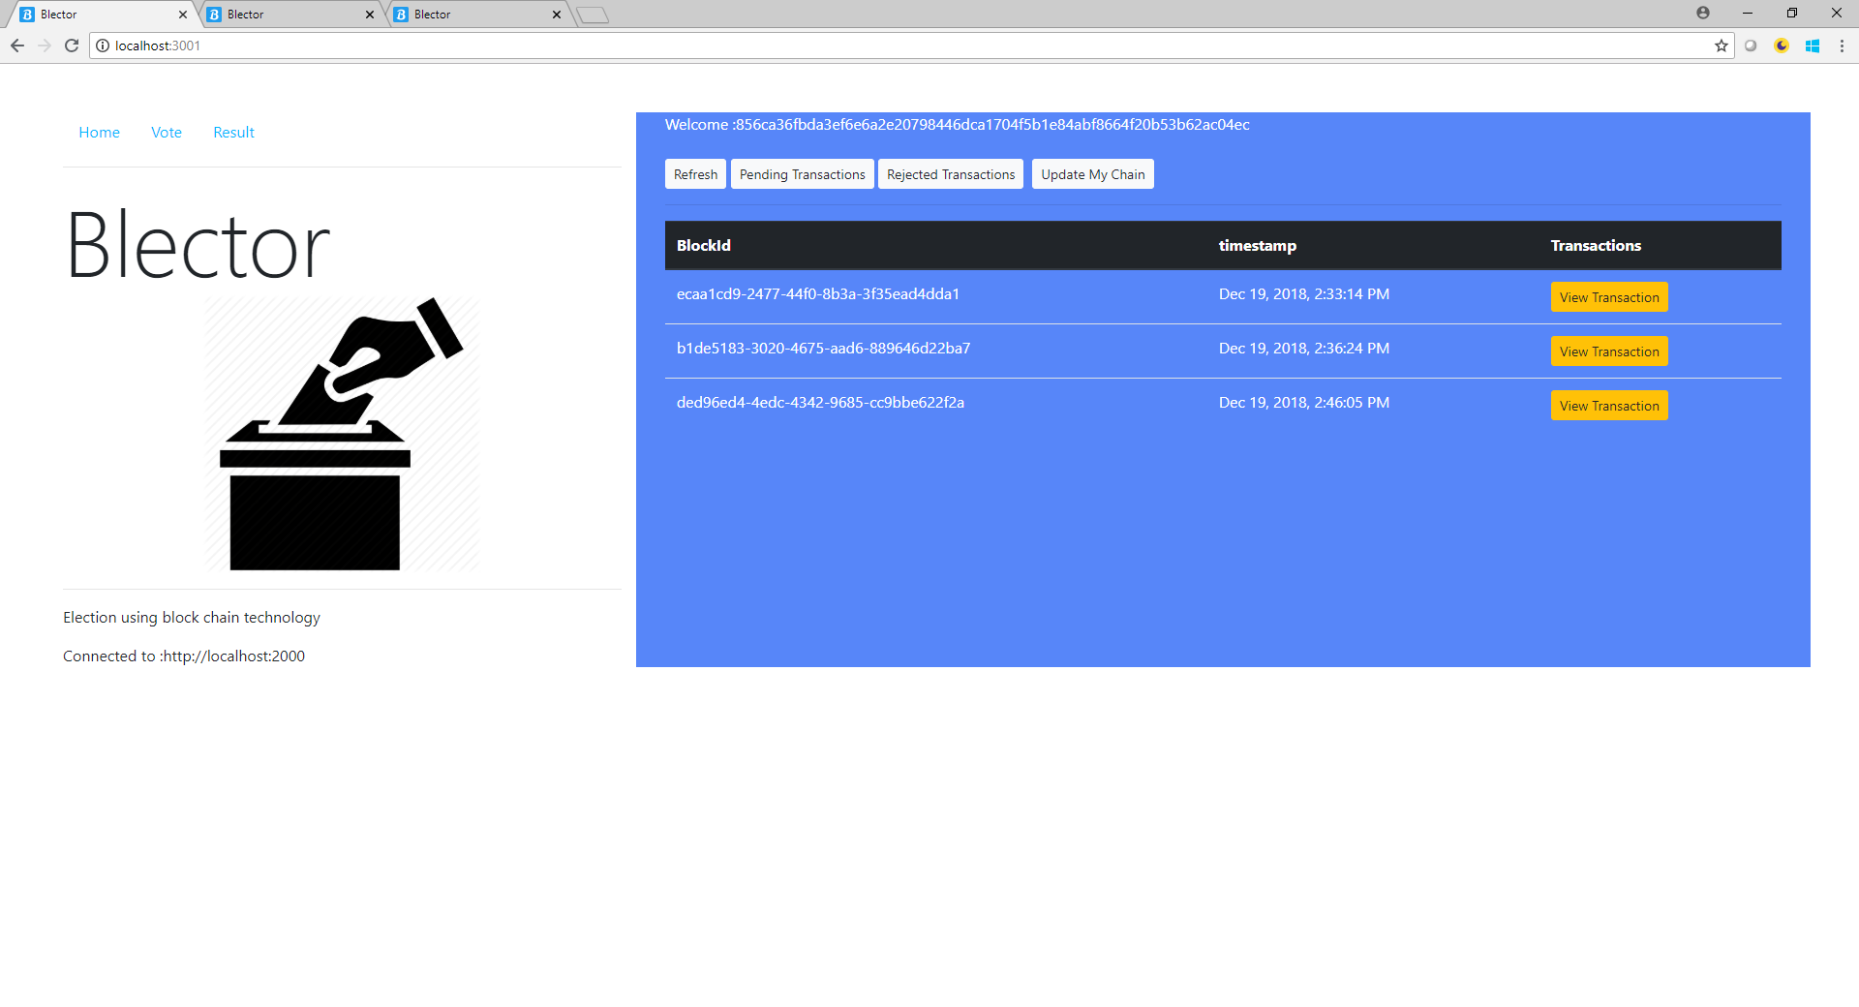
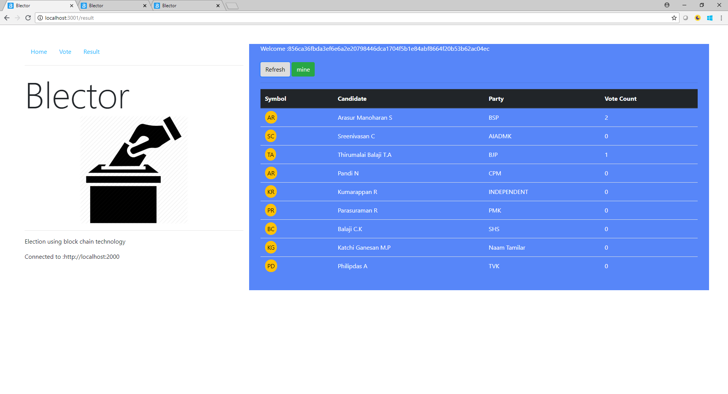
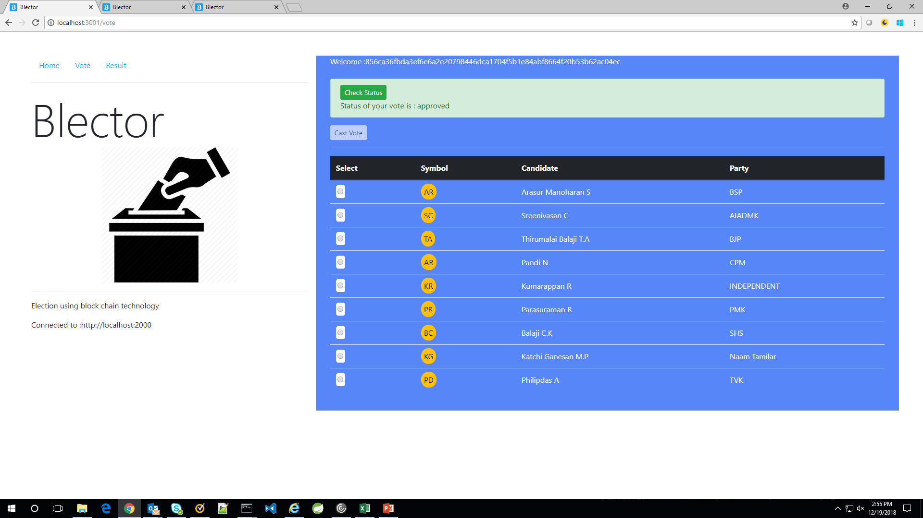

Slide 14
Thank you

