Slide 1

MACHINE LEARNING LAB PROJECT SEMINAR
TITLE:FAKE PRODUCT REVIEW DETECTION
-K.Lakshmi chetana
22321A1240
III IT-A

Slide 2
INTRODUCTION
Autistic Spectrum Disorder (ASD) is a neurodevelopmental condition that has significant healthcare costs associated with it. Early diagnosis of ASD can greatly reduce these costs. However, the current procedures for ASD diagnosis often involve lengthy waiting times and are not cost effective. As the number of ASD cases continues to rise worldwide, there is an urgent need to develop easily implemented and effective screening methods.
To address this issue, we aim to tackle the binary classification problem of ASD screening in adults using machine learning. The objective is to build a model that can predict whether a person has a possibility of having ASD based on a set of attributes. By leveraging the power of machine learning, we intend to develop a time-efficient and accessible screening tool that can assist healthcare professionals in the initial assessment of ASD in adults.

Slide 3
PROBLEM STATEMENT
Autism Spectrum Disorder (ASD) affects millions of individuals worldwide, presenting unique challenges in social interaction, communication, and behavior. Early diagnosis is critical for effective intervention and support, but the diagnostic process is often subjective, time-intensive, and limited by the availability of trained specialists.
By developing an effective screening model, we aim to provide health professionals with a valuable tool that can help prioritize individuals for further clinical diagnosis, thereby reducing waiting times and improving the overall efficiency of the ASD diagnostic process.

Slide 4
KEY TECHNOLOGIES
1.Machine Learning Algorithms-
Logistic Regression: Utilized for binary classification to predict whether an individual is likely to have Autism Spectrum Disorder (ASD).
2.Data Preprocessing Tools-
Pandas, NumPy, MinMaxScaler (from sklearn)
3.Data Visualization Tools
Seaborn and Matplotlib: Used for creating violin plots, swarm plots, and histograms to explore patterns in the data and visualize relationships between features.

Slide 5
4. Encoding and One-Hot Encoding
Categorical variables such as gender, ethnicity, and family history are converted into numerical representations using one-hot encoding to ensure compatibility with machine learning models.
5.Frameworks and Libraries
scikit-learn: Used for machine learning model implementation, including logistic regression, data splitting, and performance evaluation (e.g., cross-validation and F-beta score).
IPython Display: Used to visually present the dataset and summaries during development.

Slide 6
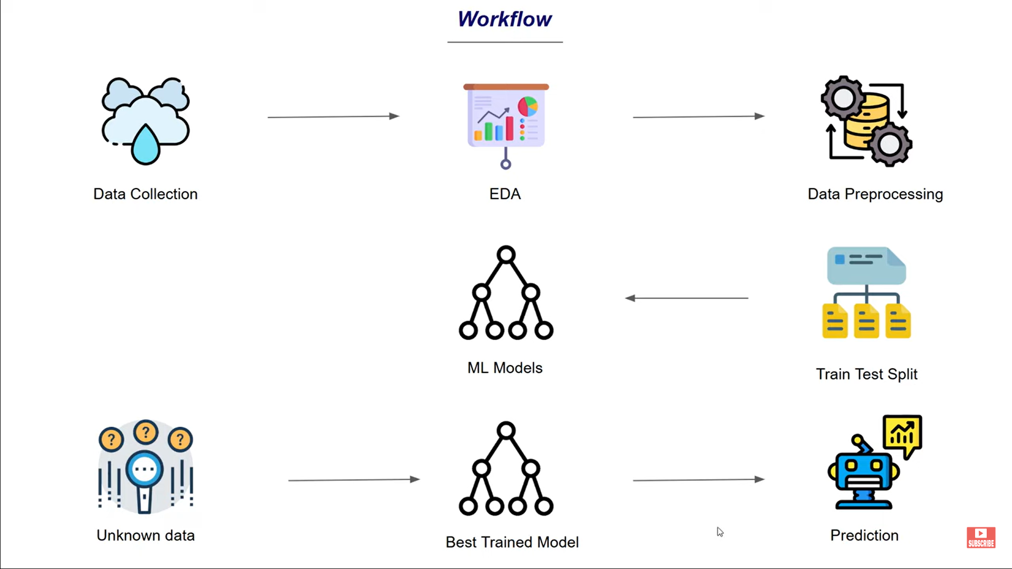
SYSTEM DESIGN/ARCHITECTURE

Slide 7
DATA PREPROCESSING
Steps:
Dataset Loading: Loaded autism_data.csv and explored basic statistics.
Missing Data Handling:
Identified missing values.
Removed incomplete records.
Feature Scaling & Encoding:
Normalized numerical features (age, result) using MinMaxScaler.
Applied one-hot encoding for categorical variables.
Label Conversion: Transformed Class/ASD:
'YES'
'NO'
Data Splitting: Divided data into 80% training and 20% testing sets.
Visualizations:
Violin plots for relationships.
Histogram of ASD classification.
Final Dataset: Clean and preprocessed data ready for model training.

Slide 8
MACHINE LEARNING MODEL
Model Selection:
Chose Logistic Regression for its simplicity and effectiveness in binary classification.
Cross-Validation:
Used 10-fold cross-validation to evaluate the model’s performance.
Average cross-validation score calculated.
Accuracy for logistic regression is 99.7%,f-beta is 0.994
User Input Prediction:
Created a pipeline for real-time user input. Encoded and scaled user data to align with the training dataset.
Provided prediction:
Output: "Autism Detected" or "No Autism Detected" based on the model’s decision.

Slide 9
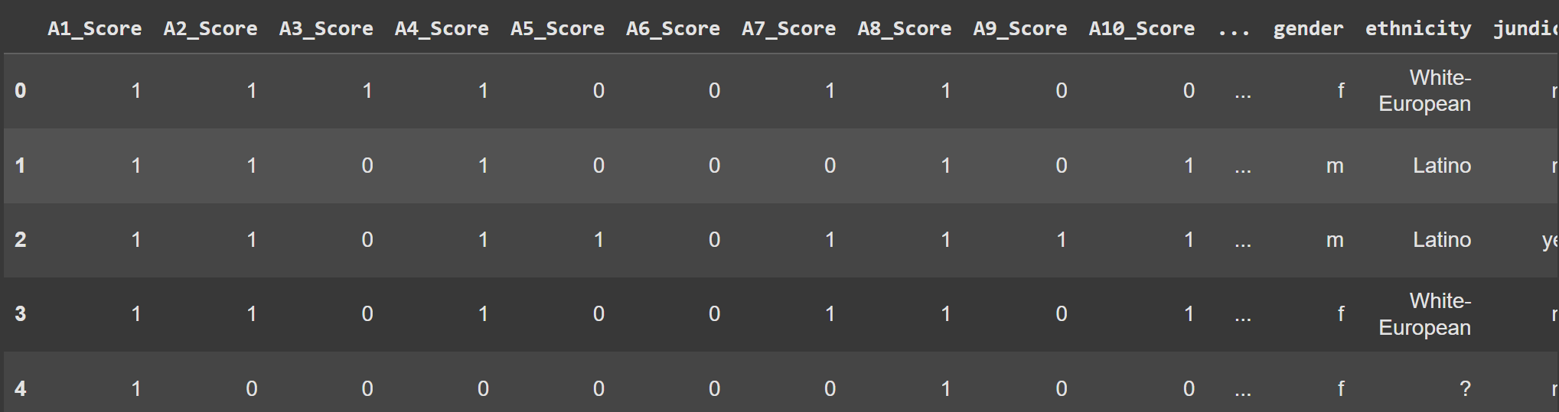
DATASET

Slide 10
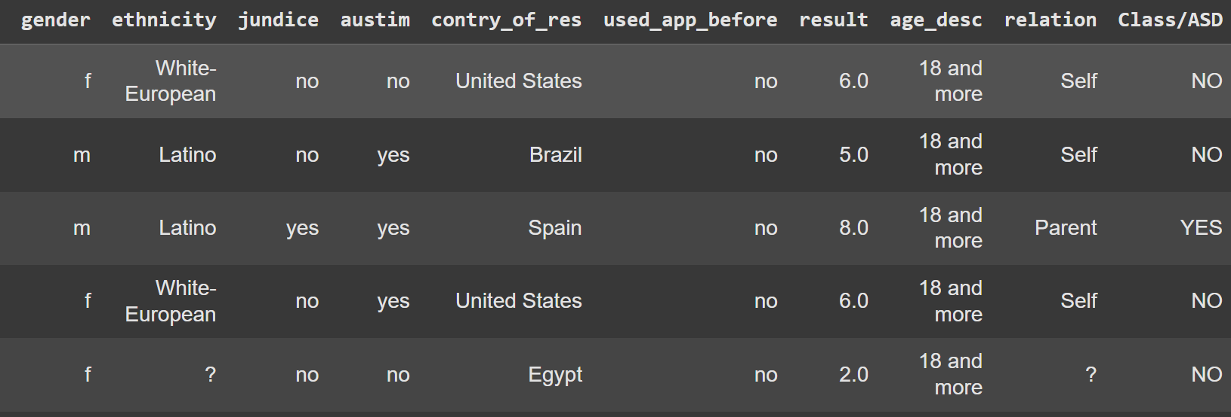

Slide 11
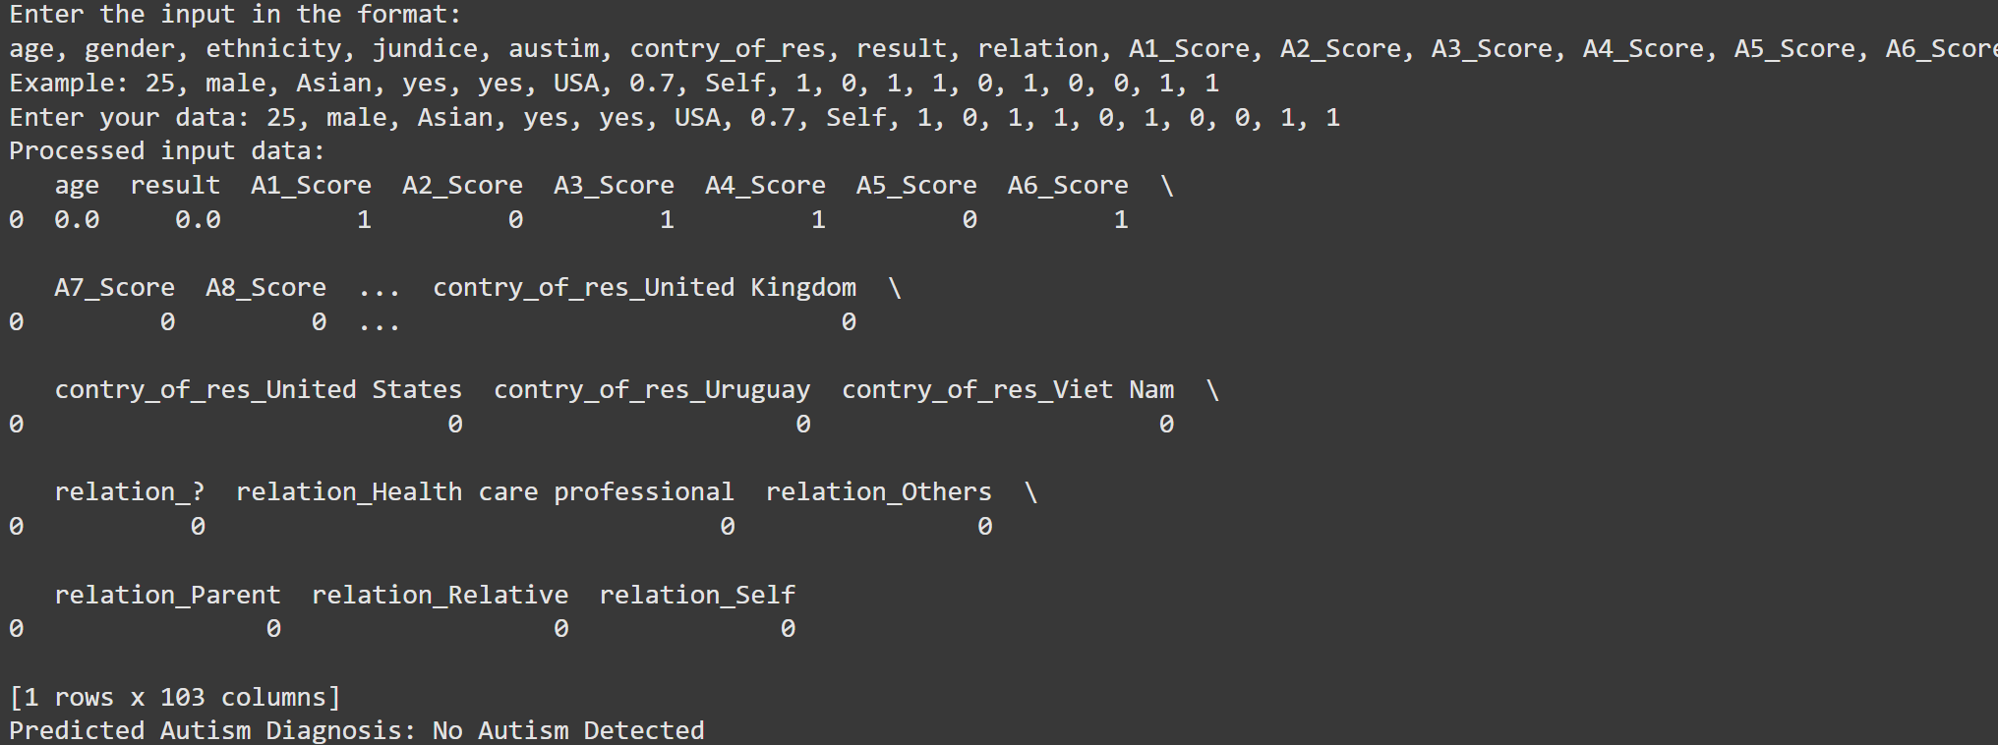
Output/performance:

Slide 12
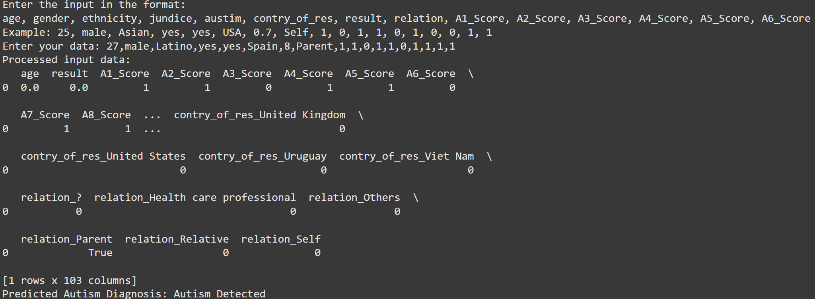

Slide 13
Conclusion
End Users: Healthcare professionals and researchers can use the tool for initial screenings and data-driven insights to aid clinical decisions.
Utility: Early and accurate detection facilitates timely interventions, improving outcomes for individuals with ASD and supporting caregivers.

