Slide 1
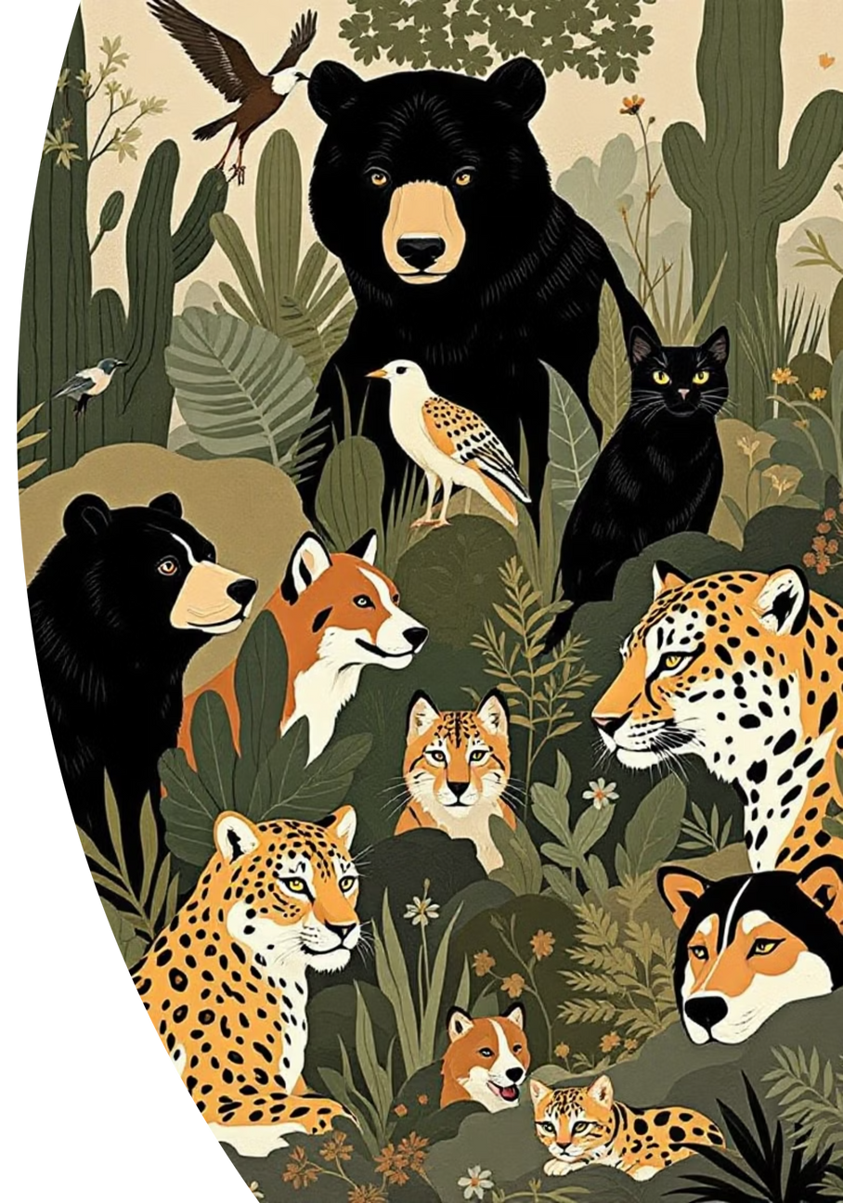
AI-Powered Animal Classification System
Deep Learning Solution for 75+ Species Recognition
Notes:
1

Slide 2

The Problem & Solution
The Challenge
Our Solution
Manual classification is time-consuming and lacks accuracy
95%+ accuracy across 75+ species
Instant classification under 1 second
Traditional methods aren't scalable
User-friendly web interface
Limited accessibility for non-experts
Self-improving through feedback
Notes:
2

Slide 3
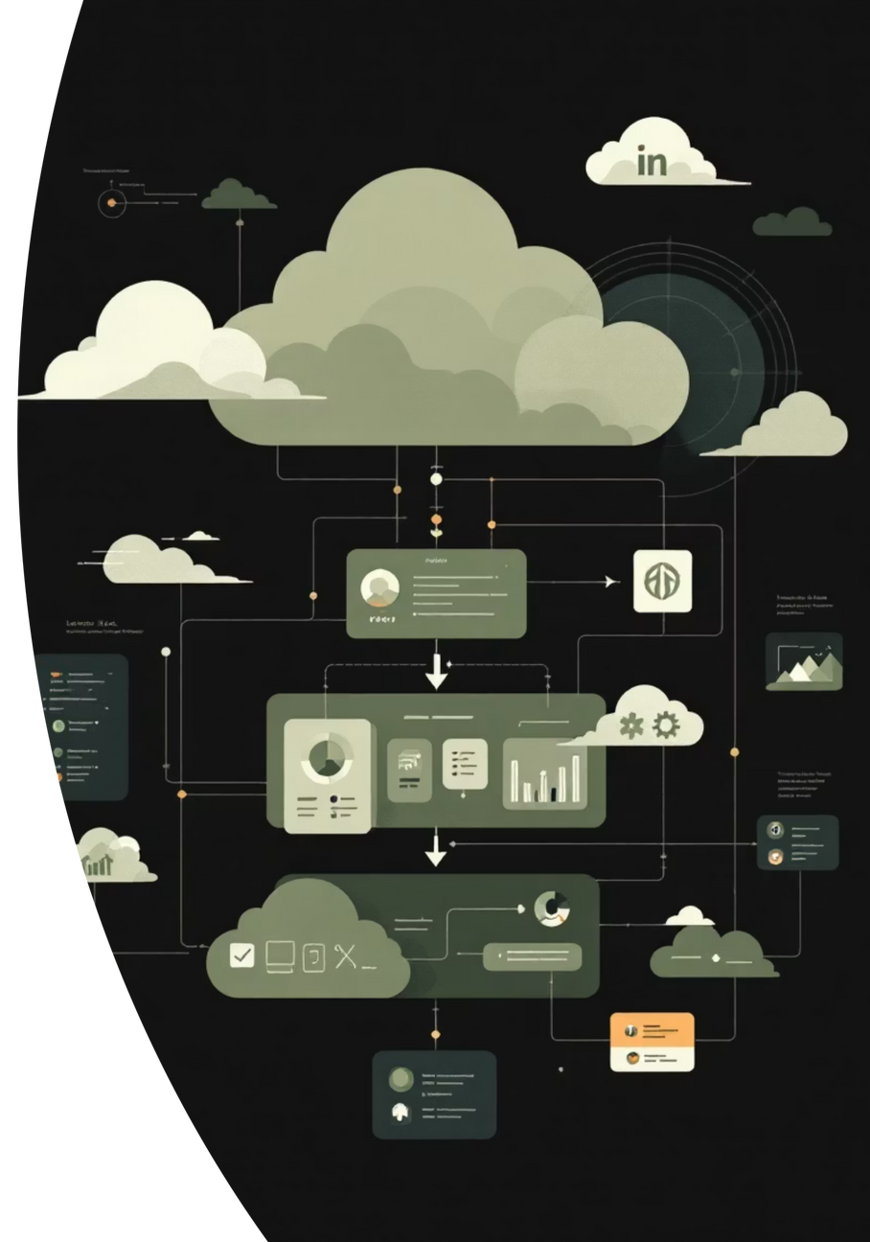




Technical Architecture
Frontend Layer
Bootstrap 5 with responsive design and vanilla JavaScript
FastAPI Backend
Async, high-performance API with security features
ResNet18 Model
PyTorch 2.0+ with transfer learning from ImageNet
Feedback Loop
Incremental learning with JSON-based storage
Deployed using Docker + Docker Compose with pytest testing achieving 80%+ coverage
Notes:
3

Slide 4
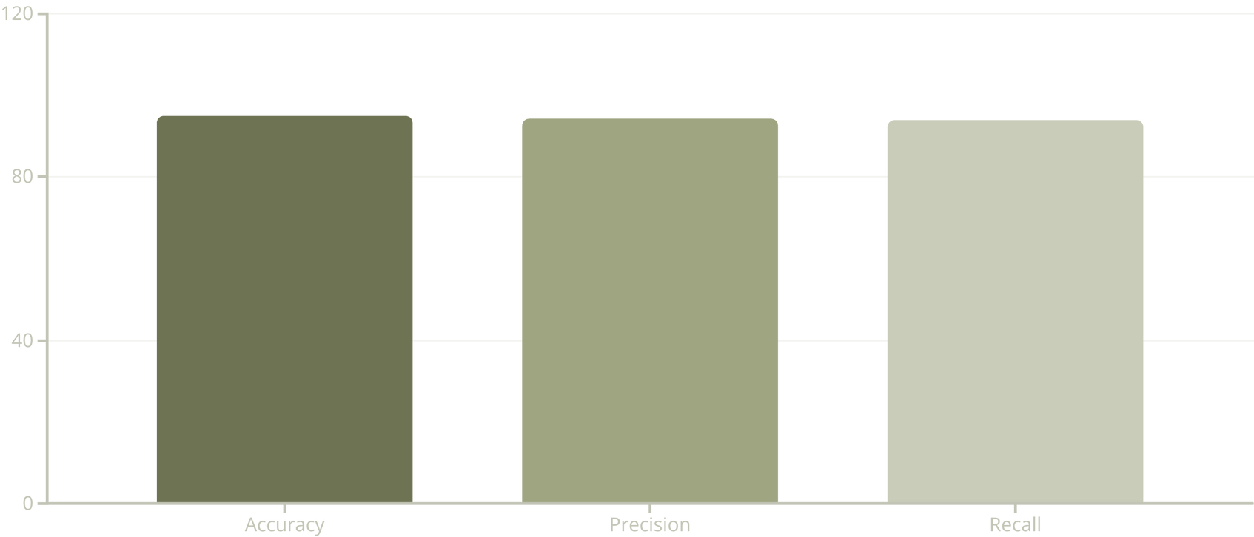
Dataset & Model Performance
75+ Species
95%+ Accuracy
High Precision
6 bears, 15+ birds, 5 cat breeds, 6 big cats, 5 dog breeds, and more
Inference under 1 second with ImageNet pre-training
94.2% precision and 93.8% recall average
Notes:
4

Slide 5




Key Features - Part 1
Advanced Classification
User-Friendly Interface
Visual Explanations
Real-time image analysis with multi-species support for 75+ animals. Shows confidence scores and top-3 predictions.
Drag & drop image upload with mobile-responsive design. Instant results display in a clean, modern UI.
Grad-CAM heatmap visualization shows what the model sees, building user trust with educational value.
Notes:
5

Slide 6
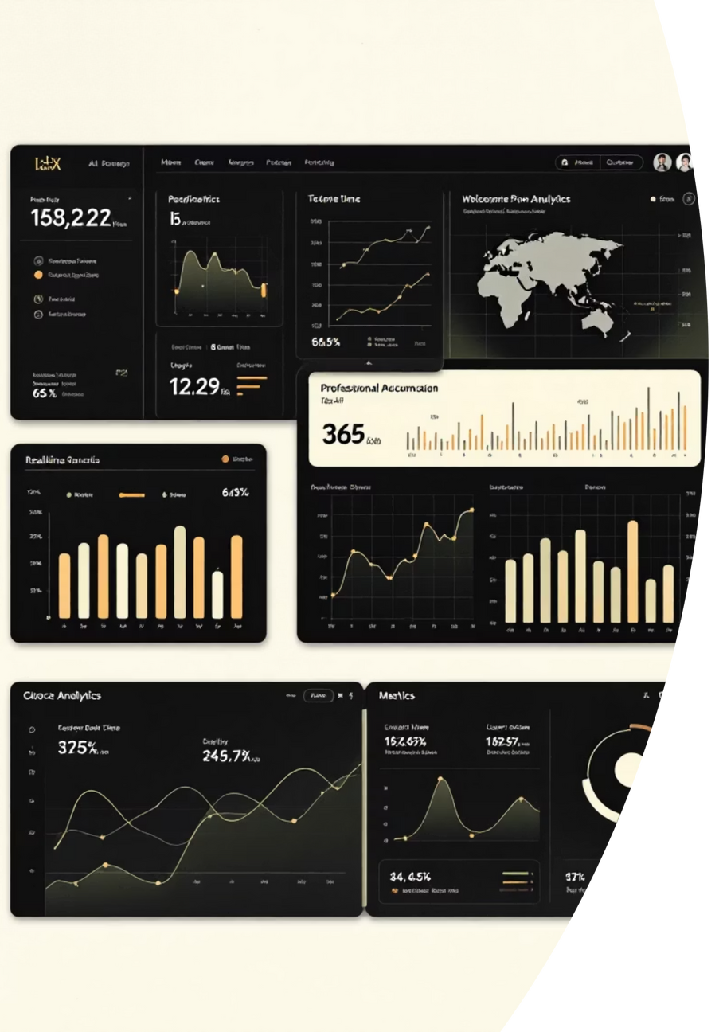
Key Features - Part 2
1
2
Incremental Learning
Analytics Dashboard
Learns from user corrections without catastrophic forgetting using smart replay mechanism and automatic model updates.
Real-time performance metrics with confusion matrix visualization, class-wise accuracy, and feedback statistics.
3
Security & Performance
Rate limiting (100 req/60s), input validation, security headers (CSP), file upload protection, and async processing.
Notes:
6

Slide 7
Workflow & User Journey
01
02
03
Upload Image
Get Prediction
View Visualization
Drag & drop or click to upload. Supports JPG, PNG, JPEG formats.
Model analyzes image and returns top-3 predictions with confidence scores.
Grad-CAM heatmap overlay highlights important regions for visual explanation.
04
05
Provide Feedback
Analytics
Correct predictions if wrong, submit feedback, and model learns automatically.
View performance metrics, track improvements, and monitor usage.
Notes:
7

Slide 8





Incremental Learning System
Traditional ML Problem
Our Solution
Train once, deploy, static model
User feedback flows into correction log, smart sampling combines 70% feedback with 30% replay, fine-tunes model, and deploys updated version for better accuracy.
Errors accumulate over time
Retraining requires full dataset
Targeted Updates
Replay Mechanism
Focus on classes with errors
Prevents forgetting
Fast Training
Measurable Improvement
5-10 minutes per update
Track accuracy gains
Notes:
8

Slide 9





Deployment & Infrastructure
Docker Deployment
Containerized deployment with docker-compose. App runs on port 8000, TensorBoard on port 6006.
Testing & Quality
Comprehensive pytest suite with 80%+ code coverage. Unit and integration tests for API endpoints.
Monitoring
Health check endpoints, TensorBoard integration, analytics dashboard, and real-time metrics.
Scalability
Easy horizontal scaling, cloud-ready for AWS, Azure, GCP, Render with environment-based configuration.
Notes:
9

Slide 10


Impact & Future Roadmap
75+
95%
<1s
Species Supported
Accuracy Achieved
Response Time
Real-World Applications
Wildlife conservation and species identification
Pet industry breed identification
Educational interactive learning tools
Tourism nature guide applications
Research dataset creation assistance
Future Roadmap
Q1 2025
Q3 2025
Expand to 150+ species, add video classification
Multi-language support, real-time camera integration
1
2
3
4
Q2 2025
Q4 2025
Mobile app (iOS/Android), API monetization
Blockchain for model versioning
Notes:
10

