Slide 1

A MAJOR PROJECT ON POWER ENHANCEMENT WITH GRID STABILIZATION OF RENEWABLE ENERGY-BASED GENERATION SYSTEM USING UPQC-FLC-EVA TECHNIQUE
UNDER THE GIUDENCE OF
Mr.B.PRAVEEN
Assistant Proffesor
Presented by
K.EPSIBA 22C45A0210
B.ASHADEVI 22C45A0206
MD.SOHAIL 21C45A0248
CH.KARTHIK 22C45A0215
DEPARTMENT OF ELECTRICAL AND ELECTRONICS ENGINEERING

Slide 2
ABSTRACT
The increasing reliance on solar and wind energy introduces voltage fluctuations, harmonic distortions, and grid instability.
A Unified Power Quality Conditioner (UPQC) integrated with a Fuzzy Logic Controller (FLC) and an Evolutionary Algorithm-Based Voltage Regulator (EVA) enhances power stability and mitigates voltage sags, harmonics, and reactive power issues.
By combining compensation (UPQC), adaptive control (FLC), and dynamic voltage regulation (EVA), the system ensures uninterrupted power supply, significantly improves grid reliability, and demonstrates proven effectiveness through simulation and analysis.

Slide 3
Literature Survey
Solar and wind energy cause voltage instability, frequency fluctuations, and power quality issues in the grid.
Traditional UPQC and rule-based FLC approaches struggle with intermittent generation and dynamic load variations.
Limited studies explore the integration of UPQC, FLC, and EVA for comprehensive power quality enhancement in renewable energy systems.

Slide 4
INTRODUCTION
Solar and wind energy introduce voltage fluctuations, harmonics, and grid instability.
This research develops a stabilization system using UPQC, FLC, and EVA to enhance power quality and grid performance.
The system improves grid stability, enhances energy efficiency, supports large-scale renewable adoption, and advances smart grid technology.

Slide 5
Existing System
Rely on fossil fuels with minimal renewable energy integration.
Solar PV and wind energy operate independently with limited storage and grid interaction.
Conventional methods like SVC and UPFC lack adaptability, requiring intelligent optimization with FLC and EVA.

Slide 6
Proposed System
It Combines UPQC, FLC, and EVA to enhance power quality and grid stability in renewable energy-based generation.
Utilizes solar, wind, and energy storage to ensure continuous power despite fluctuations.
UPQC mitigates voltage issues, FLC enables real-time adaptive control, and EVA optimizes voltage and reactive power flow for seamless renewable energy integration.

Slide 7
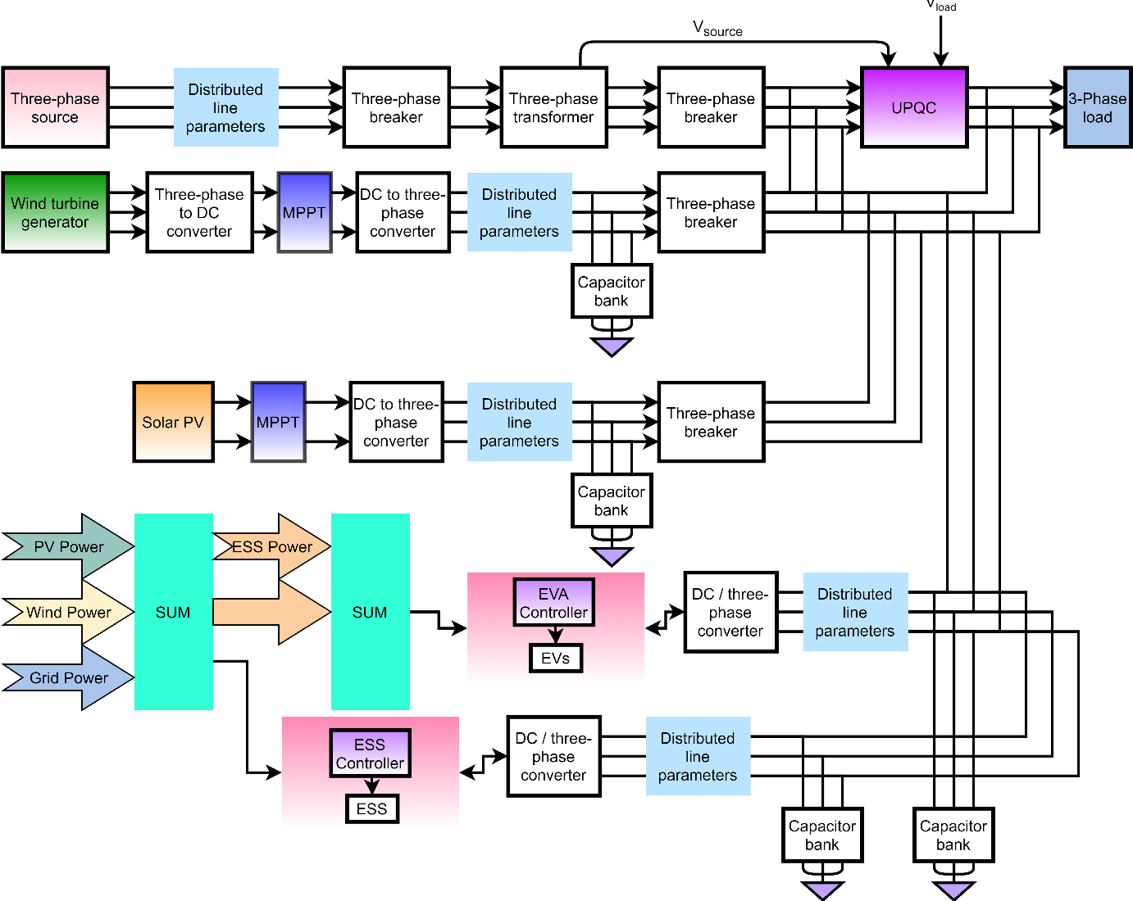
Block Diagram

Slide 8
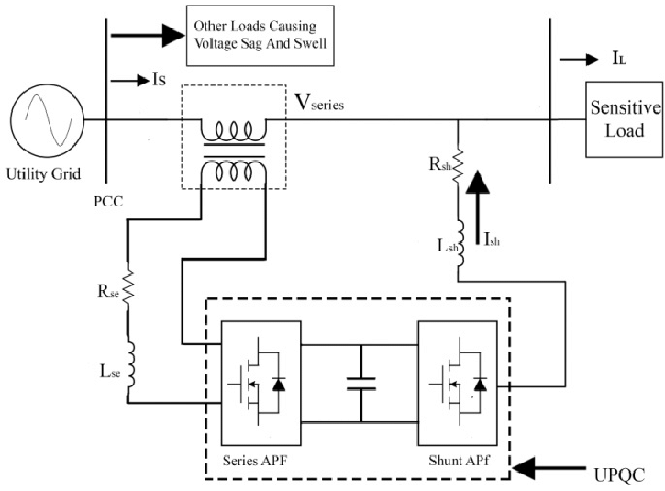
UNIFIED POWER QUALITY CONDITIONER

Slide 9
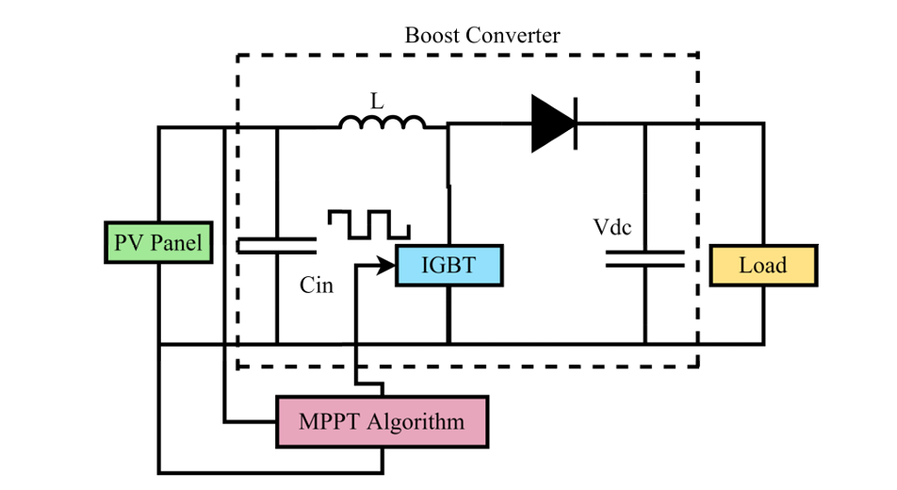
MAXIMUM POWER POINT TRACKING

Slide 10
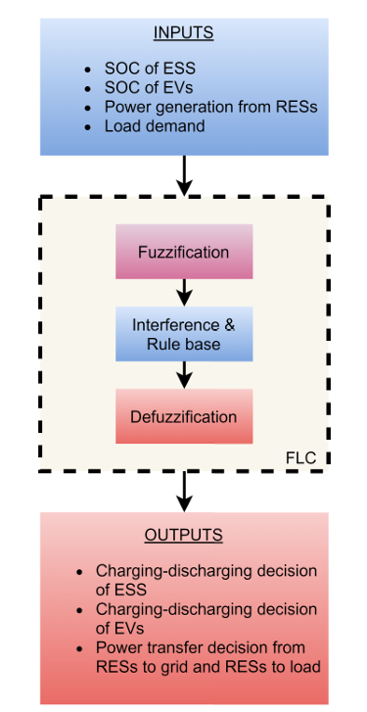
FLC-based control of PV-WE-ESS-EV system

Slide 11
Working
UPQC, FLC, and EVA work together to enhance power quality and stabilize the grid with renewable energy sources like solar and wind.
Renewable energy intermittency causes voltage fluctuations, harmonics, and reactive power imbalances.
Series and shunt compensators monitor and correct disturbances by injecting or absorbing power for grid stability.
FLC dynamically adjusts UPQC parameters, ensuring real-time response to power generation variations and improving grid reliability.

Slide 12
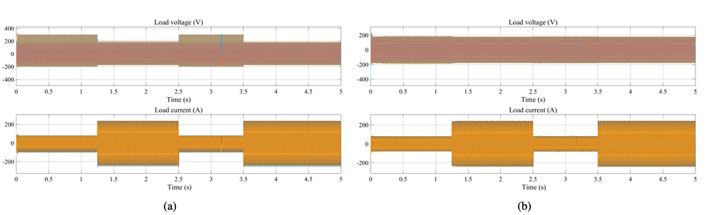
Wave Forms
(a) Voltage and current quality under unavailability of PV-WE and without the addition of EVs (The waveforms are distorted), and (b) Voltage and current quality under unavailability of PV-WE and with the addition of EVs (Waveform quality is improved).

Slide 13
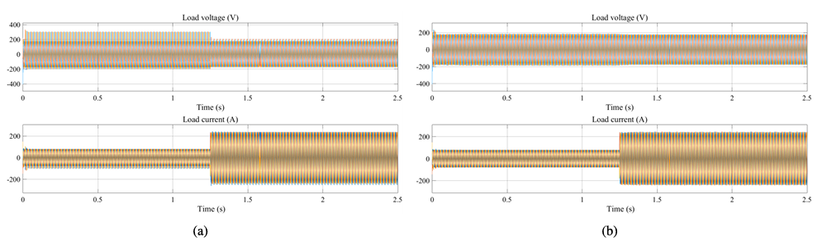
(a) Voltage and current of load side without EVA under the availability of PV-WE in lesser amount for time span 0 to 2.5 s shows high distortions in the different loading conditions, and (b) Voltage and current of load side with EVA under the availability of PV-WE in lesser amount for time span 0 to 2.5 s. The load power is fulfilled and the waveforms of voltage and current are improved under different loading conditions.

Slide 14
Applications
Smart Grid Systems
Industrial Power Systems
Microgrids and Distributed Generation
Electric Vehicle (EV) Charging Stations
Data Centers and Critical Infrastructure

Slide 15
Advantages
Reduces voltage sags, harmonics, and reactive power fluctuations for a stable supply.
Mitigates disturbances for smooth solar and wind energy adoption.
Balances power between renewables, storage, and the grid.
Supports industries, microgrids, and large-scale renewable farms.
Addresses grid challenges, encouraging renewable energy use.

Slide 16
Disadvantages
The integration of UPQC, FLC, and EVA requires advanced power electronics and computational resources, increasing setup costs.
The system relies on real-time data from sensors, and any errors in measurement can affect performance.
In smart grids, communication between the system components and controllers must be fast and reliable, any network delays can affect performance.

Slide 17
Conclusion
The UPQC-FLC-EVA system enhances power quality, stabilizes renewable energy integration, and optimizes voltage regulation through real-time adaptive compensation.
It mitigates voltage fluctuations, harmonics, and reactive power issues, ensuring efficient and reliable power distribution.
The proposed PV-WE-ESS-EV system ensures the grid system reliability and enhances the power quality of the system because of EVs addition to the grid. It is also observed that the distortions in voltage and current waveforms are avoided using the UPQC-FLC-EVA technique. The THD of load and source-side voltages and currents are obtained and are lesser than 5% using the proposed technique.

Slide 18
