Slide 1

Bus Ticket Booking System
Seat reservation, waiting list and cancellation management
Third-year CSE DBMS project
IIITDM Kurnool • Team of three
Oracle Database 21c XE · Django · Python
Notes:
Timing: about 0.8 minutes.
Introduce the project as a working browser application backed by Oracle. State that the focus is reservation correctness, fairness after cancellation and demonstrable DBMS rules. Each team member can introduce their assigned portion.
Source: BusBook project report and repository, reviewed 2 November 2026. Live database totals are a dated snapshot. Payments and refunds are simulated.

Slide 2
The reservation problem
One physical seat can appear on many trips. A booking must claim it for exactly one scheduled trip.
01
No double booking
02
Fair cancellation
03
Traceable lifecycle
Two passengers may select the same seat at the same time.
A released seat should reach the next waiting passenger.
Holds, confirmations, cancellations and refunds must agree.
1.2 min
2 / 14
Notes:
Timing: about 1.2 minutes.
Explain why a per-bus seat list is insufficient. We use TripSeat as per-trip inventory. The database must arbitrate concurrent claims and preserve a coherent state if any part of a multi-seat booking fails.
Source: BusBook project report and repository, reviewed 2 November 2026. Live database totals are a dated snapshot. Payments and refunds are simulated.

Slide 3
Passenger and staff workflow
1
2
3
4
Search
›
Reserve
›
Confirm
›
Manage
Find future direct trips
Select up to six trip seats
Simulate payment and print ticket
Cancel or join waiting list
Staff maintain buses, seats and trips in Django admin. Oracle views feed the Insights dashboard.
1.2 min
3 / 14
Notes:
Timing: about 1.2 minutes.
Walk through the passenger journey before discussing internals. Login is required for booking. Holds last ten minutes. A full trip presents the waiting list. Staff get Django admin and reporting. No real money moves.
Source: BusBook project report and repository, reviewed 2 November 2026. Live database totals are a dated snapshot. Payments and refunds are simulated.

Slide 4
Technical architecture
Browser
Django
Oracle XE
›
›
Forms, seat map, tickets
URLs, views, services, ORM
Tables, indexes, triggers, views
Local team demo: host laptop runs Django and Oracle; teammates connect through the same Wi-Fi or hotspot.
2 min
4 / 14
Notes:
Timing: about 2 minutes.
Explain request flow from browser to Django URL routing, views and service functions. Django ORM opens transactions against BUSBOOKING in XEPDB1. Oracle validates writes and computes reporting views. SQL Developer accesses the same Oracle schema for evidence. GitHub stores code and documentation, not the live database. Local access works with or without internet after setup.
Source: BusBook project report and repository, reviewed 2 November 2026. Live database totals are a dated snapshot. Payments and refunds are simulated.

Slide 5
Data model and relationships
Bus
physical vehicle and operator
Booking
passenger claim and status
Seat
number unique within a bus
Payment
simulated capture or refund
Trip
route, times, bus and fare
WaitlistEntry
FIFO demand and offers
TripSeat
one seat on one trip
BookingStatusEvent
status history
2 min
5 / 14
Notes:
Timing: about 2 minutes.
Describe the key relationships: Bus has Seats and Trips; Trip plus Seat become TripSeat inventory with a unique trip-seat constraint; Booking belongs to User and Trip, and TripSeat rows reference Booking when reserved; Payment belongs to Booking; WaitlistEntry references Trip and User and may offer a TripSeat; BookingStatusEvent tracks status changes. Normalization separates facts according to their dependencies.
Source: BusBook project report and repository, reviewed 2 November 2026. Live database totals are a dated snapshot. Payments and refunds are simulated.

Slide 6
Oracle integrity rules
Keys and checks
Triggers
Conditional unique indexes
Primary and foreign keys; unique trip-seat; fare, time and state checks.
Cross-table trip/bus consistency; offer-trip match; booking audit; bus schedule overlap.
One active queue entry per passenger and trip; one live offer per seat.
These rules apply even when a write bypasses the web interface.
2 min
6 / 14
Notes:
Timing: about 2 minutes.
Give examples of DBMS concepts with exact use. Checks enforce row-local rules such as positive fare and valid time order. Foreign keys protect references. Triggers enforce rules spanning tables, including matching offered seat to trip and no overlapping trips for one bus. Oracle function-based unique indexes use expressions that return NULL for inactive rows, allowing history while preventing duplicate active entries or offers. The status audit is written by an Oracle trigger.
Source: BusBook project report and repository, reviewed 2 November 2026. Live database totals are a dated snapshot. Payments and refunds are simulated.

Slide 7
Atomic booking and concurrency
1
Lock the selected TripSeat rows
2
Recheck availability in Oracle
3
Create booking and attach every seat
4
Commit all changes together
Race test: 20 Oracle sessions, one successful hold, 19 seat conflicts.
1.8 min
7 / 14
Notes:
Timing: about 1.8 minutes.
Explain atomicity: a failure on the second seat rolled back the first seat and booking. Explain isolation: select_for_update locks inventory rows, and one of 20 concurrent sessions won a test for one seat. Mention consistency through Oracle constraints and durability after commit. The 20-session result is a test result, not a throughput benchmark.
Source: BusBook project report and repository, reviewed 2 November 2026. Live database totals are a dated snapshot. Payments and refunds are simulated.

Slide 8
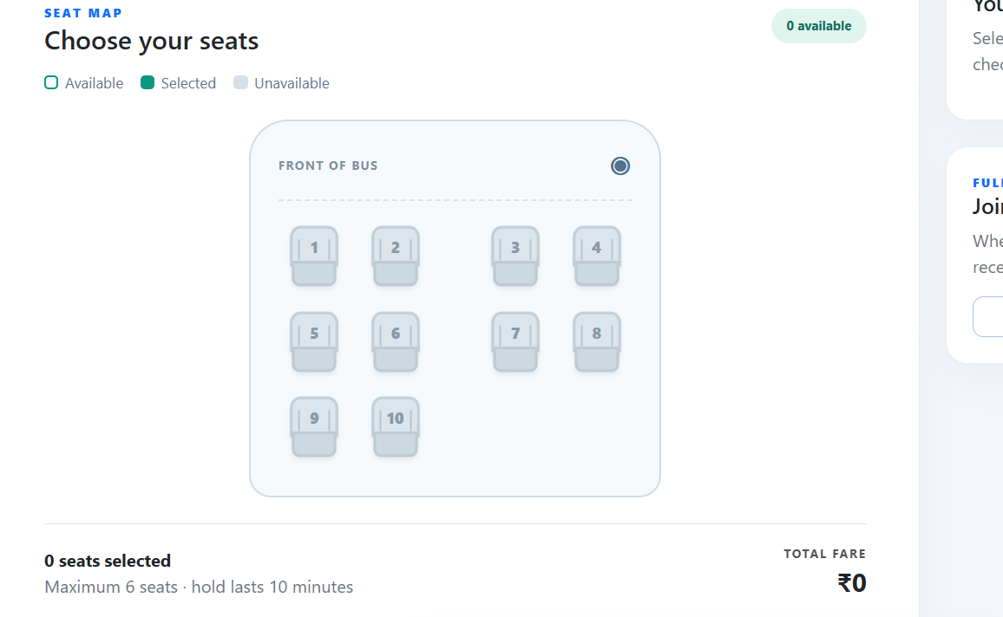
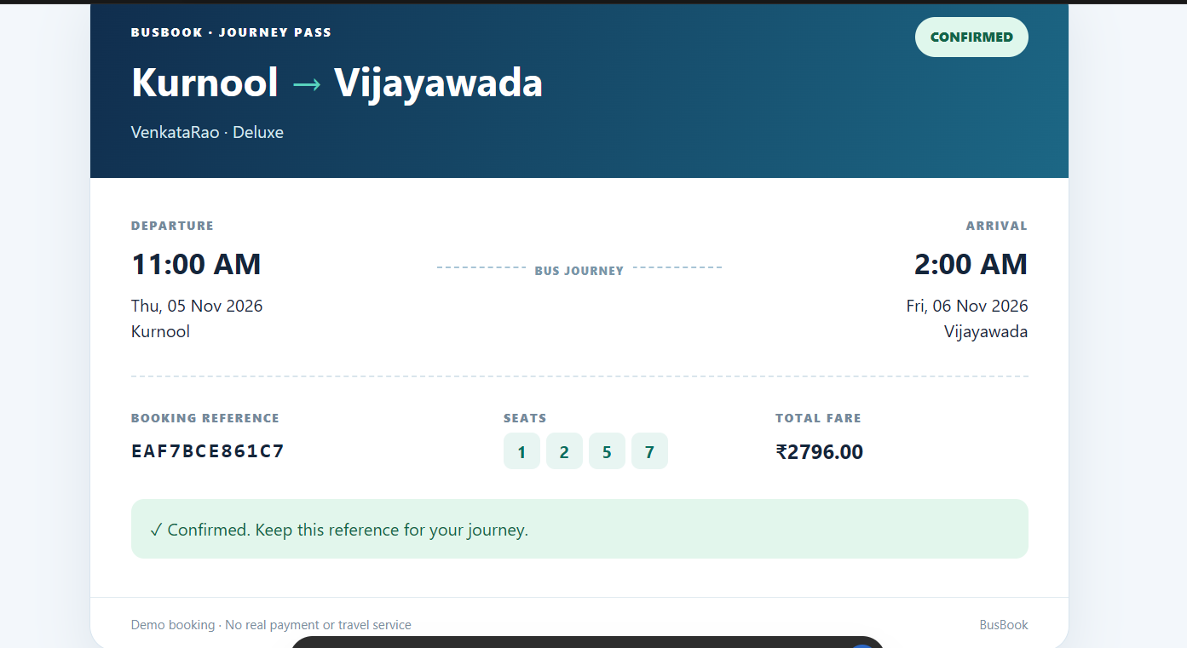
Seat selection and ticket
Visual seat layout
Printable journey pass
1.3 min
8 / 14
Notes:
Timing: about 1.3 minutes.
Show the bus-style seat map and the resulting ticket. Available seats can be selected; booked seats cannot. The ticket shows reference, route, times, operator, seat numbers and fare. It is a demo ticket, not a valid travel document.
Source: BusBook project report and repository, reviewed 2 November 2026. Live database totals are a dated snapshot. Payments and refunds are simulated.

Slide 9
Cancellation and waiting list
Cancel
Release all seats and simulate refund
Offer
First waiting passenger gets a seat for 10 minutes
Expire or leave
Move the offer to the next passenger
Accept
Confirm the offered seat
1.8 min
9 / 14
Notes:
Timing: about 1.8 minutes.
Explain FIFO position from V_WAITLIST_QUEUE, which uses analytic SQL. Cancellation releases inventory, and the first eligible passenger receives an offer. A ten-minute expiry or deliberate queue exit can pass the offer onward. Verification commands showed the first passenger got a seat, expiry moved it to the second, and the second accepted. Cancellation is whole-booking only.
Source: BusBook project report and repository, reviewed 2 November 2026. Live database totals are a dated snapshot. Payments and refunds are simulated.

Slide 10
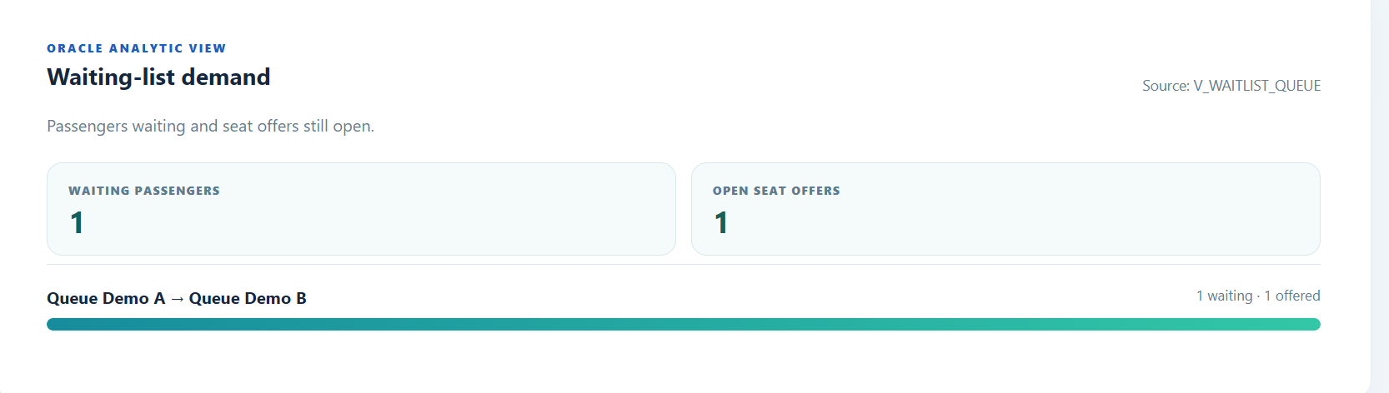
Reporting directly from Oracle
V_TRIP_OCCUPANCY
Booked and available trip seats
V_TRIP_REVENUE
Captured, refunded and net simulated amounts
V_WAITLIST_QUEUE
FIFO queue position from analytic SQL
1.5 min
10 / 14
Notes:
Timing: about 1.5 minutes.
The Insights page reads Oracle views rather than recomputing the metrics from arbitrary UI state. V_TRIP_OCCUPANCY counts seat inventory, V_TRIP_REVENUE aggregates simulated captured and refunded payments, and V_WAITLIST_QUEUE uses an analytic function for queue positions. The pictured preview had one waiting passenger and one open offer; temporary preview data was removed afterward.
Source: BusBook project report and repository, reviewed 2 November 2026. Live database totals are a dated snapshot. Payments and refunds are simulated.

Slide 11
Verification and recovery
20 sessions
One reservation winner
Rollback
No partial multi-seat booking
FIFO
Expiry and queue exit tested
Data Pump
Export/import restored schema
Schedule
No overlapping active trips
1.5 min
11 / 14
Notes:
Timing: about 1.5 minutes.
State each verification result precisely. The recovery drill imported a schema copy into BUSBOOKING_RESTORE, checked row counts and verified triggers and views. That redundant test schema was subsequently removable while the exported dump remains the backup. An EXPLAIN PLAN showed the route and FIFO queries using the intended indexes.
Source: BusBook project report and repository, reviewed 2 November 2026. Live database totals are a dated snapshot. Payments and refunds are simulated.

Slide 12
Project scope achieved
13
33
640
4
3
buses
trips
trip-seat rows
valid triggers
reporting views
Snapshot from 2 November 2026
Multiple operators, bus types and routes are available for demonstration.
1 min
12 / 14
Notes:
Timing: about 1 minutes.
These are a dated read-only snapshot, not constants. The 13 buses include the original bus and 12 demo buses. The 33 trips include the original trip and 32 demo trips. 640 TripSeat rows represent per-trip inventory. The project report records the same snapshot. Avoid implying 640 physical seats: there were 244 physical Seat rows.
Source: BusBook project report and repository, reviewed 2 November 2026. Live database totals are a dated snapshot. Payments and refunds are simulated.

Slide 13
Future improvements
Production security
HTTPS, environment secrets and hardened deployment
Customer updates
Email or SMS for booking and seat offers
Travel operations
Intermediate stops, partial cancellations and validation
Payments
Real gateway integration with reconciliation
1.2 min
13 / 14
Notes:
Timing: about 1.2 minutes.
These are future features, not current capabilities. Today, payments and refunds are simulated, all trips are direct, cancellation is whole-booking and access is intended for a local demo. Explain the next technical challenges: security review, external integrations, stop-based seat inventory and reconciliation.
Source: BusBook project report and repository, reviewed 2 November 2026. Live database totals are a dated snapshot. Payments and refunds are simulated.

Slide 14
THANK YOU
Questions and live demonstration
Notes:
Timing: about 0.5 minutes.
Thank the professor and audience. Invite questions. Keep the application and SQL Developer ready to demonstrate a seat hold, cancellation or Oracle view.
Source: BusBook project report and repository, reviewed 2 November 2026. Live database totals are a dated snapshot. Payments and refunds are simulated.

