Slide 1

Image Sharpening Using Knowledge Distillation
Karthik H (Team Leader), Razeen,
Sneha Mariam Samuel

Slide 2
Problem Statement
Develop a lightweight image sharpening model to enhance blurred video frames using knowledge distillation between a teacher and student network.
Category: Artificial Intelligence – Image Processing and Enhancement

Slide 3
Components of Project
Dataset Preparation: Used GoPro dataset with added resolution degradation (downscaling & upscaling).
Teacher Model: High-capacity model producing sharp outputs from blurred inputs.
Student Model: Lightweight model trained to replicate teacher outputs for real-time use.
Knowledge Distillation: Trained using Reconstruction, VGG Perceptual, Feature, and Edge Losses.

Slide 4
Implementation Challenges
Maintaining high MS-SSIM while minimizing model size and inference time
Achieving real-time performance on high-resolution (1080p) video frames
Effectively balancing multiple loss functions (Reconstruction, Perceptual, Feature, Edge)
Ensuring generalization across varying types of motion blur and lighting conditions
Avoiding overfitting while training on a limited dataset
Optimizing for deployment efficiency on low-resource or edge devices

Slide 5
Proposed Solution
Teacher Model
Used a high-performance pre-trained model (Restormer) for image sharpening.
Provides high-quality, sharp outputs but is computationally heavy.
Acts as a guide during training, not used during inference.
Generates soft outputs that the student model learns to mimic.
Ensures the student can approach teacher-level performance without heavy resource usage

Slide 6
Proposed Solution
Student Model
Designed a lightweight, fast student model for real-time deployment.
Trained using knowledge distillation to replicate the teacher’s outputs.
Loss functions used: Reconstruction Loss , Feature Loss, Edge Loss , VGG Perceptual Loss.
Capable of processing 1920×1080 images at 30–60 fps.
Achieves MS-SSIM above 90% and strong SSIM scores across diverse inputs, making it well-suited for video conferencing and similar real-time scenarios.
Evaluated using MS-SSIM, a more robust and perceptually accurate metric than SSIM that captures structural similarity across multiple scales.

Slide 7
Key Features
Enhances blurred video frames caused by low bandwidth or compression
Lightweight student model suitable for real-time use
High processing speed: 30–60 frames per second on 1080p resolution
Achieves over 90% MS-SSIM and strong SSIM, ensuring high visual accuracy Maintains perceptual quality even in bandwidth-limited video conferencing.
Uses knowledge distillation to mimic a complex teacher model
Human-subjective evaluation through Mean Opinion Score (MOS)
Deployable on edge devices (e.g., laptops, mobile, conferencing tools)

Slide 8
Process flow
Load pre-blurred images from the GoPro dataset
Simulate resolution degradation via downscaling and upscaling
Pass degraded inputs through both Teacher and Student models
Teacher model generates high-quality sharp outputs
Train Student model using Reconstruction, Feature, VGG Perceptual, and Edge losses
Evaluate performance using SSIM, PSNR, FPS, and MOS
Deploy Student model for real-time sharpening on 1080p inputs

Slide 9
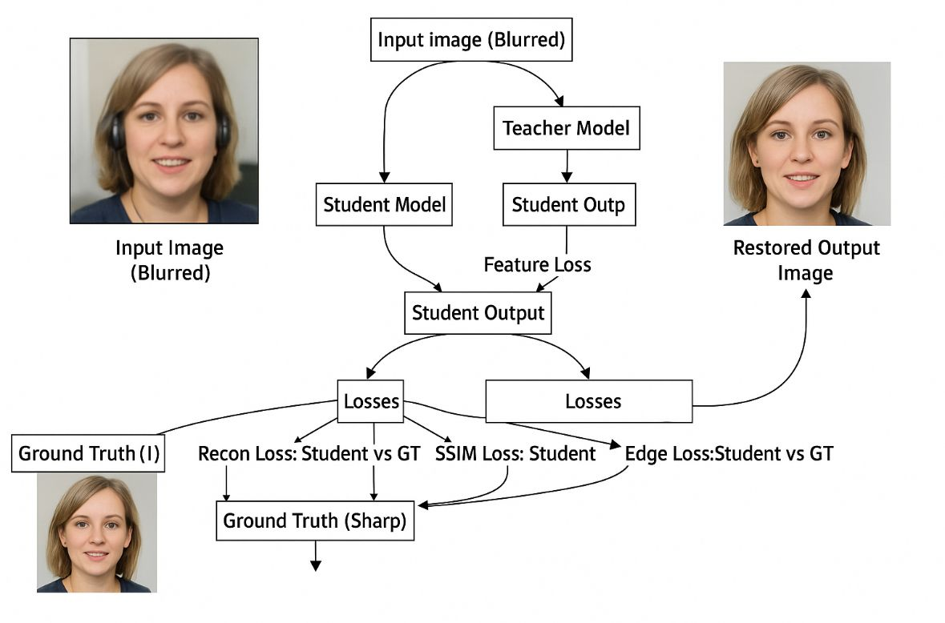
Architecture Diagram
9

Slide 10
Technologies used
PyTorch
TorchVision
OpenCV
Pillow
Scikit-image
NumPy
MS-SSIM
LPIPS
TorchMetrics
TensorBoard(tb-nightly)
Tqdm
Einops
Gdown

Slide 11
Team members and contribution
Karthik H (Team Leader): Designed and implemented the core knowledge distillation framework. Took charge of integrating custom loss functions, optimizing the training pipeline, and benchmarking the student model's performance against the teacher model.
Razeen: Prepared training and validation datasets, supported model training, tuned hyperparameters, and evaluated performance on previously unseen data.
Sneha Mariam Samuel: Facilitated the training workflow and model integration. Developed architecture diagrams, documented the methodology, and created the final project report and presentation materials.

Slide 12
Future Scope
Integrate temporal consistency modules to ensure stable restoration across consecutive video frames, reducing perceptual flickering.
Employ advanced model compression techniques such as quantization and pruning to enable deployment on ultra-low-power microcontrollers.
Expand training datasets to include extreme motion blur and low-light conditions, improving robustness across diverse real-world scenarios.
Explore multi-modal approaches by incorporating additional inputs like depth or inertial sensor data to achieve richer and more context-aware restoration.

Slide 13
Conclusion
Developed a lightweight image sharpening model using knowledge distillation.
Trained the student model with guidance from a high-performance teacher model.
Achieved real-time performance of 30–60 fps on 1920×1080 resolution images.
Maintained high visual quality, achieving around 0.95 SSIM and 0.97 MS-SSIM on video streams, ensuring excellent perceptual sharpness.
Validated performance through both quantitative metrics (SSIM, MS-SSIM, PSNR) and human subjective evaluations (MOS).

Slide 14
References
Zamir et al., “Restormer: Efficient Transformer for High-Resolution Image
Restoration,” CVPR 2022
Zhang et al., “Image Super-Resolution Using Deep Convolutional Networks,”
IEEE TPAMI
Wang et al., “Image Quality Assessment: From Error Visibility to Structural
Similarity,” IEEE TIP
Kornia Docs: https://kornia.readthedocs.io
PyTorch Docs: https://pytorch.org/docs/
Restormer GitHub: https://github.com/swz30/Restormer
NVIDIA Developer Blog – “Deploying AI at the Edge”

