Slide 1

Major Project – II
Review - 2
Presented By — << your name >>, << team member >>
Project Name : Explainable Dermoscopic Lesion Analysis
EfficientNet-B3 · Grad-CAM · ABCD morphometry · severity grading
Mentor / Guide Name : << guide name >>
UDP ID - U<< id >>

Slide 2

Contents
Progress Since Review-1
Project Objectives
System Design / Architecture
Module-wise Progress
Implementation Progress
AI Tools Used
Challenges and Solutions
Partial Output
Plan for Review-3
References

Slide 3
Progress Since Review-1
Work completed before Review-1
HAM10000 studied: 10,015 images, 7 diagnostic classes, 67% melanocytic nevi
Exploratory analysis + SVM baseline (HOG + colour histogram)
EfficientNet-B3 training notebook, reported 80.17% accuracy
Work completed after Review-1
Notebooks refactored into an installable package: 18 modules, 5,356 lines in src/derm
FastAPI backend with 12 endpoints + browser workstation UI (3,353 lines)
Explainability: Grad-CAM / Grad-CAM++ scored against the lesion mask
Quantitative Stolz ABCD morphometry as an independent, non-neural evidence stream
Uncertainty: TTA, MC dropout, predictive entropy, BALD
Severity grading (0-100) with one-directional safety overrides
Rule-based clinical narrative + PDF report, SQLite case store, change tracking
Reproducible data-leakage audit; 149 automated tests, all passing
Review-1 Remark | Action Taken | Status
1. << paste your actual Review-1 remark >> e.g. “justify the reported accuracy” | Ran a reproducible leakage audit: the notebook's image-wise split leaks 36.13% of test images. Switched to lesion-grouped splitting (0% leakage) and tagged all notebook figures as self-reported. | Completed
2. << paste remark >> e.g. “model must be explainable and have a working front end” | Added Grad-CAM/Grad-CAM++ with an attention-alignment score, ABCD morphometry, and a full FastAPI + browser application replacing the notebook-only workflow. | Completed

Slide 4
Project Objectives
Original objectives
Classify dermoscopic images into the 7 HAM10000 categories with EfficientNet-B3
Benchmark against a classical SVM baseline
Produce a Grad-CAM visual explanation for each prediction
Derive an automated severity indication from the prediction
Updated objectives (added after Review-1)
Quantitative Stolz ABCD morphometry — evidence that does not depend on learned weights
Uncertainty quantification so unsure cases are escalated, not silently guessed
Longitudinal change tracking — the “E” of ABCDE, which a single image cannot show
Deterministic clinical narrative + PDF report for handover
Reproducible data-integrity audit and a checkpoint verifier
Scope modifications
Splitting changed from image-wise to lesion-grouped, to remove near-duplicate leakage
Training moved off local hardware: an 8 GB M2 drove swap to 13.9 GB (documented, not hidden)
Narrative kept rule-based rather than an LLM, so every sentence traces to a measurement

Slide 5
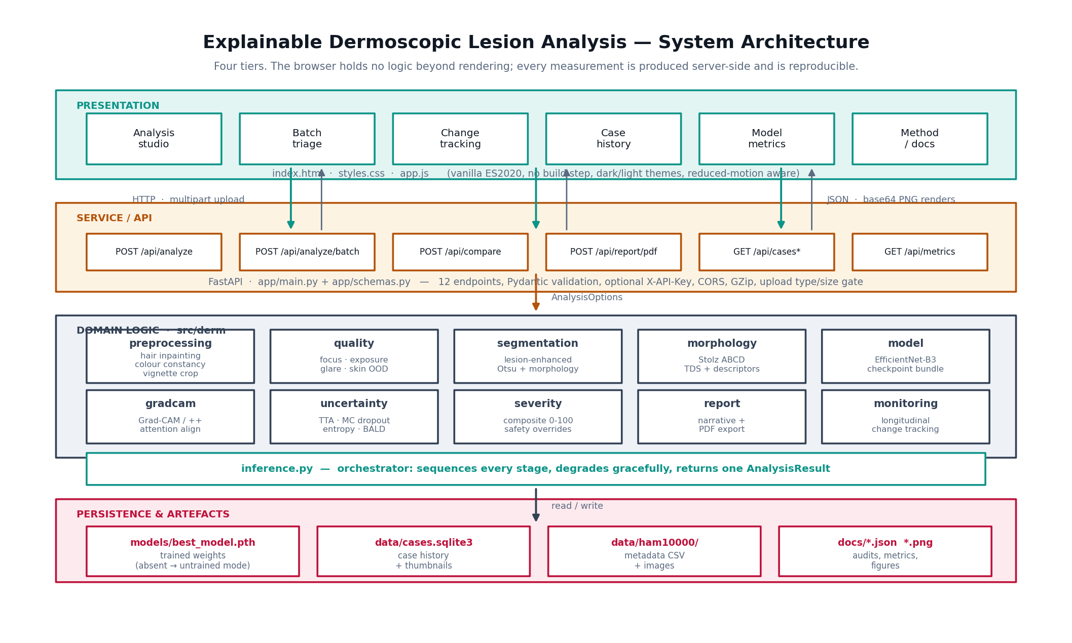
System Design / Architecture

Slide 6
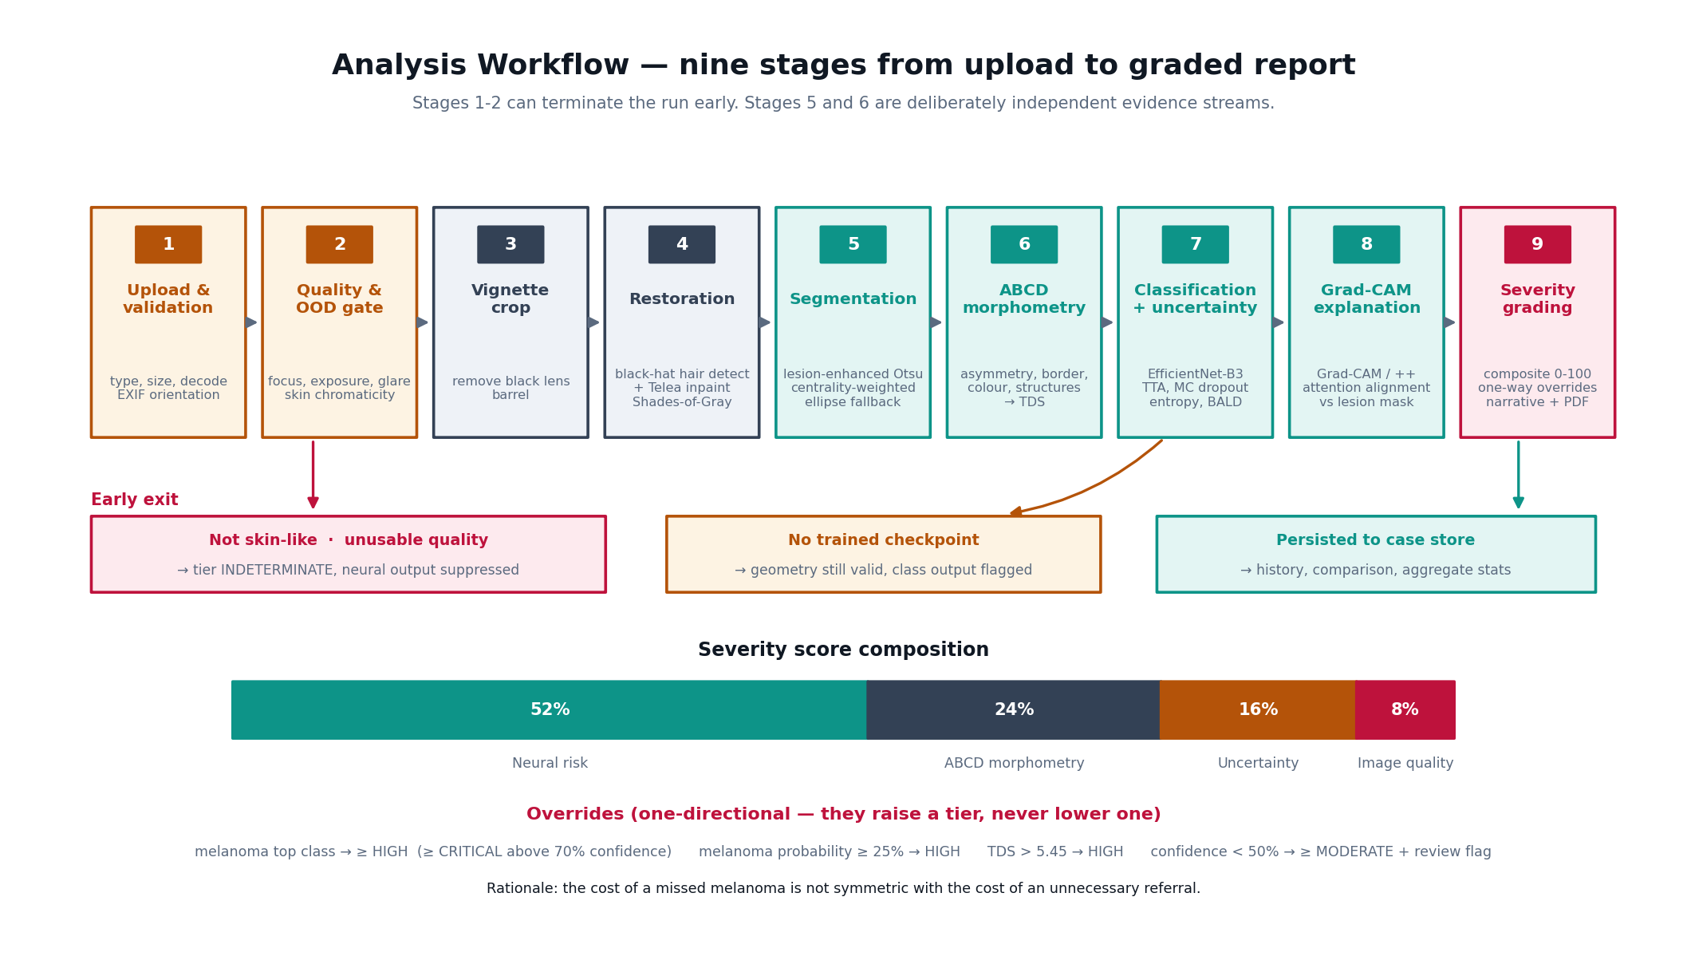
Workflow Diagram

Slide 7
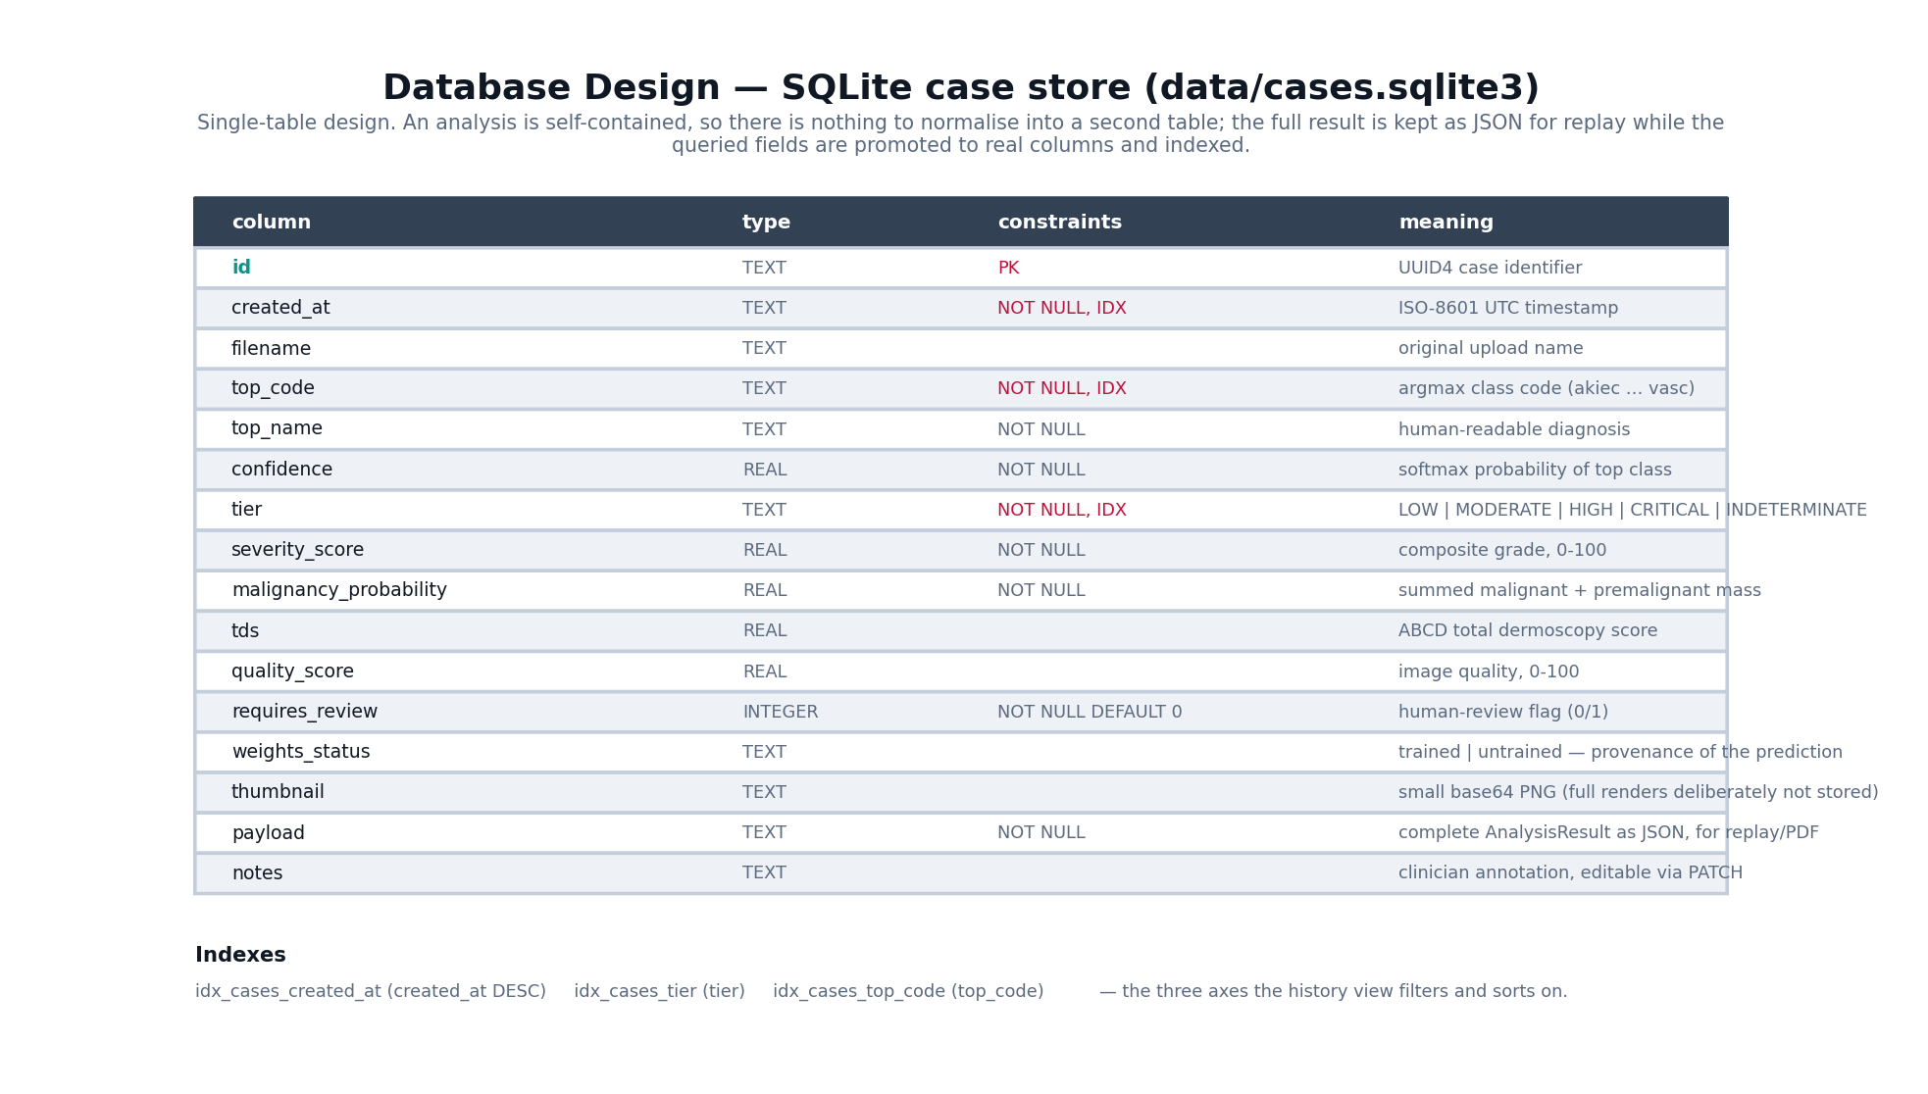
Database Design

Slide 8
Module-wise Progress
Module | Description | Status
1. Preprocessing | Hair detection + Telea inpainting, Shades-of-Gray colour constancy, lens-vignette crop, EXIF handling | Complete
2. Quality & OOD gate | Focus (variance of Laplacian), exposure, contrast, glare, and a skin-chromaticity test that rejects non-skin images | Complete
3. Segmentation | Lesion-enhanced Otsu, morphological cleanup, centrality-weighted component, ellipse fallback with reduced confidence | Complete
4. ABCD morphometry | Asymmetry about principal axes, 8-sector border irregularity, six-colour counting, structure approximation → TDS | Complete
5. Classification | EfficientNet-B3 (timm), checkpoint bundle with graceful untrained fallback and explicit weights_status | Complete
6. Explainability | Grad-CAM and Grad-CAM++ with hook cleanup, scored for attention alignment against the lesion mask | Complete
7. Uncertainty | Dihedral TTA, MC dropout, predictive entropy, BALD mutual information, verdict classification | Complete
8. Severity grading | Composite 0-100 score with one-directional melanoma / TDS / low-confidence safety overrides | Complete
9. Reporting | Deterministic rule-based narrative and ReportLab PDF export | Complete
10. Change tracking | Two-capture longitudinal comparison with optional millimetre calibration | Complete
11. Persistence | SQLite case store: history, filters, aggregate statistics, annotations | Complete
12. Backend | FastAPI service, 12 endpoints, Pydantic validation, optional API-key auth | Complete
13. Frontend | Vanilla-JS clinical workstation: studio, batch triage, tracking, history, metrics | Complete
14. Validation | 149 automated tests on synthetic fixtures + smoke test + checkpoint verifier | Complete
15. Data integrity | Reproducible leakage audit written to docs/split_audit.json | Complete
16. Dataset acquisition | All 10,015 HAM10000 images downloaded from Harvard Dataverse and downscaled to 195 MB on disk | Complete
17. Trained weights | Classifier head fitted on frozen ImageNet EfficientNet-B3 features (linear probe); passes all 21 checkpoint verification checks | Complete
18. Evaluation | Measured on the leak-free test split: 53.7% balanced accuracy, 0.379 macro-F1, ROC-AUC 0.838, ECE 0.096 | Complete
19. End-to-end fine-tune | Needs a CUDA GPU; the linear probe is the CPU-feasible substitute | Review-3
20. Deployment | Containerisation, auth hardening and hosting | Review-3

Slide 9
Implementation Progress
Technologies: Python 3.11 · PyTorch 2 + timm · OpenCV · scikit-image · scikit-learn · FastAPI + Uvicorn · Pydantic v2 · ReportLab · SQLite · vanilla HTML/CSS/ES2020 (no build step)
Overall implementation: ~9,000 lines of application code and ~1,300 lines of tests.
Module | Completion
Image processing pipeline (preprocess, quality, segmentation, ABCD) | 100%
Explainability (Grad-CAM / Grad-CAM++, attention alignment) | 100%
Uncertainty + severity grading | 100%
Reporting, change tracking, case store | 100%
FastAPI backend (12 endpoints) | 100%
Frontend workstation UI | 100%
Automated tests (149 passing) + leakage audit | 100%
Dataset acquisition — all 10,015 images | 100%
Trained weights (linear probe) + evaluation | 100%
End-to-end fine-tune (needs a CUDA GPU) | 40%
Deployment & packaging | 35%

Slide 10
AI Tools Used
AI Tool | Purpose | Sample Prompt | Outcome
Kiro (Claude Opus 5) AI IDE agent | Primary development assistant: refactoring the notebooks into a package, writing the FastAPI service and the frontend, and generating the test suite. | “Analyse this HAM10000 notebook project in detail and convert it into a working frontend + backend application with Grad-CAM, ABCD morphometry and severity grading; all features must actually work.” | 18-module src/derm package, 12-endpoint API and full UI. Verified by 149 passing tests and an end-to-end smoke test rather than by reading the code alone.
Kiro (agentic debugging) | Root-causing defects that unit tests surfaced in the inference pipeline. | “MC dropout returns a standard deviation of ~1e-6, so the uncertainty estimate is inert. Find out why and fix it.” | Found that timm's EfficientNet applies dropout functionally, so model.train() alone did not make passes stochastic. Fix confirmed by an assertion that MC variance is non-zero.
Kiro (data audit) | Independently checking the accuracy claim carried over from Review-1. | “HAM10000 has repeated photographs of the same lesion. Quantify how much of the notebook's test set leaks from training, per class.” | Produced scripts/audit_leakage.py and docs/split_audit.json: 36.13% of test images leak, 63.5% for melanoma. Reproducible from the metadata CSV alone, so the finding is checkable, not asserted.
Kiro (working within a hardware limit) | Obtaining real trained weights without a GPU, after full fine-tuning exhausted the machine's memory. | “Don't train images on my Mac. Download the dataset and make the whole project work end to end.” | Split transfer learning in two: forward-only feature extraction (bounded RAM, 472 MB peak) then a linear head fit in seconds. Balanced accuracy 14.3% → 53.7%. Verified by 21 checkpoint checks including per-class recall on real images, which is what proves the class order is not permuted.
ChatGPT / Claude (chat) | Clarifying the clinical basis of the Stolz ABCD rule and the Grad-CAM++ weighting before implementing them. | “Explain how the Stolz ABCD total dermoscopy score is weighted, and how Grad-CAM++ differs from Grad-CAM.” | Implementation cross-checked against the original papers; the TDS weights and the >5.45 threshold were taken from the literature, not from the model's suggestion.
GitHub Copilot | Inline completion for repetitive code: dataclass fields, argparse wiring, docstrings. | (inline completion, no discrete prompt) | Reduced boilerplate typing. All completions reviewed before commit; no completion was accepted into numerical logic unchecked.
<< remove any row your team did not actually use >>

Slide 11
Challenges and Solutions
Challenge | Solution Implemented
Reported 80.17% accuracy could not be trusted: HAM10000 holds 10,015 images of only 7,470 lesions, so an image-wise split puts near-duplicate photographs of the same lesion in train and test. | Wrote a metadata-only audit (scripts/audit_leakage.py). Measured 36.13% test leakage overall, 70.1% for BCC and 63.5% for melanoma. Switched to lesion-grouped splitting, which audits at 0.00%. All unverified figures are now tagged self_reported in the UI.
Severe class imbalance — 67% of the dataset is melanocytic nevi, so plain accuracy rewards a model that ignores melanoma. | Checkpoint selection on macro-F1 instead of accuracy, class-weighted loss, and balanced accuracy plus per-class recall reported alongside a melanoma safety-net catch rate.
Training EfficientNet-B3 locally was not viable: on an 8 GB M2 the MPS backend drove swap to 13.9 GB and cut free disk from 9.2 GB to 2.9 GB in ninety seconds. | Diagnosed as a hardware limit, not a code defect, and documented. Added scripts/bench.py to measure throughput before committing, and a disk-frugal downloader that streams one archive at a time and downscales on extraction (2.9 GB → ~350 MB).
A missing or mismatched checkpoint could silently yield confident, plausible, wrong diagnoses — the most dangerous failure mode here. | weights_status is surfaced through the API and the UI, and the app refuses to present untrained output as meaningful. scripts/verify_checkpoint.py additionally rejects wrong class counts, permuted class order, and uniform (untrained) outputs.
MC dropout produced ~1e-6 variance, making the uncertainty estimate meaningless; Grad-CAM also failed inside torch.inference_mode(). | timm applies dropout functionally, so train() alone was insufficient — stochasticity is now activated explicitly. Grad-CAM escapes the outer inference-mode context so gradients can flow. Both are covered by regression tests.
Hair, glare and the black lens barrel were being read as pigment, corrupting the ABCD measurements. | Directional black-hat hair detection with Telea inpainting plus vignette cropping. The restored frame drives geometry only — the classifier still receives the un-restored image, avoiding a silent train/serve skew.

Slide 12
Partial Output
Working end-to-end today, with trained weights loaded
Demo flow: upload a dermoscopic image → quality gate → segmentation overlay → ABCD rings and TDS → ranked class probabilities → Grad-CAM split-view against the original → severity tier with recommended action → clinical narrative → PDF download.
Batch triage: many images scored and returned in severity order, so review time goes where the risk is.
Track change: two captures of one lesion compared, with millimetre measurement when a field-of-view width is supplied.
Case history: persisted cases with tier/class filters, aggregate statistics and annotation.
Model metrics: measured vs self-reported provenance, plus the leakage audit rendered in-app.
Measured results on the leak-free test split (1,523 images, 1,120 lesions)
Balanced accuracy 53.7% · accuracy 55.0% · macro-F1 0.379 · ROC-AUC 0.838 · ECE 0.096 after temperature scaling
Melanoma recall 55.5%; the severity safety net escalates 59.2% of true melanomas to HIGH/CRITICAL, at a 15.3% benign over-referral cost.
Chance is 14.3% and a trivial always-nevus model scores 14.3% balanced accuracy, so the head has genuinely learned.
Weights come from a LINEAR PROBE: the classifier head was fitted on frozen ImageNet EfficientNet-B3 features. The backbone was not fine-tuned, because that needs a GPU. Reported as a probe, never as a fine-tuned model.
149/149 automated tests passing; smoke test green across all 12 endpoints; checkpoint passes all 21 verification checks including class-order confirmation on real images.
Leakage audit reproducible from metadata: 36.13% image-wise vs 0.00% lesion-grouped.
Full-pipeline CPU inference ≈ 2.9 s per image on an Apple M2.
<< paste UI screenshots here: analysis studio, Grad-CAM split view, batch triage, PDF report >>

Slide 13
Plan for Review-3
Remaining module implementation
Fine-tune the full backbone end to end on Kaggle / Colab / a CUDA GPU — the linear probe's 53.7% balanced accuracy is the CPU ceiling, not the method's
Expect the biggest gain on the rare classes: df precision is 0.065 and akiec 0.20, because a frozen ImageNet backbone has no dermoscopy-specific features
Re-verify with scripts/verify_checkpoint.py --images before trusting the result
Testing
Extend the 149-test suite with trained-model integration tests and per-class recall floors
Re-run the melanoma safety-net audit against real weights
Integration & documentation
Regenerate docs/evaluation.json, confusion matrix and calibration figures from the real run
Replace every self_reported figure with a measured one, or state plainly that it is unverified
Final project report and user guide
Performance optimisation
ONNX export / quantisation to cut the 2.9 s CPU inference time
Response caching for repeated figure and metrics requests
Final deployment
Containerise, enable DERM_API_KEY, serve over HTTPS, add structured logging

Slide 14
References
1. Tschandl P., Rosendahl C., Kittler H. The HAM10000 dataset, a large collection of multi-source dermatoscopic images of common pigmented skin lesions. Scientific Data 5, 180161 (2018). doi:10.1038/sdata.2018.161
2. Harvard Dataverse, HAM10000 distribution. doi:10.7910/DVN/DBW86T (CC BY-NC 4.0).
3. Tan M., Le Q. EfficientNet: Rethinking Model Scaling for Convolutional Neural Networks. ICML 2019.
4. Selvaraju R. R. et al. Grad-CAM: Visual Explanations from Deep Networks via Gradient-based Localization. ICCV 2017.
5. Chattopadhyay A. et al. Grad-CAM++: Improved Visual Explanations for Deep Convolutional Networks. WACV 2018.
6. Gal Y., Ghahramani Z. Dropout as a Bayesian Approximation: Representing Model Uncertainty in Deep Learning. ICML 2016.
7. Houlsby N. et al. Bayesian Active Learning for Classification and Preference Learning. arXiv:1112.5745 (2011).
8. Guo C. et al. On Calibration of Modern Neural Networks. ICML 2017.
9. Stolz W. et al. ABCD rule of dermatoscopy: a new practical method for early recognition of malignant melanoma. European Journal of Dermatology, 1994.
10. Telea A. An Image Inpainting Technique Based on the Fast Marching Method. Journal of Graphics Tools, 2004.
11. Finlayson G., Trezzi E. Shades of Gray and Colour Constancy. Color Imaging Conference, 2004.
12. Wightman R. PyTorch Image Models (timm). github.com/huggingface/pytorch-image-models

Slide 15

Thank You
Questions & Demo

