Slide 1


Data Transmission through Ultrasonic Sound
By:
Shreyas R
Karthik K Bhat
Praphul Gowda
Guide:
Dr. Anuradha M

Slide 2
Problem Statement
Design a prototype that is able to transfer digital data using ultrasonic sound
# | Details | Value | Unit | Remark
1 | Transmission Length | 30 | centimetre | Maximum length
2 | Transmitter Power | TBD | Watt
3 | Power Supply | 5 | Volts
4 | Transmission Speed | 40 | kHz
5 | Communication Protocol | UART
6
7

Slide 3
Introduction
Short-range connectivity among electronic devices is essential to build a connected world.
With billions of connected devices, the need for devices to identify and communicate with each other is increasing.
Radio Frequency based wireless communication rely on high power radio transmitters

Slide 4
Why Ultrasonic Data Transmission?
Data can be transmitted with standard speakers and microphones.
Ultrasonic bypasses the physical limitation of short-range RF.
Similar to other communication protocols, data can be encrypted and transmitted.
Properties of sound enable quick localised data transfers which is key factor in sharing resources based on proximity.

Slide 5
Progress Timeline
Week 1
Literature Survey
Week 2
Understand working of Transducer and HC-SR04
Week 3
Design and simulation of Transmitter circuit #1
Week 4
Week 5
Design and simulation of Transmitter circuit #2
Exploring suitable receiver circuits

Slide 6
Literature Survey
The 18.5 to-20 kHz is inaudible to most humans and yet realizable with commodity speakers and microphones in mobile devices.
Modulation is made in such a way that makes it robust to noise and reverberation in the environment.
Speakers of common phone produces 74 dB SPL at 18 kHz whereas the threshold is 86 dB SPL to be audible.
The range is reliable for a maximum distance ranging from 2 m to 10 m.

Slide 7
Applications
Ultrasonic data transmission can be used under-water.
Short-range, secure resource sharing between devices.
Data transmission in places where electromagnetic radiations are harmful e.g. Petrol bunks, Healthcare

Slide 8
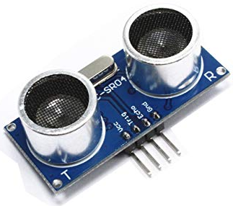
HC-SR04
HC-SR04 is an ultrasonic distance sensor.
It has two transducers – one acting as a transmitter and the other as receiver.
It has four pins:
VCC – Positive terminal of the power source.
Trig – Trigger pin to send burst of ultrasonic.
Echo –Echo pin to receive the reflected ultrasonic sound.
GND – Negative terminal of power source

Slide 9
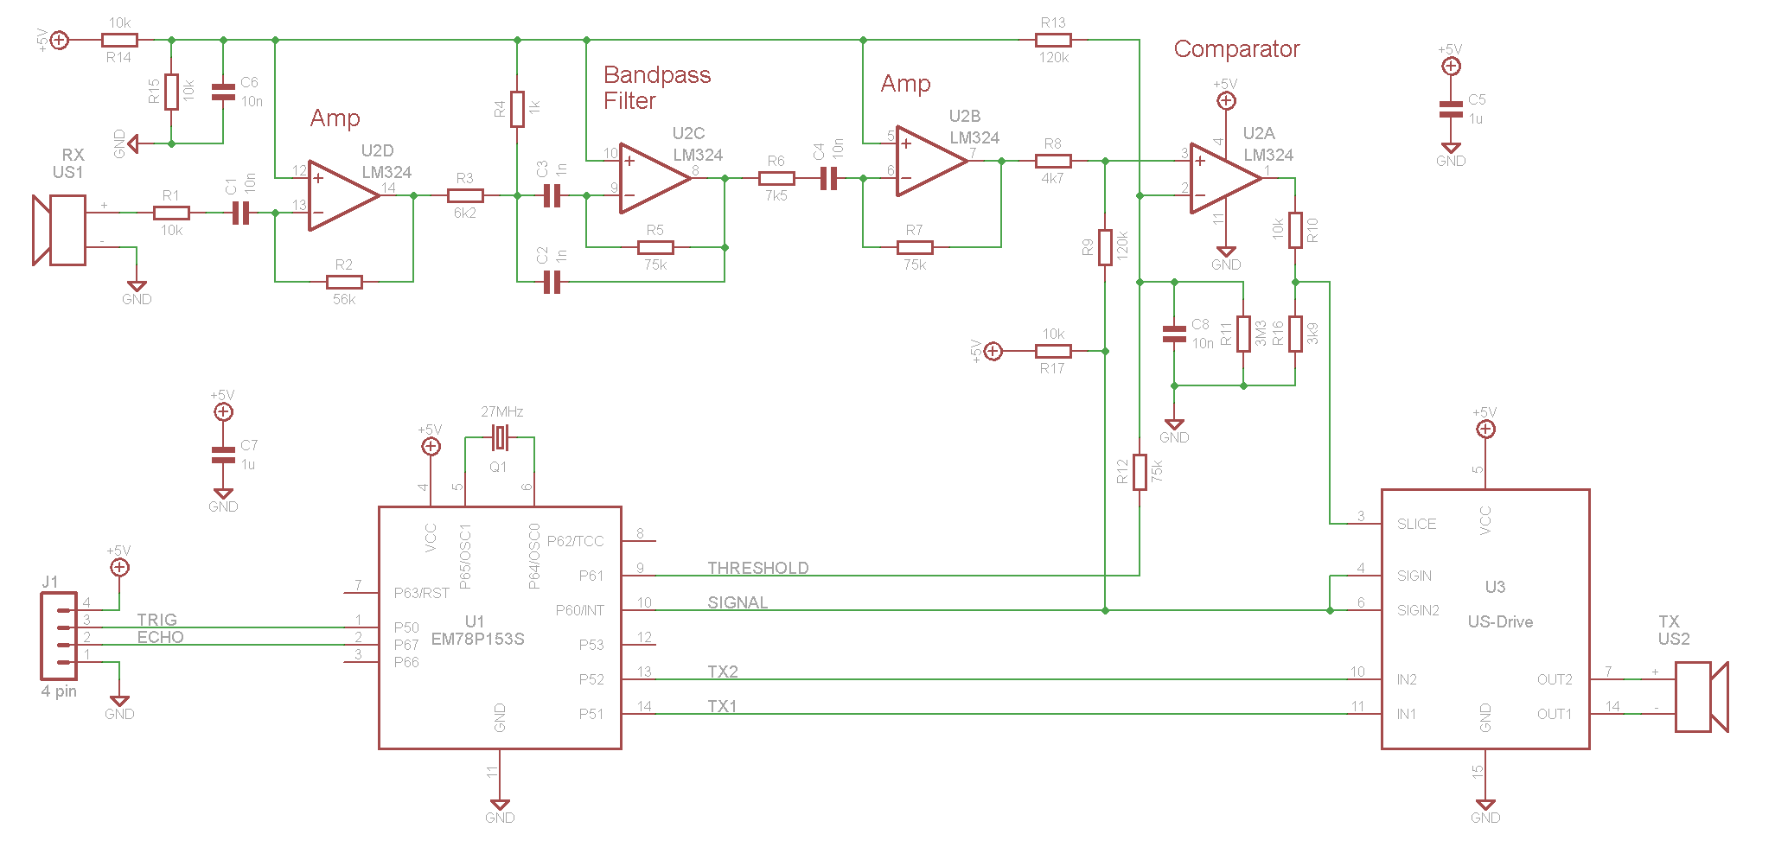
HC-SR04 Circuit
HC-SR04 Ultrasonic sensor circuit

Slide 10
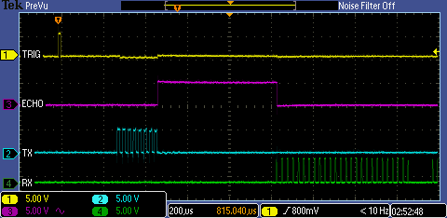
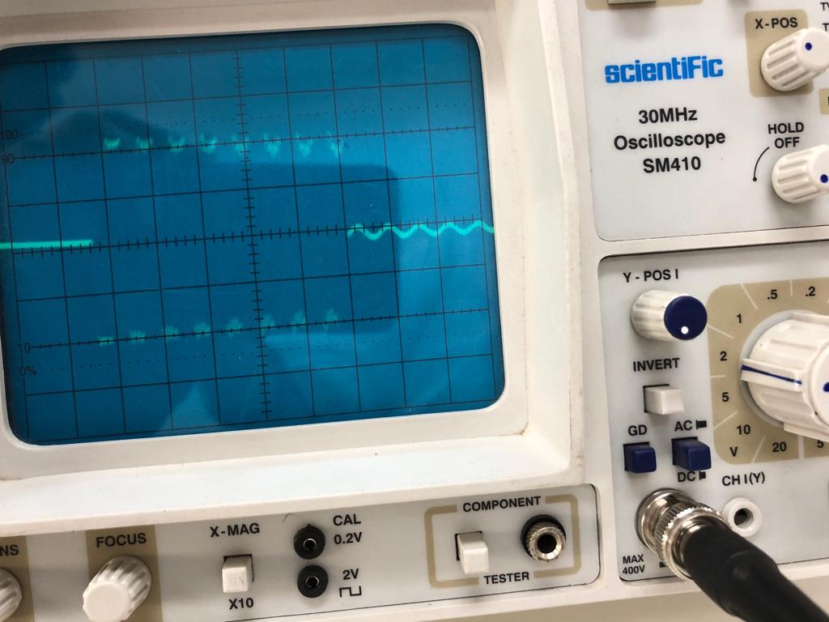
Working of HC-SR04
Trigger pin is given a pulse.
A burst of 8 pulses of 40 kHz is sent via transducer.
The echo pin is set high.
Once reflected wave is detected, the echo pin is set low.
Scope shot of signal timing
(Source: pcserviceselectronics.co.uk)
Scope shot at Tx
(Taken at lab)

Slide 11
Approach
Microcontroller (with UART)
Ultrasonic Transmitter
Ultrasonic Receiver
Microcontroller (with UART)
Data to be sent
Data received

Slide 12
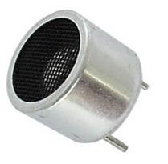
Transducers
The transducer is a device that converts electrical signal to physical quantity or vice versa.
The main criteria to choose a ultrasonic transducer are the resonant frequency, radiation pattern and sensitivity.
Sensitivity affects the efficiency of the transducer and also attributes to the SNR.
For the receiver and transmitter, we would be using 40 kHz ultrasonic transducer.
Notes:
>> With properly designed circuits these sensors can easily achieve a range of more than 20 feet.
>> The power rating of the transducer is quite low when compared with other transducers and the optimum operating voltage is around 6 volts.

Slide 13
Transmitter Circuits
Transmitter Circuit #1
The circuit uses a JFET to modulate the amplitude of carrier signal with respect to the message signal.
Generating high-frequency carrier signals is not easy and required output was not obtained in this circuit.
Transmitter Circuit #2
Uses PNP and NPN transistors to bring the current levels to an optimum range which is suitable for the ultrasonic transducers to operate.
The current levels varies with respect to the message signal.

Slide 14
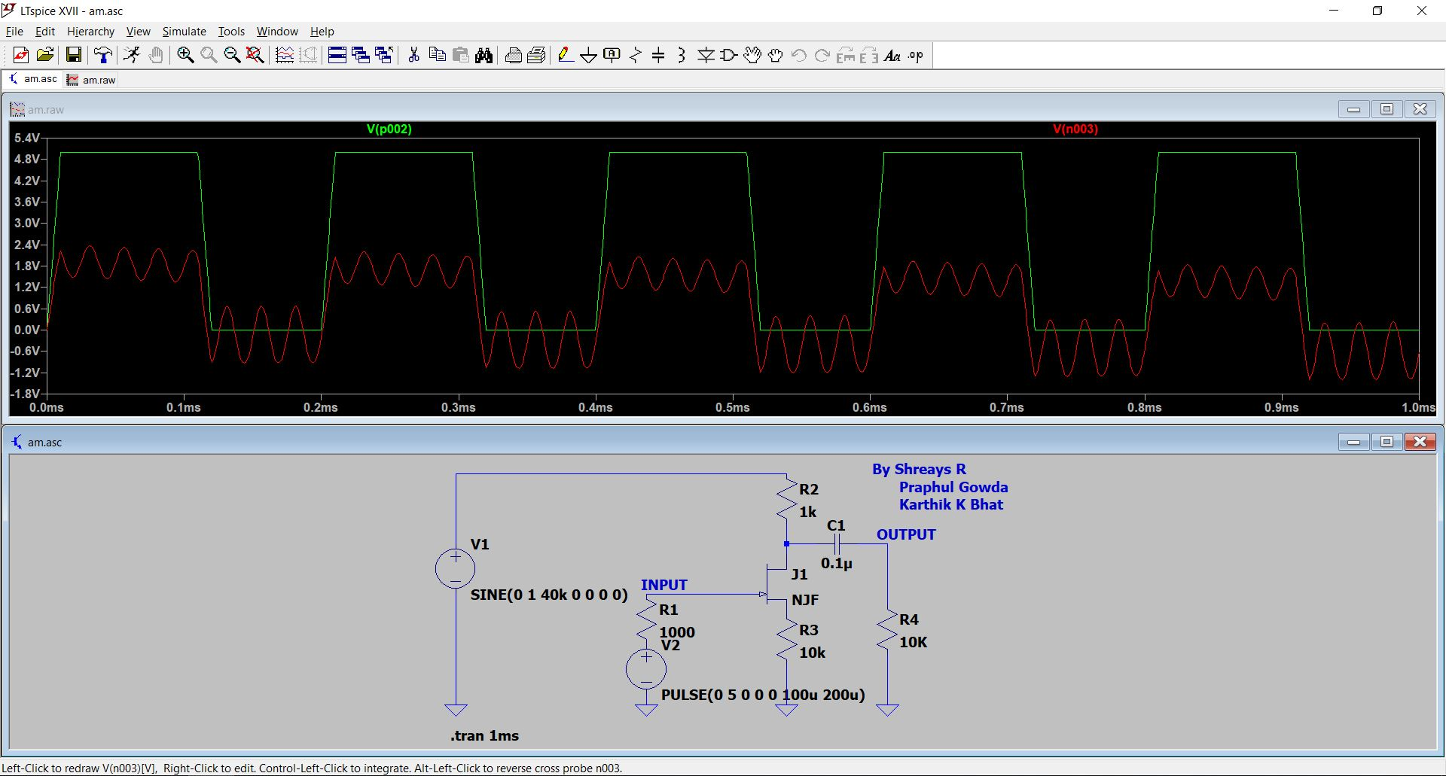
Transmitter Circuit #1 Simulation
Simulation of Amplitude Modulation Circuit using JFET on LTSpice software

Slide 15
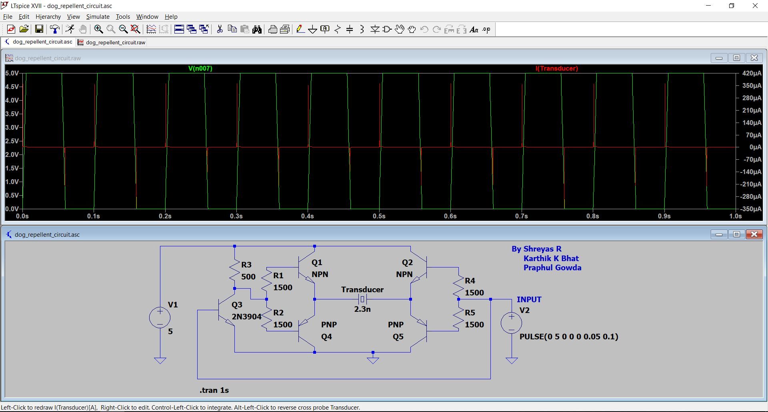
Transmitter Circuit #2 Simulation
Simulation of Ultrasonic Transducer Driver Circuit on LTSpice software

Slide 16
Planned Timeline
Week 6
Design and simulation of Receiver Circuit
Week 7
Circuit building
Week 8 & 9
Testing and Test results
Week 10
Week 11
Update circuits based on test results
Final circuit and conclusion of project

Slide 17
References
https://lisnr.com/resources/blog/ultrasonic-data-transmission-compares-rf/
https://ieeexplore.ieee.org/document/8080245
http://www.kerrywong.com/2011/01/22/a-sensitive-diy-ultrasonic-range-sensor/
http://www.pcserviceselectronics.co.uk/arduino/Ultrasonic/electronics.php
kHz | Kilo Hertz
UART | Universal Asynchronous Receiver Transmitter
RF | Radio Frequency
dB | Decibels
dB SPL | Sound Pressure Level (1 Pascal is equal to SPL of 94 dB)
m | meter
SNR | Signal to Noise Ratio
GND | Ground
JFET | Junction Field effect transistor

