Slide 1
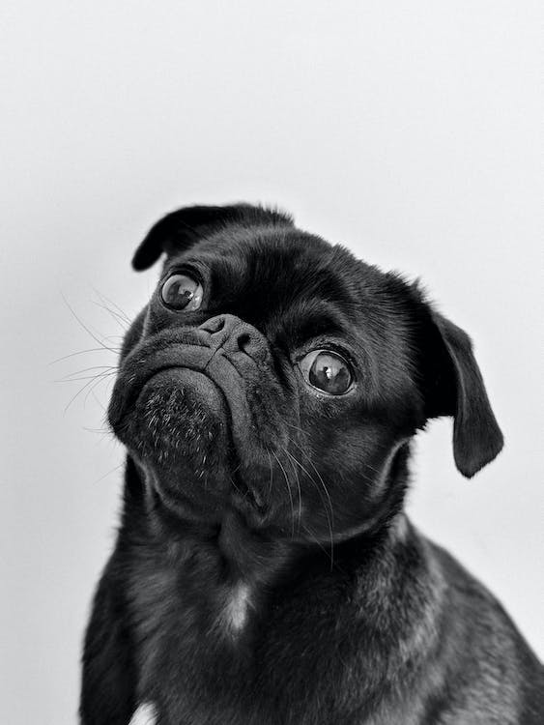

TINY PAWS
ANIKETH K
KARTHIK R
K SREE HARSHA
KUSHAL S
RAINA ELFREDA REGO

Slide 2
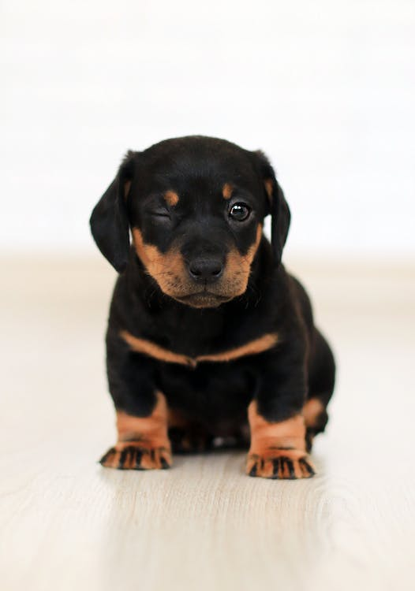
PROBLEM
STATEMENT
The existing landscape of pet care applications is characterized by fragmentation, with each app specializing in a specific aspect of pet ownership. This scattered approach creates significant inconveniences for pet owners who are seeking a unified solution for their diverse pet-related needs.

Slide 3
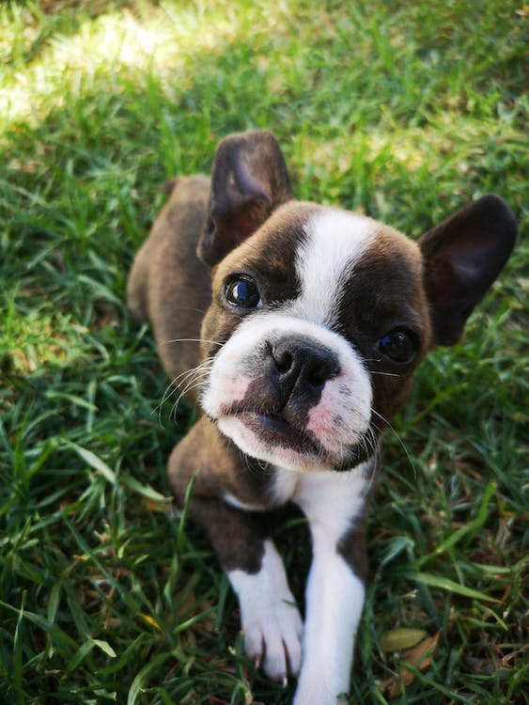
SOLUTION
OVERVIEW
Tiny paws provides all the services and features required for a pet owner under one simplified application and website which is currently scattered over various platforms.
This innovative platform uses recommendation algorithm done using ai and ml for boost in the store sales.
Plans of introducing the document storage facilities makes it more easier and future proof for pet owners

Slide 4
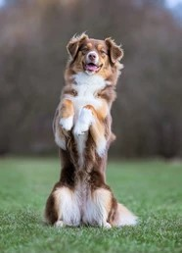
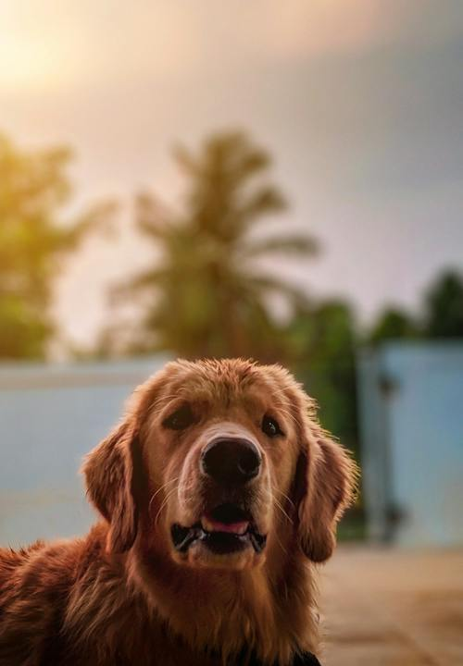
DESCRIPTION
Tiny paws Pvt Ltd is an innovative pet care platform that not only simplifies pet parenting but also transforms the pet care industry. We provide a comprehensive and user-friendly app that serves as a one-stop solution for all pet-related needs.
This platform also provide an opportunity for non-pet owners to earn extra income by taking care of others pets and providing various services on demand.

Slide 5
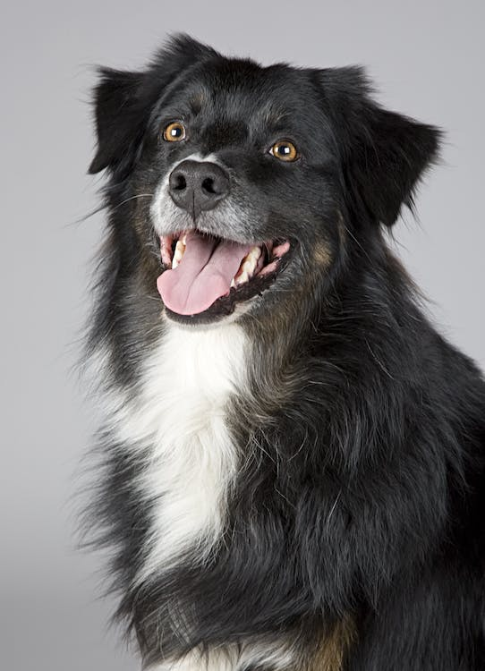
SERVICES
LOCAL SERVICE LOCATOR
DOCUMENT STORAGE
HIRING A CARETAKER
EARNING OPPORTUNITY FOR NON PET OWNERS
LOCATING A MATING PARTNER
STORE FOR PET NEEDS
VACCINATION REMINDERS

Slide 6
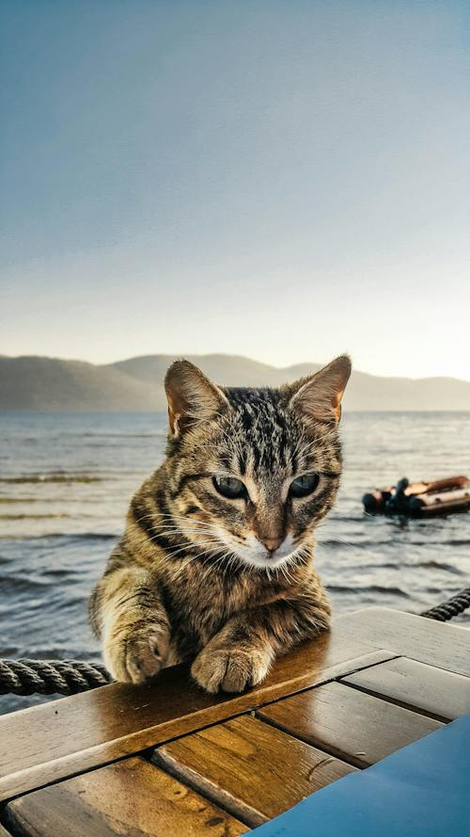
MARKET RESEARCH
According to Market Decipher, the pet care market in India was estimated at INR 7,400 crore in 2021. The market is expected to reach INR 2,10,000 crore by 2032.
The pet care industry in India has had over 19.2% CAGR in the past decade. The pet population in India is estimated at around 32 million.
Source: google.com

Slide 7

BUSINESS
MODEL
Value Proposition
Tiny Paws offers an all in one platform for a variety of services and features that include recommendation algorithm and an integrated store.
Key Partners
Pet Service providers such a veterinary clinics, pet accessory stores, groomers and suppliers for the integrated store.
Target Audience
Pet Owners and Pet lovers.
Revenue Streams
Through AdSense by displaying ads next to the content of the website.
Affiliate Marketing and E Commerce.
Weekly or Monthly Subscription Plans.

Slide 8
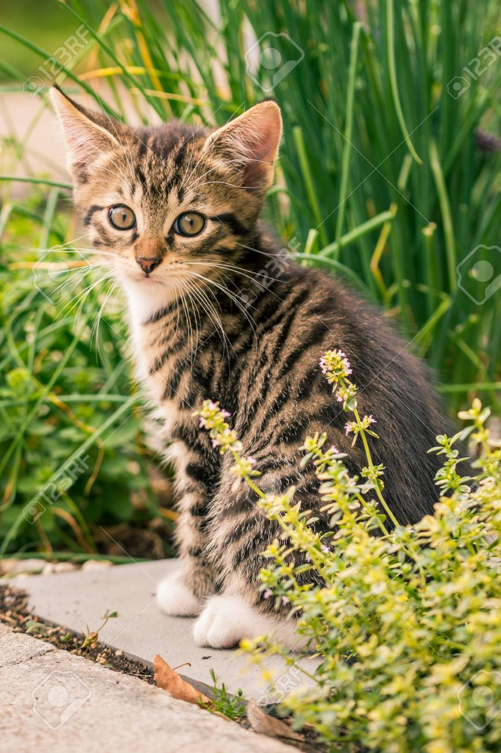
SWOT
ANALYSIS
Strengths
Tiny Paws is an all in one platform that offers recommendations , vaccination tracking, pet services and pet store integration.
Weakness
Tiny Paws is a new entrant in the market, building awareness among pet owners differentiating itself may be a challenge.

Slide 9
Opportunities
The vacant spot for a all in one platform for all the pet needs and services gives us and opportunity find a break in the market and establish a brand.
Threats
The already established companies can adopt this business model and integrate more features.
Compliance with local and international regulations related to pet services, e-commerce, and data protection is crucial.
SWOT
ANALYSIS

Slide 10
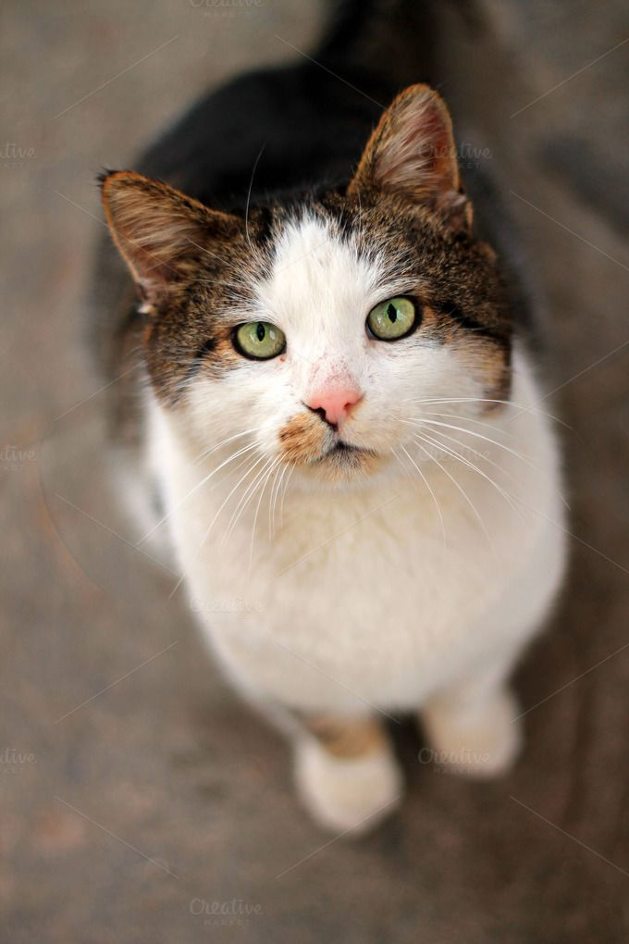
TECHNOLOGY/
INNOVATION
Machine Learning
Machine Learning (ML) can significantly enhance the user experience of a website by providing personalized and adaptive features.
Suggest products, services, or content based on the user's preferences and past behavior.
MongoDB
MongoDB's document-oriented structure and indexing capabilities make read and write operations efficient leading to quicker response times when retrieving data from the database
This scalability ensures that as the user base of a website grows, the performance remains optimal, resulting in a smoother and faster user experience

Slide 11
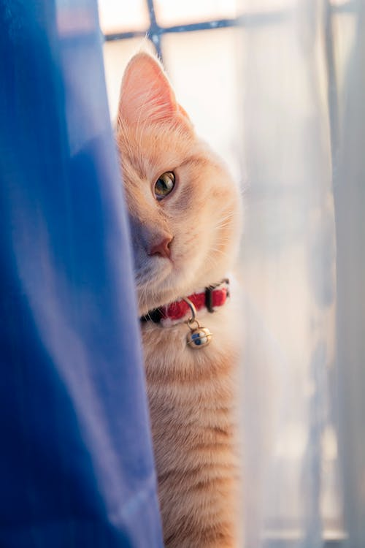
COMPETITIORS
heads up for tail :Is a private label and multi-brand retailer of pet products (dogs and cats) such as apparel, beds, toys, food, grooming and other accessories. Users can browse through various types of products and search by brand and place an online order for door delivery.
Rover :Rover is a website that connects pet owners with pet sitters, boarders and dog walkers. Pet carers create profiles advertising their services, then pet owners send messages to book the services they require.

Slide 12
WEBSITE RUN-THROUGH

Slide 13
Recommendation Algorithm RUN-THROUGH

Slide 14
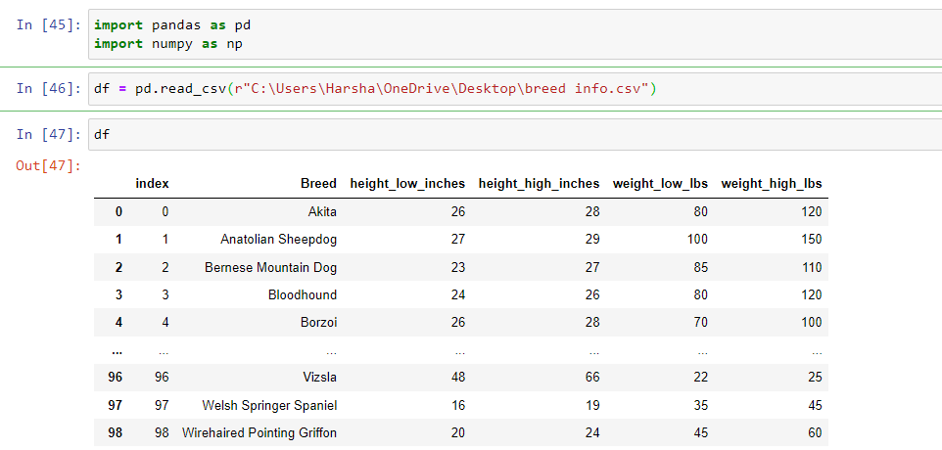

Slide 15
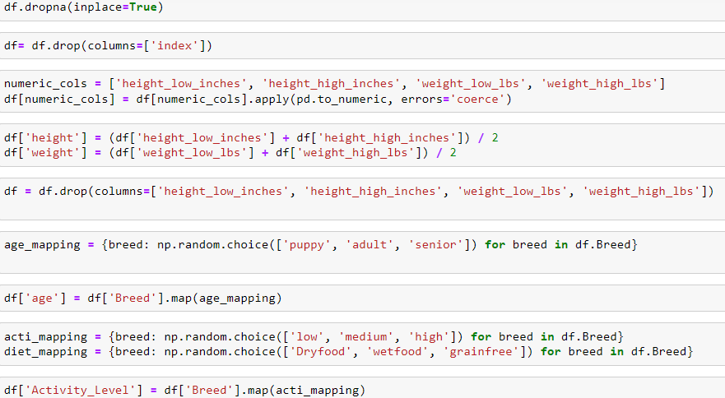

Slide 16
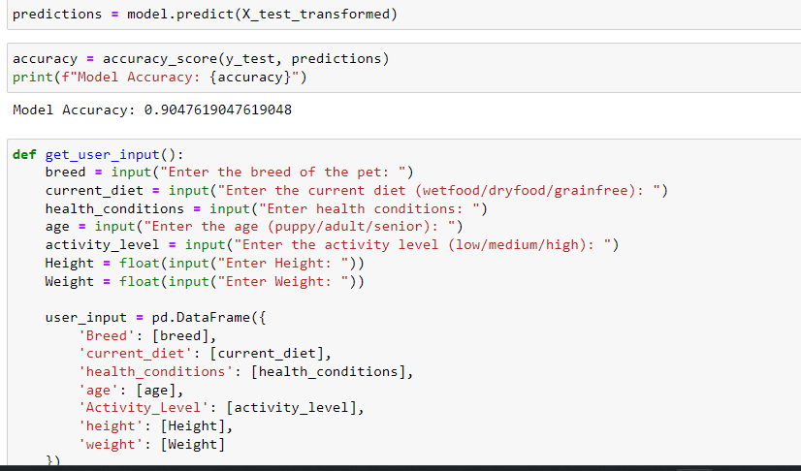

Slide 17
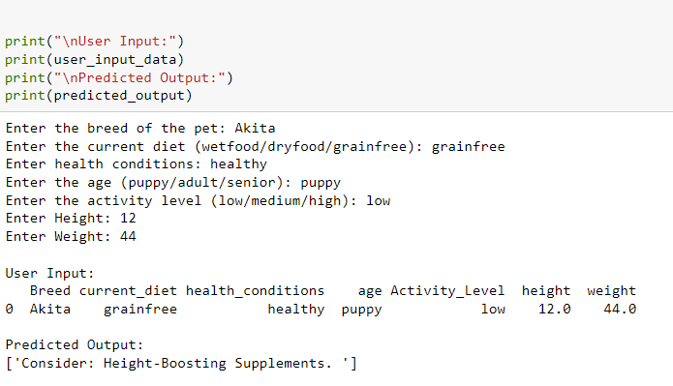

Slide 18
APP SCREENSHOTS

Slide 19
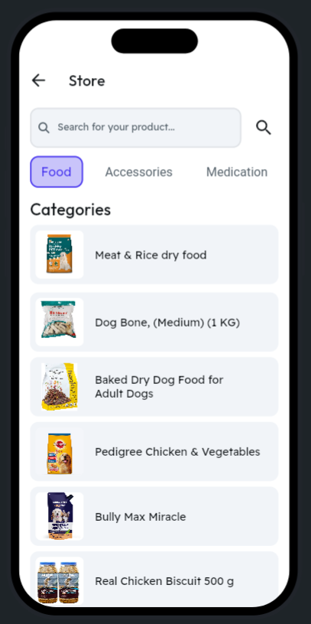
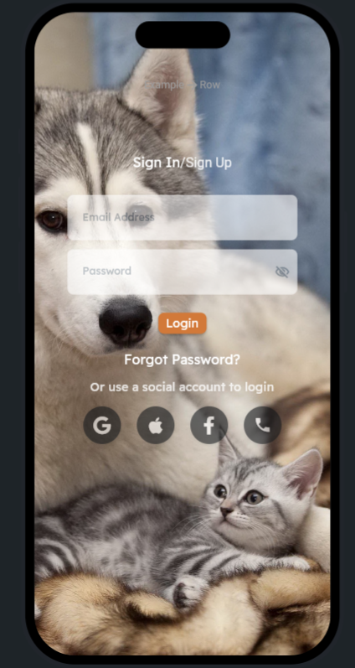
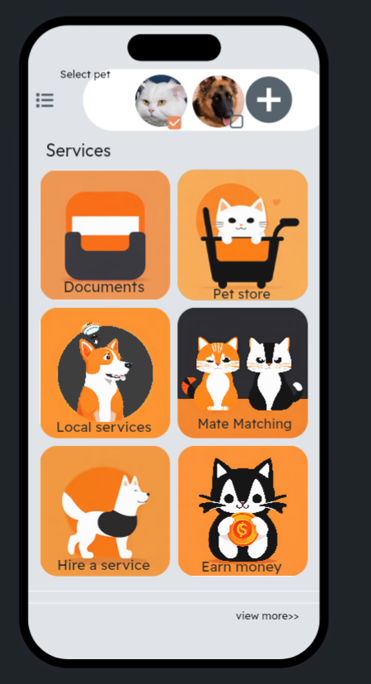

Slide 20
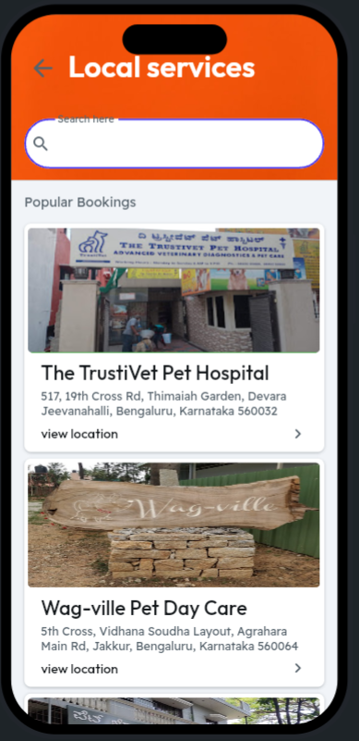
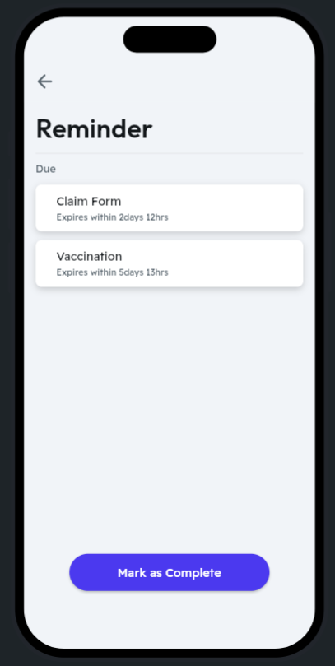
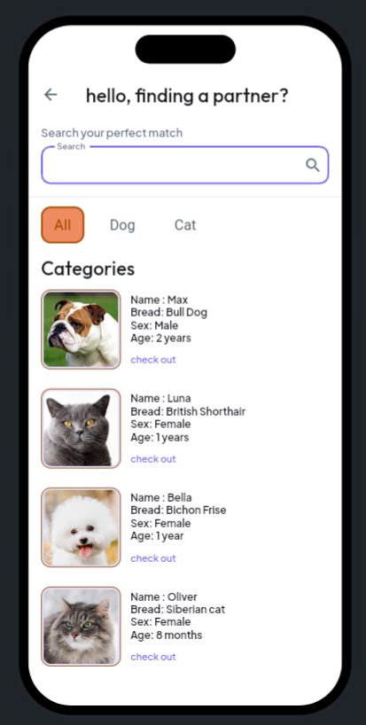

Slide 21


