Slide 1


Empowering Independence: The Sip-and-Puff Device
Assistive technologies are not a luxury; they are lifelines that restore dignity and unlock the potential trapped by physical limitations, fundamentally improving not just a 'quality of life' metric, but the human experience of independence.

Slide 2
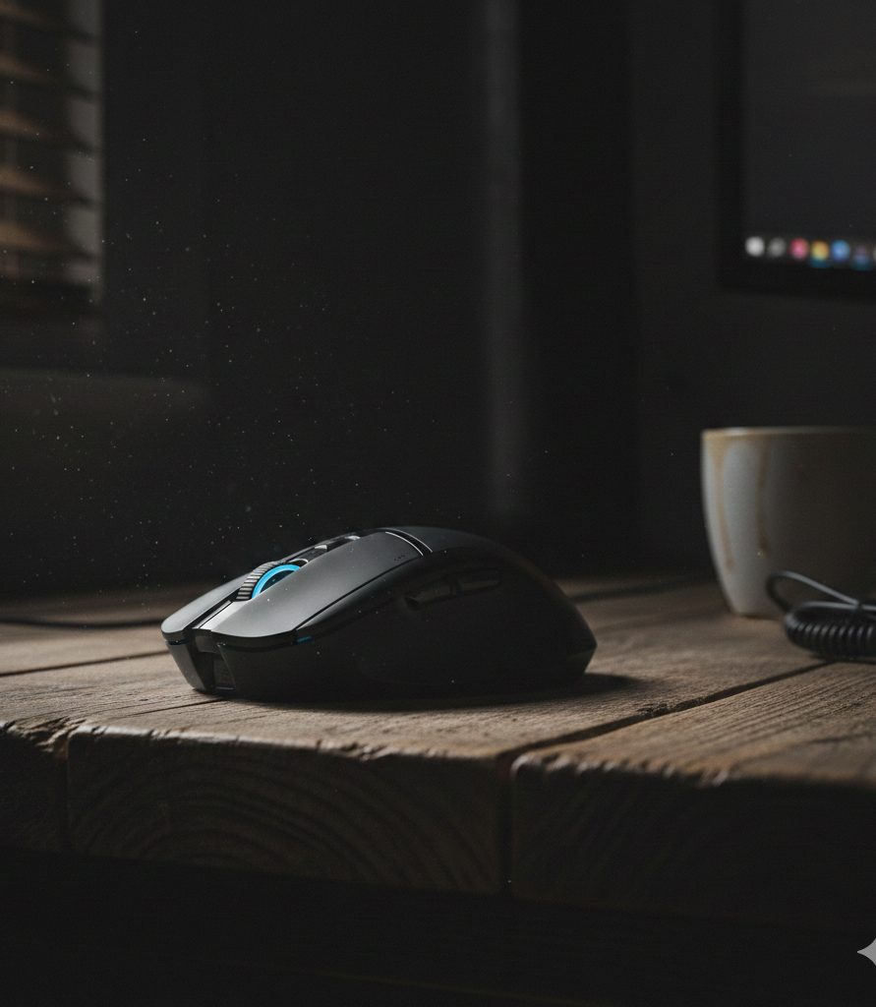
Problem Statement
People with severe upper-body mobility limitations often struggle with basic digital actions like clicking, typing, or steadying a hand that most people take for granted.
When illness or accidents remove abilities once felt natural, the impact is both physical and deeply emotional. Technology that once offered freedom can begin to feel out of reach, limiting opportunities to learn, work, connect, and express oneself. In a world that relies heavily on digital interaction, this lack of access can lead to isolation and dependence.
It also creates challenges in maintaining privacy and security, since relying on others for digital tasks can expose personal information and reduce one’s control over sensitive data.

Slide 3
Objective
Provide Hands-Free Cursor Control: Offer a specialized human-computer interface for hands-free cursor control.
Maintain Digital Independence: Crucial for maintaining digital independence and accessibility for individuals with severe motor impairments.
Solve the Digital Access Problem: Effectively bypass the need for manual dexterity to solve the problem of digital access for individuals with severe physical disabilities.
Translate Respiratory Commands: Translate the user's respiratory commands (sip/puff) into cursor movements and mouse clicks.
Facilitate Full Participation: Facilitate full participation in the digital sphere, overcoming limitations to engaging in professional work, education, and communication.

Slide 4
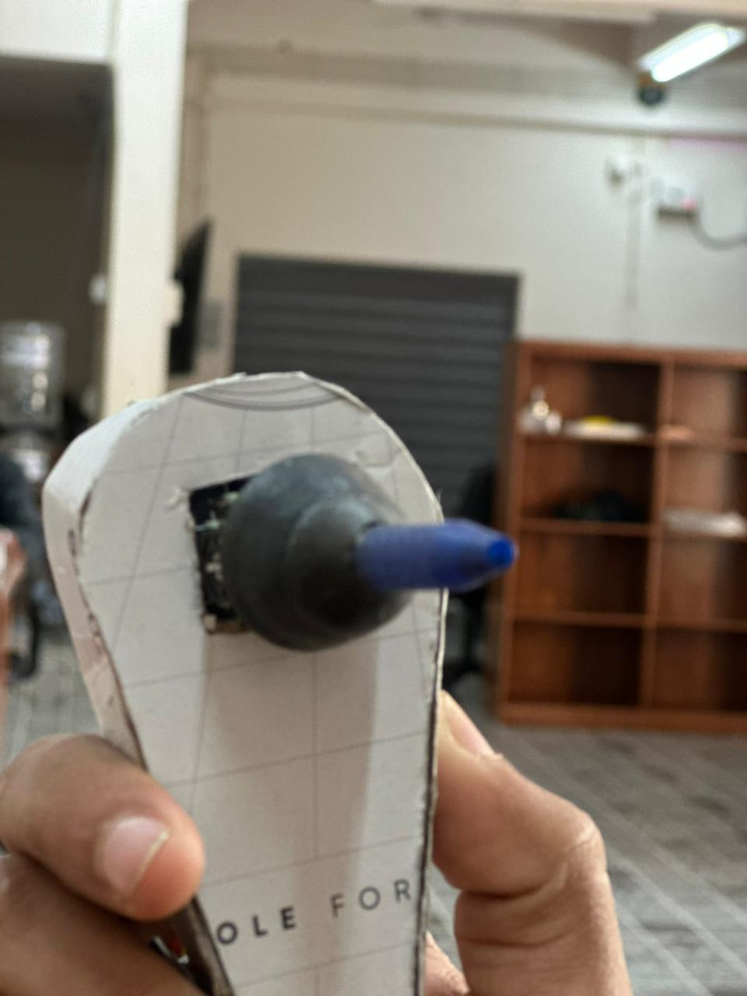
TECHNICAL OVERVIEW
The core functionality relies on three main components
*Air Pressure Sensor :This is the core component that detects the applied pressure.
It registers positive pressure for a "puff".
It registers negative pressure for a "sip".
The detected pressure is then converted into an electrical signal.
*Joystick module:controlling cursor movement in assistive technology
*Controller/Microprocessor:This component interprets the electrical signal received from the sensor
It maps the signal to specific mouse functions, such as cursor movement or clicking.

Slide 5
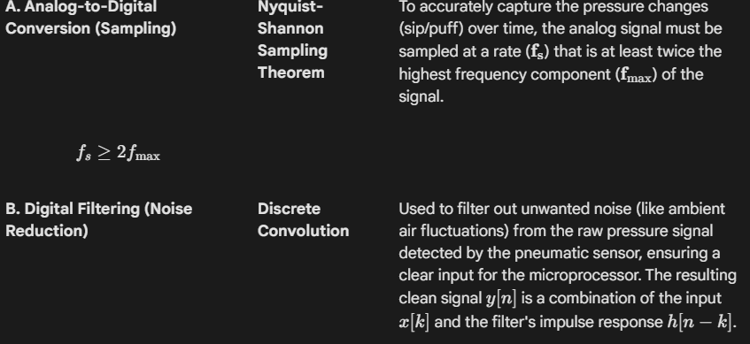

Slide 6
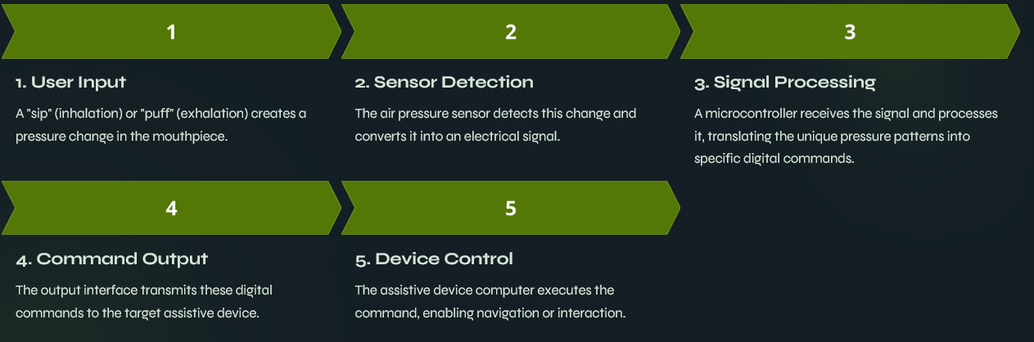
System Architecture / Block Diagram

Slide 7
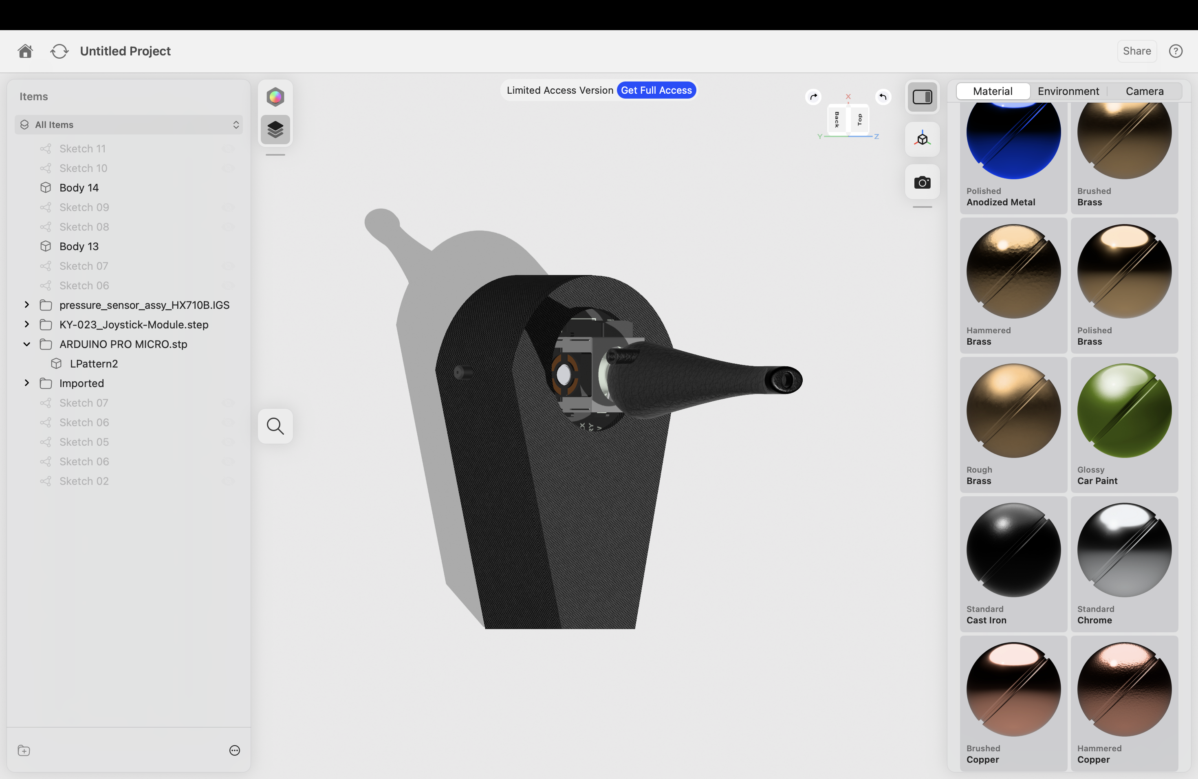
The future of this technology
The new 3D printed design is for comfortable and convenient use.

Slide 8

Upcoming updates
Expanded Applications: The technology is expanding beyond controlling computers and wheelchairs to manage environmental control units (smart home devices) and even adjustable beds.
Wireless Connectivity: Newer models, such as the QuadJoy 4, support Bluetooth connectivity, allowing users to control computers, tablets, and smartphones (iOS, Android) without wires.

Slide 9
CONCLUSION
The SIP and Puff (SNP) mouse is an indispensable assistive technology that effectively solves the problem of digital access for individuals with severe physical disabilities.
It translates respiratory commands (sips and puffs) into cursor movements and mouse clicks, empowering users to regain autonomy in the digital sphere.

Slide 10

THANK YOU......

