Slide 1
GROUP 7016
Major Project-Review I
01/09/2024
Automated Resume Analysis & Skill Suggesting Website using NLP
Under Guidance of Dr.K.Dhanasree Devi Ma’am

Slide 2
Agenda
Abstract
Introduction
Problem Statement & Objectives
Literature Surveys
UML Diagrams
Existing System vs Proposed Systems
Methods and Methodologies
Conclusion and Future Scope

Slide 3
ABSTRACT
By synergizing cutting-edge technology with recruitment needs, we present a dynamic solution an automated resume analysis and skill suggestion platform.
The current system for screening resumes employs a manual process in which recruiters or human resource managers evaluate job applications based on their qualifications, experience, and other factors.
To create an innovative Automated Resume Analysis & Skill Suggesting Website utilizing Resume Parser and NLP APIs.
By automating the extraction of crucial information such as skills, qualifications, and personal details from resumes, the platform streamlines the recruitment process for companies. By assessing applicant skills against job requirements, the system calculates scores to aid in effective short listing.
It is streamlined, data-driven approach to enhance the recruitment process for both job seekers and employers.

Slide 4
INTRODUCTION
By synergizing cutting-edge technology with recruitment needs, we present a dynamic solution an automated resume analysis and skill suggestion platform.
Harnessing the capabilities of Natural Language Processing (NLP), we redefine the job application process.
Tedious manual resume screening is a thing of the past as our system adeptly assesses resumes, extracting pivotal skills.
Elevating the matching game, it takes a step further by offering proactive skill recommendations for fostering career growth. Embrace a smarter way of talent acquisition and career progression with us.

Slide 5
PROBLEM STATEMENT
The current system for screening resumes employs a manual process in which recruiters or human resource managers evaluate job applications based on their qualifications, experience, and other factors.
The demand for efficient recruitment solutions grows, existing systems may face scalability challenges. Inflexible architectures and limited integration capabilities hinder their ability to accommodate increasing user loads and diverse recruitment environments.
With the increasing importance of data security and privacy, existing systems may fall short in implementing robust measures to safeguard user information. This raises concerns among both job seekers and employers about the confidentiality and integrity of their data.

Slide 6
OBJECTIVE
The objective is to create an innovative Automated Resume Analysis & Skill Suggesting Website utilizing Resume Parser and NLP APIs.
By automating the extraction of crucial information such as skills, qualifications, and personal details from resumes, the platform streamlines the recruitment process for companies.
Using applicant skills and required skillset, the system calculates scores, facilitating efficient shortlist of candidates for interview calls.
This solution offers a seamless and effective approach to talent acquisition and job seeker advancement.

Slide 7
LITERATURE SURVEYS
TITLE | AUTHORS | METHODOLOGY | PROPOSED SYSTEM | CONS | CONCLUSION
Job Recommender Systems: A Survey | Zheng Siting , Hong Wenxing , Zhang Ning , Yang Fan LINK: https://ieeexplore.ieee.org/document/6295216 | The job recommender systems for job recruiting domain have emerged and enjoyed explosive growth in the last decades. User profiles and recommendation technologies in the job recommender system have gained attention and investigated in academia and implemented for some application cases in industries. | Personalized recommender systems have gained much attentions by researchers and been widely used in many domains in the last decades. The job recommender system is proposed for job seekers who search job positions and recruiters who find candidates on the Internet by applying the concept of personalized recommender systems into the job recruiting domain. | New users may receive less accurate job suggestions, leading to a potentially frustrating experience. Biased recommendations can perpetuate and reinforce existing societal inequalities, affecting diversity and fairness in the job market. | For a job recommender system, researchers focus on the user profile and recommendation technology at the aim of improving the accuracy and performance. User profile is the statistical foundation for the recommender system. For the user of a job recommender system, i.e. job seekers or recruiters, not only their personal information but also their behavior information are indicating their preferences and interests and can both be integrated into a hybrid user profile.

Slide 8
TITLE | AUTHORS | METHODOLOGY | PROPOSED SYSTEM | CONS | CONCLUSION
Automated Collaborative Filtering Applications for Online Recruitment Services | Rachael Rafter, Keith Bradley & Barry Smyth LINK: https://link.springer.com/chapter/10.1007/3-540-44595-1_48 | ACF algorithms can analyze the job preferences and history of users to recommend relevant job opportunities. By considering the preferences and behaviors of similar users, the system can suggest jobs that match a user's skills, experience, and interests. | For employers seeking suitable candidates, ACF can help by matching job requirements with the profiles of potential candidates. By analyzing historical data on successful hires and the preferences of hiring managers, the system can provide suggestions on candidates who are likely to be a good fit for a particular position. | In collaborative filtering, the system relies on user-item interactions. If the data is sparse, meaning that users have limited interactions with items, the system may find it challenging to make accurate predictions and recommendations. | By analyzing historical data and user interactions, ACF can streamline the job matching process, saving time for both candidates and employers.

Slide 9
TITLE | AUTHORS | METHODOLOGY | PROPOSED SYSTEM | CONS | CONCLUSION
A Novel Knowledge Extraction Framework for Resumes Based on Text Classifier | Jie Chen, Zhendong Niu & Hongping Fu LINK: https://link.springer.com/chapter/10.1007/978-3-319-21042-1_58 | The Training Pipeline involves a comprehensive process, beginning with Data Collection and Annotation. A diverse dataset of labeled resumes, with annotated information, is used to train the model. The subsequent Model Training phase involves splitting the dataset into training, validation, and test sets, optimizing hyper parameters for improved performance. | The proposed system is a sophisticated Resume Knowledge Extraction Framework designed to streamline the process of extracting valuable information from resumes using advanced text classification techniques. | The framework may struggle with understanding the context of information, leading to misinterpretation of details, especially when sentences or phrases are complex. | The development of a Resume Knowledge Extraction Framework represents a significant stride towards enhancing the efficiency and effectiveness of resume analysis in the context of hiring processes. This framework leverages advanced text classification techniques to extract valuable information such as skills, education, and experience from resumes.

Slide 10
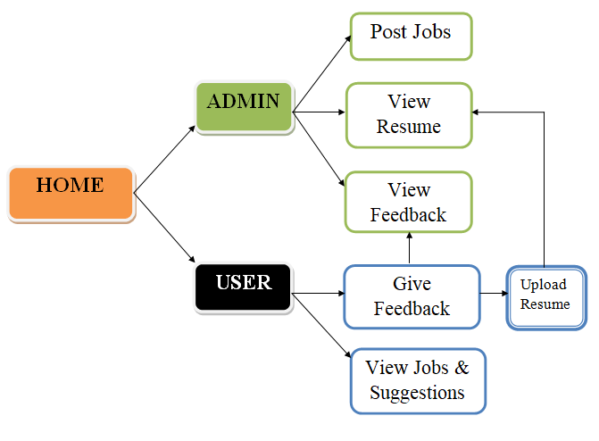
UML DIAGRAMS
SYSTEM ARCHITECTURE

Slide 11
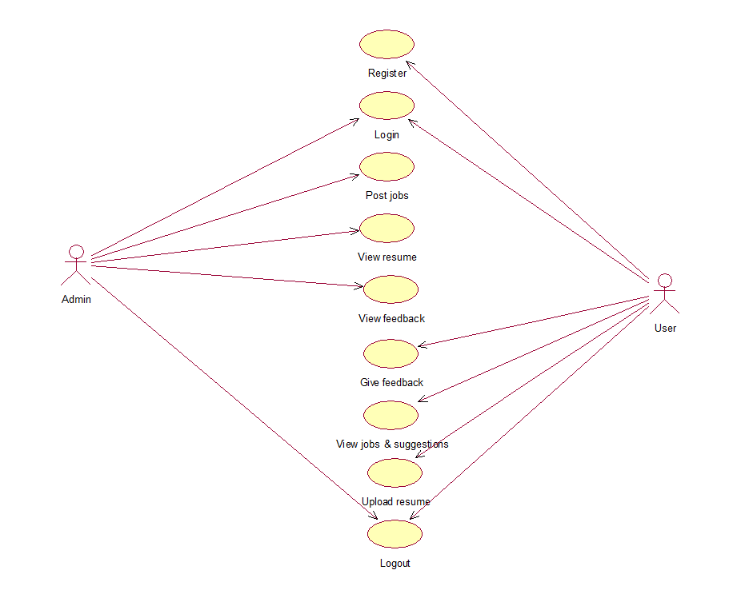
UML DIAGRAMS
USECASE DIAGRAM

Slide 12
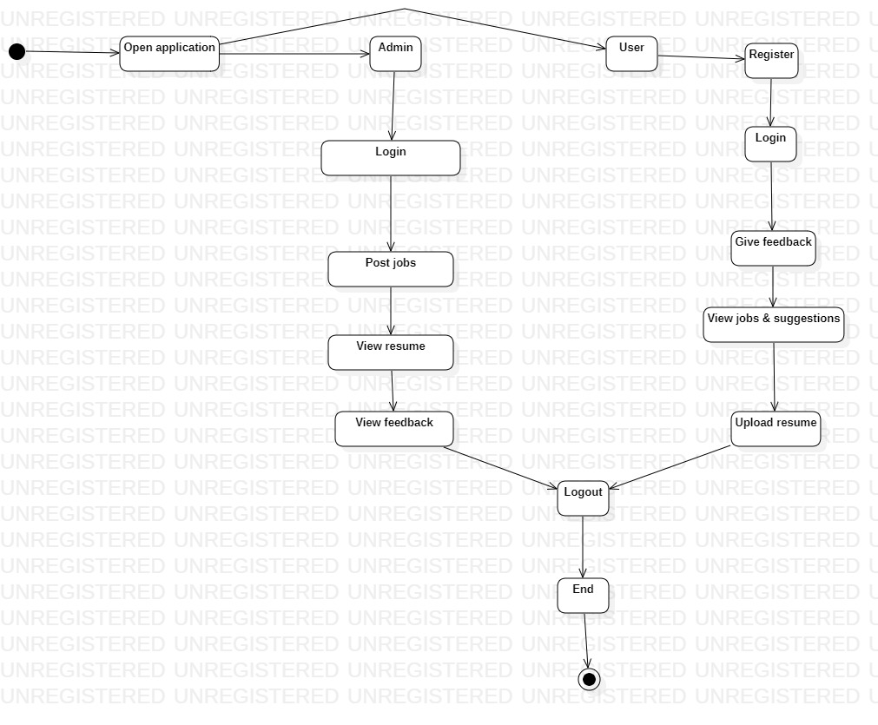
UML DIAGRAMS
ACTIVITY DIAGRAM

Slide 13
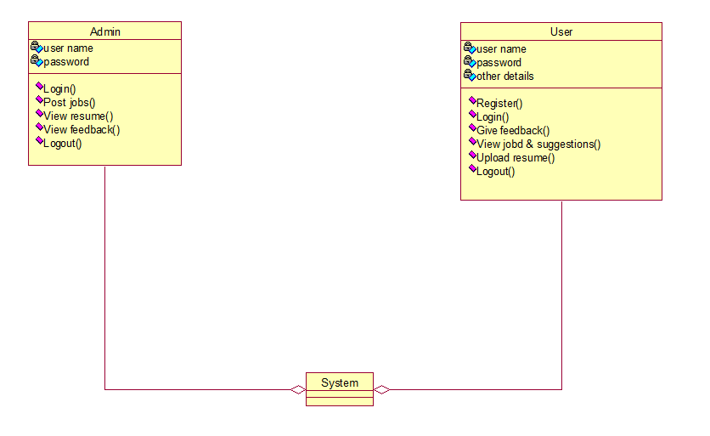
UML DIAGRAMS
CLASS DIAGRAM

Slide 14
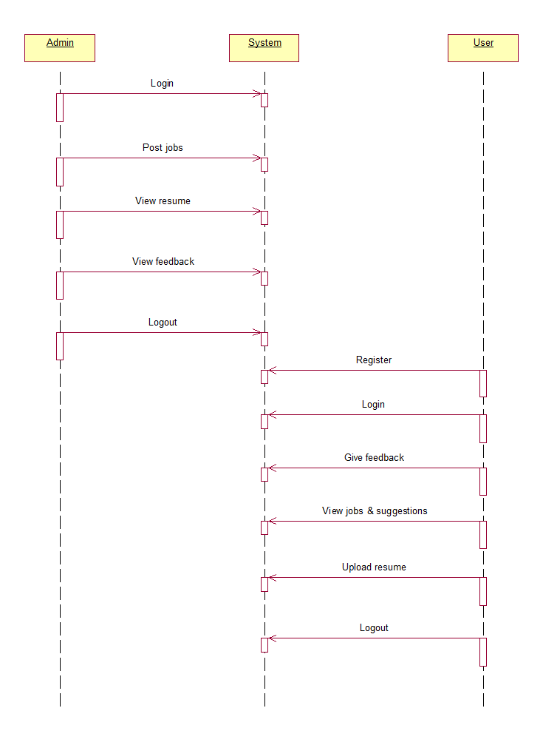
UML DIAGRAMS
SEQUENCE DIAGRAM

Slide 15
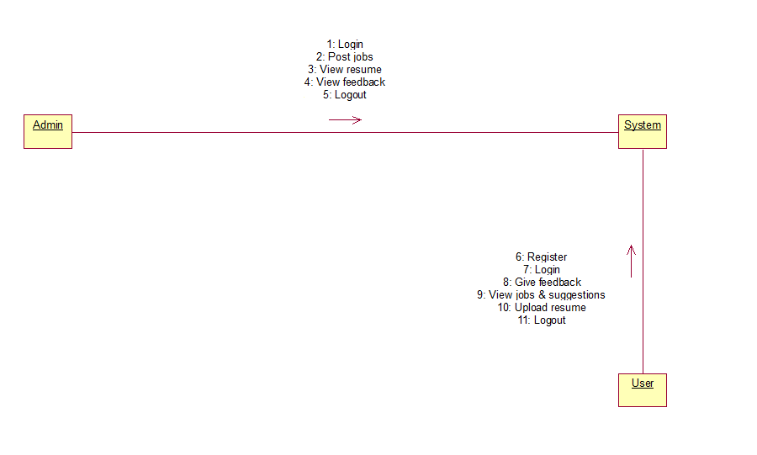
UML DIAGRAMS
COLLABORATION DIAGRAM

Slide 16
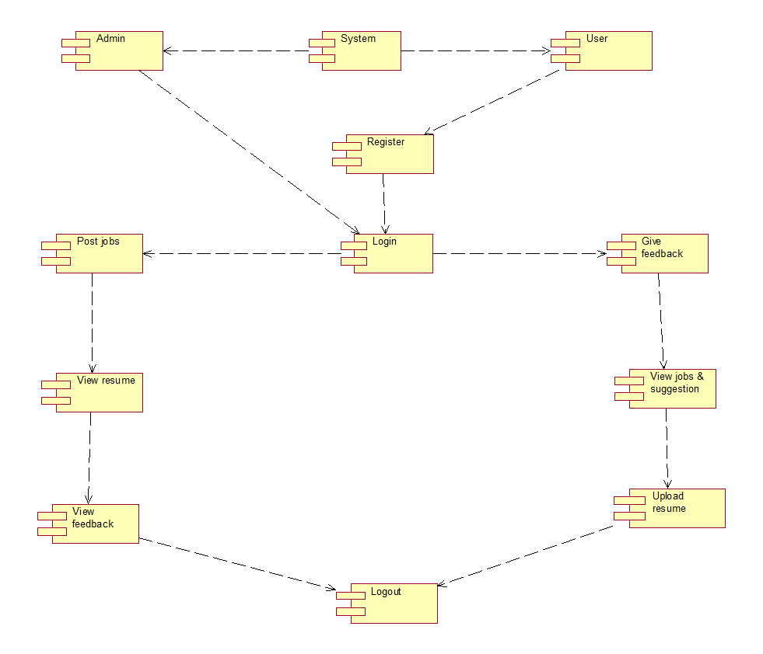
UML DIAGRAMS
COMPONENT DIAGRAM

Slide 17
EXISTING SYSTEM
Traditional resume analysis systems often rely on basic keyword matching, lacking the ability to grasp the contextual nuances of language. This limitation results in an incomplete understanding of a candidate's professional journey, leading to inaccurate skill identification.
The existing systems struggle to extract skills accurately from resumes, particularly when confronted with diverse formats and expressions. This inadequacy leads to a fragmented representation of a candidate's capabilities, hindering the ability to make informed hiring decisions.
DISADVANTAGES:
Insufficient customization
Narrow Focus
Language prejudice
Without context

Slide 18
PROPOSED SYSTEM
Current automated resume screening systems evaluate job applications for relevance to a given job description using a variety of NLP approaches, such as entity identification, semantic search, and machine learning.
It utilizes predefined modules to identify and extract information such as contact details, skills, work experience, and education.
Our system is designed to scale with the growing demands of users. Additionally, it offers seamless integration capabilities, allowing for compatibility with various platforms and services within the recruitment ecosystem.
ADVANTAGES:
Language Autonomy
More Accurate candidate matching
Working knowledge on unstructured data

Slide 19
Working Modules / Methodologies
ADMIN MODULE
01 Admin Login
02 Post Jobs
03 View Resume Score & Feedback

Slide 20
USER MODULE
1
3
New User Signup
View Jobs & get suggestions
2
4
User Login
Upload resume and get resume score

Slide 21
CONCLUSION
This project aims to develop an advanced Resume Analysis & Skill Suggestion Website using NLP and Resume Parser.
The primary goal is to automate the extraction of skills, qualifications, and personal details from resumes, easing the burden of manual screening for companies.
By assessing applicant skills against job requirements, the system calculates scores to aid in effective shortlisting.
This solution offers a streamlined, data-driven approach to enhance the recruitment process for both job seekers and employers.

Slide 22
THANK YOU
NAME | PIN NO.
AKSHITH | 222010303005
ABHISHT | 222010303010
KARTHIK | 222010303050
CHETNA | 222010304010

