Slide 1
AMS-opt: Analog Circuit Graph Pipeline + Contrastive GNN
Structural + Functional graphs → Combined graph → GNN embeddings
Generated 2026-01-04

Slide 2
Problem & Goal
Represent SPICE netlists as graphs suitable for learning.
Fuse physical connectivity with functional (KG) knowledge.
Learn circuit-level embeddings via contrastive learning.
Enable retrieval/cluster analysis across circuit families.

Slide 3
End-to-End Pipeline
1) Netlist → Structural Graph (`get_netlist_to_SG.py`)
2) LLM KG → Functional Graph, then variant expansion (`transform_fun_graph.py`)
3) Structural + Functional → Combined Graph (`combine_graphs.py`)
4) Combined Graph → NPZ features/adjacency (`comb_graph_to_gnn.py`)
5) Contrastive GNN training (`gnn_training/scripts/train.py`)

Slide 4
Structural Graph (Stage 1)
Nodes: devices, terminals, nets.
MOS is abstracted as device + (D,G,S) terminal nodes.
Edges: device→terminal and terminal→net (MOS); device→net (generic).
Output: `str_graph.json`.
Notes:
Implementation: get_netlist_to_SG.py
MOS: dev:Mx, term:Mx:D/G/S, net:<name>.
Non-MOS: dev:<name> directly connected to net nodes.

Slide 5
Functional / Knowledge Graph (Stage 2)
Nodes: performance metrics, substructures, parameters.
Edges: relations like directly-proportional / trade-off / belongs-to / influences.
Variant expansion creates relation-specific nodes.
All relations are collapsed to `connects` edges between appropriate variants.
Output: `fun_updated.json`.
Notes:
See scripts/transform_fun_graph.py
Performance variants: -ambiguous, -trade-off, -directly-proportional
Parameter variants: -directly-proportional, -inversely-proportional
Links are rewritten to relation-conditioned variant endpoints; relation label becomes 'connects'.

Slide 6
Combined Graph Fusion (Stage 3)
Merge nodes and deduplicated links from SG and KG.
Add device→parameter links for MOS devices: `dev:Mk`→`W_Mk`, `L_Mk`.
Result is a single heterogeneous graph for learning.
Output: `comb_graph.json`.
Notes:
See scripts/combine_graphs.py
Merging strategy: functional nodes first, then overlay structural nodes (struct attrs win).
Device-to-parameter links are created if missing.

Slide 7
Node Feature Vector (Stage 4)
Type + Subcategory
Type one-hot (6): performance, sub-structure, parameter, net, device, terminal.
Subcategory slots (4) depend on node type.
Examples: performance {orig, ambiguous, trade-off, directly-prop}
parameter {orig, directly-prop, inversely-prop, unused}
Meaning Block
Concatenated blocks: [perf meaning | substructure meaning].
Perf uses base metric (variants map to base).
Substructure IDs are normalized to canonical names.
Produces `comb_graph_gnn.npz` + meta JSON.
Notes:
See scripts/comb_graph_to_gnn.py
Feature layout: 6(type) + 4(subcat) + meaning_dim.
Meaning dim is sized as max(perf_dim_max + sub_dim_max, 4).
Performance 'Gain-trade-off' sets subcat slot but meaning uses 'Gain'.

Slide 8
GNN Architecture
Encoder: multi-layer GIN (sum aggregation + MLP).
Readout: mean pooling over nodes → graph embedding.
Projection head: MLP for contrastive loss.
Outputs: embedding (encoder) and projection (used in loss).
Notes:
See gnn_training/models/gin_model.py
GINConv: h' = MLP((1+ε)h + A·h)
Readout: mean(h_nodes) then MLP to embedding_dim.
ProjectionHead: 2-layer MLP to projection_dim.

Slide 9
Contrastive Objective: NT-Xent
Anchor z_i should match its positive z_j (same circuit, perturbed).
Negatives: other positives in the batch; optional hard negatives.
Similarity: cosine(z_i, z_j) / temperature.
Loss: cross-entropy where the positive logit is the correct class.
Notes:
See gnn_training/losses/nt_xent_loss.py
For each anchor k: logits = [sim(z_i[k], z_j[k]), sim(z_i[k], z_j[others]), hard_neg_sims].
Label is always 0 (the first logit).

Slide 10
Hard Negatives (Overlap-Based)
Mine negatives among circuits with non-zero substructure overlap.
Weighted NT-Xent can upweight high-overlap negatives.
This pushes apart circuits that look structurally similar.
Notes:
Hard negative miner lives under gnn_training/pairs/sampling.py
Weighted loss: weights = 1 + hard_neg_weight * similarity_overlap.

Slide 11
Consistency Loss (Batch Similarity)
Compute pairwise circuit similarity matrix sim[i,j] ∈ [0,1] from substructure overlap.
Encourage embedding distances to respect similarity structure.
Two options: margin-based hinge or MSE on normalized distances.
Combined loss: L = L_NT-Xent + w * L_consistency.
Notes:
See gnn_training/losses/consistency_loss.py
Margin form uses: relu(margin + dist(i,j) - sim(i,j)*max_dist).
Alternative uses MSE between normalized dist and (1-sim).

Slide 12
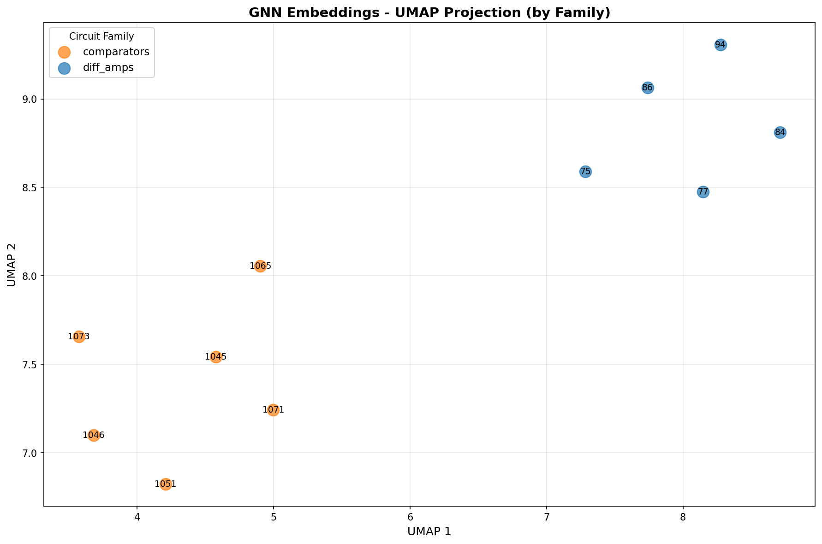
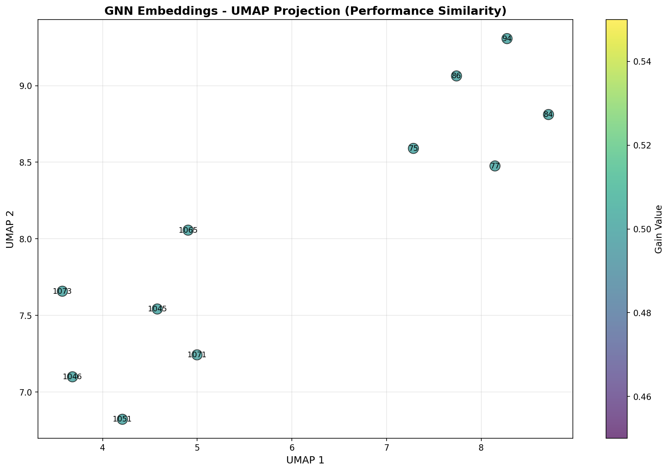
Qualitative Results (UMAP)

Slide 13
Artifacts & Repro
Graphs: `str_graph.json`, `fun_updated.json`, `comb_graph.json`.
GNN data: `comb_graph_gnn.npz` + `comb_graph_gnn_meta.json`.
Training: configs under `gnn_training/config/`, checkpoints under `checkpoints_*`.
Viz: `scripts/visualize_embeddings_umap.py`, interactive plot HTML.

