Slide 1

CodeBasics Resume Project Challenge #4
Providing Insights to Management in Consumer Goods Domain
Developed By: Aryan Pokhriyal

Slide 2

What is AtliQ Hardwares?
AtliQ Hardware (imaginary company) is one of the leading computer hardware producers in India and well expanded in other countries too.

Slide 3

Problem Statement What is the problem?
The management in AtliQ Hardware noticed that they do not get enough insights to make quick and smart data-informed decisions. They want to expand their data analytics team by adding several junior data analysts.
Tony Sharma, their data analytics director wanted to hire someone who is good at both tech and soft skills. Hence, he decided to conduct a SQL challenge which will help him understand both the skills.
And my goal is to complete the challenge by writing efficient SQL queries for given Ad-Hoc Requests, and get selected in the data analytics team!

Slide 4






Tools Used
Brick & Mortar
Platforms
E-Commerce

Slide 5

Retailer
Channel
Direct
Distributor
Fiscal Year
Sept - Aug
Asia-Pacific (APAC)
European Union (EU)
Regions
Latin America (LA)
North America (NA)

Slide 6
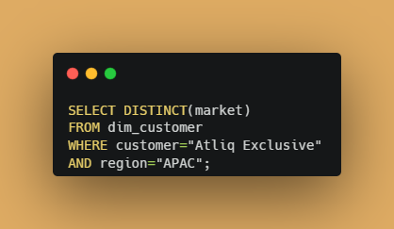
Request #1 Provide the list of Markets in which customer “AtliQ Exclusive” operates its business in APAC region

Slide 7
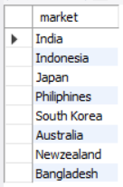
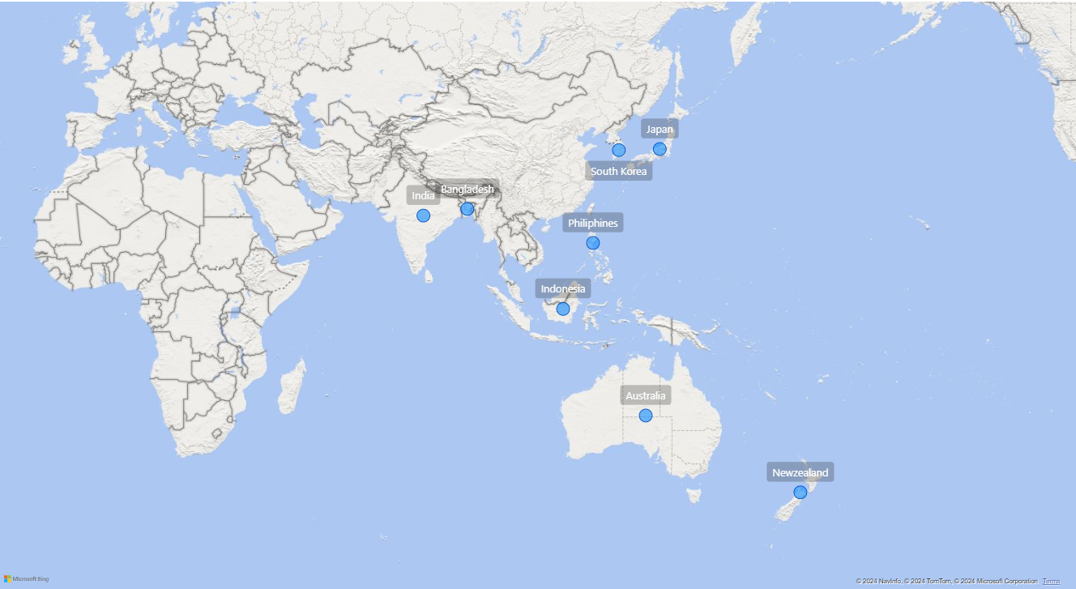
Output
Visualization

Slide 8
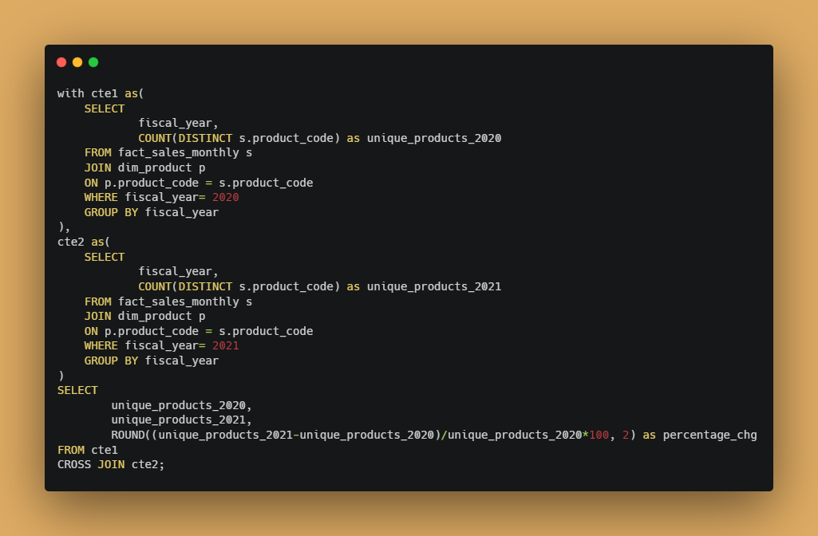
Request #2 What is the percentage of unique product increase in 2021 v/s 2020?

Slide 9
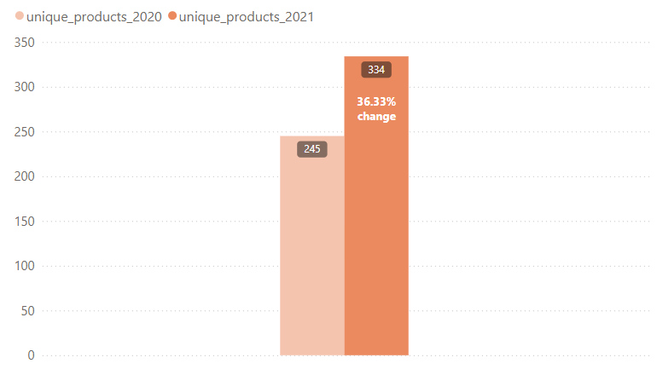

Output
Visualization
The company had more unique products in 2021 than in 2020!

Slide 10
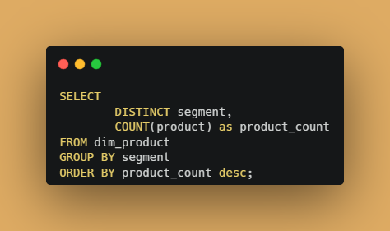
Request #3 Provide a report with all the unique product counts for each segment and sort them in descending order of the product counts.

Slide 11
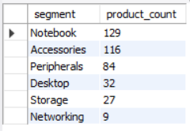
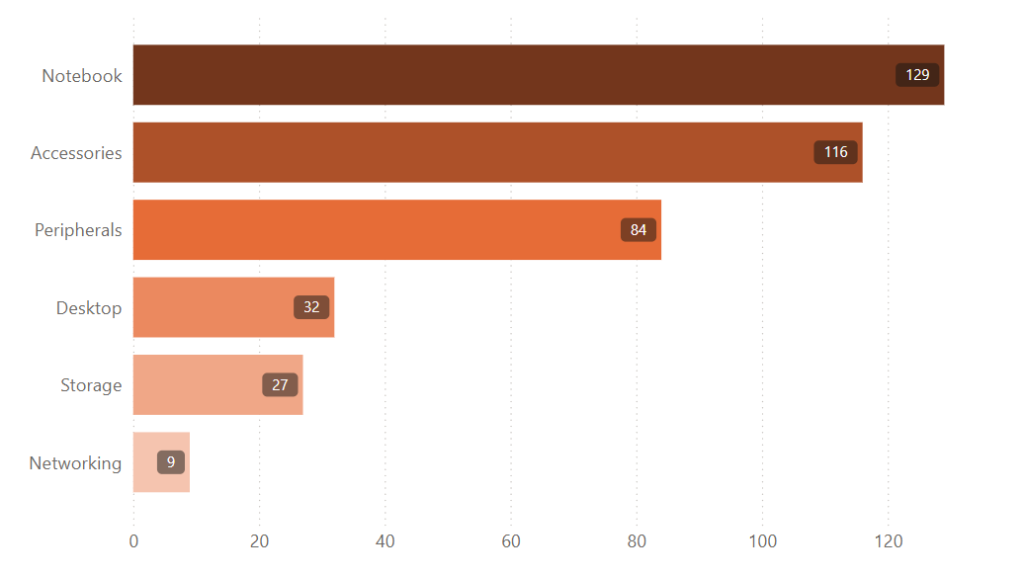
Output
Segment with most product count in 2 yrs: Notebooks (129)
Visualization
Segment with least product count in 2 yrs:
Networking (9)
Notebooks, Accessories and Peripherals contribute to 83% of the total Unique Product Count.
Segments with the least product count:
Desktop, Storage and Networking

Slide 12
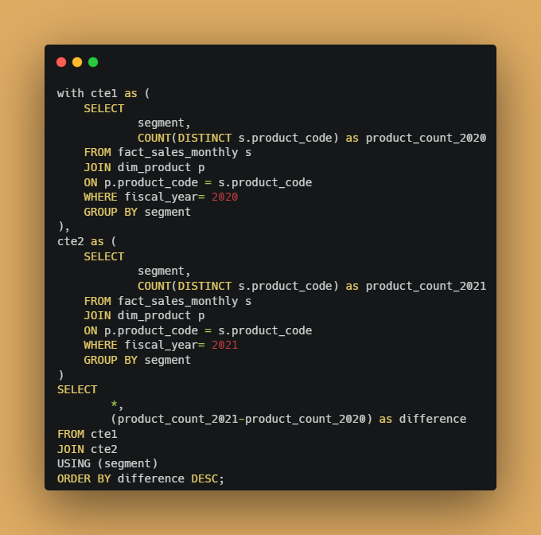
Request #4 Follow-up: which segment had the most increase in unique products in 2021 v/s 2020?

Slide 13
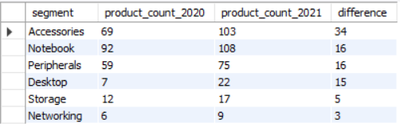
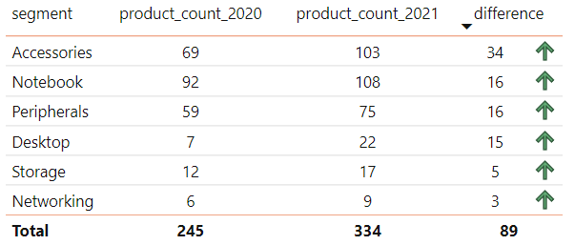
Output
Visualization
Accessories had the largest increase in manufacturing
Accessories, Notebook and Peripherals
had the most increase in unique product because of their higher manufacturing growth.

Slide 14
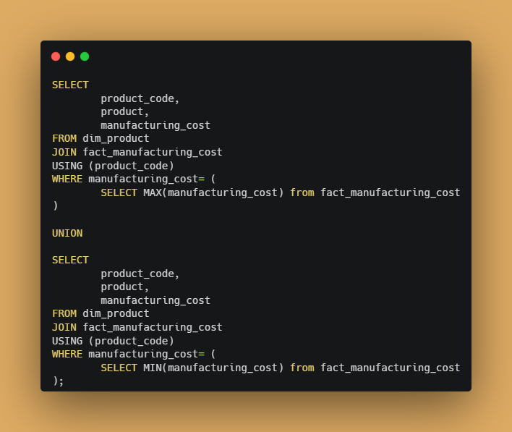
Request #5 Get the products that have the highest and lowest manufacturing costs

Slide 15

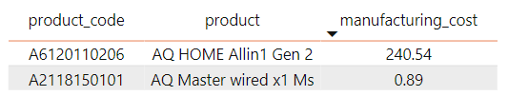

AQ Home Allin 1 Gen 2
($240.54)
Output
AQ Master wired x1 Ms
($0.89)

Slide 16
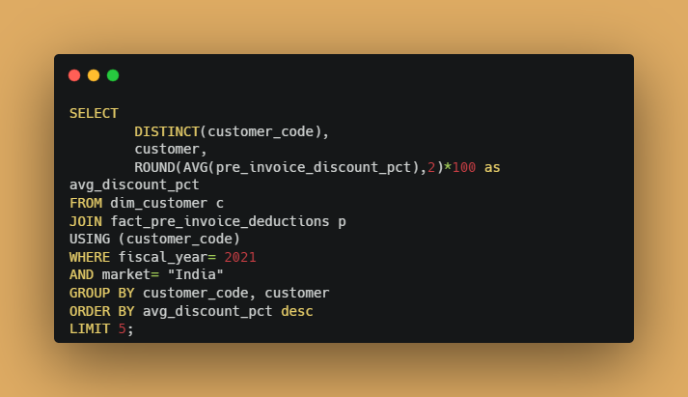
Request #6 Generate a report which contains the top 5 customers who received an average high pre_invoice_discount_pct for the fiscal year 2021 and in the Indian market

Slide 17
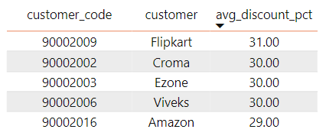
Output

Slide 18
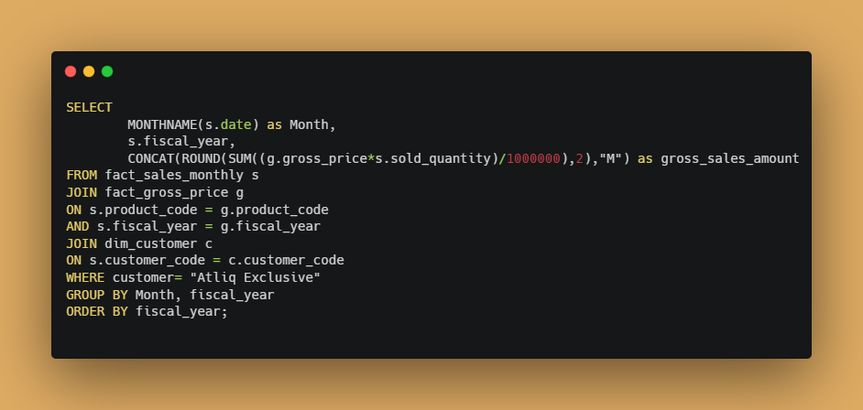
Request #7 Get the complete report of the gross sales amount for the customer “Atliq Exclusive” for each month.

Slide 19
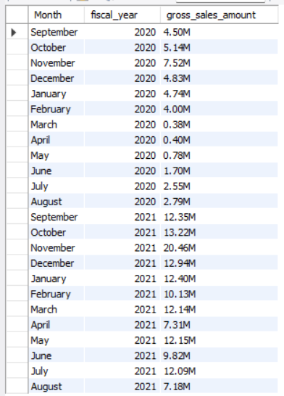
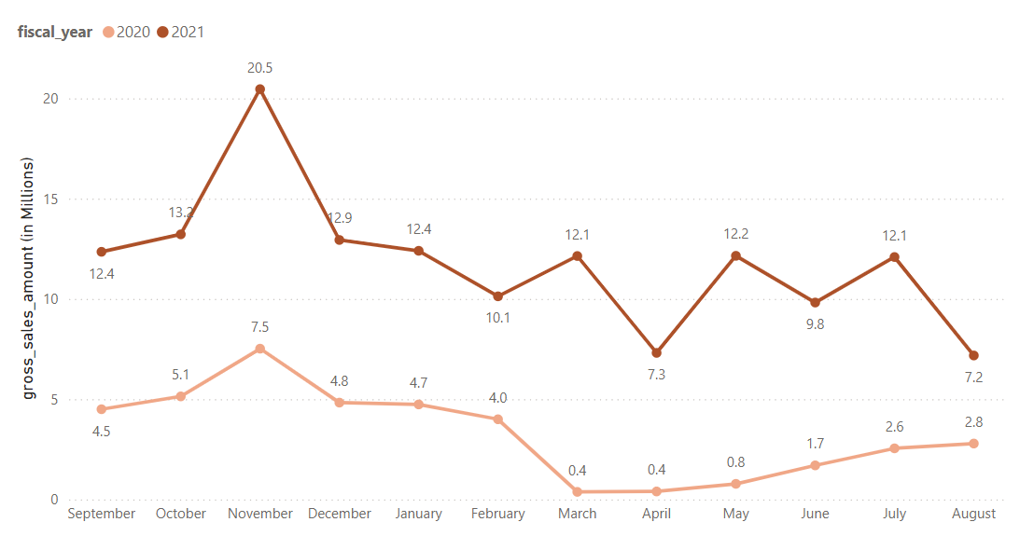
Output
Visualization
The sudden drop in gross sales amount in March FY 2020 (from $4 Million to $0.4 Million ) was due to the start of the pandemic period of COVID-19 virus. After that, we can see a gradual increase as the market were starting to open and gaining more sales.

Slide 20
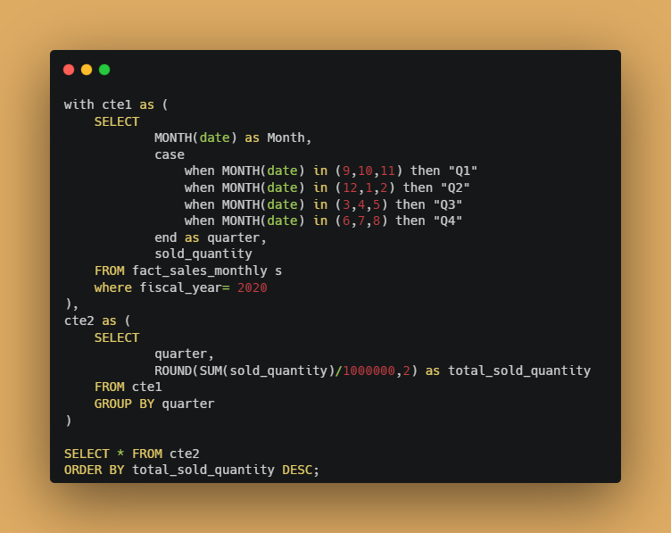
Request #8 In which quarter of 2020, we got the maximum total_sold_quantity?

Slide 21
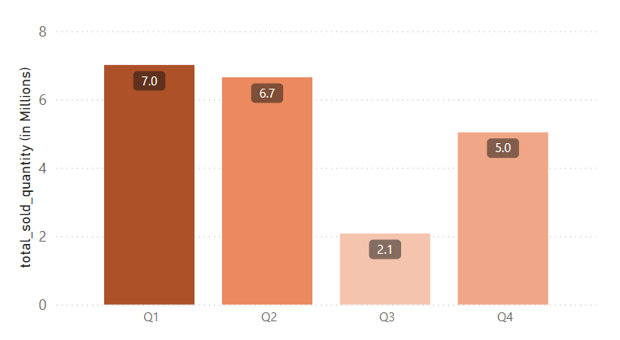
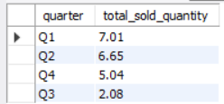
Output
Visualization
Quarter 1 was the one with the highest total sold quantities(in millions) of products in 2020.
Sudden drop in Quarter 3 of 2020 because of the lower manufacturing growth due to COVID-19 pandemic. No consumers, No growth!

Slide 22
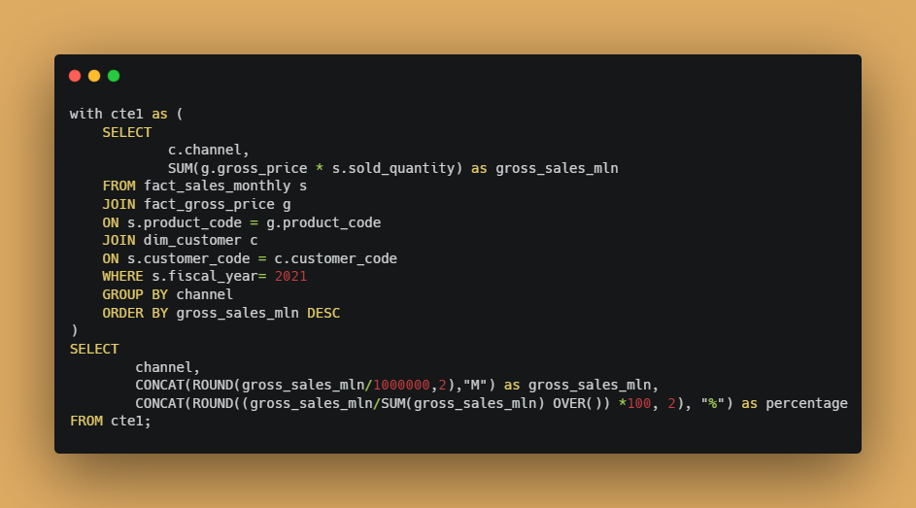
Request #9 Which channel helped to bring the most gross sales in fiscal year 2021?

Slide 23
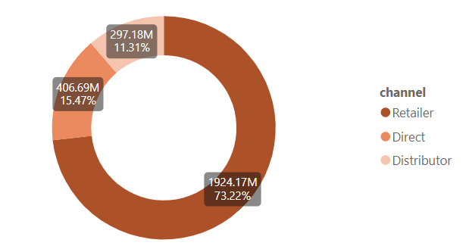

Output
Visualization
Highest contribution by:
Retailers (73.22%)
The reason could be that people go offline to their preferred retail store and buy the products, rather than going to Company’s own store or any large distributor.

Slide 24
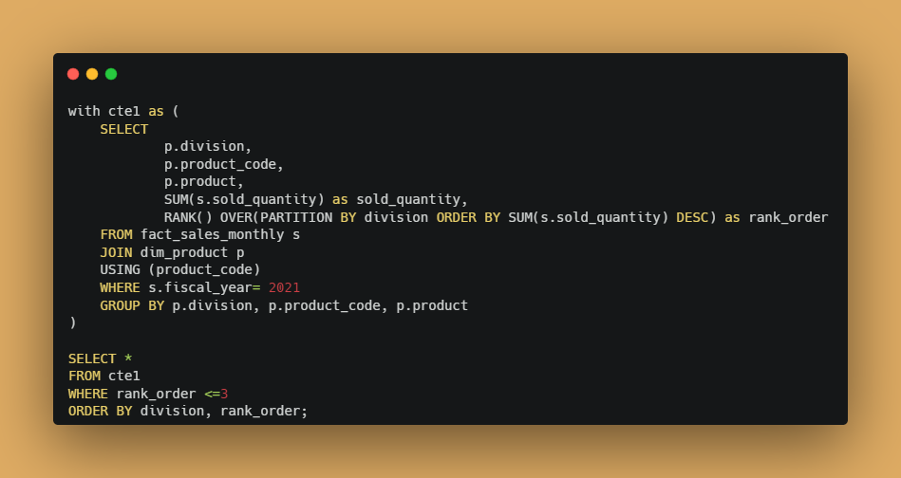
Request #10 Get the Top 3 products in each division that have a high total_sold_quantity in the fiscal year 2021

Slide 25
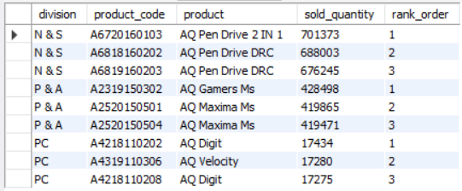
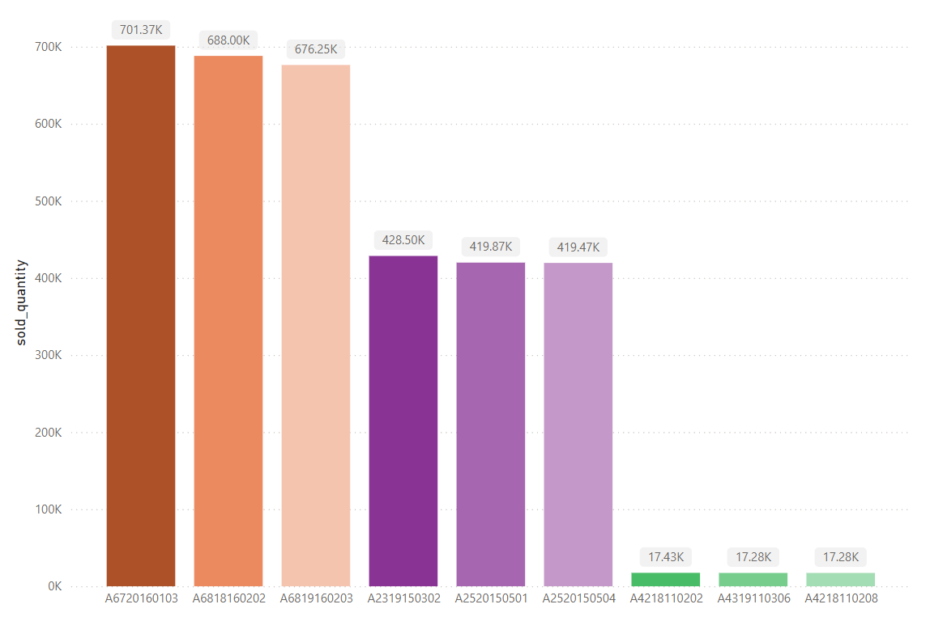
Output
Pen Drives, Mouse and Laptops are the Top 3 products in fiscal year 2021.
Pen Drives(N&S) are the top products in Top 3 products, for fiscal year 2021.
Visualization

Slide 26
Thank you!

