Slide 1
Dual-Stream Feature Fusion for Fake News Detection
Addressing Domain Shift & Micro-Text Limitations
Presenters: Sai Karthik Varma Indukuri, Srivatsa Vuppalanchi, Gandhar Sidhaye

Slide 2
Problem Statement & Motivation
Problem: LLMs are great at semantic meaning but ignore structural/psychological markers of deception (readability, hyperbole).
Our Hypothesis: Fusing explicit linguistic features with dense contextual embeddings will create a more robust classifier.

Slide 3
Datasets
LIAR (Micro-Text):
Focus: 12.8k Short political statements from PolitiFact.
Median Length: ~15 words.
Example: “The health care law is a job-killer." (Label: False)
FakeNewsNet (Macro-Text):
Focus: 23k full-length web articles (GossipCop & Politifact).
Median Length: 450+ words.
Example: A 1200+ word detailed investigative report on celebrity financial scandals

Slide 4
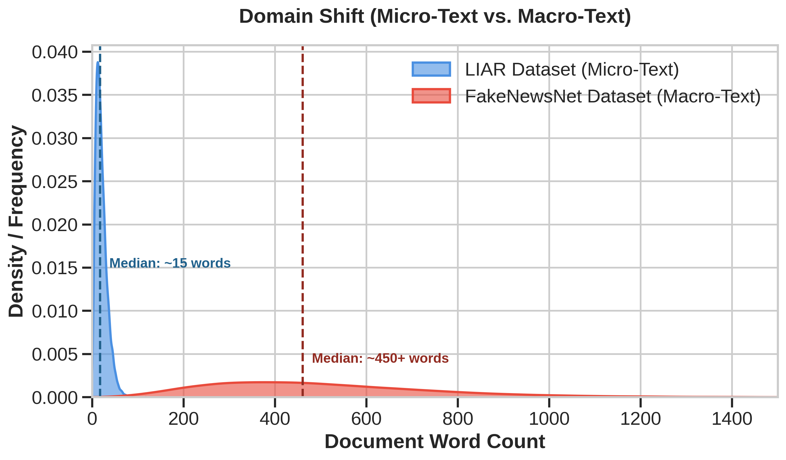
The Datasets: Micro-Text vs. Macro-Text
LIAR vs FakeNewsNet:
Zero overlap between the word counts in both datasets.
This massive gap is a Domain Shift.
A model that has only ever learned to classify 15-word political quotes will fail when suddenly forced to read 500-word news articles.

Slide 5
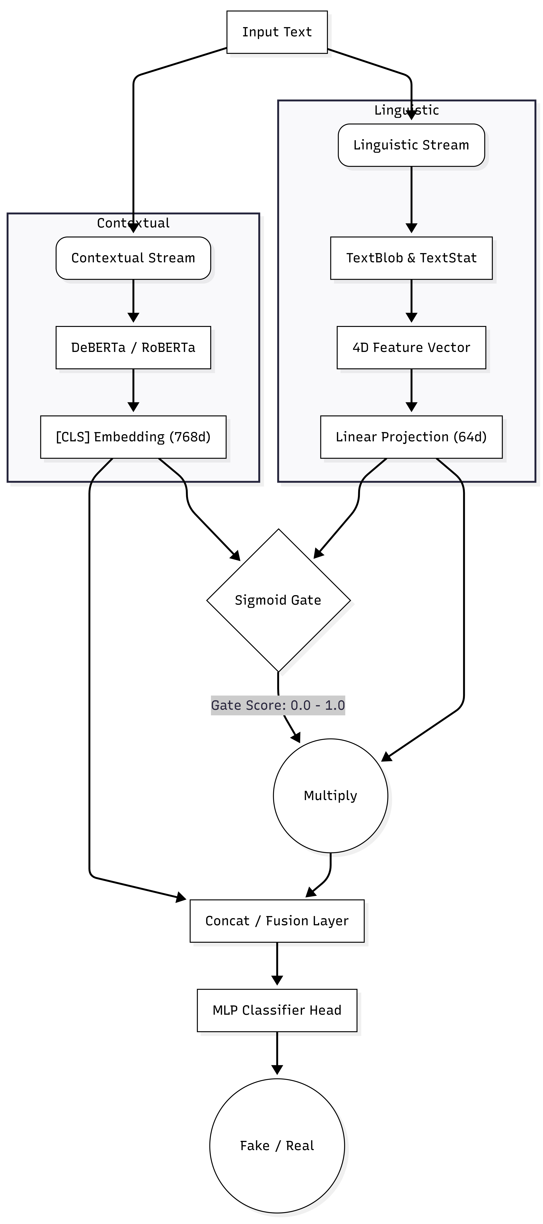
Architecture - Gated Dual-Stream Network
Contextual Stream: Dense semantic embeddings captured via pre-trained Transformer (DeBERTa/RoBERTa).
Linguistic Stream: Explicit psychological & structural markers (Polarity, Readability, Lexical Diversity).
The Fusion Problem: Linguistic features act as statistical noise on micro-texts (short quotes).
A Sigmoid Gate that dynamically regulates the linguistic stream, "closing" for short quotes and "opening" for full-length articles.

Slide 6
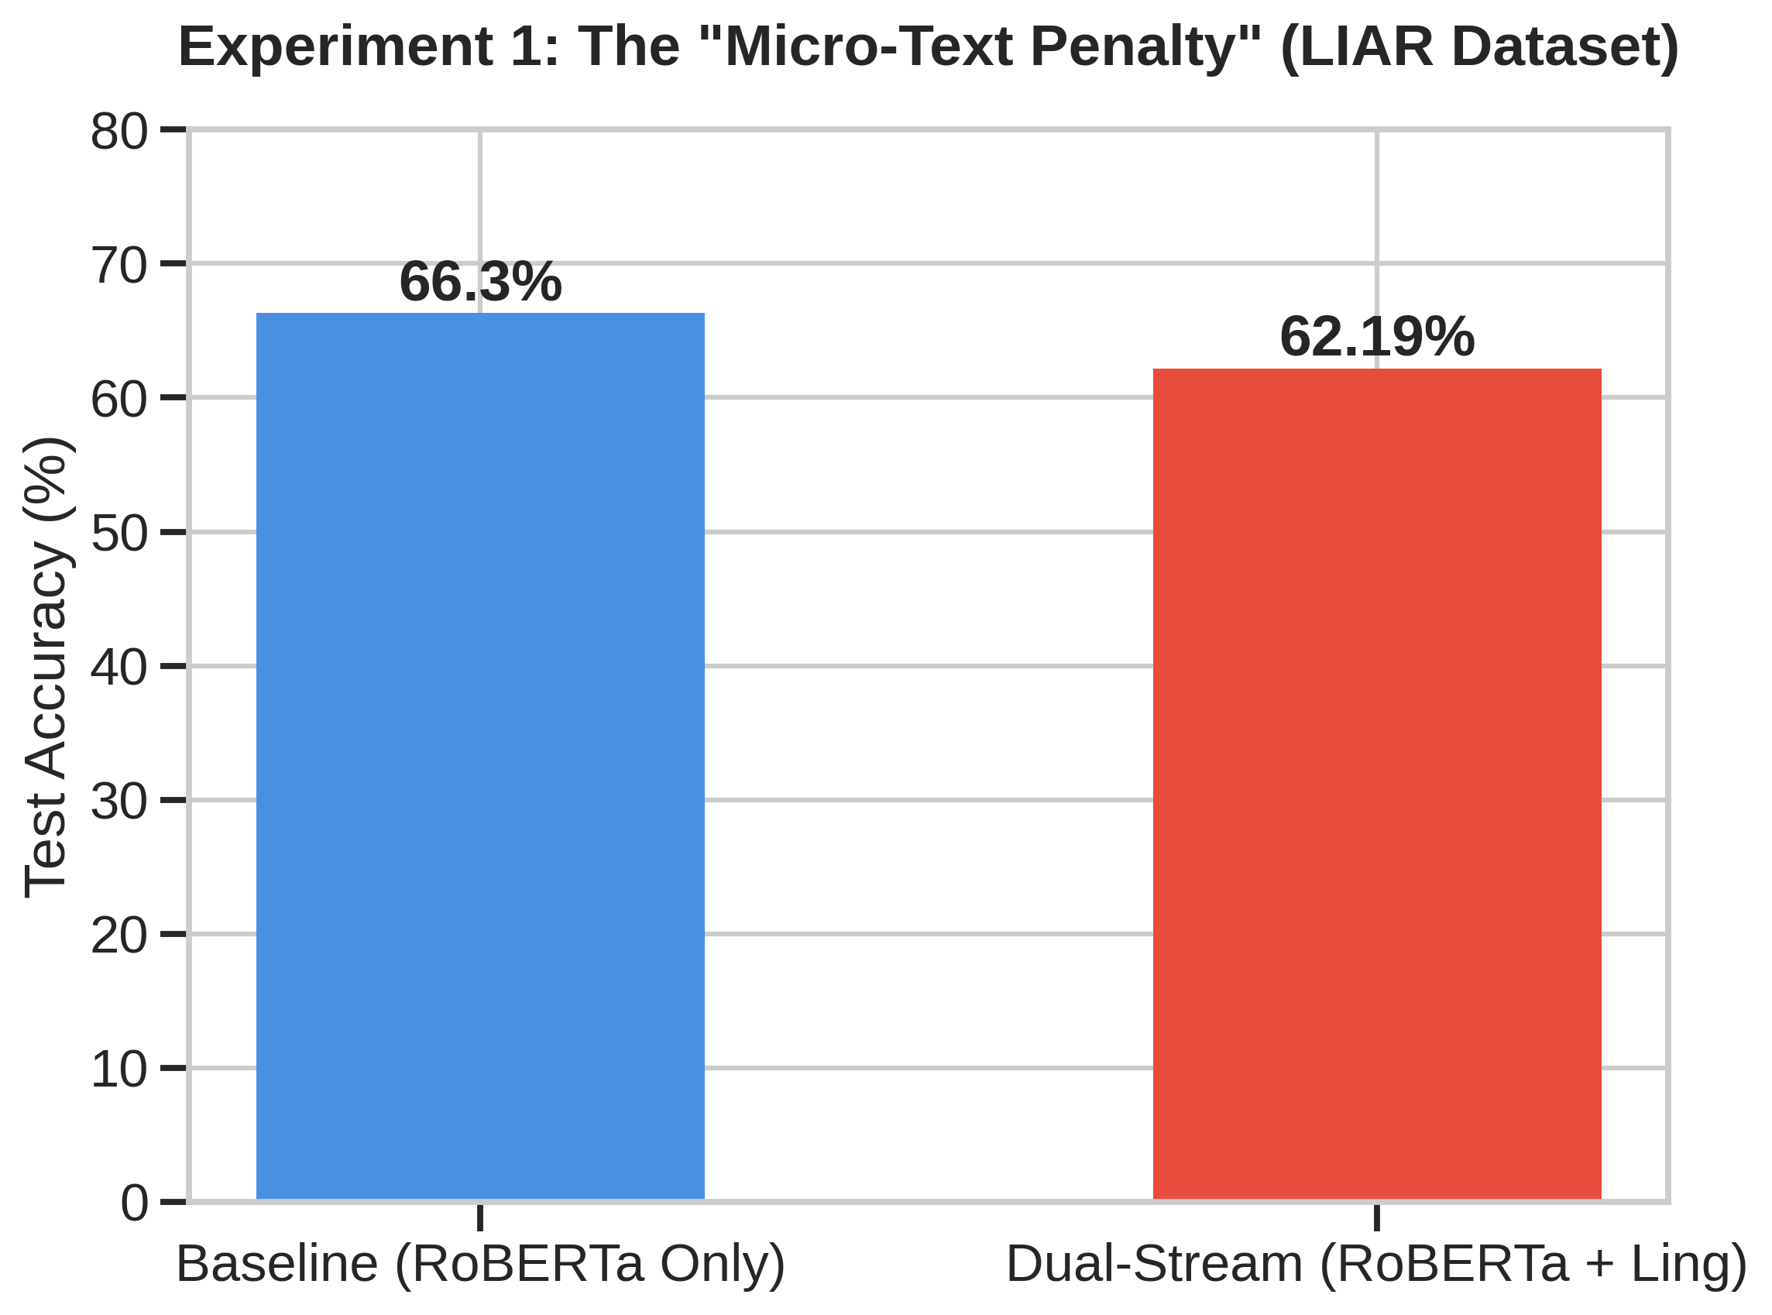
Exp. 1 - Ablation Study & Micro-Text Penalty
Objective: Compare pure semantic attention (RoBERTa-only) vs. our Dual-Stream architecture on the LIAR dataset.
Result: Baseline outperformed Dual-Stream by ~4%.
Micro-Text Penalty: Handcrafted features (Readability, Lexical Diversity) measure document-level structure.
When applied to 15-word quotes, these features act as statistical noise.
Explicit features actively hurt performance on micro-texts.

Slide 7
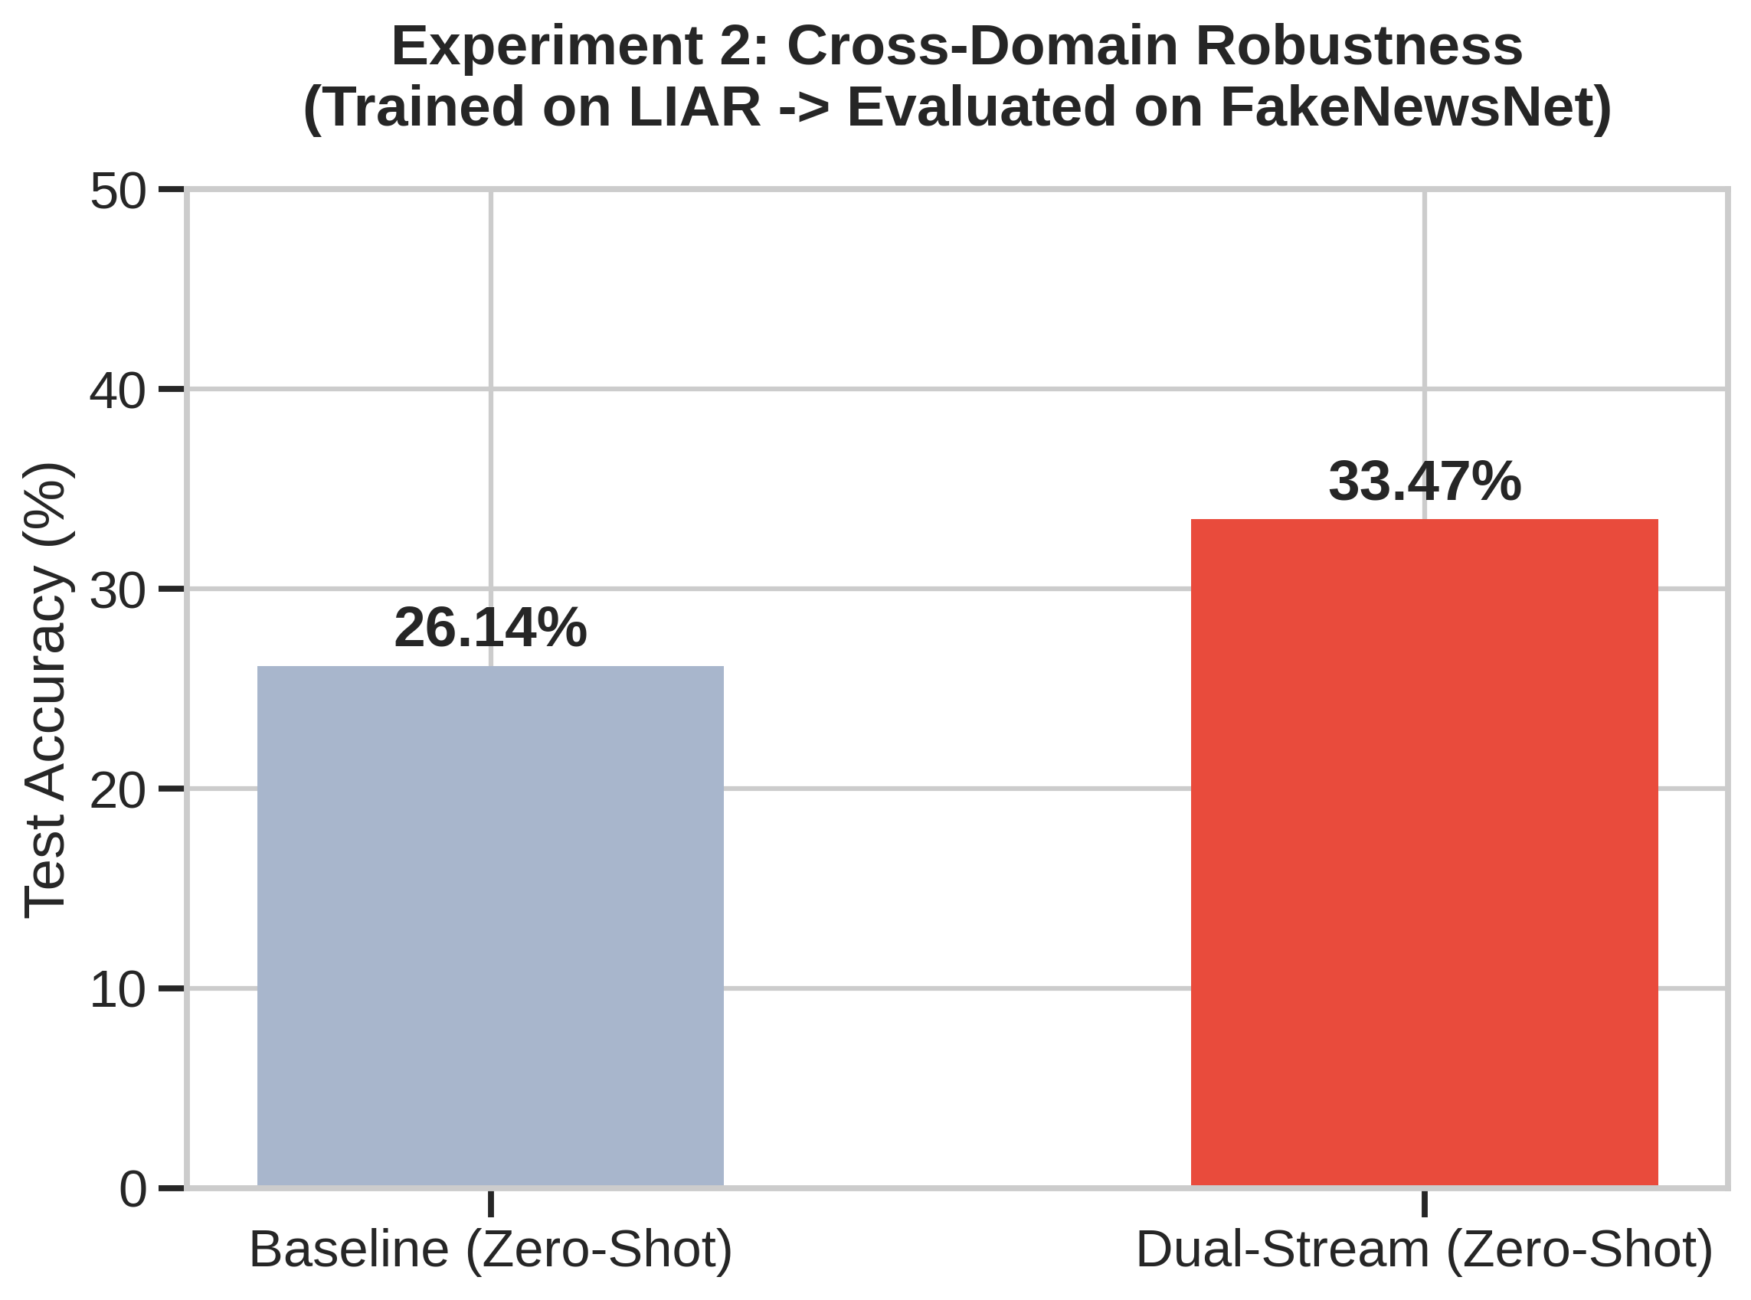
Exp. 2 - Cross-Domain Robustness
Objective: Zero-Shot transfer - Train on LIAR politics and Test on FakeNewsNet web articles.
Catastrophe: Baseline accuracy collapsed to 26.14% showcasing Extreme Domain Shift.
Recovery: Dual-Stream retained 7.3% more accuracy than the baseline.
Inference: While linguistic features hurt micro-texts, they act as crucial, domain-agnostic structural anchors when the semantic vocabulary completely changes.

Slide 8
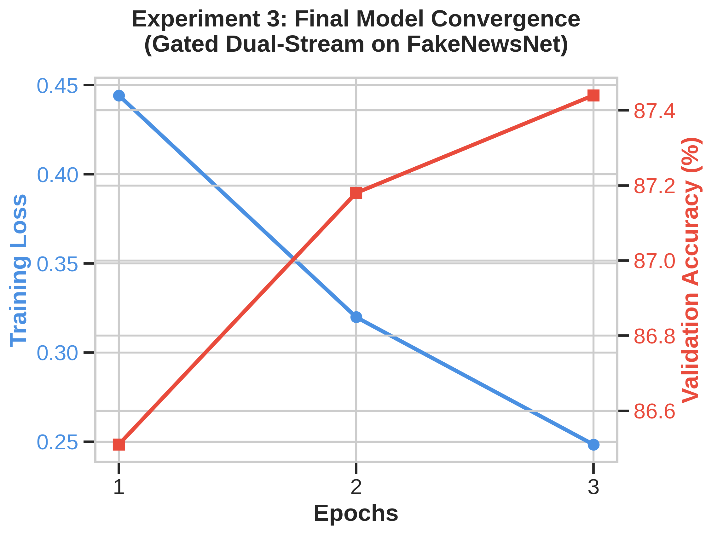
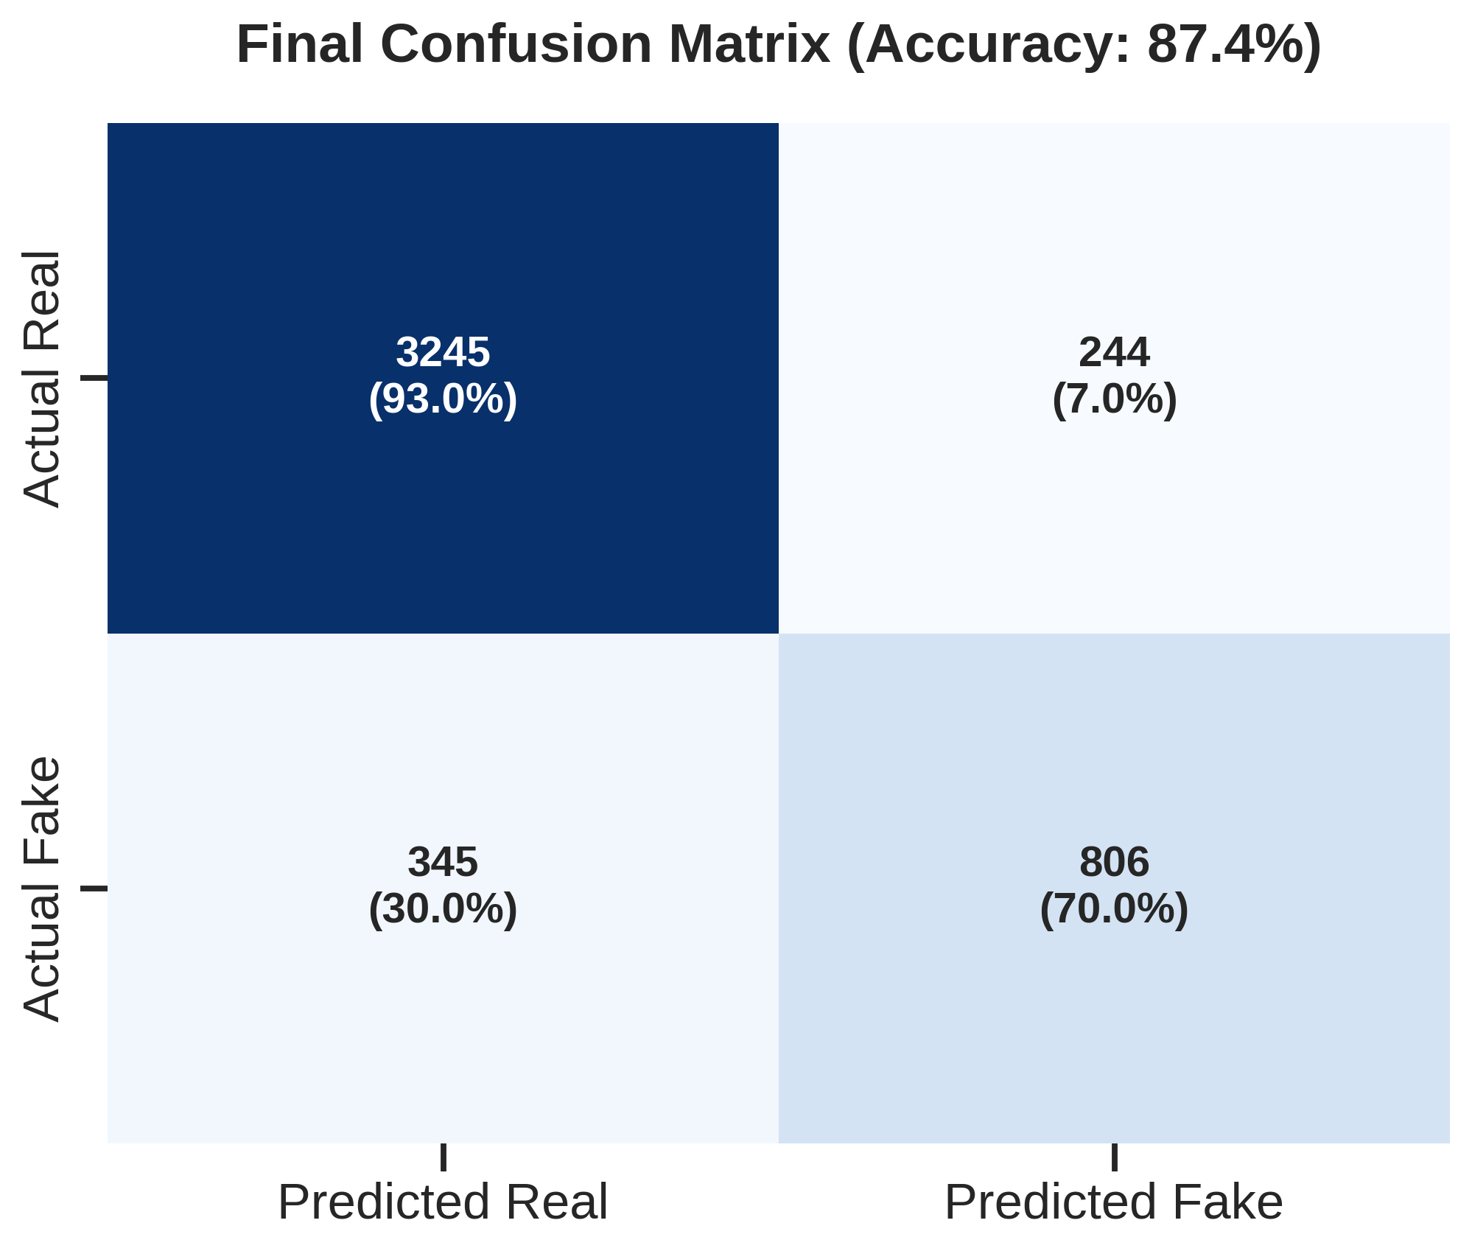
Exp. 3 - Final Gated Architecture
Setup: Trained the upgraded Gated Dual-Stream (DeBERTa-v3) directly on FakeNewsNet.
Results:
Accuracy: 87.4%
Recall for Fake News: Jumped from 0% to 70% after class-weighting.
Conclusion: Gated feature fusion successfully handles macro-texts with high accuracy.
Implemented NaN-safeguards to prevent gradient explosions, applied Class Weights [0.66, 2.01] to handle the 75/25 dataset imbalance.

Slide 9
Final Model Generalization
Model: Gated Dual-Stream (DeBERTa-v3 + Linguistic Features)
Training Set: FakeNewsNet (Macro-Text)
Test Results:
FakeNewsNet (In-Domain): 87.44% Accuracy (Recall for Fake: 70%)
LIAR (Cross-Domain): 56.43% Accuracy (Recall for Fake: 21%)
Key Insight:
Training on long-form articles provides a much more robust "Structural Anchor."
The model achieved 56% on LIAR (better than the 33% we saw when doing the reverse experiment earlier).

Slide 10
Conclusion & Future Work
Key Takeaways:
Feature fusion is a trade-off: highly effective for macro-texts, detrimental to micro-texts.
Dynamic Gating successfully bridges this gap.
Explicit features provide vital robustness against Out-of-Distribution (OOD) data.
Future Work:
Scale the backbone to larger models (e.g., Llama-3).
Incorporate multi-modal streams (analyzing article images alongside text).

Slide 11
References
Yang, Y., Liu, J., Yang, Y., & Cen, L. (2024). Dual-stream fusion network with multi-head self-attention for multi-modal fake news detection. Applied Soft Computing, 167(B), 112358.
He, P., Gao, J., & Chen, W. (2021). DeBERTa: Decoding-enhanced BERT with Disentangled Attention. International Conference on Learning Representations (ICLR).
Shu, K., Mahudeswaran, D., Wang, S., Lee, D., & Liu, H. (2020). FakeNewsNet: A Data Repository with News Content, Social Context, and Spatiotemporal Information. Big Data, 8(3), 171-188.
Wang, W. Y. (2017). "Liar, Liar Pants on Fire": A New Benchmark Dataset for Fake News Detection. Proceedings of the 55th Annual Meeting of the Association for Computational Linguistics (ACL).

Slide 12
Thank You Project Repository: https://github.com/karthik-vi/DualStream-Fusion-FakeNews Sai Karthik Varma Indukuri, Srivatsa Vuppalanchi, Gandhar Sidhaye

