Slide 1
Fix Your Pix
An image filling tool built using
Deep Convolutional Generative Adversarial Networks
Guide: Deepthi S Narayan, Professor, Department of Computer Applications, PES University
By, Karthik D PES12017 Harsha K Y PES1201801839 Aashay S Vanpal PES1201802189

Slide 2
Abstract
The project is an image inpainting tool built using a DCGAN model.
DCGAN tries to make the best out of Contextual and Perceptual information by using Statistics and Machine Learning.
We provide a solution to filling missing parts of images, and removing unwanted objects from images by creating an image inpainting tool using DCGAN.
The model is trained on the CelebFaces Attributes Dataset (CelebA).

Slide 3
Introduction
How would you fill in the missing information?
Contextual and Perceptual information
Today's best approaches use Statistics and Machine Learning to come up with an approximate technique

Slide 4
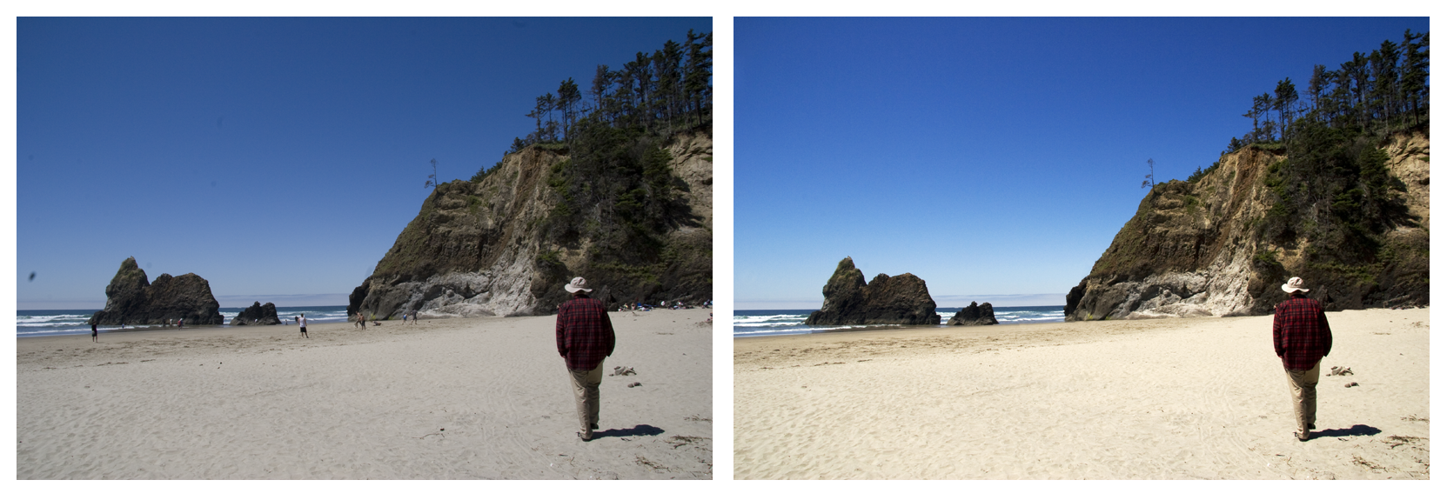
An Example Image

Slide 5
Literature Survey
Models that can learn patterns and classify them are not capable of generating new patterns based on the trained data
These models can not be used to generate new patterns which can be used to fill in missing information or reconstruct images
We use DCGAN to generate new patterns which has a wide range of applications
DCGANs are based on a Convolutional model but is not as easy to train

Slide 6
Tools and Technologies
Dataset
CelebA, FaceScrub
Pre-processing
OpenCV, dLib
Model
DCGAN (Deep Convolutional Generative Adversarial Networks)
Training
Tensorflow
Languages and Libraries
Python 3.6, openCV, dLib, Tensorflow, flask (other dependencies)

Slide 7
Functional Requirements
Pre-process the images to have only faces and resize to 64x64
Train the model using the dataset
Test the model for accuracy
Reconstruct the images to be as close to the original as possible

Slide 8
Non-functional Requirements
Scaling: To be able to train the model not just for faces, but for all sorts of images (animals, inanimate objects, etc..)
Performance: Increase training speed
Security: Everyone should not be able to reconstruct images. It would be a breach of privacy, so, only authorized personnel should be able to login

Slide 9
Users

Slide 10
Modules
Initialize Model: Choose the best model for the task at hand
Train: Provide data to the configured model to learn from patterns and create statistics that can be used for predictions
Score: Create predictions using the trained models
Evaluate: Measure the accuracy of a trained model, or compare multiple models

Slide 11
What we have done so far...

