Slide 1


Easwari Engineering College
Department of Computer Science and Engineering
A Network Coding Equivalent Content Distribution Scheme for P2P-VoD Streaming
Project Members:
L. Karthik Chandran
M. Karthik
Karthika Sindhu
Guide:
Mrs. N. Senthamarai, M.E., (Ph.D)
A.P. Sr. Gr.
2/05/13
<Final Review>
1

Slide 2
Objectives
To solve the problems with content distribution in P2P networks
  To reduce delays caused by random access (assuming that the network quality is ideal).
  To facilitate video access by new peers even if initial parent node is unable to respond.
2/05/13
<Final Review>
2

Slide 3
Motivation
Video streaming services are on the rise
  P2P technology, especially, is being used more often to share larger files such as videos.
  The algorithm proposed in this paper can reduce delays and improve seek performance in videos.
2/05/13
<Final Review>
3

Slide 4
Literature Survey (1)
Distributed Storage to Support User Interactivity in Peer-to-Peer Video Streaming
Ken Yiu, W.-P., Xing Jin ; Gary Chan, S.-H. [IEEE 2006]
Techniques/algorithms/Approaches used :
Distributed Video Storage using DHT and VMesh
Performance Achieved :
Pointers to peers which are storing video segments far away from the current playback position can help a user seek a far away position more efficiently.
The seeking latency is very low.
Drawbacks :
If a node loses some segments because of background traffic, it needs to request for retransmission from its parent.
In the case of a large group of users, the number of clusters is very large and the search cost is high.
2/05/13
<Final Review>
4

Slide 5
Literature Survey (2)
A Dynamic Skip List-based Overlay for On-Demand
Media Streaming with VCR Interactions
Dan Wang, Jiangchuan Liu [IEEE 2008]
Techniques/algorithms/Approaches used :
MULTI-SUPPLIER DATA SCHEDULING :
Network Coding based Data Scheduling.
Performance Achieved :
Dynamic Skip List (DSL), for on-demand overlay media streaming.
Drawbacks :
Layers are not well-balanced, which leads to inaccurate jumps and hence more segment losses.
Under high speeds, the quality of the system is much worse.
2/05/13
<Final Review>
5

Slide 6
Literature Survey (3)
P2VoD: Providing Fault Tolerant Video-on-Demand Streaming in Peer-to-Peer Environment
Do, T.T., Hua, K.A. ; Tantaoui, M.A. [IEEE 2004]
Techniques/algorithms/Approaches used:
Join Algorithm
Parent selection using:
  Round Robin Selection
  Smallest Delay Selection
  Smallest Distance Selection
Performance Achieved:
Allows clients to join the system faster and also requires less time for an affected client to recover from a failure
Drawbacks :
High Seek Latency
High Segment miss rate
2/05/13
<Final Review>
6

Slide 7
Issues in the Existing Systems
Search cost is High
Jump performance is poor
Startup time is long
Needs to maintain index for locating parent peers
2/05/13
<Final Review>
7

Slide 8
Proposed System
Child peer need not search for new parent peers to view next segment.
With sufficient encoded blocks, the original segment can be decoded.
Seek and jump performance is vastly improved.
2/05/13
<Final Review>
8

Slide 9
System Architecture
LAN Connection
Peer
Peer
Server
Peer
Peer
2/05/13
<Final Review>
9

Slide 10

Functional Architecture
Request for video
DECODING
VIDEO
SEGMENTATION
CACHING
Data
PLAYER
BUFFER
ENCODING INTO BLOCKS
PEER
Data
Request for video
DECODING
SERVER
Data
CACHING
PLAYER
BUFFER
PEER
.
.
.
2/05/13
<Final Review>
10

Slide 11
List of Modules
1. Segmentation & Encoding
2. Retrieval & Playback
2/05/13
<Final Review>
11

Slide 12
Module 1
Segmentation & Encoding
Input : Video
Divide video into X segments
Further, divide each segment into blocks b using Interleaving scheme
Encode the blocks using a random co-efficient vector using NCECD scheme
Output : Encoded blocks
2/05/13
<Final Review>
12

Slide 13
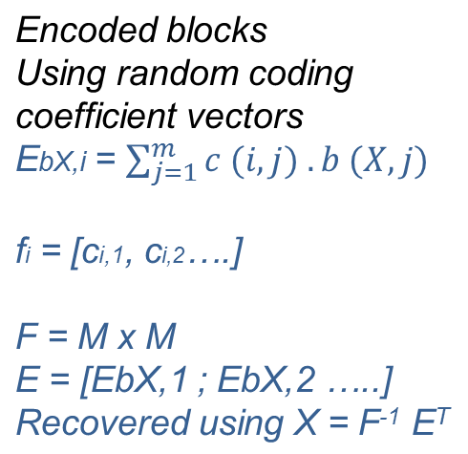
FLOWCHART
Segmentation & Encoding
Video
Segmentation
Segments
(X1,X2…Xn)
Dividing segments into blocks
Blocks
(bX,1 ; bX,2… bX,m)
Basic interleaving scheme
NCECD scheme
Encoding
Encoded blocks
2/05/13
<Final Review>
13

Slide 14
Module 2
Retrieval and Playback
Input : Encoded blocks
Retrieve the desired segments
Store other blocks in local cache and relay when required
When sufficient blocks are available, start playback
Decode the video as its buffered
Output : Video playback
2/05/13
<Final Review>
14

Slide 15
FLOWCHART
Retrieval and Playback
Encoded blocks
Relay
Segment Cache
Sufficient blocks received?
NO
Wait
YES
Video
2/05/13
<Final Review>
15

Slide 16
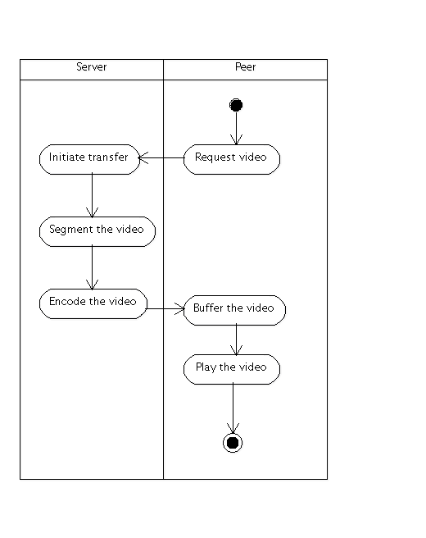
Activity Diagram
2/05/13
<Final Review>
16

Slide 17
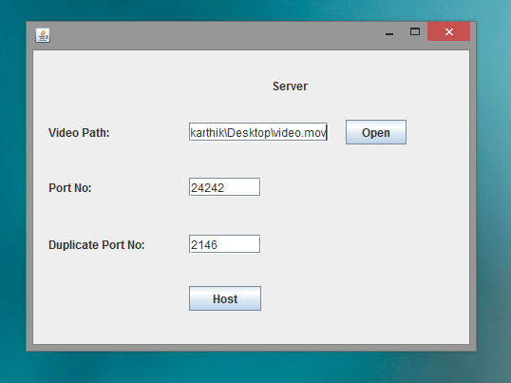
Screenshots
Initial setup of the Server to allow incoming connections
2/05/13
<Final Review>
17

Slide 18
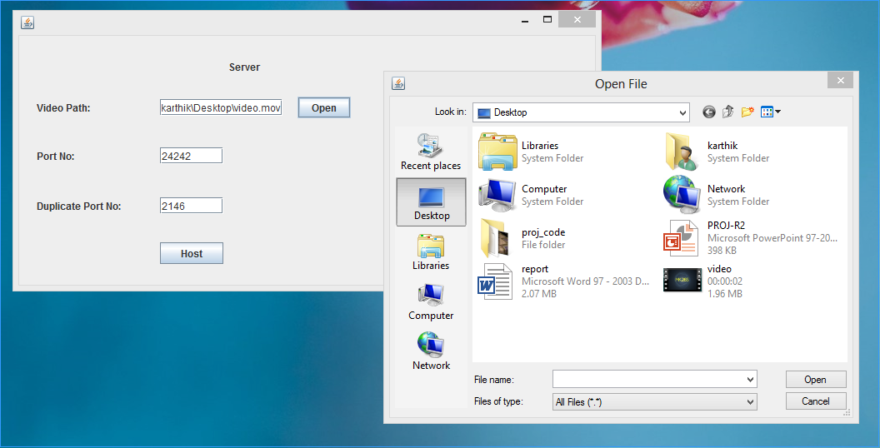
Screenshots
Selecting a default video to host
2/05/13
<Final Review>
18

Slide 19
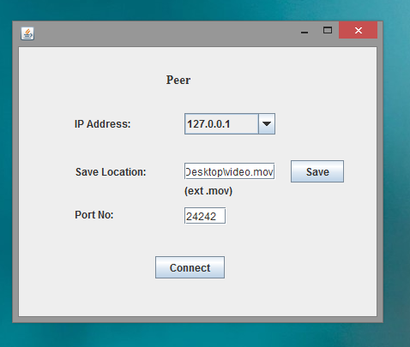
Screenshots
Starting up the Peer
2/05/13
<Final Review>
19

Slide 20
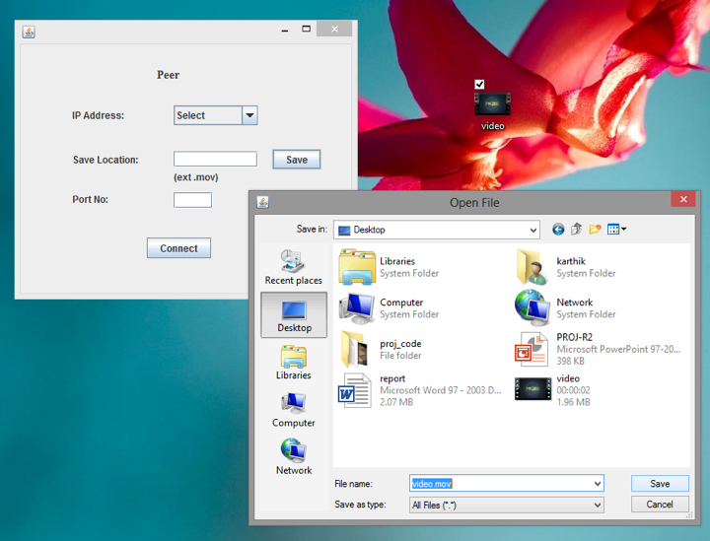
Screenshots
Choosing a location to save the video
2/05/13
<Final Review>
20

Slide 21
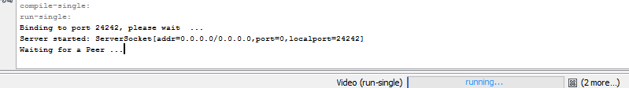
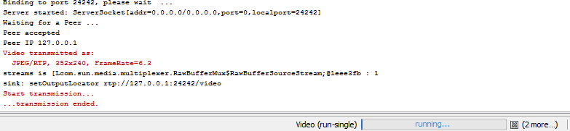
Screenshots
Listening for incoming connections
After peer connects
2/05/13
<Final Review>
21

Slide 22
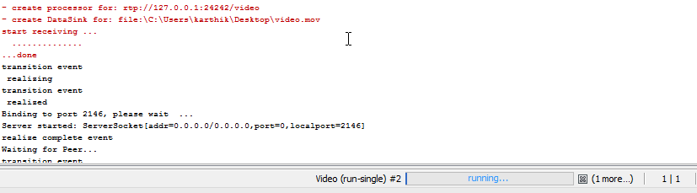
Screenshots
Peer receiving video
2/05/13
<Final Review>
22

Slide 23
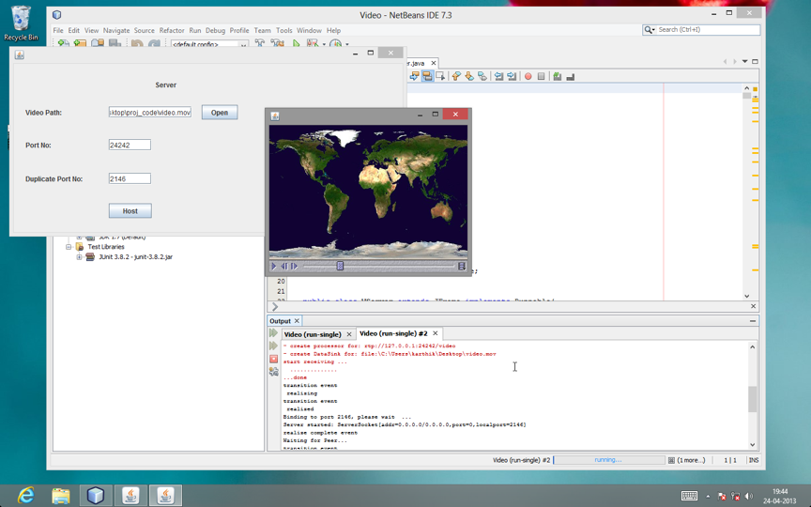
Screenshots
Final video playback
2/05/13
<Final Review>
23

Slide 24
System Requirements
OS Platform : Windows 7/8
Development tools required : NetBeans 7
  Language Platform : Java (JDK 1.7)
  Additional software : JRE, JMF package
Additional H/W Req.: LAN connection
System : Intel Core processor, 1 GB RAM
2/05/13
<Final Review>
24

Slide 25
References
Yung-Cheng Kao, Chung-Nan Lee, Peng-Jung Wu, and Hui-Hsiang Kao, (2012), “A Network Coding Equivalent Content Distribution Scheme for Efficient Peer-to-Peer Interactive VoD Streaming”, IEEE Transactions On Parallel And Distributed Systems, IEEE, Vol. 23, Issue: 6, pp: 985-994
Dan Wang, Jiangchuan Liu, (2008), “A Dynamic Skip List-based Overlay for On-Demand Media Streaming with VCR Interactions”, IEEE Transactions on Parallel and Distributed Systems, IEEE, Vol. 19, Issue: 4, pp: 503 - 514
Do, T.T., Hua, K.A., Tantaoui, M.A., (2004), “P2VoD: Providing Fault Tolerant Video-on-Demand Streaming in Peer-to-Peer Environment”, In the proceeding of “IEEE International Conference on Communications, 2004”, pp: 1467 - 1472 Vol.3
Ken Yiu, W.-P., Xing Jin, (2006), “Distributed Storage to Support User Interactivity in Peer-to-Peer Video Streaming”, In the proceeding of “IEEE International Conference on Communications, 2006 (ICC '06)”, pp: 55- 60
2/05/13
<Final Review>
25

Slide 26
Thank You
2/05/13
<Final Review>
26

Slide 27
FLOWCHART
Segmentation & Encoding
Input
VIDEO
Segments
(X1,X2…Xn)
Basic interleaving scheme
Blocks
(bX,1 ; bX,2… bX,m)
NCECD scheme
Encoded blocks
Output
2/05/13
<Final Review>
27

Slide 28
FLOWCHART
Retrieval and Playback
Encoded Blocks
Input
Segment Cache
Peer
Peer
Relaying and obtaining segments
Peer
Peer
Is sufficient data
Received?
P2P N/W
Video Playback
Decoded as buffered
Output
2/05/13
<Final Review>
28

