Slide 1
Autoencoders and its Applications based on Neural Networks
21MAT212 Mathematics for Intelligence systems
Group-13
Abhinandhu A -AM.EN.U4AIE20002
Maddala H S M Krishna Karthik -AM.EN.U4AIE20046
Marasani Jayasurya -AM.EN.U4AIE20048

Slide 2
Outline
Introduction
Mathematics involved in Autoencoders
Types of Autoencoders
Dataset
Applications of Autoencoders - Image Reconstruction & Denoising
Results
Conclusion
References

Slide 3
Introduction
Neural Networks
A process that mimics the way human brain operates
Composed of Multiple Nodes
Nodes take the input and perform simple operations on data
Result of these operations is passed to other neurons.
The output at each node is called its activation or node value.
It contains two types of network topologies:
Feed Forward
Feed Back

Slide 4
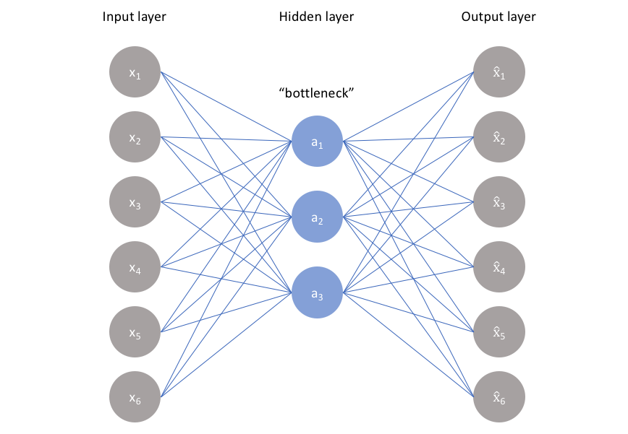
Autoencoders
A type of Artificial Neural Networks used to learn data encodings in an unsupervised manner.
Main aim is to learn how to represent higher dimensional data in lower dimensional data.
It compresses the input and again reconstructs the the input
Introduced in 1980s by Hinton and his group
Architecture of Autoencoders:
Encoder
Bottleneck
Decoder

Slide 5
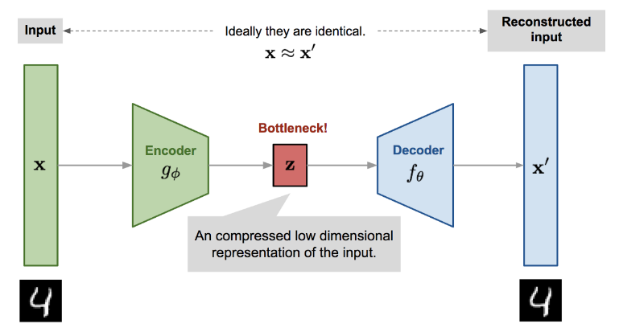
Mathematics in Autoencoders
Z = g(Wx + b)
x’= f(W’Z + c)

Slide 6
Types of Autoencoders
Undercomplete autoencoders
Regularisation Autoencoders
Sparse autoencoders
Contractive autoencoders
Denoising autoencoders
Variational Autoencoders (for generative modelling)
Advanced Autoencoders

Slide 7
Dataset
The dataset used is Fashion-MNIST which is taken from Kaggle Website.
It includes 60,000 items of training set and 10,000 items of testing set.
Each Sample is 28*28 grayscale image with a label of 10 categories.
The Dataset consists of 785 columns out of which 784 columns are pixel values and a column consists of which type of category the image belongs.
Each pixel value indicates the lightness or darkness which ranges from 0 to 255.

Slide 8
Applications of Autoencoders
Image Denoising
Image Reconstruction
Conversion of grayscale images to colour images
Classification
Clustering
Anomaly Detection
Recommendation Systems
Dimensionality Reduction
Image Compression
Image Generation

Slide 9
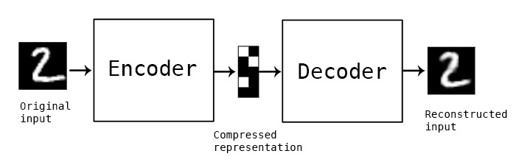
Image Reconstruction
Input image is fed into autoencoder and gets reconstructed by using decoding and encoding strategy to minimize the reconstruction error.

Slide 10
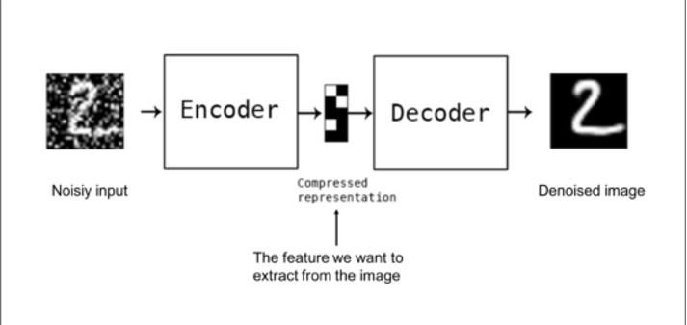
Image Denoising
The noisy input image (clean image + noise) is fed into the autoencoder as input and the output noiseless output is reconstructed by minimizing the reconstruction loss from the original target output (noiseless).

Slide 11
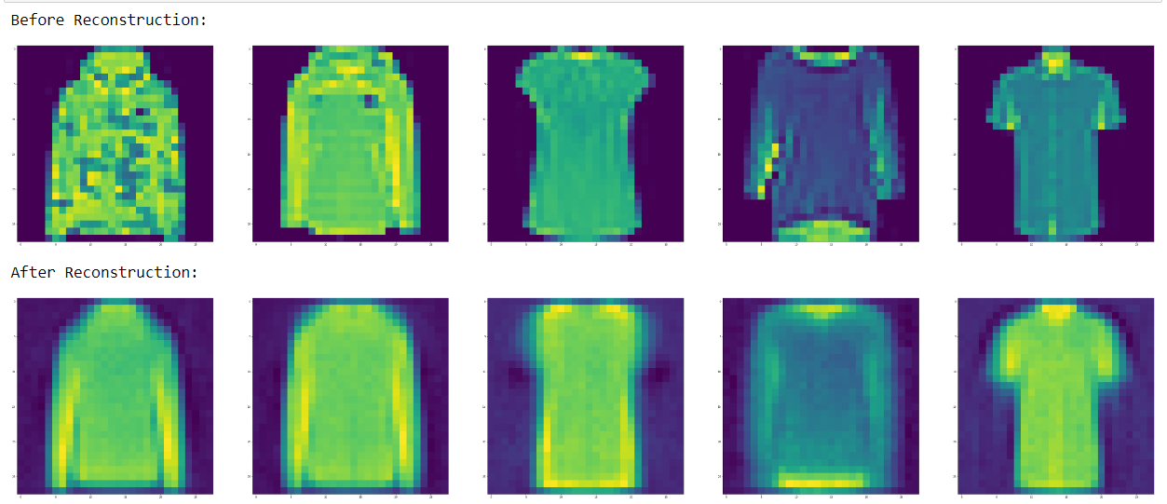
Results
Output of the Image Reconstruction:

Slide 12
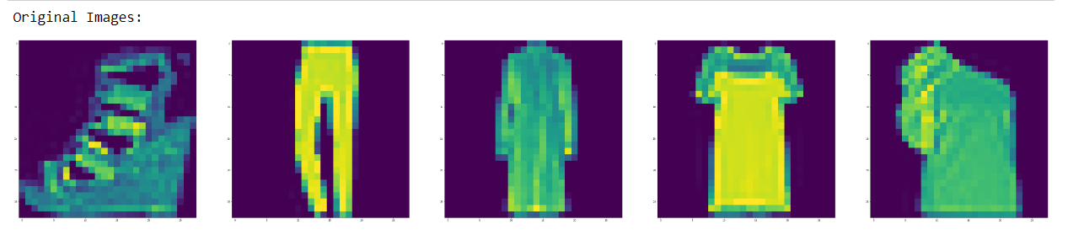
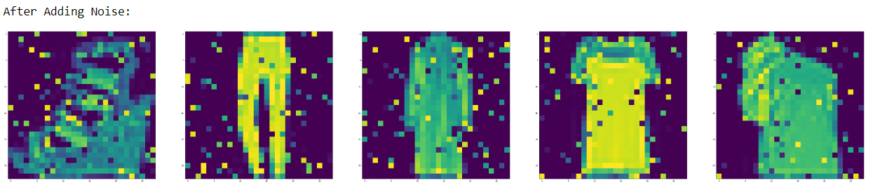
Contd..
Results of Image Denoising:

Slide 13
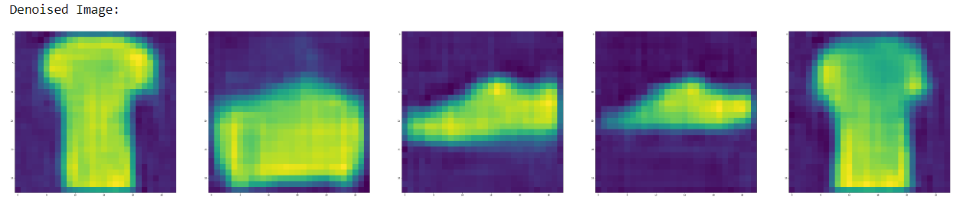
Contd..

Slide 14
Conclusion
Autoencoders are a type of neural network architecture that has a wide range of applications in computer vision, natural language processing, and other fields.
An Under Complete autoencoder is used to implement an image reconstruction application.
An denoising autoencoder is used to implement an image denoising application.
The paper provides a brief overview of autoencoders and their various types and applications.

Slide 15
References
https://iq.opengenus.org/applications-of-autoencoders/
https://towardsdatascience.com/6-applications-of-auto-encoders-every-data-scientist-should-know-dc703cbc892b
https://www.v7labs.com/blog/autoencoders-guide
https://www.analyticsvidhya.com/blog/2021/06/complete-guide-on-how-to-use-autoencoders-in-python/
https://blog.keras.io/building-autoencoders-in-keras.html

Slide 16
Thank You

