Slide 1

Improving the classification accuracy in the case of Unbalanced dataset
Group-19
Konijeti Sri Vyshnavi AM.EN.U4AIE20042
Maddala H S M Krishna Karthik AM.EN.U4AIE20046
Methuku Samhitha AM.EN.U4AIE20049
Suravarapu Ankith AM.EN.U4AIE20070

Slide 2
Abstract
Fraud has risen dramatically as a result of advances in technology and global connections. Detection and prevention are two approaches for preventing fraud. The dataset used to detect credit card fraud is heavily skewed and different sorts of misclassification errors may incur different costs, so it's critical to keep track of them. Classification techniques have promise for detecting both fraudulent and non-fraudulent transactions. The major goal of this research is to improve the XGBoost (eXtreme Gradient Boosting) strategy by applying resampling approaches to handle a class imbalance in datasets. XGBoost is a popular machine learning model that is utilized in areas such as fraud detection.

Slide 3
Problem Statement
Credit card payment is one of the prevalent means of transactions carried out in both online and offline purchases.
Latest technology and worldwide communications, fraud has increased significantly.
In Credit card fraud transactions there are so many ways to find like Random forest,rule based mining, neural network etc.
The Best method to detect that transaction is fraud or not by using XGBoost method.
It having more accuracy with compared to other models.
We are doing XGBoost with imbalance in the dataset with using resampling techniques.

Slide 4
XGBoost in Mathematics
We have to construct a Base Model and calculate the Probability.
We need to calculate the residual.
After Getting the residual we need to construct the decision tree.
We need to compute the Similarity Weight of the Root node.
If we have more than two categories we can divide them as a nodes
We have to compute the Similarity Weight of the left and right node.
In This step we will compute the Gain of the nodes.
Next we have to calculate the Post Pruning.
We need to predict the probability.
We need to check that if the probability< similarity Weight . Then we need to cancel that node.
Repeat till we get the best probability value.

Slide 5
Algorithm Used : XGBoost
Basically, XGBoost is an algorithm. Also, it has recently been dominating applied machine learning. XGBoost is an implementation of gradient boosted decision trees.
WHAT IS XGBOOST?
XGBoost is a decision-tree-based ensemble Machine Learning algorithm.
It is used in prediction of unstructured data
It has enhanced performance and speed in tree based machine learning algorithms.
We use XGBoost when we have large number of observations in training data.
It performs well when the data has mixture of numerical and categorical features or just numeric features.

Slide 6
Dataset
The dataset used in this project is “Credit Card Fraud Detection” dataset which is referred as a standard imbalanced machine learning dataset. Link
This dataset contains credit card transactions that occurred over two days in September 2013 by European cardholders, where we have 492 frauds out of 284,807 transactions.
The dataset is highly unbalanced, the frauds class account for 0.172% of all transactions
It contains Time, Amount, and Class features with 28 features which are obtained by PCA.
The answer variable is 'Class,' and it has a value of 1 when there is fraud and 0 when there's not.

Slide 7
Methods Implementation
Step 1: Start the process
Step 2: Load the available Credit Card Fraud Detection(CCFD) dataset.
Step 3: Normalize the number of features
Step 4: Divide the dataset into two parts first one is in training & the other one is in testing
Step 5: After this get undersampled transaction data
Step 6: On this undersampled transaction data apply XGBoost classifier to classify fraud activities
Step 7: Evaluate results by accuracy, precision, recall, AUC and ROC curves.
Step 8: Stop.
Github link

Slide 8
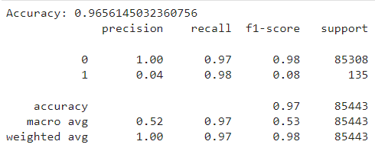
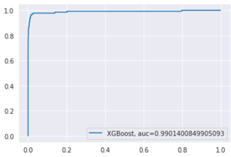
Result and Conclusion
The performance of the classifier is measured and it has an accuracy of 97%.
Also, the performance is measured using ROC and AUC curves. And it has an AUC of 0.99.
As we know that the greater the AUC, the better the model is at distinguishing between normal and fraud transactions.
We conclude that we have reached a very satisfactory number in detecting fraud in relation to the original model, which has increased to 97%.

Slide 9
References
C. V. Priscilla and D. P. Prabha, "Influence of Optimizing XGBoost to handle Class Imbalance in Credit Card Fraud Detection," 2020 Third International Conference on Smart Systems and Inventive Technology (ICSSIT), 2020, pp. 1309-1315, doi: 10.1109/ICSSIT48917.2020.9214206
Vedant Mayekar, Siddharth Mattha, Sohan Choudhary, Prof Amruta Sankhe. “ONLINE FRAUD TRANSACTION DETECTION USING MACHINE LEARNING”, International Research Journal of Engineering and Technology (IRJET) Volume: 08 Issue: 05, May 2021
Nishant Sharma, “CREDIT CARD FRAUD DETECTION PREDICTIVE MODELING”, A Paper Submitted to the Graduate Faculty of the North Dakota State University of Agriculture and Applied Science, May 2019.
L. L. Minku, S. Wang, and X. Yao, “Online ensemble learning of data streams with gradually evolved classes,” IEEE Transactions on Knowledge and Data Engineering, vol.28, no. 6, pp. 1532–1545, 2016.
] Bhusari, V., & Patil, S. (2016). Study of hidden markov model in credit card fraudulent detection. In 2016 World Conference on Futuristic Trends in Research and Innovation for Social Welfare (Startup Conclave) (pp. 1-4). IEEE.

